Slide 1
Text Clustering
Hongning Wang
CS@UVa

Slide 2
Today’s lecture
Clustering of text documents
Problem overview
Two basic types of clustering algorithms
Evaluation metrics

Slide 3
Clustering problem in general
Discover “natural structure” of data
What is the criterion?
How to identify them?

Slide 4
Clustering problem in general
Clustering: the process of grouping a set of objects into classes of similar objects
Basic criteria
high intra-class similarity
low inter-class similarity
No (little) supervision signal about the underlying clustering structure
Need similarity/distance as guidance to form clusters

Slide 5







What is the “natural grouping”?
Clustering is very subjective!
Similarity metric is important!
Similarity by gender
Similarity by source of ability
Similarity by costume

Slide 6
Clustering in text mining
Access
Serve for IR applications
Sub-area of DM research
Mining
Filter
information
Discover knowledge
Text clustering
Add
Structure/Annotations
Based on NLP/ML techniques
Organization

Slide 7
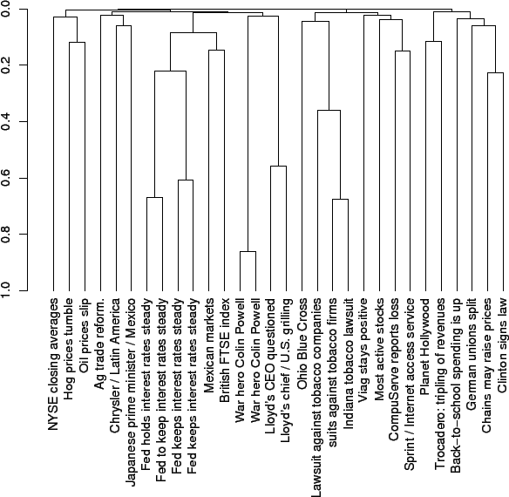
Applications of text clustering
Organize document collections
Automatically identify hierarchical/topical relation among documents

Slide 8
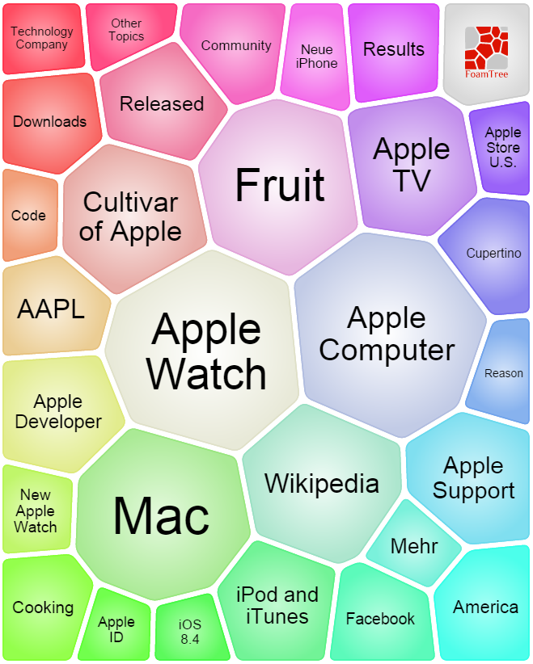
Applications of text clustering
Grouping search results
Organize documents by topics
Facilitate user browsing

Slide 9
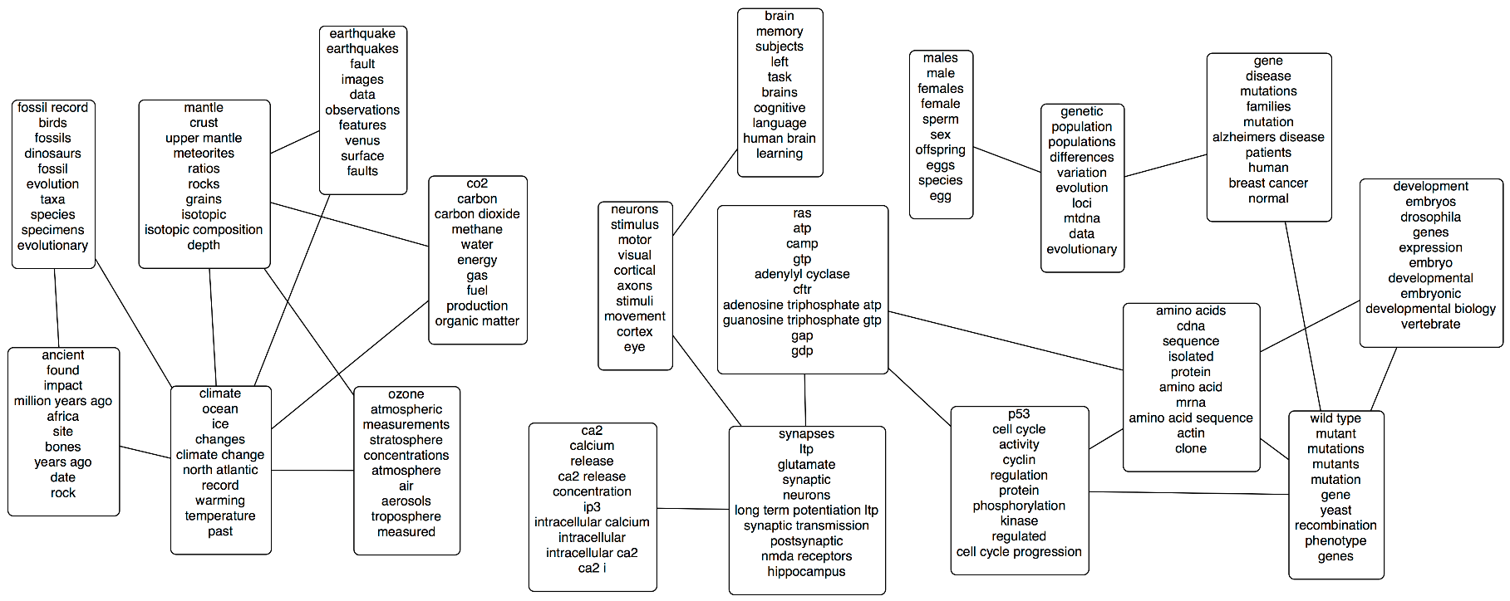
Applications of text clustering
Topic modeling
Grouping words into topics
Will be discussed later separately

Slide 10
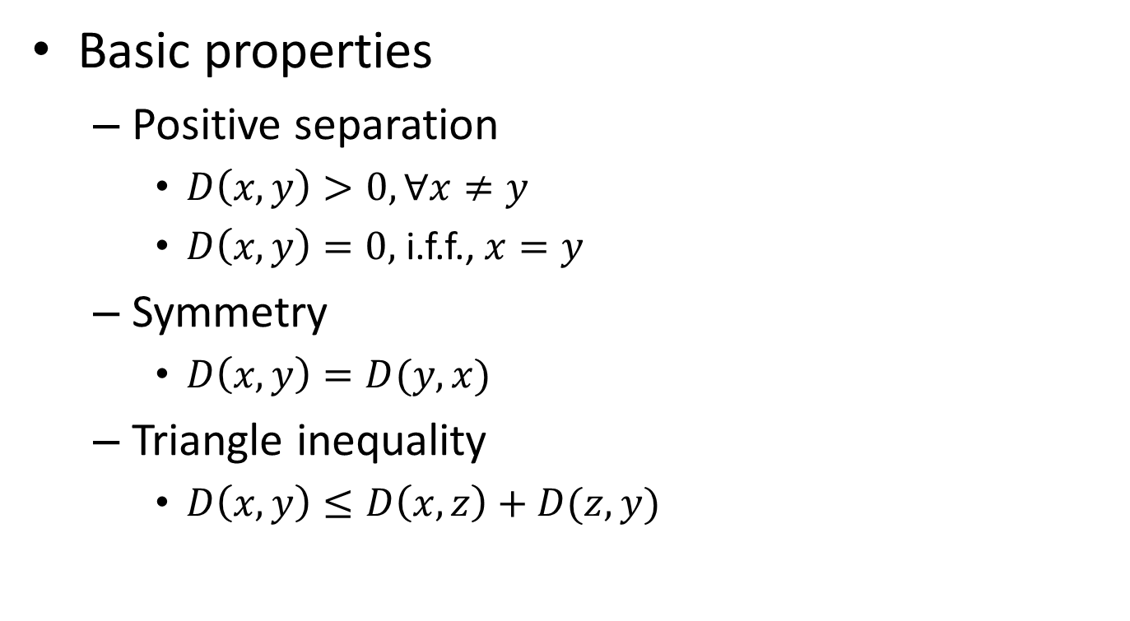
Distance metric
Basic properties
Positive separation
$D\left(x,y\right)>0, ∀x≠y$
$D\left(x,y\right)=0,$i.f.f., $x=y$
Symmetry
$D\left(x,y\right)=D(y,x)$
Triangle inequality
$D\left(x,y\right)≤D\left(x,z\right)+D(z,y)$

Slide 11
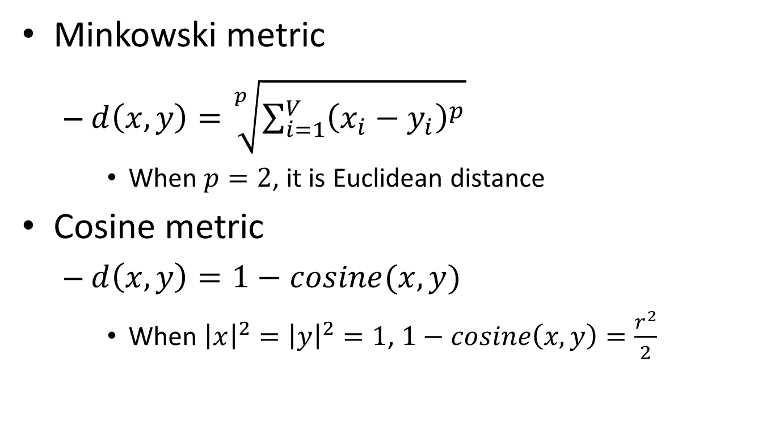
Typical distance metric
Minkowski metric
$d\left(x,y\right)=\sqrt[p]{\sum_{i=1}^{V}{{\left(x_{i}−y_{i}\right)}^{p}}}$
When $p=2$, it is Euclidean distance
Cosine metric
$d\left(x,y\right)=1−cosine(x,y)$
When ${\left|x\right|}^{2}={\left|y\right|}^{2}=1$, $1−cosine\left(x,y\right)=\frac{r^{2}}{2}$

