Slide 1
Statistical Machine Translation
Hongning Wang
CS@UVa

Slide 2
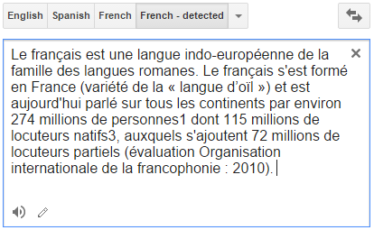

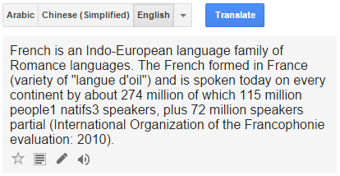
Machine translation

Slide 3
How do human translate languages?
Is a bilingual dictionary sufficient?
John loves Mary.
John told Mary a story.
Jean aime Marie.
Jean a raconté une histoire à Marie.
John is a computer scientist.
John swam across the lake.
Jean est informaticien.
Jean a traversé le lac à la nage.

Slide 4
Correspondences
A bilingual dictionary is clearly insufficient!
One-to-one
John = Jean, aime = loves, Mary=Marie
One-to-many/many-to-one
Mary = [à Marie]
[a computer scientist] = informaticien
Many-to-many
[swam across __] = [a traversé __ à la nage]
Reordering required
told Mary¹ [a story]² = a raconté [une histoire]² [à Marie]¹

Slide 5
Lexical divergences
Different senses of homonymous words generally have different translations
Different senses of polysemous words may also have different translations
English - German
(river) bank - Ufer
(financial) bank - Bank
I know that he bought the book: Je sais qu’il a acheté le livre.
I know Peter: Je connais Peter.
I know math: Je m’y connais en maths.

Slide 6
Syntactic divergences
Word order
SVO (Sbj-Verb-Obj), SOV, VSO,…
fixed or free?
Head-marking vs. dependent-marking
Dependent-marking (English): the man’s house
Head-marking (Hungarian): the man house-his
Pro-drop languages can omit pronouns
Italian (with inflection): I eat = mangio; he eats = mangia
Chinese (without inflection): I/he eat: chīfàn

Slide 7
Semantic divergences
Aspect
English has a progressive aspect
‘Peter swims’ vs. ‘Peter is swimming’
German can only express this with an adverb:
‘Peter schwimmt’ vs. ‘Peter schwimmt gerade’
Clearly, a bilingual dictionary is insufficient; and machine translation is difficult!

Slide 8
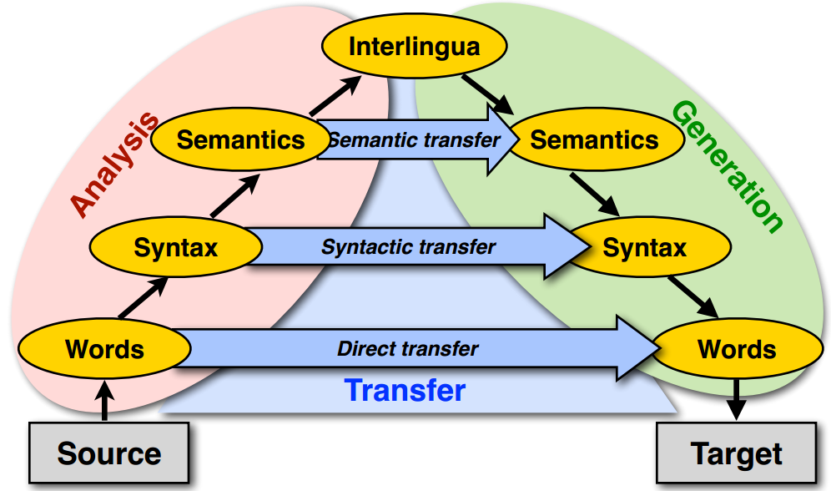
Machine translation approaches
The Vauquois triangle

Slide 9
Statistical machine translation
Main stream of current machine translation paradigm
The idea was introduced by Warren Weaver in 1949
Re-introduced in 1993 by researchers at IBM's Thomas J. Watson Research Center
Now it is the most widely studied/used machine translation method
1966: ALPAC report: human translation is far cheaper and better - kills MT for a long time

Slide 10
Noisy-Channel framework ^{[Shannon 48]}
Translating French to English
$$Eng^{∗}=argmax_{Eng}p(Eng|Fre)$$
Source
Transmitter
(encoder)
Noisy
Channel
Receiver
(decoder)
Destination
Eng
Fre
Eng’
P(Eng)
P(Fre|Eng)
P(Eng’|Fre)=?
Language model
Translation model
Observation
Guessed input

Slide 11
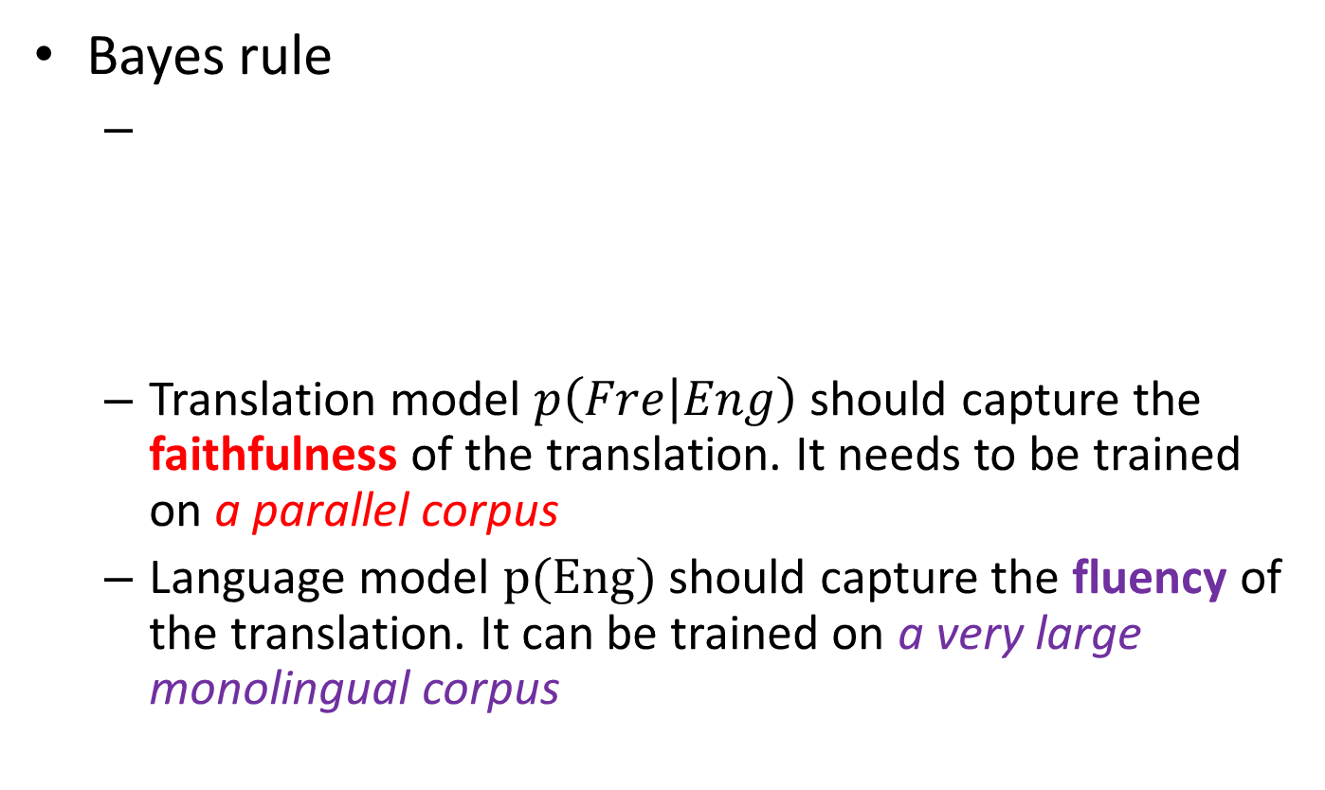
Translation with a noisy channel model
Bayes rule
Translation model $p\left(Fre | Eng\right)$ should capture the faithfulness of the translation. It needs to be trained on a parallel corpus
Language model $p(Eng)$ should capture the fluency of the translation. It can be trained on a very large monolingual corpus
$$Eng^{∗}=argmax_{Eng}p(Eng|Fre)$$
$$=argmax_{Eng}p\left(Fre | Eng\right)p(Eng)$$
Observed (given)
Translation Model
Language Model

Slide 12
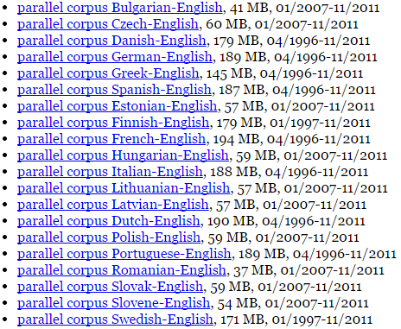
Parallel corpora
The same text in two (or more) languages
High-quality manually crafted translations
European Parliament Proceedings Parallel Corpus

Slide 13

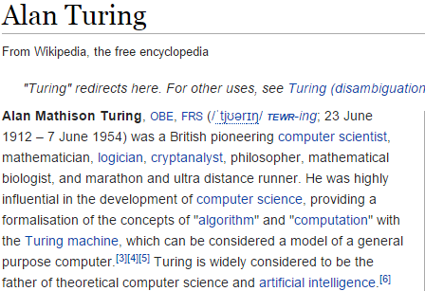
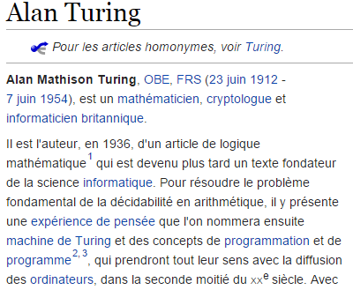
Parallel corpora
The same text in two (or more) languages
High-quality manually crafted translations

Slide 14

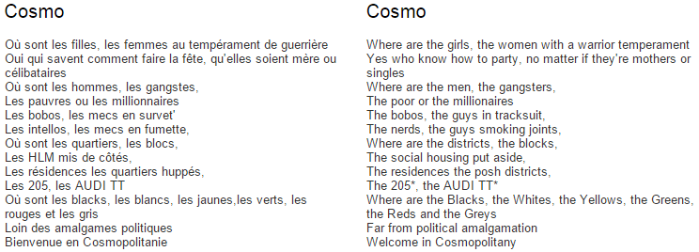
Parallel corpora
The same text in two (or more) languages
High-quality manually crafted translations

Slide 15
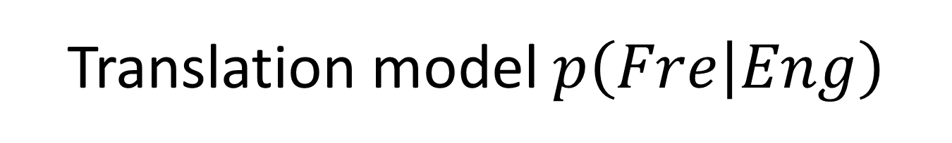
Translation model $p\left(Fre | Eng\right)$
Specifying translation probabilities
This probability needs word-alignment to estimate
English | French | Frequency
green witch | grüne Hexe | …
at home | zuhause | 10534
at home | daheim | 9890
is | ist | 598012
this week | diese Woche | …

Slide 16
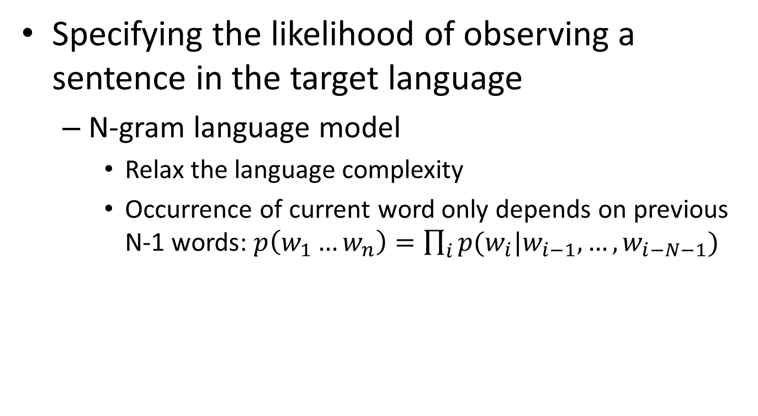

Language model $p(Eng)$
Specifying the likelihood of observing a sentence in the target language
N-gram language model
Relax the language complexity
Occurrence of current word only depends on previous N-1 words: $p\left(w_{1}…w_{n}\right)=\prod_{i}{p(w_{i}|w_{i−1},…,w_{i−N−1}) }$

Slide 17
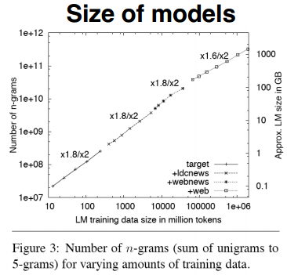
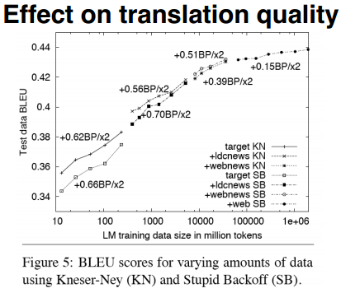
Language model $p(Eng)$
Specifying the likelihood of observing a sentence in the target language
Google (2007) uses 5-grams to 7-grams, which result in huge models, but the effect on translation quality levels off quickly

Slide 18
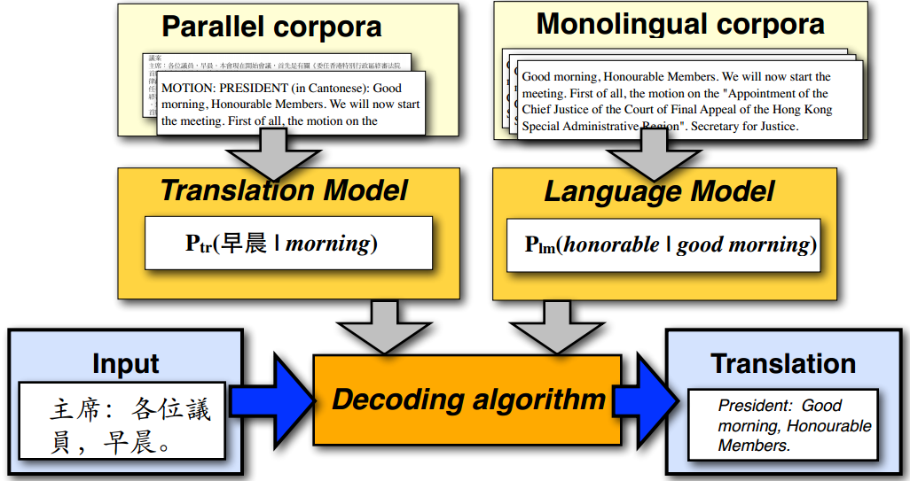
Statistical machine translation

Slide 19
IBM translation models
A generative model based on noisy channel framework
Generate the translation sentence e with regard to the given sentence f by a stochastic process
Generate the length of f
Generate the alignment of e to the target sentence f
Generate the words of f
$$Eng^{∗}=argmax_{Eng}p\left(Fre | Eng\right)p(Eng)$$

Slide 20
Word alignment
One to many
John told Mary a story.
Jean a raconté une histoire à Marie.
Target sentence
 | Jean | a | raconté | une | histoire | à | Marie
John
told
Mary
a
story
Source sentence

Slide 21
Word alignment
Many to one and missing word
John swam across the lake.
Jean a traversé le lac à la nage.
Target sentence
A special symbol
 | Jean | a | traversé | le | lac | à | la | nage
NULL
John
swam
across
the
lake
Source sentence

Slide 22
Representing word alignments
Alignment table
 |  | 1 | 2 | 3 | 4 | 5 | 6 | 7 | 8
 |  | Jean | a | traversé | le | lac | à | la | nage
0 | NULL
1 | John
2 | swam
3 | across
4 | the
5 | lake
Target Position | 1 | 2 | 3 | 4 | 5 | 6 | 7 | 8
Source Position | 1 | 3 | 3 | 4 | 5 | 0 | 0 | 2

Slide 23




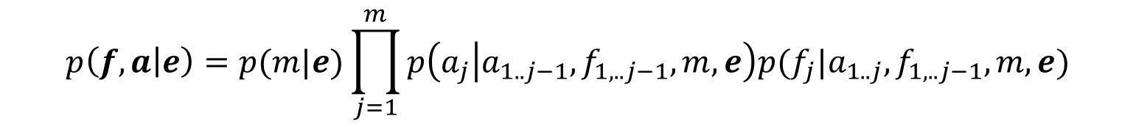
IBM translation models
Translation model with word alignment
$p\left(Fre | Eng\right)=\sum_{a∈A(Eng,Fre)}{p(Fre,a|Eng)}$
Generate the words of f with respect to alignment $a$
marginalize over all possible alignments $a$
$$p\left(f,a | e\right)=p(m|e)\prod_{j=1}^{m}{p\left(a_{j} | a_{1..j−1},f_{1,..j−1},m,e\right)p(f_{j}|a_{1..j},f_{1,..j−1},m,e)}$$
Length of target sentence f
Word alignment $a_{j}$
Translation of $f_{j}$

Slide 24
IBM translation models
Sequence of 5 translation models
Different assumptions and realization of the components in the translation models, i.e., length model, alignment model and translation model
Model 1 is the simplest and becomes the basis of follow-up IBM translation models

Slide 25
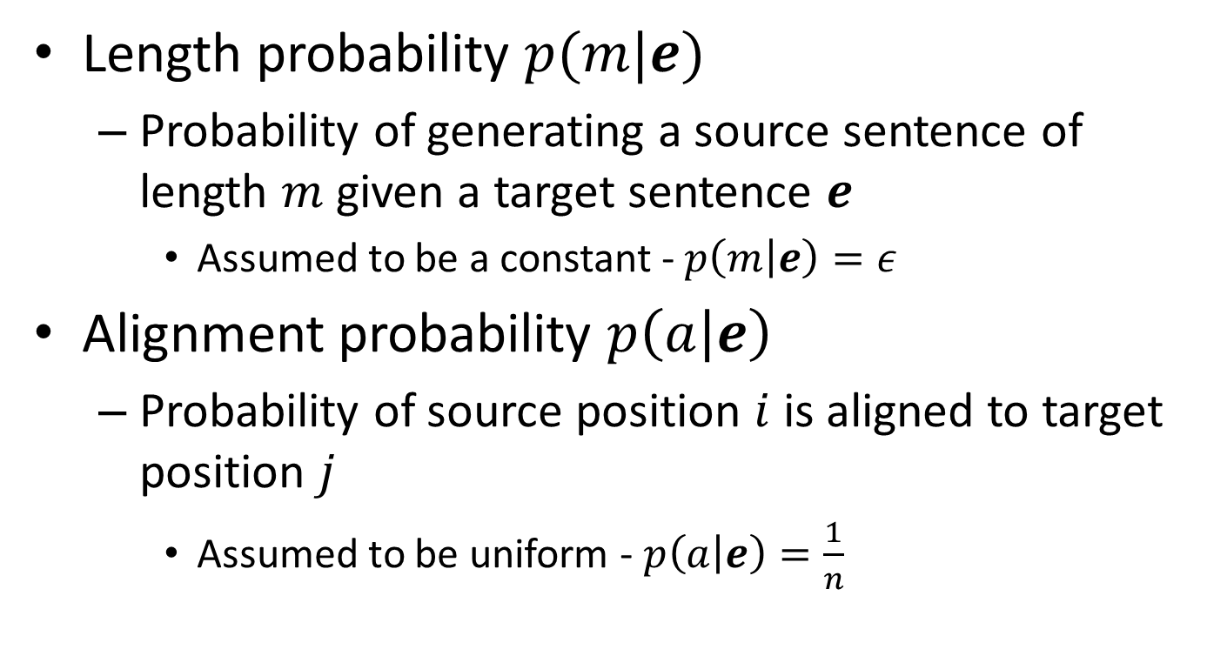
Parameters in Model 1
Length probability $p(m|e)$
Probability of generating a source sentence of length $m$ given a target sentence $e$
Assumed to be a constant - $p\left(m | e\right)=ε$
Alignment probability $p\left(a | e\right)$
Probability of source position $i$ is aligned to target position $j$
Assumed to be uniform - $p\left(a | e\right)=\frac{1}{n}$
length of source sentence

Slide 26
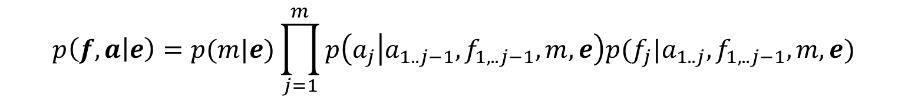

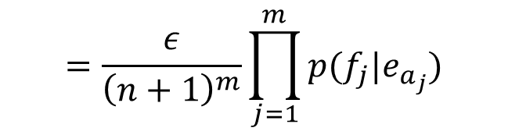
Parameters in Model 1
Translation probability $p\left(f | a,e\right)$
Probability of English word $e_{i}$ is translated to French word $f_{j}$ - $p\left(f_{j} | e_{a_{j}}\right)$
After the simplification, Model 1 becomes
$$p\left(f,a | e\right)=p(m|e)\prod_{j=1}^{m}{p\left(a_{j} | a_{1..j−1},f_{1,..j−1},m,e\right)p(f_{j}|a_{1..j},f_{1,..j−1},m,e)}$$
$$=\frac{ε}{{\left(n+1\right)}^{m}}\prod_{j=1}^{m}{p(f_{j}|e_{a_{j}})}$$
We add a NULL word in the source sentence

Slide 27
Generative process in Model 1
For a particular English sentence $e = e_{1}..e_{n}$ of length $n$
0 | 1 | 2 | 3 | 4 | 5
NULL | John | swam | across | the | lake
1. Choose a length $m$ for the target sentence (e.g m = 8)
1 | 2 | 3 | 4 | 5 | 6 | 7 | 8
? | ? | ? | ? | ? | ? | ? | ?
2. Choose an alignment $a= a_{1}…a_{m}$for the source sentence
Target Position | 1 | 2 | 3 | 4 | 5 | 6 | 7 | 8
Source Position | 1 | 3 | 3 | 4 | 5 | 0 | 0 | 2
3. Translate each source word $e_{a_{j}}$into the target language
English | John | across | across | the | lake | NULL | NULL | swam
Alignment | 1 | 3 | 3 | 4 | 5 | 0 | 0 | 2
Translation | Jean | a | traversé | le | lac | à | la | nage

Slide 28
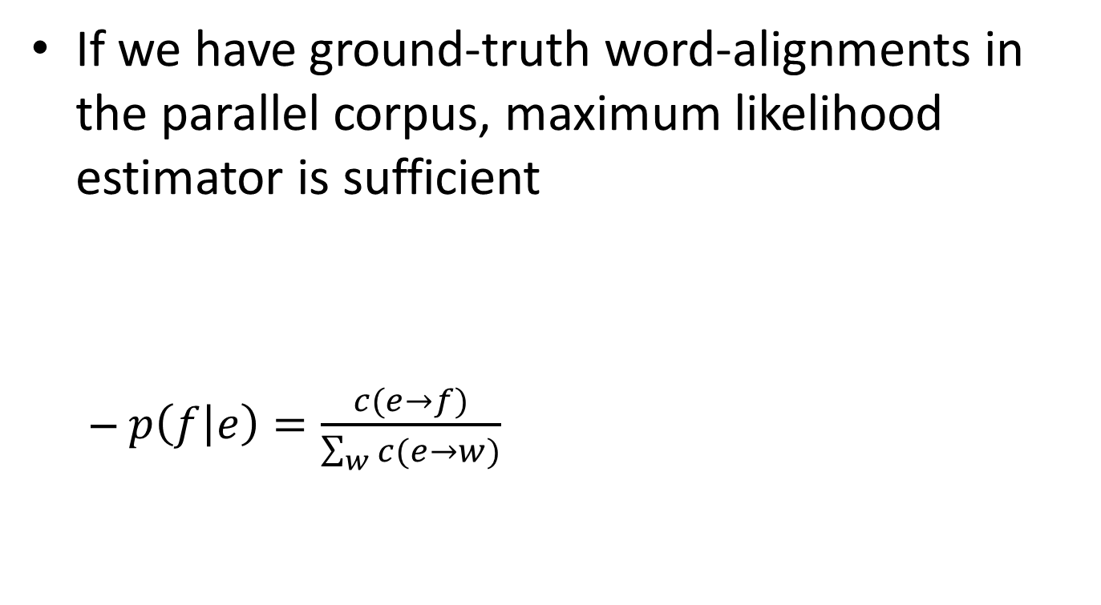
Estimation of translation probability
If we have ground-truth word-alignments in the parallel corpus, maximum likelihood estimator is sufficient
$p\left(f | e\right)=\frac{c(e→f)}{\sum_{w}{c(e→w)}}$
John told Mary a story.
Jean a raconté une histoire à Marie.

Slide 29
Estimation of translation probability
If we do not have ground-truth word-alignments, appeal to Expectation Maximization algorithm
Intuitively, guess the alignment based on the current translation probability first; and then update the translation probability
EM algorithm will be carefully discussed in our later lecture of “Text Clustering”

Slide 30
Other translation models
IBM models 2-5 are more complex
Word order and string position of the aligned words
Phase translation in the source and target languages

Slide 31
What you should know
Challenges in machine translation
Lexicon/syntactic/semantic divergences
Statistical machine translation
Source-channel framework for statistical machine translation
Generative process
IBM model 1
Idea of word alignment

Slide 32
Today’s reading
Speech and Language Processing
Chapter 25: Machine Translation

