Slide 1
Item-based Collaborative Filtering Recommendation Algorithms
Badrul Sarwar, George Karypis, Joseph Konstan, and John Riedl
WWW10, 2001
Presenter: Jinghe Zhang
04/23/2015

Slide 2
Outline
Introduction
Related Work
Collaborative Filtering based Recommendation Systems
Item-based Collaborative Filtering Algorithm
Experimental Evaluation
Conclusions

Slide 3
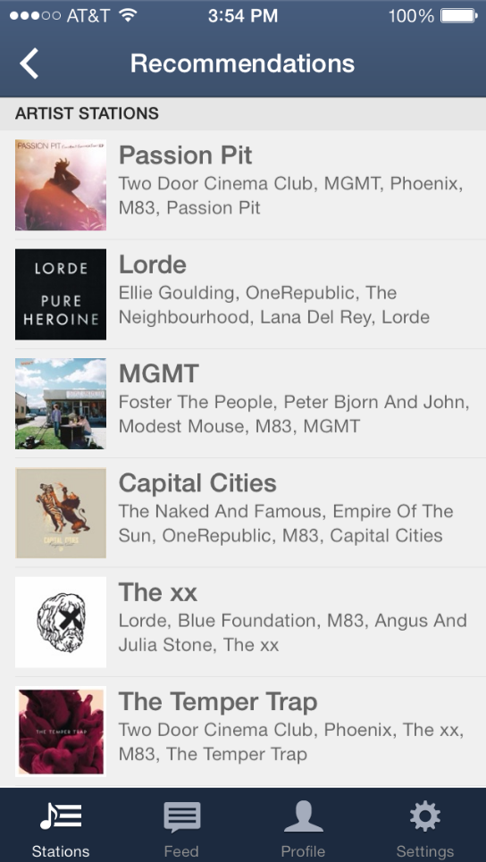
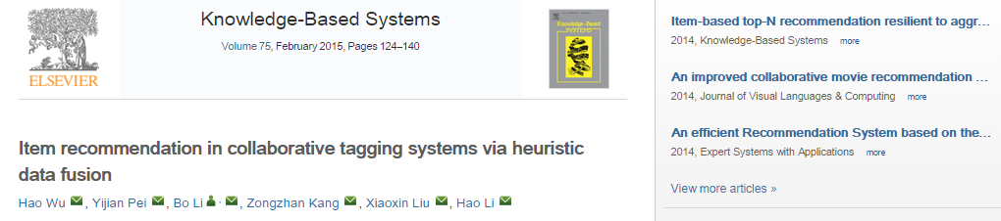
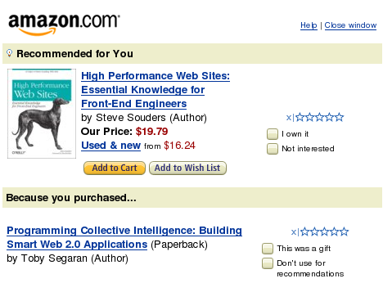
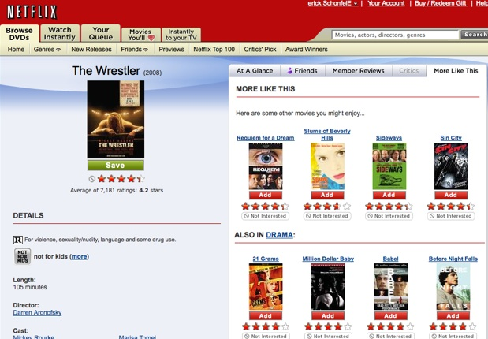
Introduction
Huge amount of information and hard to process all of them
We need technologies to help sift through all available information and recommend the most valuable to us
Recommendation systems: apply knowledge discovery techniques to the problem of making personalized recommendations for information, products or services during a live interaction.
Content-based systems: property of items
Collaborative filtering system: preferences for items by users
The Information Avalanche
Doubling the knowledge base:
1750-1900: 150 years to double
1900-1950: 50 years to double
1950-1960: 10 years to double
1960-1992: 5 years to double
By 2020, information will double every 73 days
Source: Social Media Recommendations 2012.
Source: CCTP-748: Media Theory and Cognitive Technologies 2014
Source: Pandora launches station recommendations on iOS and Android 2014.
Source: 1992 Conference Teach America, quoted by Gary Starkweather.

Slide 4
Related Work
Collaborative filtering (CF):
Recommend items preferred by similar users
Very successful and promising in research and practice
Two challenges:
Scalability: to search tens of millions of potential neighbors in real-time
Quality of recommendations
In conventional CF, search for neighbors among a large user population.
Other Techniques: clustering, etc.
Limitations: data sparsity; high dimensionality, etc.

Slide 5

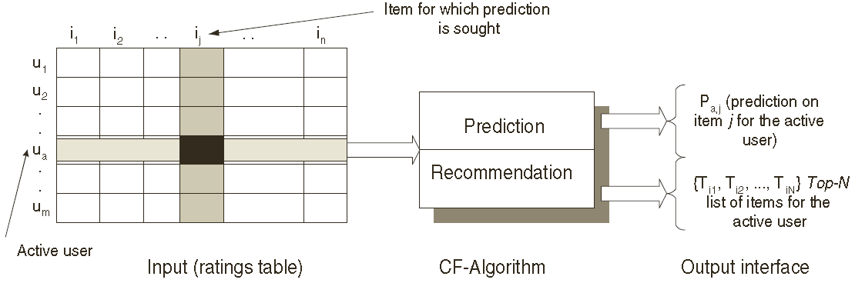
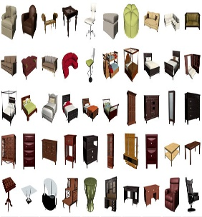

Collaborative filtering based recommender systems
Collaborative filtering: to provide item recommendations or predictions based on opinions of other like-minded users.
Users
Items
Opinions

Slide 6
Collaborative filtering based recommender systems (cont’d)
Memory-based CF: utilizes the entire user-item database to generate a prediction.
Find nearest neighbors
Combine the preferences of neighbors to produce predictions or top-N items
Model-based CF:
Develop a model of user ratings: compute the expected value of a user prediction, given the ratings on other items.
Machine learning algorithms to build the models: clustering, rule-based approaches, etc.

Slide 7


Item-based Collaborative Filtering Algorithm
Basic idea: investigate the set of items the target user has rated and compute how similar they are to the target item i and the selects k most similar items; make prediction by computing the weighted average of the user’s ratings on similar items.
Item Similarity Computation:
Cosine-based similarity
Correlation-based similarity:
Adjusted cosine-based similarity: address the differences in rating scale between different users
$$sim\left(i,j\right)= \frac{\sum_{u∈U}{(R_{u,i}−{\overline{R}}_{i})(R_{u,j}−{\overline{R}}_{j})}}{\sqrt{\sum_{u∈U}{({R_{u,i}−{\overline{R}}_{i})}^{2}}}\sqrt{\sum_{u∈U}{({R_{u,j}−{\overline{R}}_{j})}^{2}}}}$$
$$sim\left(i,j\right)= \frac{\sum_{u∈U}{(R_{u,i}−{\overline{R}}_{u})(R_{u,j}−{\overline{R}}_{u})}}{\sqrt{\sum_{u∈U}{({R_{u,i}−{\overline{R}}_{u})}^{2}}}\sqrt{\sum_{u∈U}{({R_{u,j}−{\overline{R}}_{u})}^{2}}}}$$

Slide 8
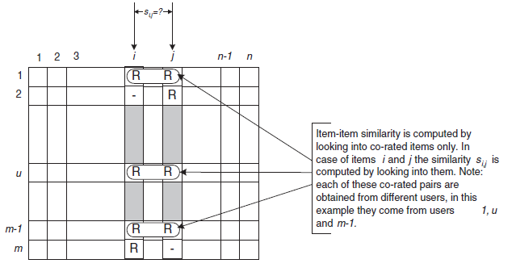


Item-based Collaborative Filtering Algorithm
Basic idea: investigate the set of items the target user has rated and compute how similar they are to the target item i and the selects k most similar items; make prediction by computing the weighted average of the user’s ratings on similar items.
Prediction Computation:
Weighted Sum: computes prediction on item i for a user by the sum of ratings on similar items by this user
Regression:
$$P_{u,i}= \frac{\sum_{all similar items, N}{(s_{i,N}∗R_{u,N})}}{\sum_{all similar items, N}{({|s}_{i,N}|)}}$$
$$R_{N}^{′}=αR_{i}+β+ε$$
Notes:
Weighted sum: basically captures how the active user rates the similar items.

Slide 9
Item-based Collaborative Filtering Algorithm
Basic idea: investigate the set of items the target user has rated and compute how similar they are to the target item i and the selects k most similar items; make prediction by computing the weighted average of the user’s ratings on similar items.
Performance Implication
Neighborhood-based CF: neighborhood formation process (user-user similarity computation) is bottleneck
Model-based approach can contribute to recommender systems to operate at high scale:
Isolate neighborhood generation and prediction generation steps: precompute item-item similarity
Consider a small fraction of similar items: k most similar items
Notes:
Weighted sum: basically captures how the active user rates the similar items.

Slide 10
Experimental Evaluation
Data set
Movie data: randomly selected users from MovieLens (43,000+ users and 3,500+ movies) to obtain 100,000 ratings
User-item matrix: 943 rows and 1,682 columns
Sparsity level: 0.9369
Evaluation metrics: mean absolute error (MAE) between ratings and predictions
Benchmark: a user-user recommender system
Parameter Tuning: neighborhood size (30), training/testing ratio (80%/20%), effects of different similarity measures (adjusted cosine)

Slide 11
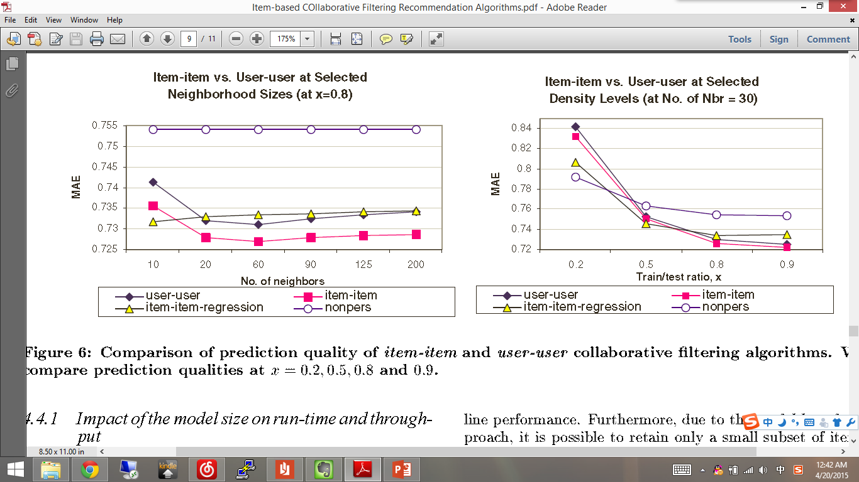
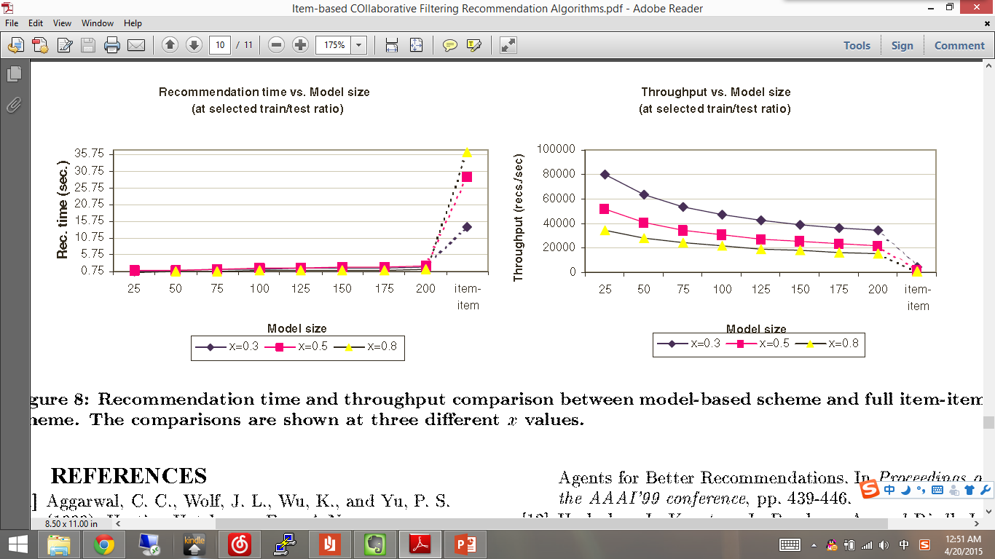
Experimental Evaluation (cont’d)
Quality and Performance Experiments:
Item-based CF outperforms user-based CF at all sparsity levels
Regression-based algorithms performs better with very sparse data set
Since item neighborhood is fairly static, which can be precomputed and results in very high online performance
Model-based approach allows us to retain a small subset of items and produce reasonably good predictions

Slide 12
Conclusions
Recommender systems are very powerful to extract valuable information which benefits both the business and the users.
Recommender systems are stressed by huge amounts of user data and new technologies are needed to improve scalability.
Proposed a new algorithm for CF-based recommender systems which allowing it to scale to large datasets and produce high-quality recommendations at the same time.

Slide 13
Thank you!

