Slide 1
Title: The Author-Topic Model for Authors and Documents
Authors: Rosen-Zvi, Griffiths, Steyvers, Smyth
Venue: the 20th Conference on Uncertainty in Artificial Intelligence
Year: 2004
Presenter: Peter Wu
Date: Apr 7, 2015
Notes:
To give you guys a little personal connection…

Slide 2
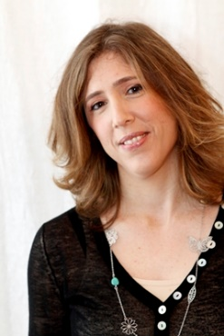
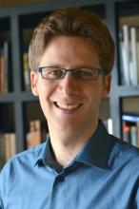
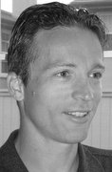
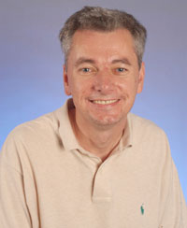
Title: The Author-Topic Model for Authors and Documents
Authors: Rosen-Zvi, Griffiths, Steyvers, Smyth
Venue: the 20th Conference on Uncertainty in Artificial Intelligence
Year: 2004
Presenter: Peter Wu
Date: Apr 7, 2015
Notes:
This paper introduced a new version of generative model for topic modeling

Slide 3
Title: The Author-Topic Model for Authors and Documents
Authors: Rosen-Zvi, Griffiths, Steyvers, Smyth,
Venue: the 20th Conference on Uncertainty in Artificial Intelligence
Year: 2004
Extension: added the modeling of authors interest
Presenter: Peter Wu
Date: Apr 7, 2015
Blei, Ng, & Jordan. "Latent dirichlet allocation." the Journal of machine Learning research 3 (2003): 993-1022.
Notes:
Built upon the original topic model…
The extension part is that they added…
If you are familiar with the original LDA…

Slide 4
Outline
Motivation
Model formulation
Parameter estimation
Evaluation
Application

Slide 5
Outline
Motivation
Model formulation
Generative process; plate notation; a comparison with LDA
Parameter estimation
Gibbs sampling
Evaluation
Application
Notes:
Describe how the generative process works; and a convenient visualization of such process; then comparison to show the difference and innovation of this paper

Slide 6
Motivation
Learning the interests of authors is a fundamental problem raised by large collection of documents.
Previous works usually adopt a discriminative approach and features chosen are usually superficial.
The authors introduced a generative model that represents each author with a distribution of weights over latent topics.
Notes:
First, it’s an important task because we have large collections; we want to learn the interests but not obvious
Of course there are people ;
The notion of authors interests is captured.
Note that the topics are latent clusters

Slide 7
Motivation
Learning the interests of authors is a fundamental problem raised by large collection of documents.
Previous works usually adopt a discriminative approach and features chosen are usually superficial.
The authors introduced a generative model that represents each author with a distribution of weights over latent topics.
Unsupervised clustering algorithm: (only) the number of topics T needs to be specified.

Slide 8
Model Formulation
It’s storytelling time for a generative model!
Suppose we have a corpus of D documents that:
spans a vocabulary of V words
is collectively composed by A authors
In this corpus, each document d:
contains words w_{d} (a subset of the V words with cardinality N_{d}; order doesn’t matter)
is composed by authors a_{d} (a subset of the A authors)
Notes:
We see what we observe and hypothesize a story of how what we see is generated; what we observe here is…

Slide 9
Model Formulation
This is what we observe!
It’s storytelling time for a generative model!
Suppose we have a corpus of D documents that:
spans a vocabulary of V words
is collectively composed by A authors
In this corpus, each document d:
contains words w_{d} (a subset of the V words with cardinality N_{d}; order doesn’t matter)
is composed by authors a_{d} (a subset of the A authors)

Slide 10
Model Formulation
This is what we observe!
It’s storytelling time for a generative model!
Suppose we have a corpus of D documents that:
spans a vocabulary of V words
is collectively composed by A authors
In this corpus, each document d:
contains words w_{d} (a subset of the V words with cardinality N_{d}; order doesn’t matter)
is composed by authors a_{d} (a subset of the A authors)
How could such a corpus be created?
Notes:
Now we ask the question how could such a corpus be created

Slide 11
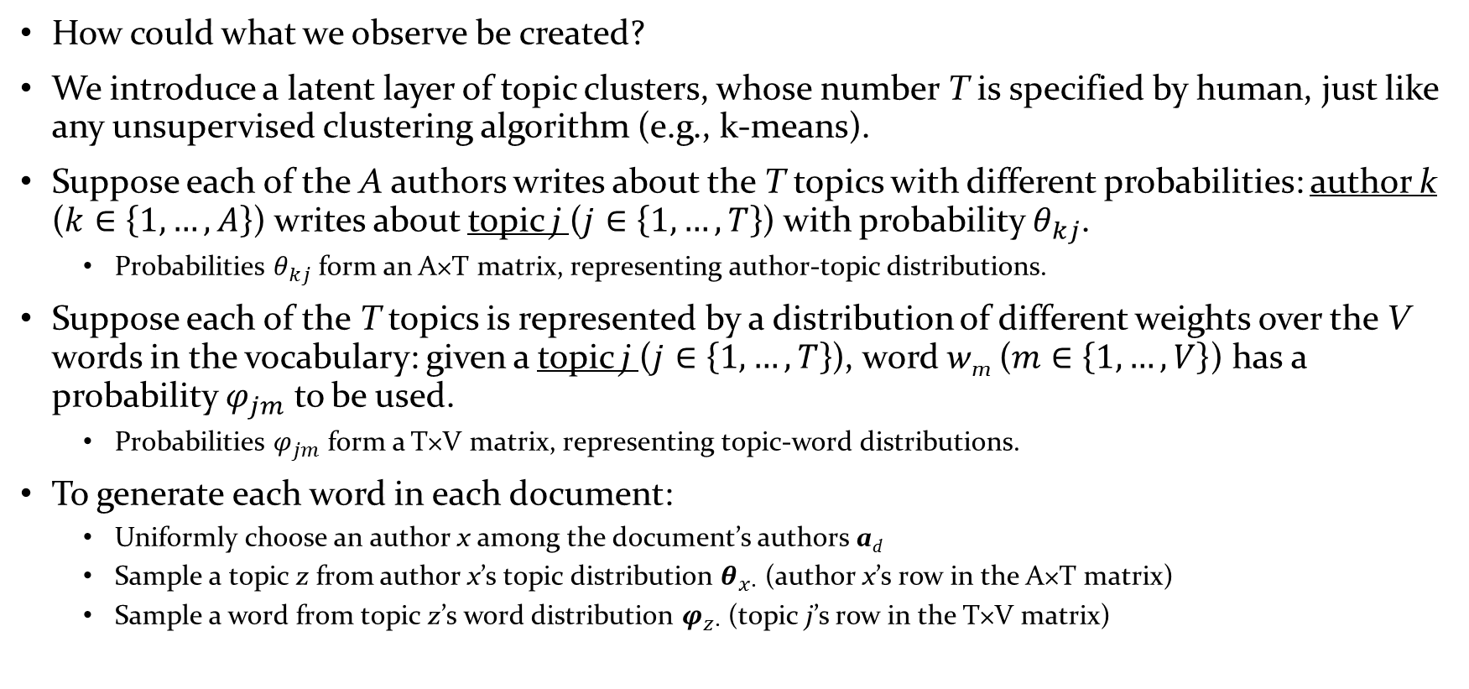
Model Formulation (Cont’d)
How could what we observe be created?
We introduce a latent layer of topic clusters, whose number T is specified by human, just like any unsupervised clustering algorithm (e.g., k-means).
Suppose each of the A authors writes about the T topics with different probabilities: author k ($k∈\left\{1,…,A\right\}$) writes about topic j ($j∈\left\{1,…,T\right\}$) with probability $θ_{kj}$.
Probabilities $θ_{kj}$ form an A×T matrix, representing author-topic distributions.
Suppose each of the T topics is represented by a distribution of different weights over the V words in the vocabulary: given a topic j ($j∈\left\{1,…,T\right\}$), word w_{m} ($m∈\left\{1,…,V\right\}$) has a probability $φ_{jm}$ to be used.
Probabilities $φ_{jm}$ form a T×V matrix, representing topic-word distributions.
To generate each word in each document:
Uniformly choose an author x among the document’s authors a_{d}
Sample a topic z from author x’s topic distribution $θ_{x∙}$ (author x’s row in the A×T matrix)
Sample a word from topic z’s word distribution $φ_{z∙}$ (topic j’s row in the T×V matrix)
Notes:
Where does these latent topics come into play? It comes between authors and words and generate two distributions.
Now we can start the generative process, or drawing;
Now a quick quiz

Slide 12
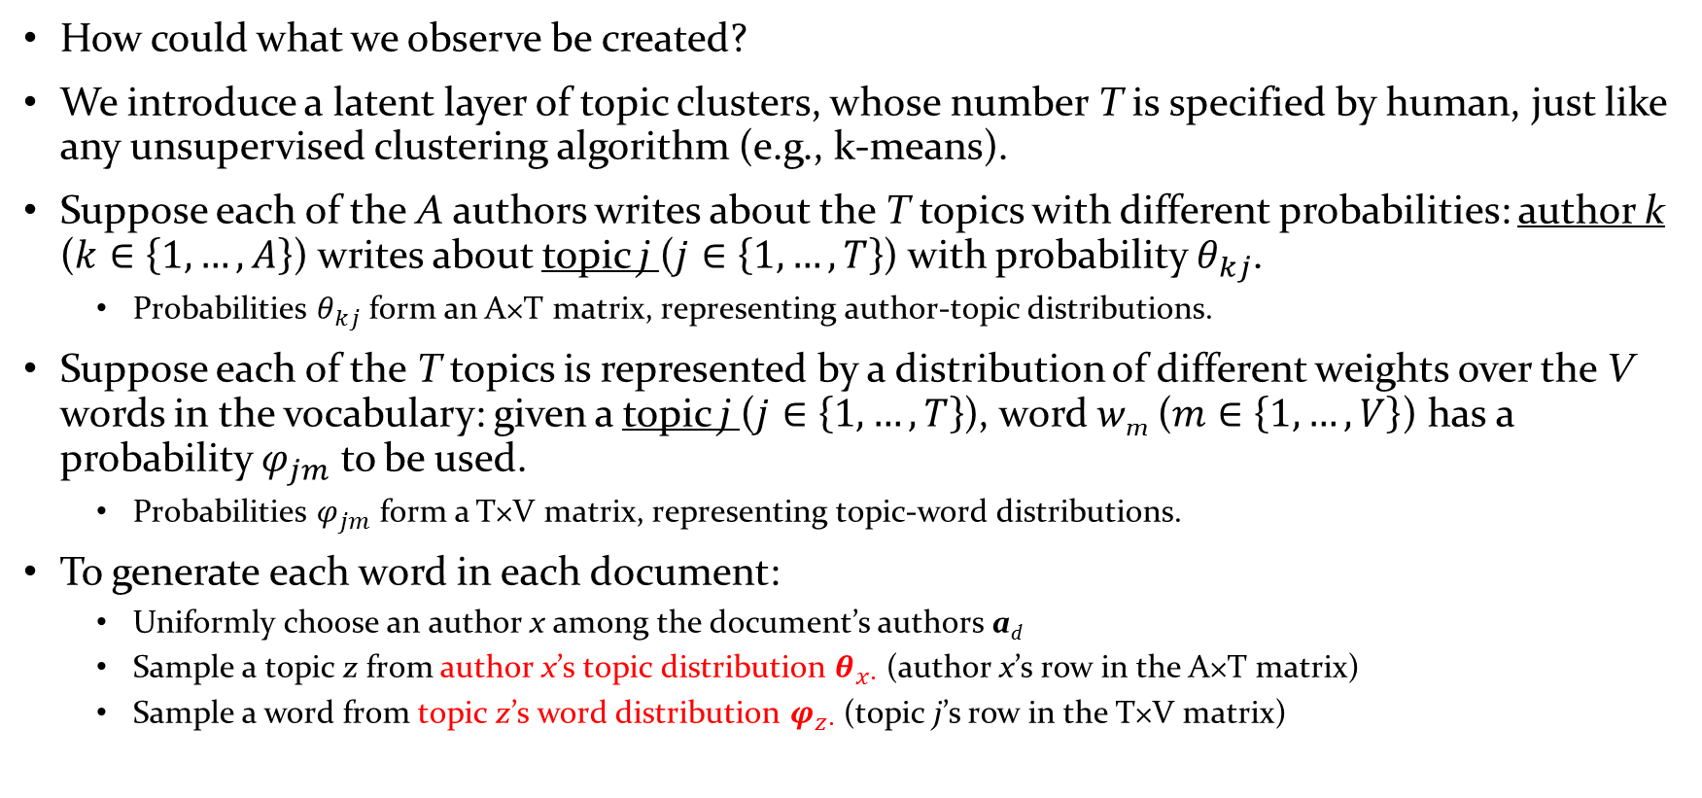
Model Formulation (Cont’d)
How could what we observe be created?
We introduce a latent layer of topic clusters, whose number T is specified by human, just like any unsupervised clustering algorithm (e.g., k-means).
Suppose each of the A authors writes about the T topics with different probabilities: author k ($k∈\left\{1,…,A\right\}$) writes about topic j ($j∈\left\{1,…,T\right\}$) with probability $θ_{kj}$.
Probabilities $θ_{kj}$ form an A×T matrix, representing author-topic distributions.
Suppose each of the T topics is represented by a distribution of different weights over the V words in the vocabulary: given a topic j ($j∈\left\{1,…,T\right\}$), word w_{m} ($m∈\left\{1,…,V\right\}$) has a probability $φ_{jm}$ to be used.
Probabilities $φ_{jm}$ form a T×V matrix, representing topic-word distributions.
To generate each word in each document:
Uniformly choose an author x among the document’s authors a_{d}
Sample a topic z from author x’s topic distribution $θ_{x∙}$ (author x’s row in the A×T matrix)
Sample a word from topic z’s word distribution $φ_{z∙}$ (topic j’s row in the T×V matrix)
What distribution is this?

Slide 13
Model Formulation (Cont’d)
How could what we observe be created?
We introduce a latent layer of topic clusters, whose number T is specified by human, just like any unsupervised clustering algorithm (e.g., k-means).
Suppose each of the A authors writes about the T topics with different probabilities: author k ($k∈\left\{1,…,A\right\}$) writes about topic j ($j∈\left\{1,…,T\right\}$) with probability $θ_{kj}$.
Probabilities $θ_{kj}$ form an A×T matrix, representing author-topic distributions.
Suppose each of the T topics is represented by a distribution of different weights over the V words in the vocabulary: given a topic j ($j∈\left\{1,…,T\right\}$), word w_{m} ($m∈\left\{1,…,V\right\}$) has a probability $φ_{jm}$ to be used.
Probabilities $φ_{jm}$ form a T×V matrix, representing topic-word distributions.
To generate each word in each document:
Uniformly choose an author x among the document’s authors a_{d}
Sample a topic z from author x’s topic distribution $θ_{x∙}$ (author x’s row in the A×T matrix)
Sample a word from topic z’s word distribution $φ_{z∙}$ (topic j’s row in the T×V matrix)
Multinomial!

Slide 14
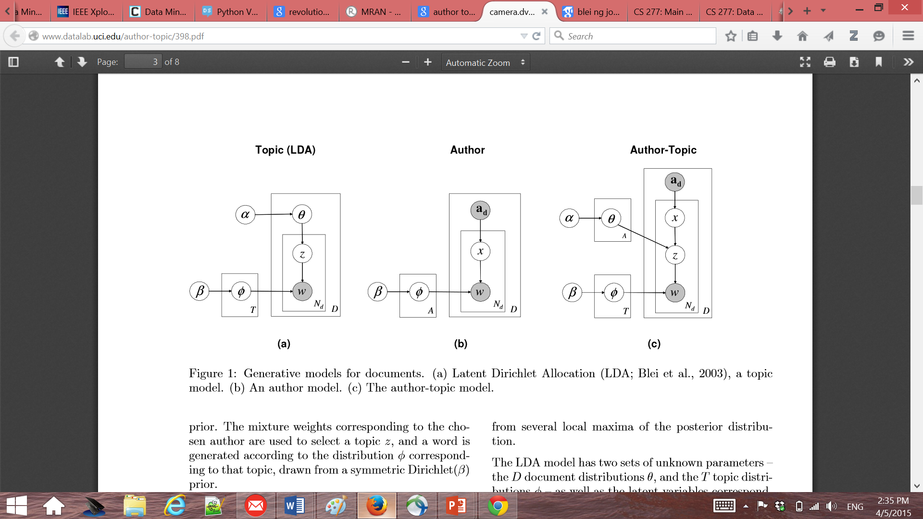
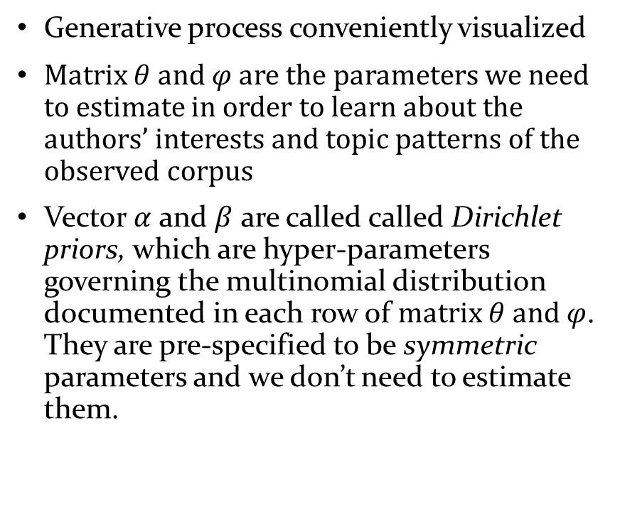
Plate Notation
Generative process conveniently visualized
Matrix $θ$ and $φ$ are the parameters we need to estimate in order to learn about the authors’ interests and topic patterns of the observed corpus
Vector $α$ and $β$ are called called Dirichlet priors, which are hyper-parameters governing the multinomial distribution documented in each row of matrix $θ$ and $φ$. They are pre-specified to be symmetric parameters and we don’t need to estimate them.
Notes:
All what we discussed last slide can be visualized by this diagram called plate notation
We can see that to generate the words matrix theta and fi are the parameters we need to estimate
What are alpha and beta?

Slide 15
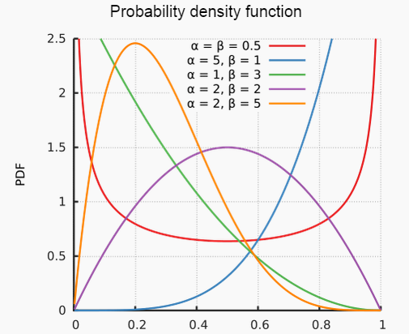
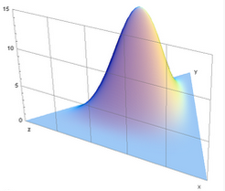
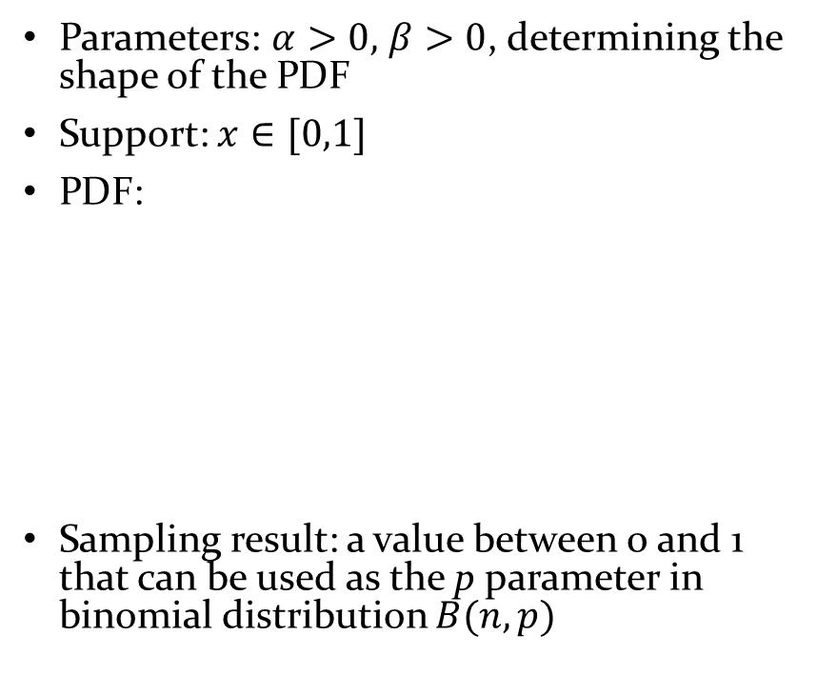
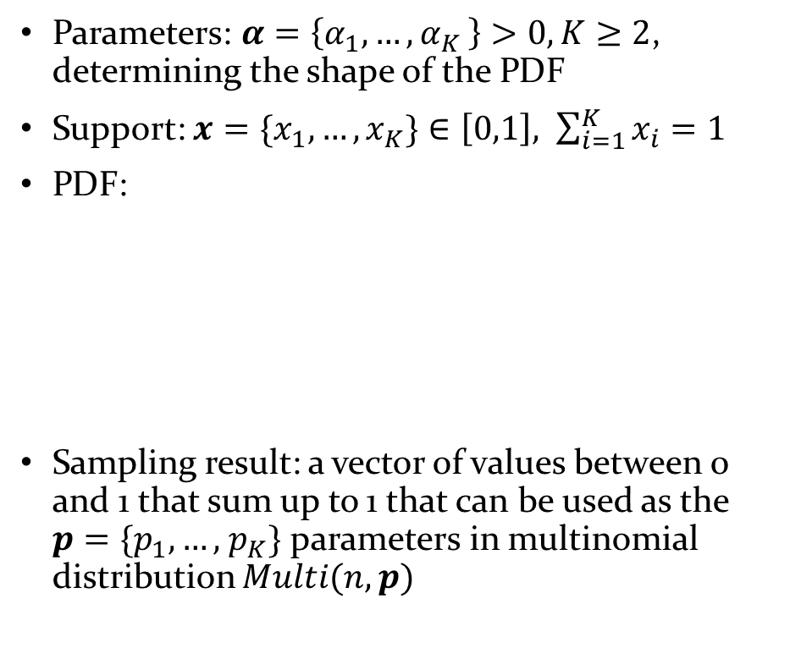
A Crash Course on Dirichlet Distribution
Beta distribution
Dirichlet distribution
Parameters: $α>0,$ $β>0$, determining the shape of the PDF
Support: $x∈[0,1]$
PDF:
Sampling result: a value between 0 and 1 that can be used as the p parameter in binomial distribution $B(n,p)$
Parameters: $α=\left\{α_{1}{,…,α}_{K}\right\}>0,K≥2$, determining the shape of the PDF
Support: ${x=\{x}_{1},…,x_{K}\}∈\left[0,1\right], \sum_{i=1}^{K}{x_{i}}=1$
PDF:
Sampling result: a vector of values between 0 and 1 that sum up to 1 that can be used as the ${p=\{p}_{1},…,$ $p_{K}\}$ parameters in multinomial distribution $Multi(n,p)$
Notes:
For convenience we set

Slide 16
A Comparison between ATF and LDA
Author-Topic Model
(Rosen-Zvi et al, 2004)
Latent Dirichlet Allocation
(Blei et al, 2003)
Notes:
Now we finished formulating the model we’ll move onto parameter estimation

Slide 17
Outline
Motivation
Model formulation
Generative process; plate notation; comparison with LDA
Parameter estimation
Gibbs sampling
Evaluation
Application

Slide 18
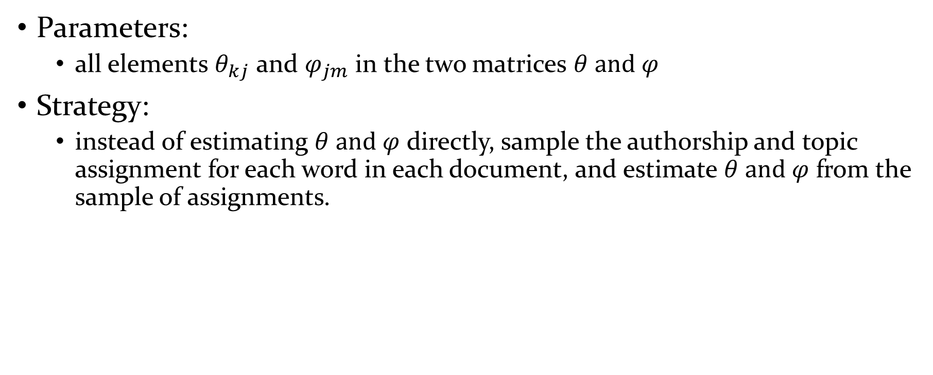
Parameter Estimation
Parameters:
all elements $θ_{kj}$ and $φ_{jm}$ in the two matrices $θ$ and $φ$
Strategy:
instead of estimating $θ$ and $φ$ directly, sample the authorship and topic assignment for each word in each document, and estimate $θ$ and $φ$ from the sample of assignments.
Notes:
The strategy is kind of complicated but look at it a little more closely

Slide 19
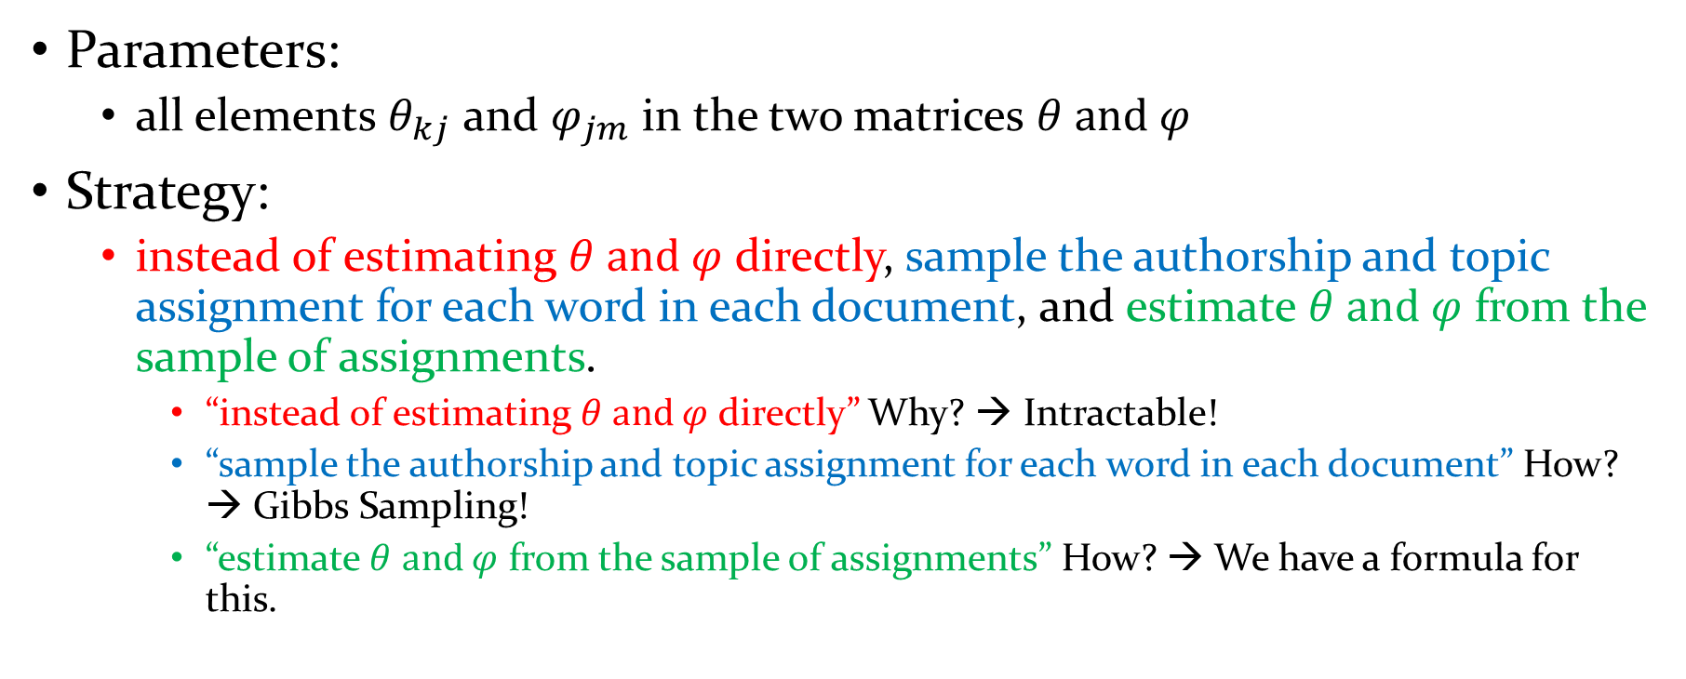
Parameter Estimation
Parameters:
all elements $θ_{kj}$ and $φ_{jm}$ in the two matrices $θ$ and $φ$
Strategy:
instead of estimating $θ$ and $φ$ directly, sample the authorship and topic assignment for each word in each document, and estimate $θ$ and $φ$ from the sample of assignments.
“instead of estimating $θ$ and $φ$ directly” Why? → Intractable!
“sample the authorship and topic assignment for each word in each document” How? → Gibbs Sampling!
“estimate $θ$ and $φ$ from the sample of assignments” How? → We have a formula for this.

Slide 20
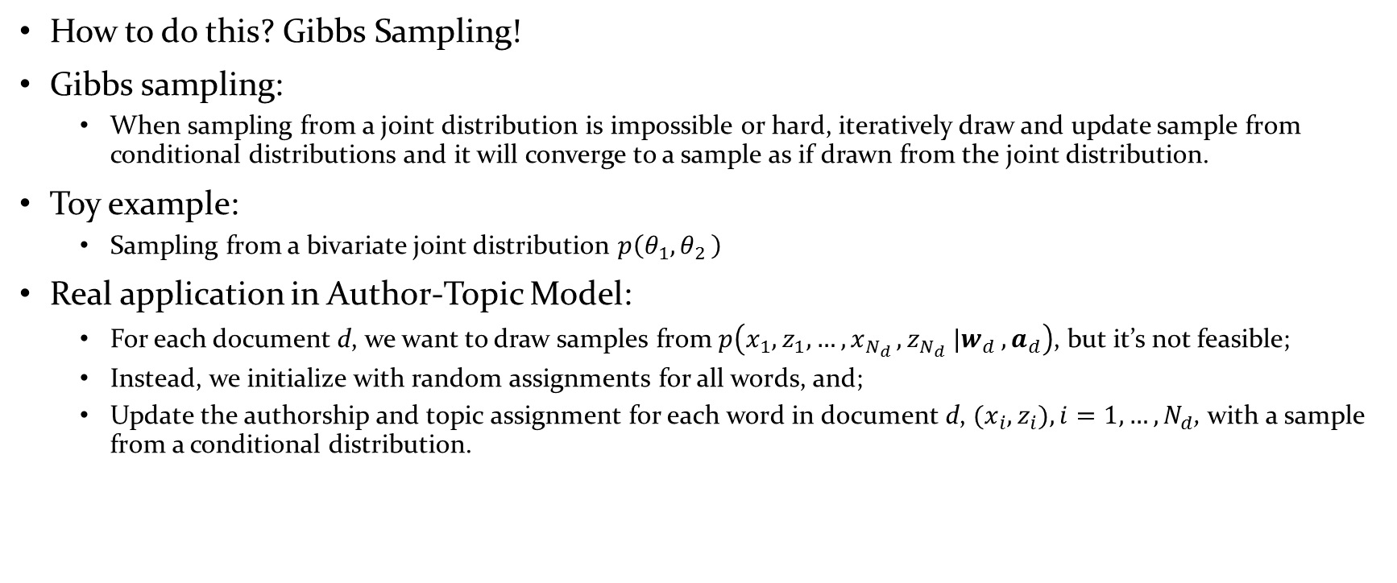
“Sample the authorship and topic assignment for each word in each document”
How to do this? Gibbs Sampling!
Gibbs sampling:
When sampling from a joint distribution is impossible or hard, iteratively draw and update sample from conditional distributions and it will converge to a sample as if drawn from the joint distribution.
Toy example:
Sampling from a bivariate joint distribution $p\left(θ_{1}{,θ}_{2}\right)$
Real application in Author-Topic Model:
For each document d, we want to draw samples from $p\left({x_{1},z}_{1}{,…{,x}_{N_{d}},z_{N_{d}} |w}_{d},a_{d}\right)$, but it’s not feasible;
Instead, we initialize with random assignments for all words, and;
Update the authorship and topic assignment for each word in document d, ${(x_{i},z}_{i}), i=1,…,N_{d}$, with a sample from a conditional distribution.
Notes:
So gibbs sampling is the practice of iteratively

Slide 21
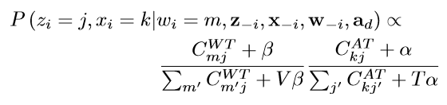
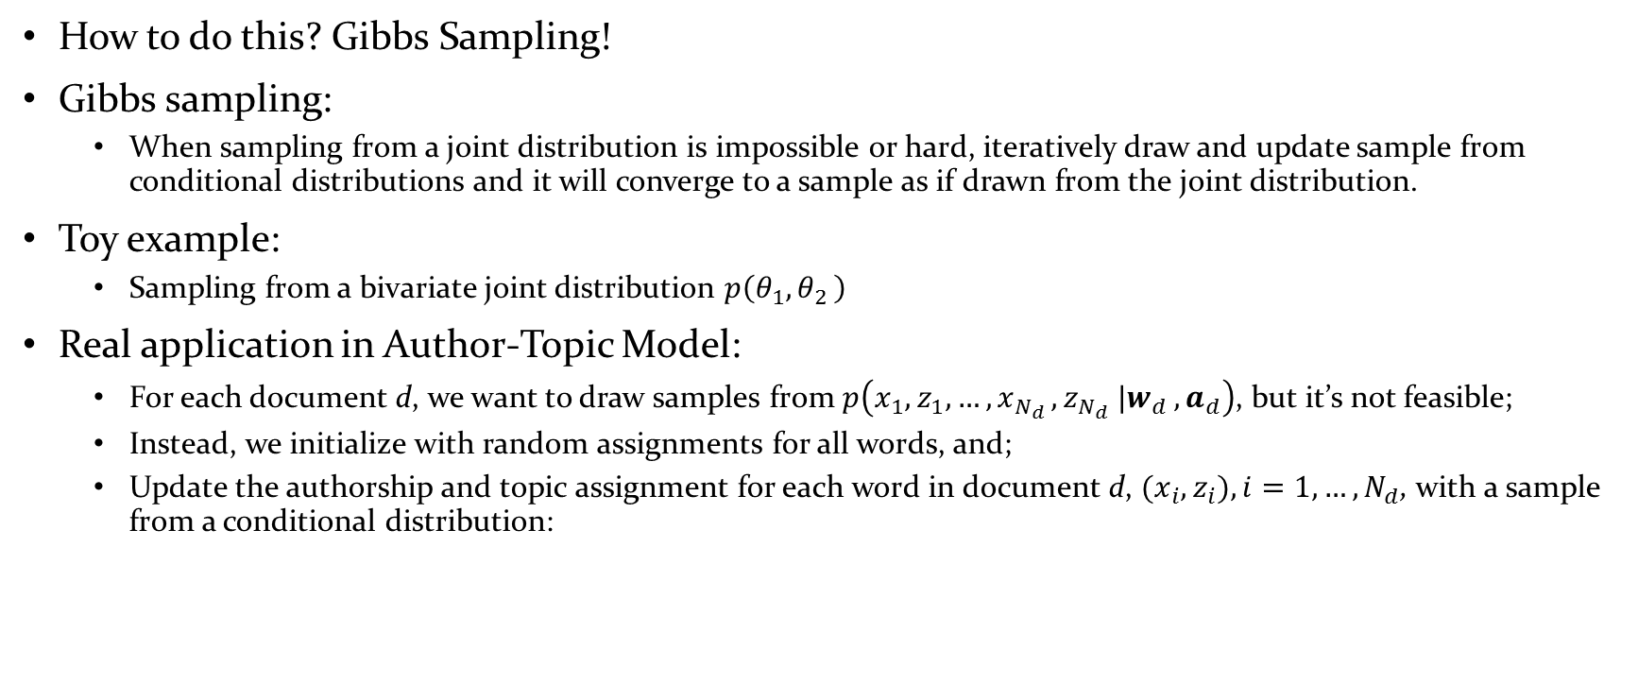
“Sample the authorship and topic assignment for each word in each document”
How to do this? Gibbs Sampling!
Gibbs sampling:
When sampling from a joint distribution is impossible or hard, iteratively draw and update sample from conditional distributions and it will converge to a sample as if drawn from the joint distribution.
Toy example:
Sampling from a bivariate joint distribution $p\left(θ_{1}{,θ}_{2}\right)$
Real application in Author-Topic Model:
For each document d, we want to draw samples from $p\left({x_{1},z}_{1}{,…{,x}_{N_{d}},z_{N_{d}} |w}_{d},a_{d}\right)$, but it’s not feasible;
Instead, we initialize with random assignments for all words, and;
Update the authorship and topic assignment for each word in document d, ${(x_{i},z}_{i}), i=1,…,N_{d}$, with a sample from a conditional distribution:
Notes:
We want to sample the author and topic assignment
The distribution of the authorship and topic assignment for one word conditioned on all other words and the assignments for all other words

Slide 22
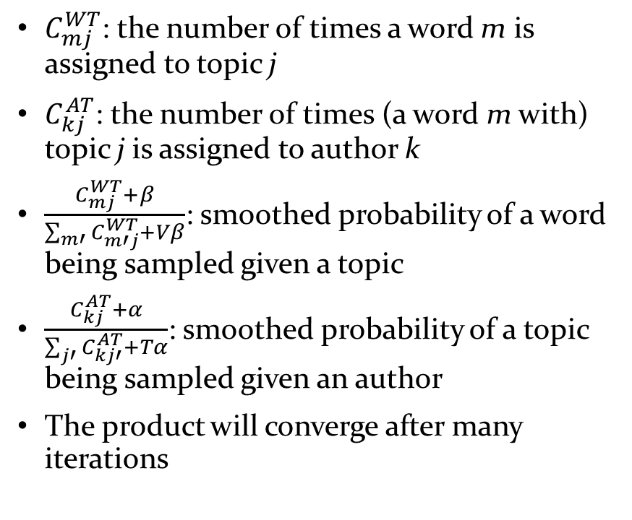
“Sample the authorship and topic assignment for each word in each document”
$C_{mj}^{WT}$: the number of times a word m is assigned to topic j
$C_{kj}^{AT}$: the number of times (a word m with) topic j is assigned to author k
$\frac{C_{mj}^{WT}+β}{\sum_{m′}{C_{m′j}^{WT}+Vβ}}$: smoothed probability of a word being sampled given a topic
$\frac{C_{kj}^{AT}+α}{\sum_{j′}{C_{kj′}^{AT}+Tα}}$: smoothed probability of a topic being sampled given an author
The product will converge after many iterations
Notes:
the distribution of the authorship and topic assignment for one word conditioned on all other words and the assignments for all other words

Slide 23

“Sample the authorship and topic assignment for each word in each document”
$C_{mj}^{WT}$: the number of times a word m is assigned to topic j
$C_{kj}^{AT}$: the number of times a word m with topic j is assigned to author k
$\frac{C_{mj}^{WT}+β}{\sum_{m′}{C_{m′j}^{WT}+Vβ}}$: smoothed probability of a word being sampled given a topic
$\frac{C_{kj}^{AT}+α}{\sum_{j′}{C_{kj′}^{AT}+Tα}}$: smoothed probability of a topic being sampled given an author
The product will converge after many iterations
Doesn’t this sound familiar?
Notes:
the distribution of the authorship and topic assignment for one word conditioned on all other words and the assignments for all other words
The two fractions are the probabilities documented in the two matrices!

Slide 24
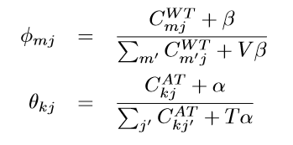
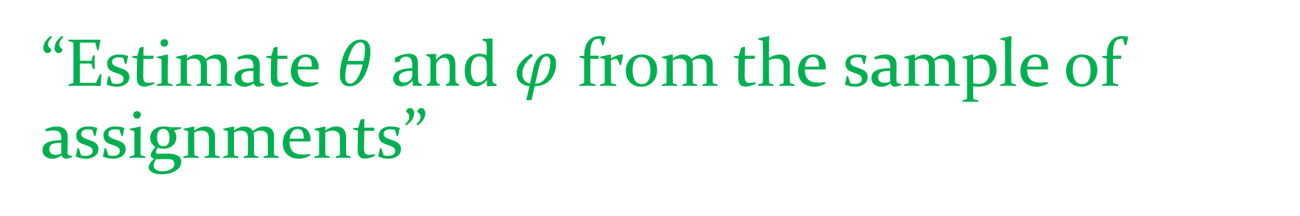
“Estimate $θ$ and $φ$ from the sample of assignments”
How to do this? We have a formula for this, which is the converged probabilities/weights in the last step:
Notes:
Sure enough, we use the formula for the conditional distribution for the parameters

Slide 25
Outline
Motivation
Model formulation
Generative process; plate notation; comparison with LDA
Parameter estimation
Gibbs sampling
Evaluation
Given a test document and its author(s), calculated perplexity score
Application
Predict the authors of a test document
Notes:
1. Perplexity: the probability that the test document is generated by the generative model we built
2. To predict the authors, simply rank the perplexity score given different authors, the ones with lower perplexities are more likely to be the real authors

Slide 26
Takeaway
By incorporating in the generative process a word-level author choosing and topic choosing according to an author-topic distribution, the Author-Topic Model manages to learn the relationship between authors and topics, and topic and words.

Slide 27
Takeaway
By incorporating in the generative process a word-level author choosing and topic choosing according to an author-topic distribution, the Author-Topic Model manages to learn the relationship between authors and topics, and topic and words.
Gibbs sampling is a solution for the difficulty of sampling from joint multivariate distributions and is used for inferring parameter values for generative models.
The Author-Topic Model can also be used to predict authors of an unseen documents
Notes:
The learned relationship between authors and topics solved the problem raised in the motivation part

Slide 28
Thank you!
Questions?

