Slide 1
Text Clustering
Hongning Wang
CS@UVa

Slide 2
Today’s lecture
Clustering of text documents
Problem overview
Applications
Distance metrics
Two basic categories of clustering algorithms
Evaluation metrics

Slide 3
Clustering v.s. Classification
Assigning documents to its corresponding categories
How to label it?

Slide 4
Clustering problem in general
Discover “natural structure” of data
What is the criterion?
How to identify them?
How many clusters?

Slide 5
Clustering problem in general
Clustering - the process of grouping a set of objects into clusters of similar objects
Basic criteria
high intra-class similarity
low inter-class similarity
No (little) supervision signal about the underlying clustering structure
Need similarity/distance as guidance to form clusters

Slide 6







What is the “natural grouping”?
Clustering is very subjective!
Distance metric is important!
group by gender
group by source of ability
group by costume

Slide 7
Clustering in text mining
Access
Serve for IR applications
Sub-area of DM research
Mining
Filter
information
Discover knowledge
Text clustering
Add
Structure/Annotations
Based on NLP/ML techniques
Organization

Slide 8
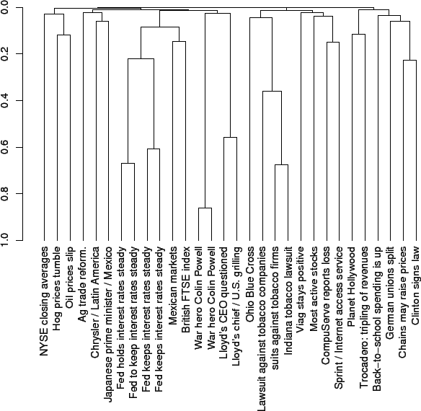
Applications of text clustering
Organize document collections
Automatically identify hierarchical/topical relation among documents

Slide 9
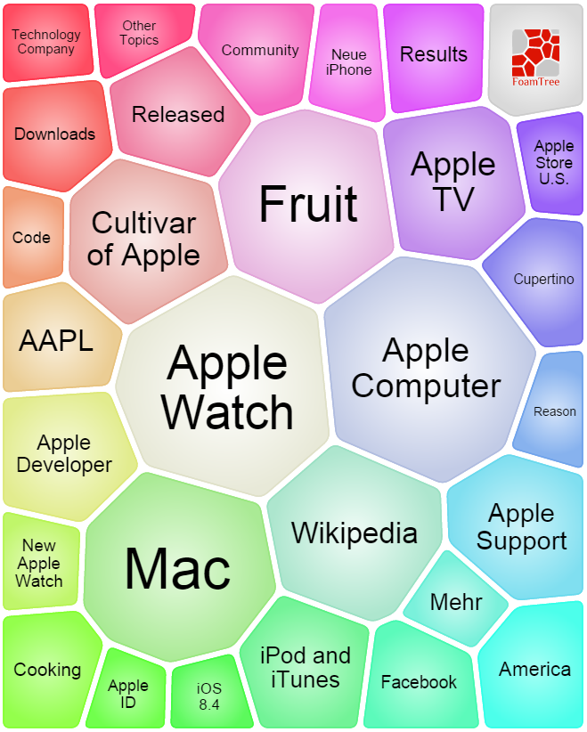
Applications of text clustering
Grouping search results
Organize documents by topics
Facilitate user browsing
http://search.carrot2.org/stable/search

Slide 10
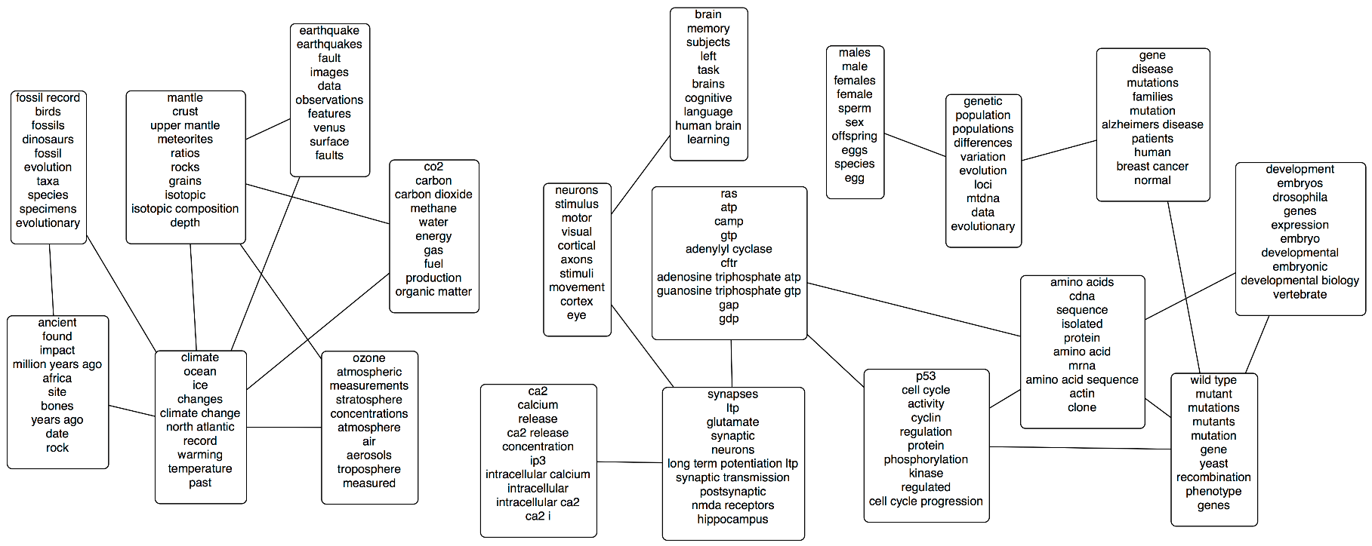
Applications of text clustering
Topic modeling
Grouping words into topics
Will be discussed later separately

Slide 11
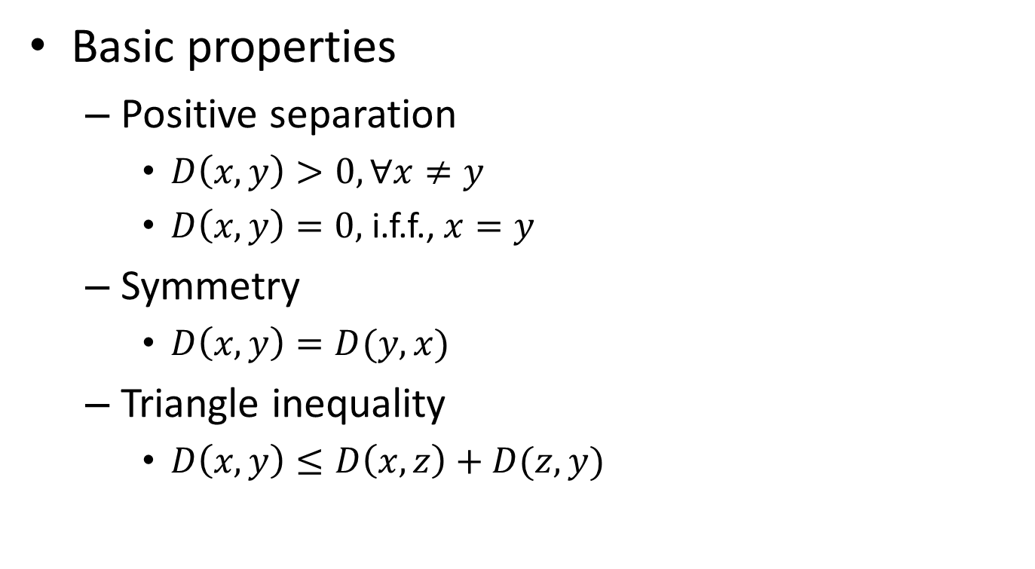
Distance metric
Basic properties
Positive separation
$D\left(x,y\right)>0, ∀x≠y$
$D\left(x,y\right)=0,$i.f.f., $x=y$
Symmetry
$D\left(x,y\right)=D(y,x)$
Triangle inequality
$D\left(x,y\right)≤D\left(x,z\right)+D(z,y)$

Slide 12
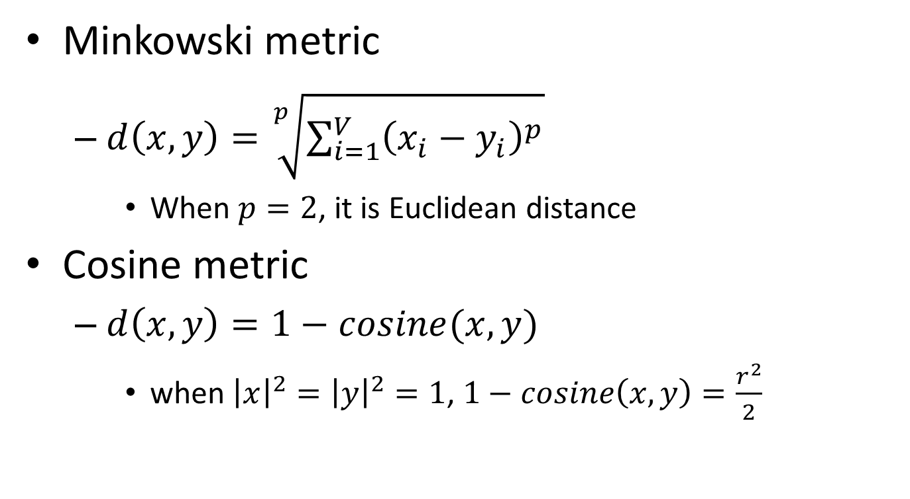
Typical distance metric
Minkowski metric
$d\left(x,y\right)=\sqrt[p]{\sum_{i=1}^{V}{{\left(x_{i}−y_{i}\right)}^{p}}}$
When $p=2$, it is Euclidean distance
Cosine metric
$d\left(x,y\right)=1−cosine(x,y)$
when ${\left|x\right|}^{2}={\left|y\right|}^{2}=1$, $1−cosine\left(x,y\right)=\frac{r^{2}}{2}$

Slide 13
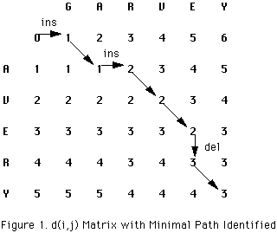
Typical distance metric
Edit distance
Count the minimum number of operations required to transform one string into the other
Possible operations: insertion, deletion and replacement
Can be efficiently solved by dynamic programming

Slide 14
Typical distance metric
Edit distance
Count the minimum number of operations required to transform one string into the other
Possible operations: insertion, deletion and replacement
Extent to distance between sentences
Word similarity as cost of replacement
“terrible” -> “bad”: low cost
“terrible” -> “terrific”: high cost
Preserving word order in distance computation
Lexicon or distributional semantics

Slide 15
Clustering algorithms
Partitional clustering algorithms
Partition the instances into different groups
Flat structure
Need to specify the number of classes in advance

Slide 16
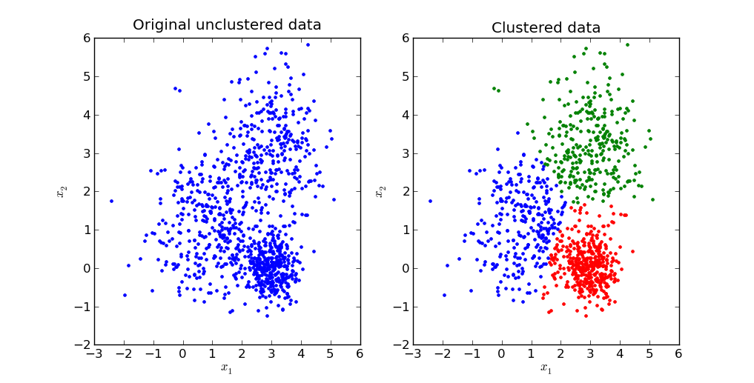
Clustering algorithms
Typical partitional clustering algorithms
k-means clustering
Partition data by its closest mean

Slide 17
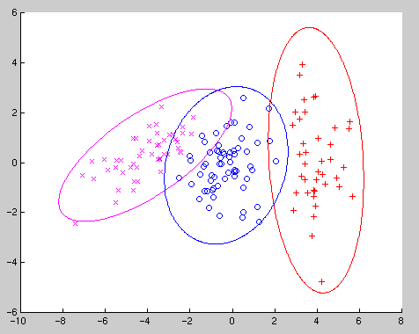
Clustering algorithms
Typical partitional clustering algorithms
k-means clustering
Partition data by its closest mean
Gaussian Mixture Model
Consider variance within
the cluster as well

Slide 18
Clustering algorithms
Hierarchical clustering algorithms
Create a hierarchical decomposition of objects
Rich internal structure
No need to specify the number of clusters
Can be used to organize objects

Slide 19
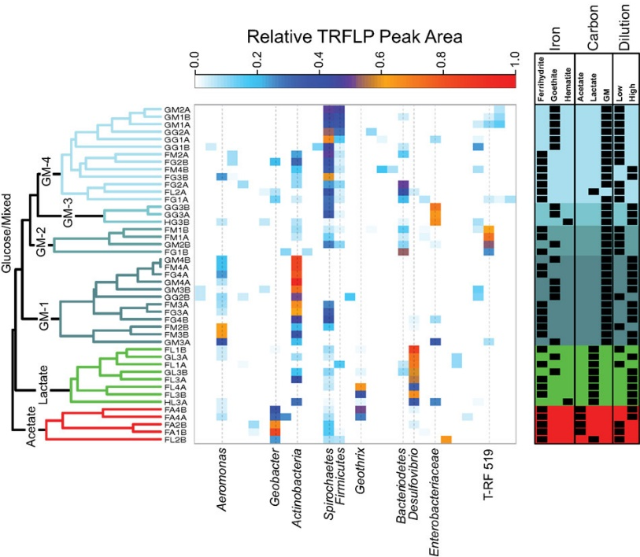
Clustering algorithms
Typical hierarchical clustering algorithms
Bottom-up agglomerative clustering
Start with individual objects as separated clusters
Repeatedly merge closest pair of clusters
Most typical usage: gene sequence analysis

Slide 20
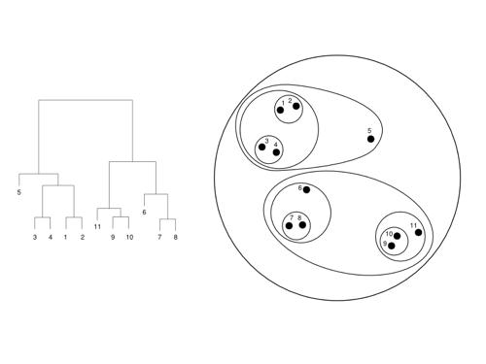
Clustering algorithms
Typical hierarchical clustering algorithms
Top-down divisive clustering
Start with all data as one cluster
Repeatedly splitting the remaining clusters into two

Slide 21
Desirable properties of clustering algorithms
Scalability
Both in time and space
Ability to deal with various types of data
No/less assumption about input data
Minimal requirement about domain knowledge
Interpretability and usability

Slide 22
Cluster validation
Criteria to determine whether the clusters are meaningful
Internal validation
Stability and coherence
External validation
Match with known categories

Slide 23
Recap: special kernels for text data
String kernel
$x$ and $y$ are two text sequences
$K\left(x,y\right)=\sum_{n}{\sum_{u∈A^{n}}{\sum_{i:u=x[i]}{\sum_{j:u=y[j]}{1}}} }$
where A is an finite alphabet of symbols
N-gram kernel (length n substrings)
All character sequence of length $n$
All occurrences of sequence $u$ in $y$
All occurrences of sequence $u$ in $x$
Insight of string kernel:
Counting the overlapping of all subsequences with length up to $n$ in $x$ and $y$
Lodhi, Huma, et al. "Text classification using string kernels." The Journal of Machine Learning Research 2 (2002): 419-444.

Slide 24
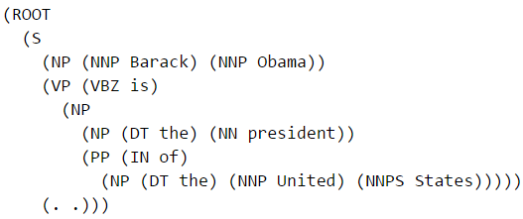
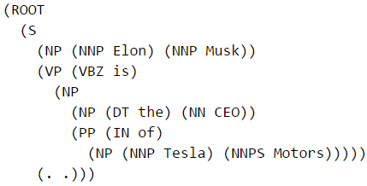

Recap: special kernels for text data
Tree kernel
Similar?
Barack Obama is the president of the United States.
Elon Musk is the CEO of Tesla Motors.
Almost identical in their dependency parsing tree!

Slide 25
Recap: special kernels for text data
Can be relaxed to allow subsequent computation under unlatching nodes
Tree kernel
$K\left(x,y\right)=\left\{\begin{aligned}0 \\ 1+K\left(x[r_{1}],y[r_{2}]\right)\end{aligned}\right.$
If $r_{1}=r_{2}$
otherwise
Search through all the sub-trees starting from root node $r$
Culotta, Aron, and Jeffrey Sorensen. "Dependency tree kernels for relation extraction." Proceedings of the ACL. P423-429, 2004.

Slide 26
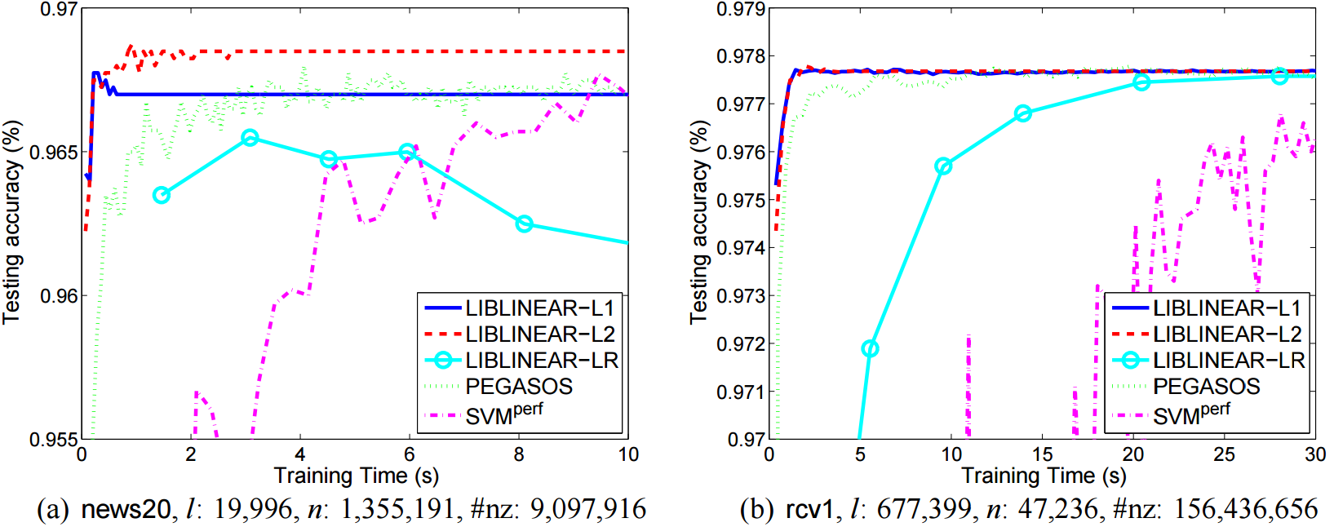
Recap: popular implementations
LIBLINEAR v.s. general SVM
Fan, Rong-En, et al. "LIBLINEAR: A library for large linear classification." The Journal of Machine Learning Research 9 (2008): 1871-1874.

Slide 27
Recap: what is the “natural grouping”?
Clustering is very subjective!
Distance metric is important!
group by gender
group by source of ability
group by costume

Slide 28
Recap: distance metric
Basic properties
Positive separation
$D\left(x,y\right)>0, ∀x≠y$
$D\left(x,y\right)=0,$i.f.f., $x=y$
Symmetry
$D\left(x,y\right)=D(y,x)$
Triangle inequality
$D\left(x,y\right)≤D\left(x,z\right)+D(z,y)$

Slide 29
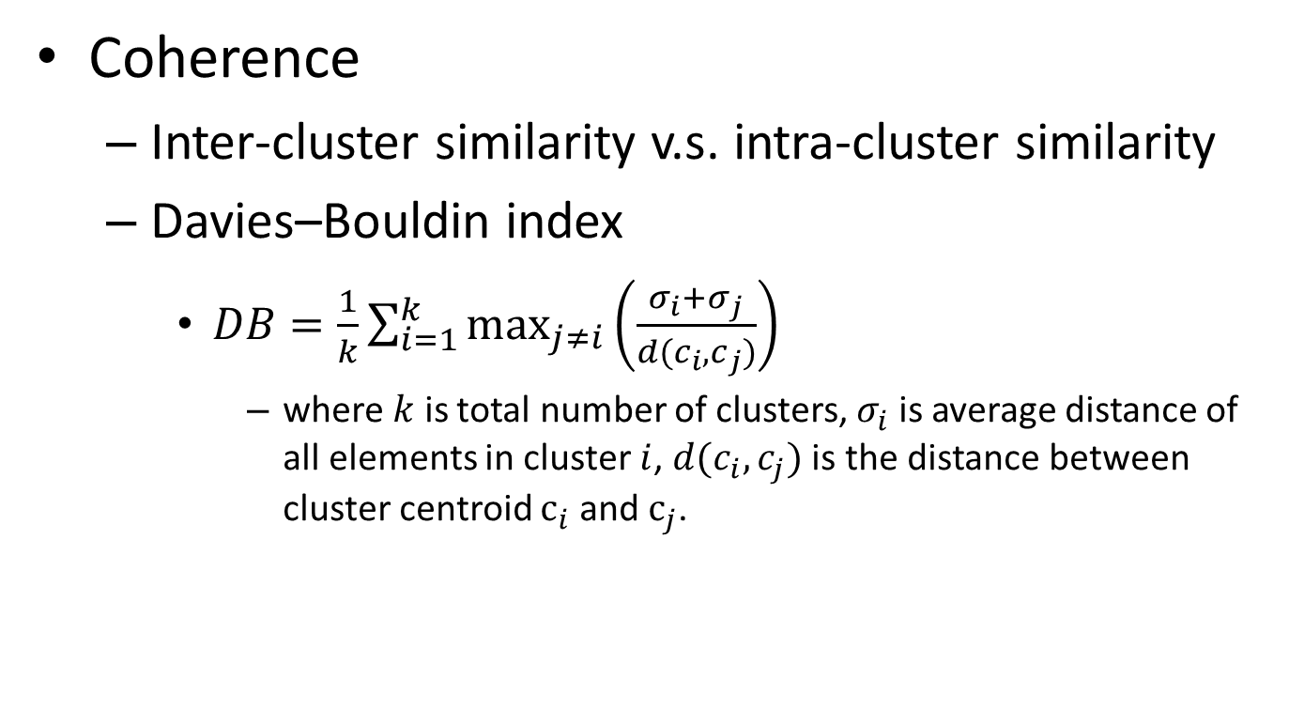
Internal validation
Coherence
Inter-cluster similarity v.s. intra-cluster similarity
Davies–Bouldin index
$DB=\frac{1}{k}\sum_{i=1}^{k}{\max_{j≠i}\left(\frac{σ_{i}+σ_{j}}{d(c_{i}, c_{j})}\right)}$
where $k$ is total number of clusters, $σ_{i}$ is average distance of all elements in cluster $i$, $d(c_{i}, c_{j})$ is the distance between cluster centroid $c_{i}$ and $c_{j}$.
Evaluate every pair of clusters
We prefer smaller DB-index!

Slide 30
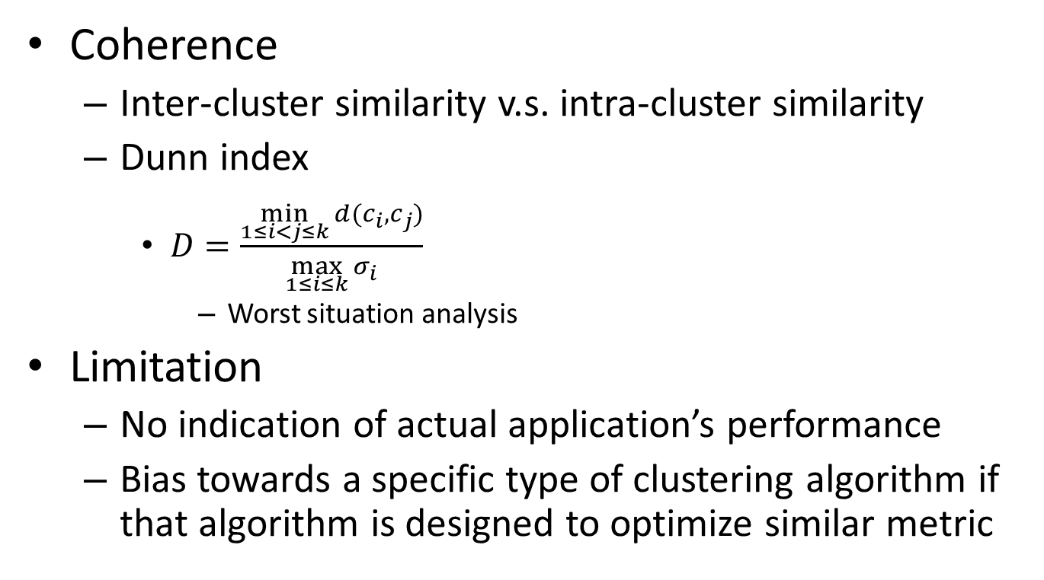
Internal validation
Coherence
Inter-cluster similarity v.s. intra-cluster similarity
Dunn index
$D=\frac{\min_{1≤i<j≤k}{d(c_{i}, c_{j})}}{\max_{1≤i≤k}{σ_{i}}}$
Worst situation analysis
Limitation
No indication of actual application’s performance
Bias towards a specific type of clustering algorithm if that algorithm is designed to optimize similar metric
We prefer larger D-index!

Slide 31
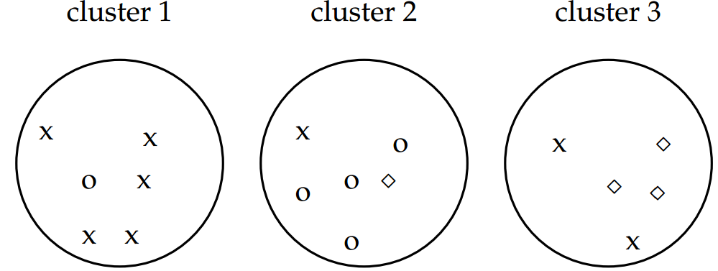
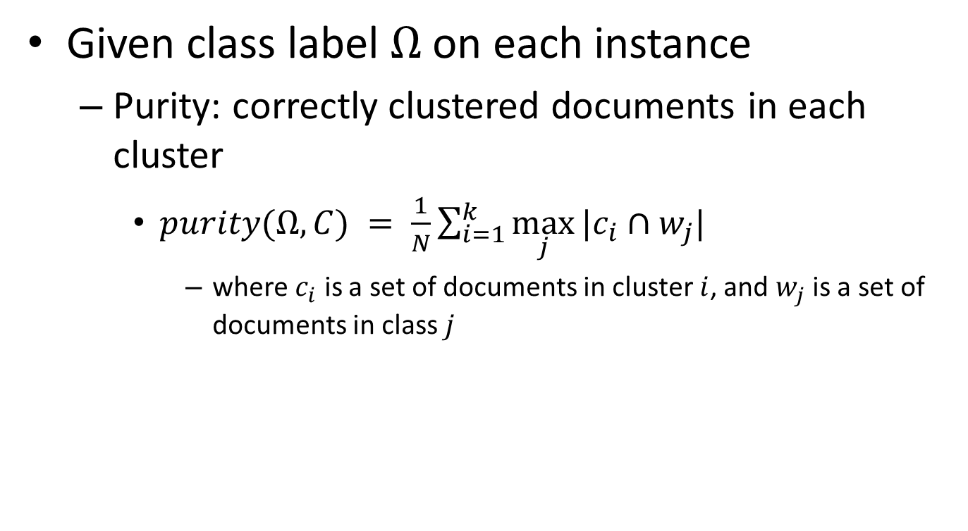


External validation
Required, might need extra cost
Given class label $Ω$ on each instance
Purity: correctly clustered documents in each cluster
$purity(Ω,C) = \frac{1}{N}\sum_{i=1}^{k}{\max_{j}{|c_{i}∩w_{j}|}}$
where $c_{i}$ is a set of documents in cluster $i$, and $w_{j}$ is a set of documents in class $j$
Not a good metric if we assign each document into a single cluster
$$purity(Ω,C) =$$
$$\frac{1}{17}\left(5+4+3\right)$$

Slide 32
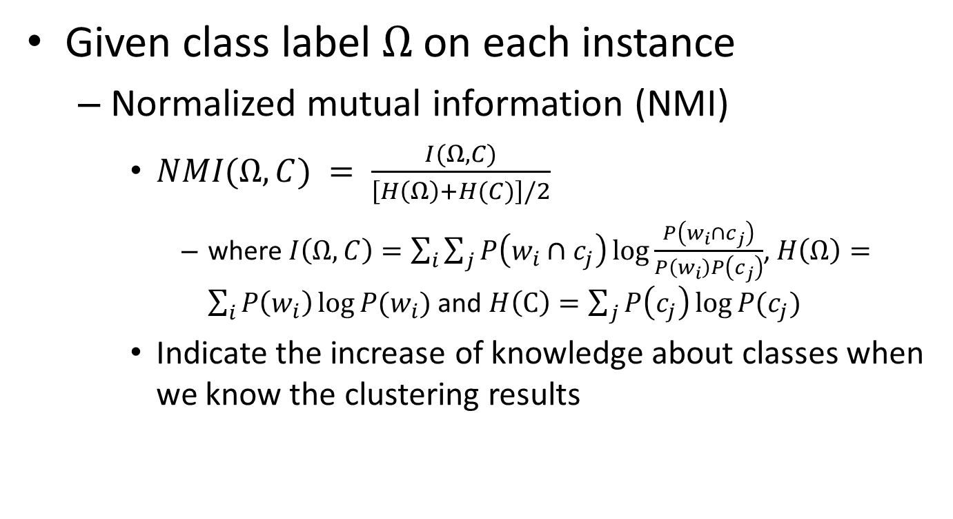
External validation
Given class label $Ω$ on each instance
Normalized mutual information (NMI)
$NMI(Ω,C) = \frac{I(Ω,C)}{\left[H\left(Ω\right)+H(C)\right]/2}$
where $I\left(Ω,C\right)=\sum_{i}{\sum_{j}{P\left(w_{i}∩c_{j}\right)\log{\frac{P\left(w_{i}∩c_{j}\right)}{P\left(w_{i}\right)P\left(c_{j}\right)}}}}$, $H\left(Ω\right)=\sum_{i}{P\left(w_{i}\right)\log{P(w_{i})}}$ and $H\left(C\right)=\sum_{j}{P\left(c_{j}\right)\log{P(c_{j})}}$
Indicate the increase of knowledge about classes when we know the clustering results
Normalization by entropy will penalize too many clusters

Slide 33
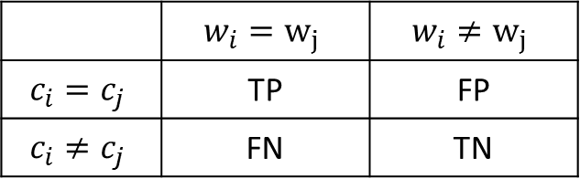
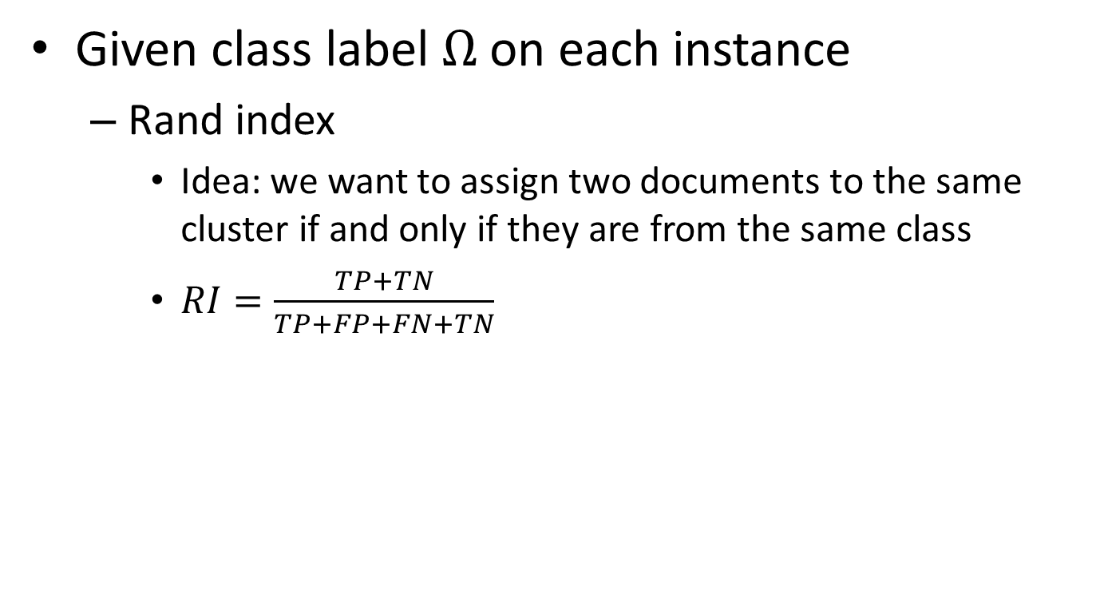
External validation
Given class label $Ω$ on each instance
Rand index
Idea: we want to assign two documents to the same cluster if and only if they are from the same class
$RI=\frac{TP+TN}{TP+FP+FN+TN}$
Essentially it is like classification accuracy
 | $$w_{i}=w_{j}$$ | $$w_{i}≠w_{j}$$
$$c_{i}=c_{j}$$ | TP | FP
$$c_{i}≠c_{j}$$ | FN | TN
Over every pair of documents in the collection

Slide 34
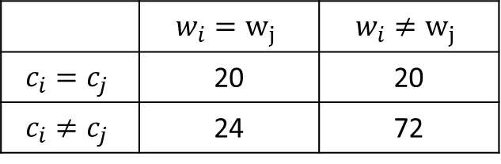

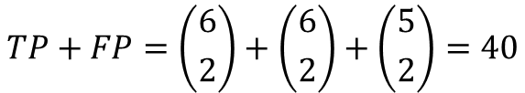
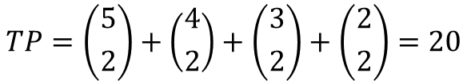
External validation
Given class label $Ω$ on each instance
Rand index
 | $$w_{i}=w_{j}$$ | $$w_{i}≠w_{j}$$
$$c_{i}=c_{j}$$ | 20 | 20
$$c_{i}≠c_{j}$$ | 24 | 72
$$TP+FP=\left({6 \atop 2}\right)+\left({6 \atop 2}\right)+\left({5 \atop 2}\right)=40$$
$$TP=\left({5 \atop 2}\right)+\left({4 \atop 2}\right)+\left({3 \atop 2}\right)+\left({2 \atop 2}\right)=20$$

Slide 35
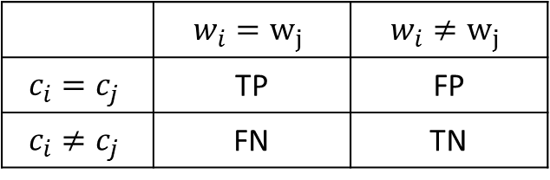

External validation
Given class label $Ω$ on each instance
Precision/Recall/F-measure
Based on the contingency table, we can also define precision/recall/F-measure of clustering quality
 | $$w_{i}=w_{j}$$ | $$w_{i}≠w_{j}$$
$$c_{i}=c_{j}$$ | TP | FP
$$c_{i}≠c_{j}$$ | FN | TN

Slide 36
What you should know
Unsupervised natural of clustering problem
Distance metric is essential to determine the clustering results
Two basic categories of clustering algorithms
Partitional clustering
Hierarchical clustering
Clustering evaluation
Internal v.s. external

Slide 37
Today’s reading
Introduction to Information Retrieval
Chapter 16: Flat clustering
16.2 Problem statement
16.3 Evaluation of clustering

