Slide 1
Lexical Semantics and Word Senses
Hongning Wang
CS@UVa

Slide 2
What is the Meaning of A Word?
Most words have many different senses
dog = animal or sausage?
lie = to be in a horizontal position or a false statement made with deliberate intent
How are the meanings of different words related?
Specific relations between senses:
Animal is more general than dog
Semantic fields
money is related to bank

Slide 3
Word Senses
What does ‘bank’ mean?
a financial institution
US banks have raised interest rates.
a particular branch of a financial institution
the bank on Main Street closes at 5pm.
the sloping side of any hollow in the ground, especially when bordering a river
In 1927, the bank of the Mississippi flooded.
a ‘repository’
I donate blood to a blood bank.

Slide 4
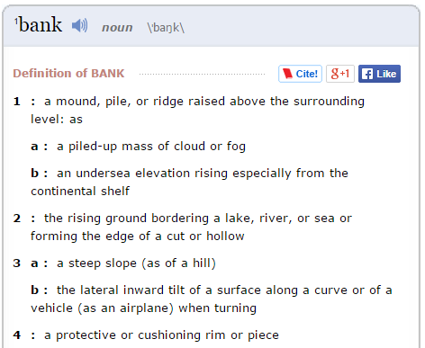
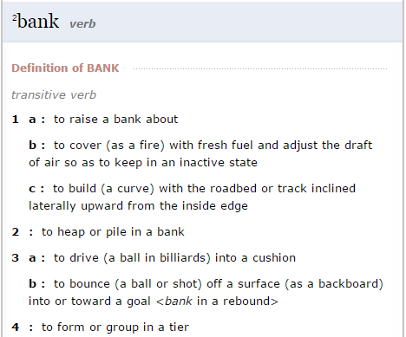
Lexicon Entries
lemmas
senses

Slide 5
Some Terminologies
Word forms: runs, ran, running; good, better, best
Any, possibly inflected, form of a word
Lemma (citation/dictionary form): run
A basic word form (e.g. infinitive or singular nominative noun) that is used to represent all forms of the same word.
Lexeme: RUN(V), GOOD(A), BANK¹(N), BANK²(N)
An abstract representation of a word (and all its forms), with a part-of-speech and a set of related word senses.
Often just written (or referred to) as the lemma, perhaps in a different FONT
Lexicon
A (finite) list of lexemes

Slide 6
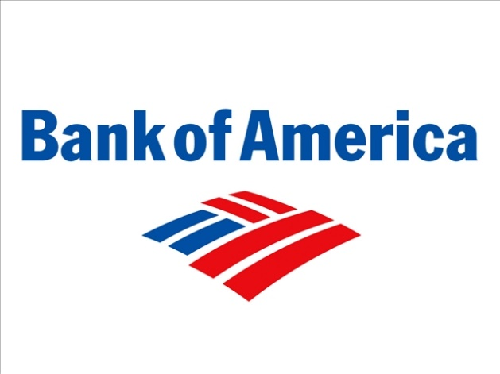
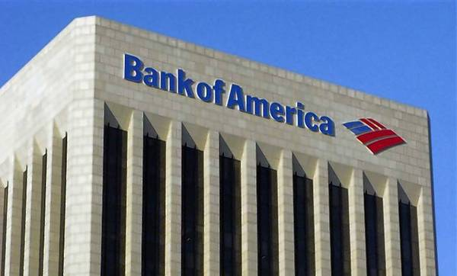
Make Sense of Word Senses
Polysemy
A lexeme is polysemous if it has different related senses
bank = financial institution or a building

Slide 7
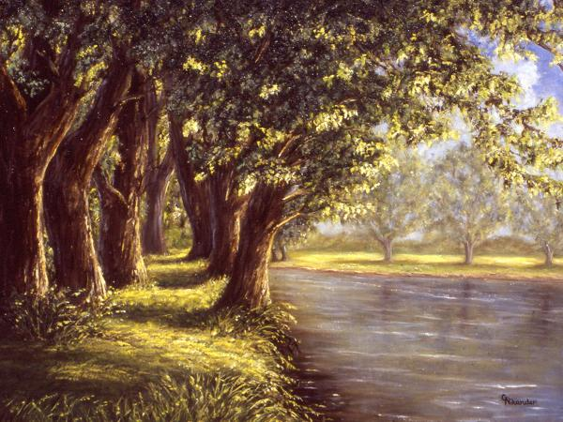
Make Sense of Word Senses
Homonyms
Two lexemes are homonyms if their senses are unrelated, but they happen to have the same spelling and pronunciation
bank = financial institution or river bank

Slide 8
Relations between Senses
Symmetric relations
Synonyms: couch/sofa
Two lemmas with the same sense
Antonyms: cold/hot, rise/fall, in/out
Two lemmas with the opposite sense
Hierarchical relations:
Hypernyms and hyponyms: pet/dog
The hyponym (dog) is more specific than the hypernym (pet)
Holonyms and meronyms: car/wheel
The meronym (wheel) is a part of the holonym (car)

Slide 9
WordNet
A very large lexical database of English:
117K nouns, 11K verbs, 22K adjectives, 4.5K adverbs
Word senses grouped into synonym sets (“synsets”) linked into a conceptual-semantic hierarchy
82K noun synsets, 13K verb synsets, 18K adjectives synsets, 3.6K adverb synsets
Avg. # of senses: 1.23/noun, 2.16/verb, 1.41/adj, 1.24/adverb
Conceptual-semantic relations
hypernym/hyponym

Slide 10
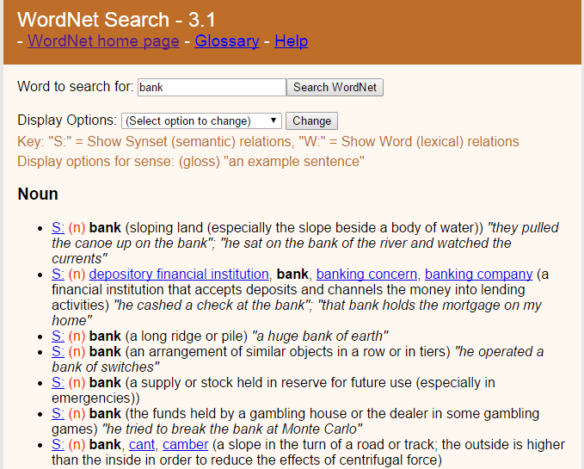
A WordNet Example
http://wordnet.princeton.edu/

Slide 11
Hierarchical Synset Relations: Nouns
Hypernym/hyponym (between concepts)
The more general ‘meal’ is a hypernym of the more specific ‘breakfast’
Instance hypernym/hyponym (between concepts and instances)
Austen is an instance hyponym of author
Member holonym/meronym (groups and members)
professor is a member meronym of (a university’s) faculty
Part holonym/meronym (wholes and parts)
wheel is a part meronym of (is a part of) car.
Substance meronym/holonym (substances and components)
flour is a substance meronym of (is made of) bread

Slide 12
Hierarchical Synset Relations: Verbs
Hypernym/troponym (between events)
travel/fly, walk/stroll
Flying is a troponym of traveling: it denotes a specific manner of traveling
Entailment (between events):
snore/sleep
Snoring entails (presupposes) sleeping

Slide 13
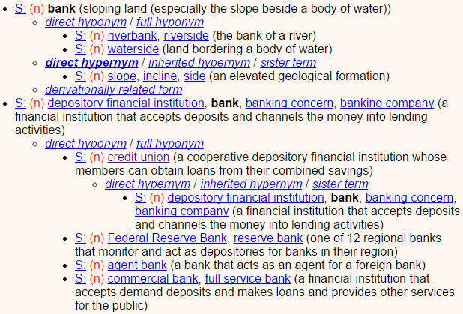
WordNet Hypernyms & Hyponyms

Slide 14
WordNet Similarity
Path based similarity measure between words
Shortest path between two concepts (Leacock & Chodorow 1998)
Path length to the root node from the least common subsumer (LCS) of the two concepts (Wu & Palmer 1994)
http://wn-similarity.sourceforge.net/

Slide 15
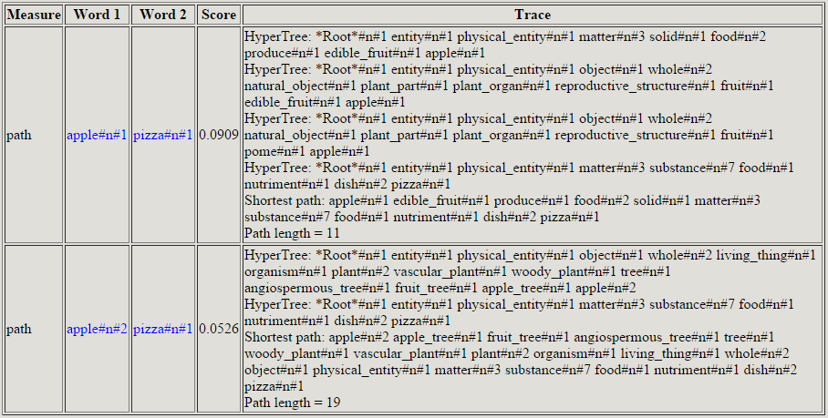
WordNet::Similarity

Slide 16
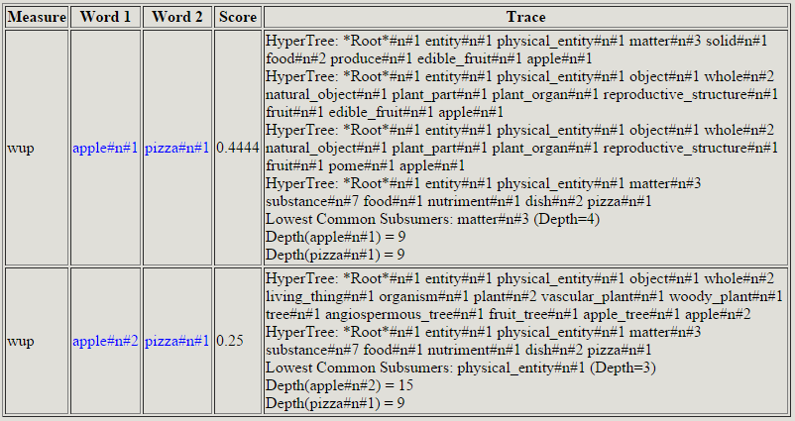
WordNet::Similarity

Slide 17
Word Sense Disambiguation
What does this word mean?
This plant needs to be watered each day.
living plant
This plant manufactures 1000 widgets each day.
factory
Word Sense Disambiguation (WSD)
Identify the sense of content words (noun, verb, adjective) in context (assuming a fixed inventory of word senses)
watered
manufactures

Slide 18
Dictionary-based Methods
A dictionary/thesaurus contains glosses and examples of a word
bank¹
Gloss: a financial institution that accepts deposits and channels
the money into lending activities
Examples: “he cashed the check at the bank”,
“that bank holds the mortgage on my home”
bank²
Gloss: sloping land (especially the slope beside a body of water)
Examples: “they pulled the canoe up on the bank”,
“he sat on the bank of the river and watched the current”

Slide 19
Lesk Algorithm
Compare the context with the dictionary definition of the sense
Construct the signature of a word in context by the signatures of its senses in the dictionary
Signature = set of content words (in examples/gloss or in context)
Assign the dictionary sense whose gloss and examples are most similar to the context in which the word occurs
Similarity = size of intersection of context signature and sense signature

Slide 20
Sense Signatures
bank¹
Gloss: a financial institution that accepts deposits and channels
the money into lending activities
Examples: “he cashed the check at the bank”,
“that bank holds the mortgage on my home”
bank²
Gloss: sloping land (especially the slope beside a body of water)
Examples: “they pulled the canoe up on the bank”,
“he sat on the bank of the river and watched the current”
Signature(bank¹) = {financial, institution, accept, deposit,
channel, money, lend, activity, cash, check, hold, mortgage, home}
Signature(bank¹) = {slope, land, body, water, pull, canoe, sit,
river, watch, current}

Slide 21
Signature of Target Word
“The bank refused to give me a loan.”
Simplified Lesk
Words in context
Signature(bank) = {refuse, give, loan}
Original Lesk
Augmented signature of the target word
Signature(bank) = {refuse, reject, request,... , give, gift, donate,... loan, money, borrow,...}

Slide 22
Learning-based Methods
Will be discussed in the lecture of “Text Categorization”

