Slide 1
Part-of-Speech Tagging & Sequence Labeling
Hongning Wang
CS@UVa

Slide 2
What is POS Tagging
Tag Set
NNP: proper noun
CD: numeral
JJ: adjective
POS Tagger
Tagged Text
Raw Text
Pierre_NNP Vinken_NNP ,_, 61_CD years_NNS old_JJ ,_, will_MD join_VB the_DT board_NN as_IN a_DT nonexecutive_JJ director_NN Nov._NNP 29_CD ._.
Pierre Vinken , 61 years old, will join the board as a nonexecutive director Nov. 29 .

Slide 3
Why POS Tagging?
POS tagging is a prerequisite for further analysis
Syntax parsing
Basic unit for parsing
Information extraction
Indication of names, relations
Machine translation
The meaning of a particular word depends on its POS tag
Sentiment analysis
Adjectives are the major opinion holders
Good v.s. Bad, Excellent v.s. Terrible

Slide 4
Challenges in POS Tagging
Words often have more than one POS tag
The back door (adjective)
On my back (noun)
Promised to back the bill (verb)
Simple solution with dictionary look-up does not work in practice
One needs to determine the POS tag for a particular instance of a word from its context

Slide 5
Define a Tagset
We have to agree on a standard inventory of word classes
Taggers are trained on a labeled corpora
The tagset needs to capture semantically or syntactically important distinctions that can easily be made by trained human annotators

Slide 6
Word Classes
Open classes
Nouns, verbs, adjectives, adverbs
Closed classes
Auxiliaries and modal verbs
Prepositions, Conjunctions
Pronouns, Determiners
Particles, Numerals

Slide 7
Public Tagsets in NLP
Brown corpus - Francis and Kucera 1961
500 samples, distributed across 15 genres in rough proportion to the amount published in 1961 in each of those genres
87 tags
Penn Treebank - Marcus et al. 1993
Hand-annotated corpus of Wall Street Journal, 1M words
45 tags, a simplified version of Brown tag set
Standard for English now
Most statistical POS taggers are trained on this Tagset

Slide 8
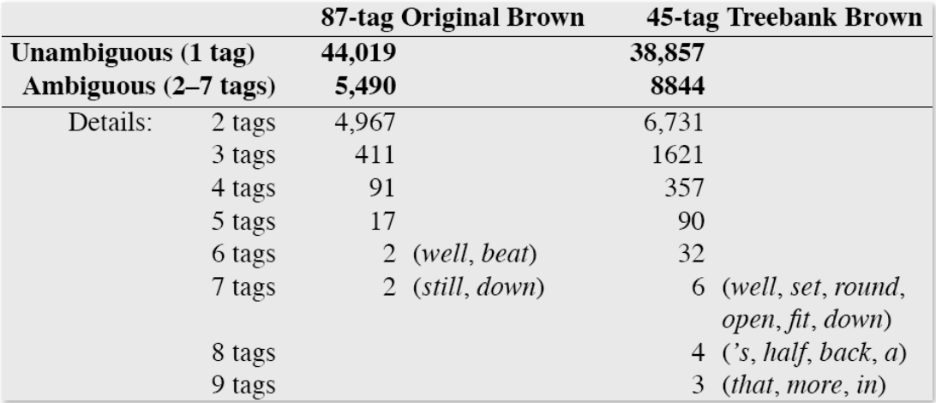
How much ambiguity is there?
Statistics of word-tag pair in Brown Corpus and Penn Treebank
11%
18%

Slide 9
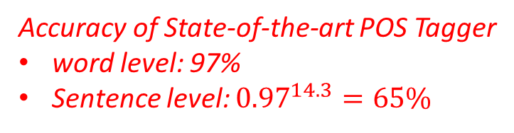
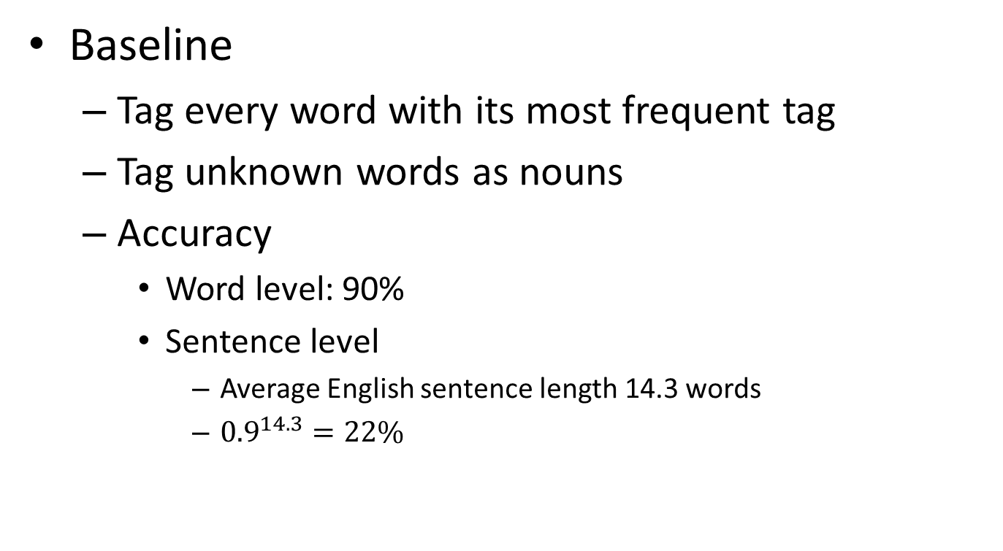
Is POS Tagging a Solved Problem?
Baseline
Tag every word with its most frequent tag
Tag unknown words as nouns
Accuracy
Word level: 90%
Sentence level
Average English sentence length 14.3 words
${0.9}^{14.3}=22\%$
Accuracy of State-of-the-art POS Tagger
word level: 97%
Sentence level: ${0.97}^{14.3}=65\%$

Slide 10
Building a POS Tagger
Rule-based solution
Take a dictionary that lists all possible tags for each word
Assign to every word all its possible tags
Apply rules that eliminate impossible/unlikely tag sequences, leaving only one tag per word
she PRP
promised VBN,VBD
to TO
back VB, JJ, RB, NN!!
the DT
bill NN, VB
R1: Pronoun should be followed by a past tense verb
R2: Verb cannot follow determiner

Slide 11
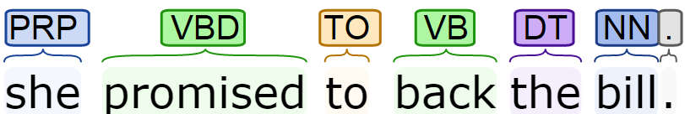
















Building a POS Tagger
Statistical POS tagging
What is the most likely sequence of tags $t$ for the given sequence of words $w$
$$t=$$
$$t^{1}$$
$$t^{2}$$
$$t^{3}$$
$$t^{4}$$
$$t^{5}$$
$$t^{6}$$
$$w=$$
$$w^{1}$$
$$w^{2}$$
$$w^{3}$$
$$w^{4}$$
$$w^{5}$$
$$w^{6}$$
$$t^{∗}=argmax_{t}p(t|w)$$

Slide 12

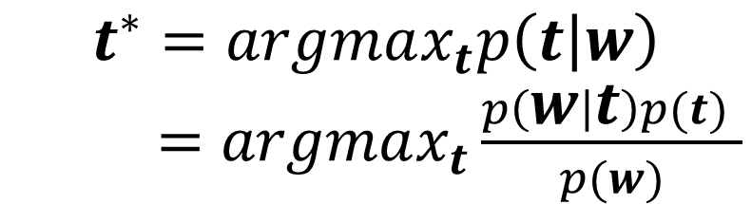
POS tagging with generative models
Bayes Rule
Joint distribution of tags and words
Generative model
A stochastic process that first generates the tags, and then generates the words based on these tags.
$$t^{∗}=argmax_{t}p\left(t | w\right)$$
$=argmax_{t}\frac{p\left(w | t\right)p(t) }{p(w)}$
$$=argmax_{t}p\left(w | t\right)p(t)$$

Slide 13
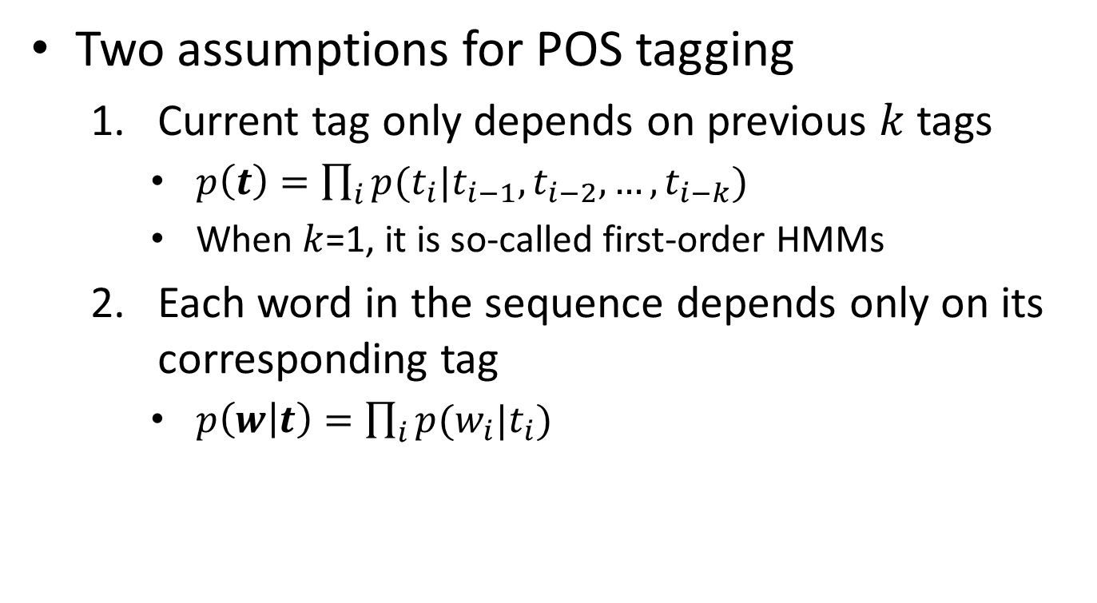
Hidden Markov Models
Two assumptions for POS tagging
Current tag only depends on previous $k$ tags
$p\left(t\right)=\prod_{i}{p(t_{i}|t_{i−1},t_{i−2},…,t_{i−k})}$
When $k$=1, it is so-called first-order HMMs
Each word in the sequence depends only on its corresponding tag
$p\left(w | t\right)=\prod_{i}{p(w_{i}|t_{i})}$

Slide 14
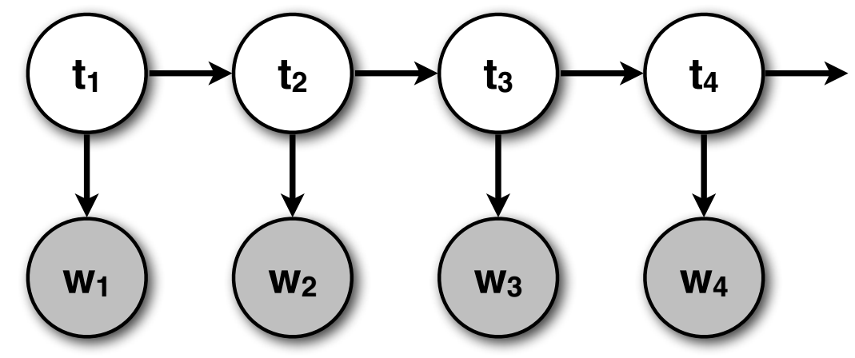


Graphical Representation of HMMs
All the tags in the tagset
$$p(t_{i}|t_{i−1})$$
Transition probability
All the words in the vocabulary
$$p(w_{i}|t_{i})$$
Emission probability
Light circle: latent random variables
Dark circle: observed random variables
Arrow: probabilistic dependency

Slide 15

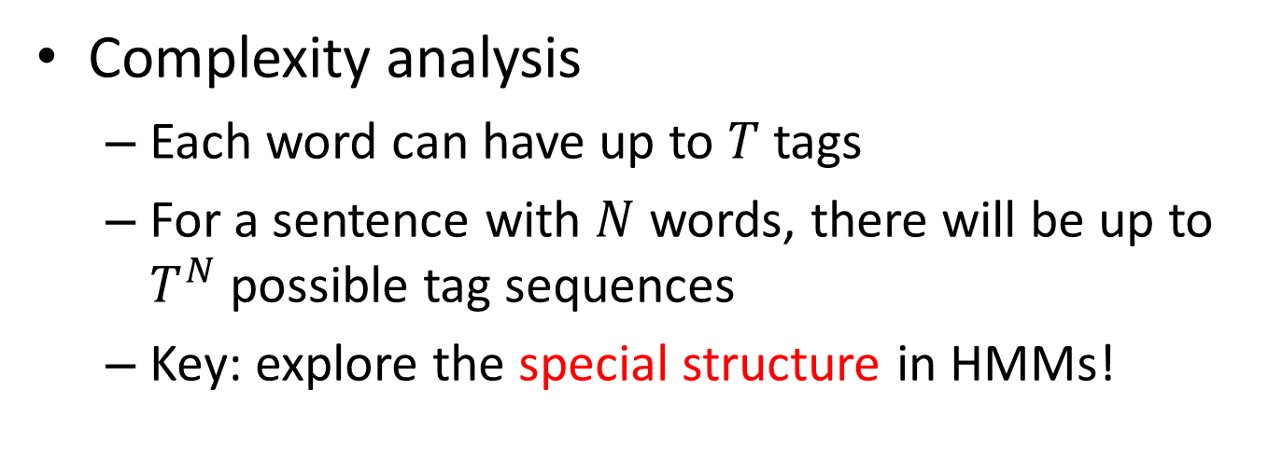
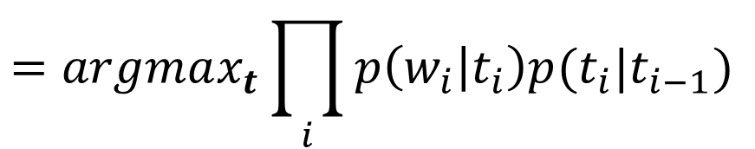
Finding the Most Probable Tag Sequence
$$t^{∗}=argmax_{t}p\left(t | w\right)$$
$$=argmax_{t}\prod_{i}{p\left(w_{i} | t_{i}\right)p(t_{i}|t_{i−1})}$$
Complexity analysis
Each word can have up to $T$ tags
For a sentence with $N$ words, there will be up to $T^{N}$ possible tag sequences
Key: explore the special structure in HMMs!

Slide 16

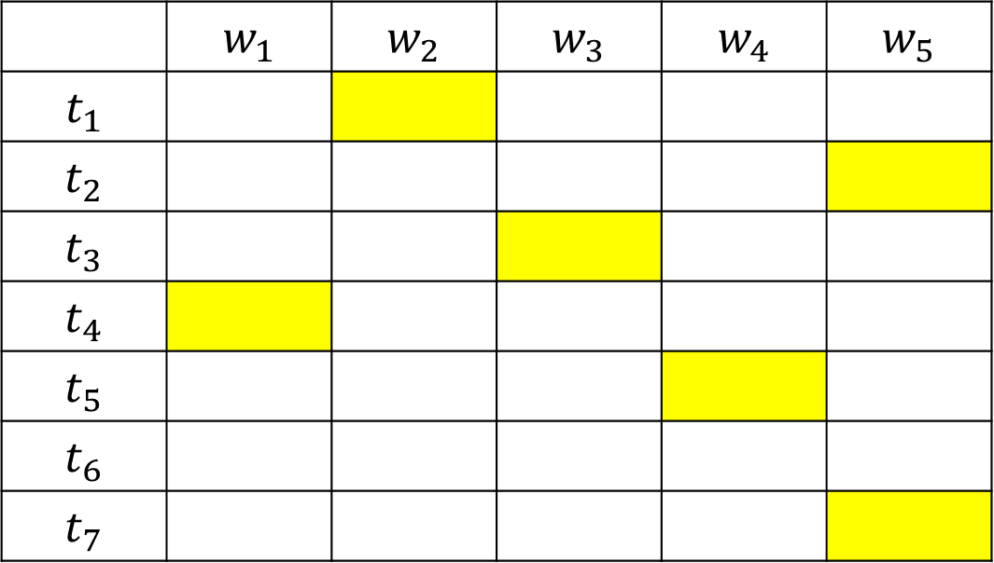



Trellis: a special structure for HMMs
$$t^{1}=t_{4}t_{1}t_{3}t_{5}t_{7}$$
$$t^{2}=t_{4}t_{1}t_{3}t_{5}t_{2}$$
Computation can be reused!
 | $$w_{1}$$ | $$w_{2}$$ | $$w_{3}$$ | $$w_{4}$$ | $$w_{5}$$
$$t_{1}$$
$$t_{2}$$
$$t_{3}$$
$$t_{4}$$
$$t_{5}$$
$$t_{6}$$
$$t_{7}$$
Word $w_{1}$ takes tag $t_{4}$.
Complexity: $O(TN)$

Slide 17
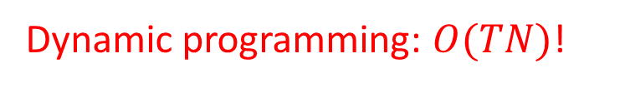
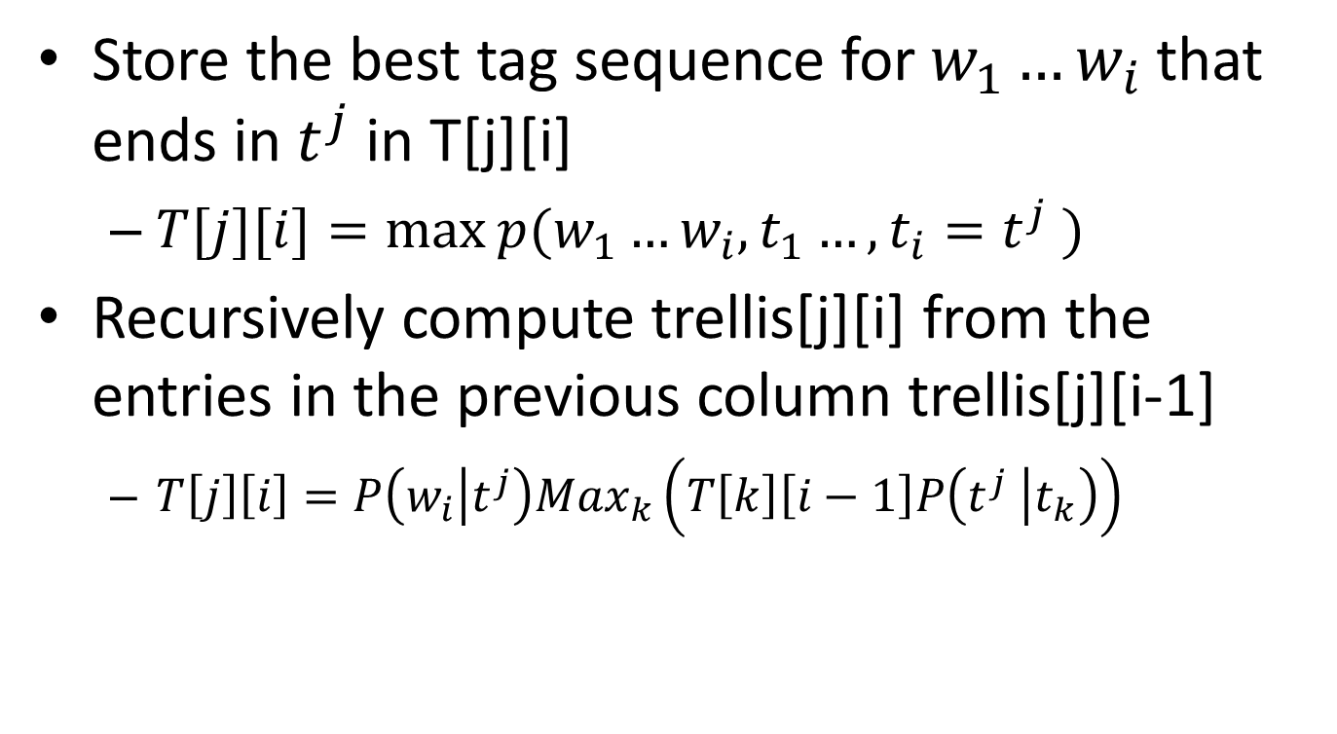
Viterbi Algorithm
Store the best tag sequence for $w_{1}…w_{i}$that ends in $t^{j}$ in T[j][i]
$T[j][i]=max⁡p(w_{1}…w_{i}, t_{1}…, t_{i}=t^{j} )$
Recursively compute trellis[j][i] from the entries in the previous column trellis[j][i-1]
$T\left[j\right]\left[i\right]=P\left(w_{i} | t^{j}\right)Max_{k}\left(T\left[k\right]\left[i−1\right]P\left(t^{j} | t_{k}\right)\right)$
Generating the current observation
Transition from the previous best ending tag
The best i-1 tag sequence
Dynamic programming: $O(TN)$!

Slide 18
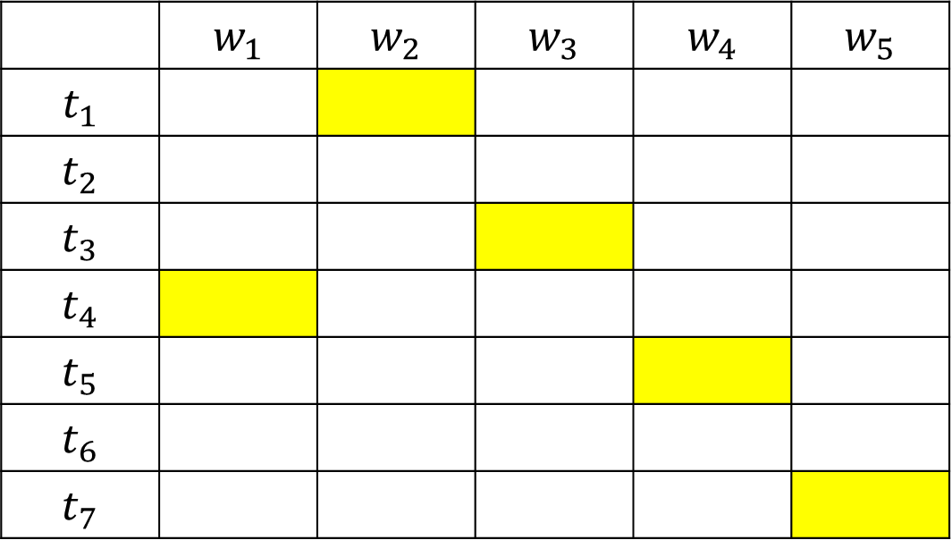
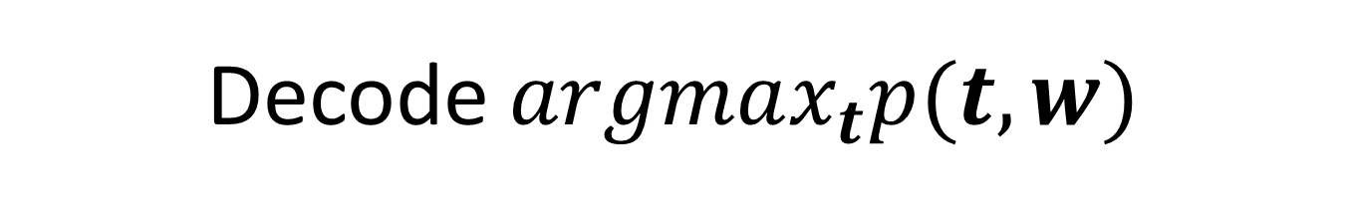
Decode $argmax_{t}p(t,w)$
Take the highest scoring entry in the last column of the trellis
Keep backpointers in each trellis to keep track of the most probable sequence
 | $$w_{1}$$ | $$w_{2}$$ | $$w_{3}$$ | $$w_{4}$$ | $$w_{5}$$
$$t_{1}$$
$$t_{2}$$
$$t_{3}$$
$$t_{4}$$
$$t_{5}$$
$$t_{6}$$
$$t_{7}$$

Slide 19

Train an HMMs Tagger
Parameters in an HMMs tagger
Transition probability: $p\left(t_{i} | t_{j}\right), T×T$
Emission probability: $p\left(w | t\right), V×T$
Initial state probability: $p\left(t | π\right), T×1$
For the first tag in a sentence

Slide 20
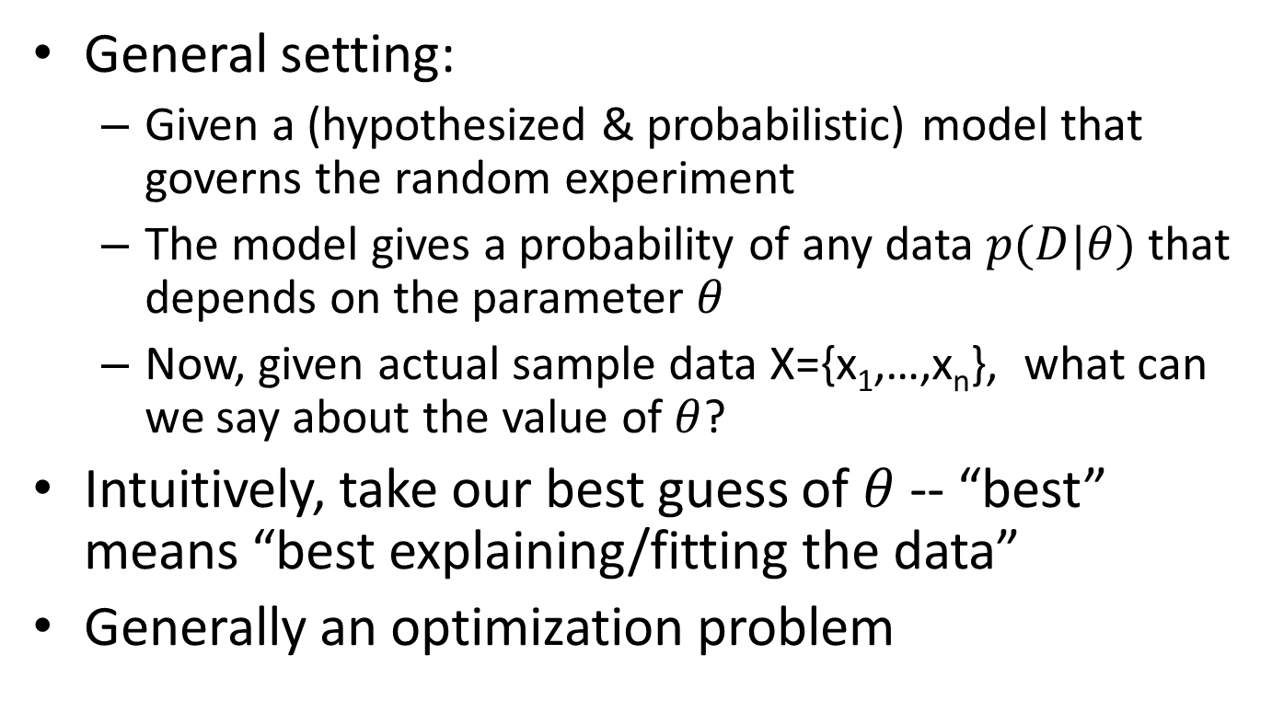
Parameter estimation
General setting:
Given a (hypothesized & probabilistic) model that governs the random experiment
The model gives a probability of any data $p(D|θ)$ that depends on the parameter $θ$
Now, given actual sample data X={x₁,…,x_{n}}, what can we say about the value of $θ$?
Intuitively, take our best guess of $θ$ -- “best” means “best explaining/fitting the data”
Generally an optimization problem

Slide 21

Maximum likelihood vs. Bayesian
Maximum likelihood estimation
“Best” means “data likelihood reaches maximum”
Issue: small sample size
Bayesian estimation
“Best” means being consistent with our “prior” knowledge and explaining data well
A.k.a, Maximum a Posterior estimation
Issue: how to define prior?
$$\hat{θ}={argmax}_{θ}P(X|θ)$$
ML: Frequentist’s point of view
$$\hat{θ}={argmax_{θ}P\left(θ | X\right)=argmax}_{θ}P\left(X | θ\right)P(θ)$$
MAP: Bayesian’s point of view

Slide 22
Illustration of Bayesian estimation
Posterior:
p(θ|X)∝ p(X|θ)p(θ)
Likelihood:
p(X|θ) X=(x₁,…,x_{N})
Prior: p(θ)
θ
θ_{α}: prior mode
θ: posterior mode
θ_{ml}: ML estimate

Slide 23
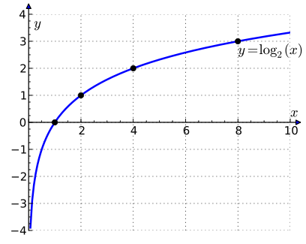

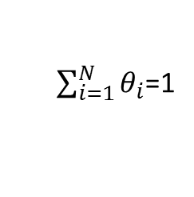
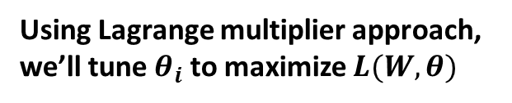
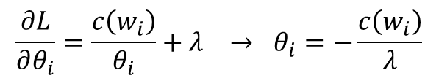

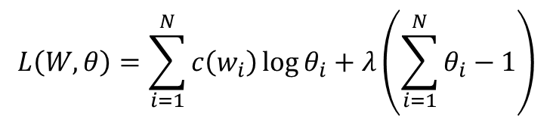
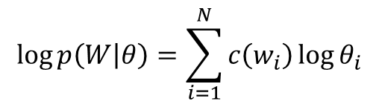

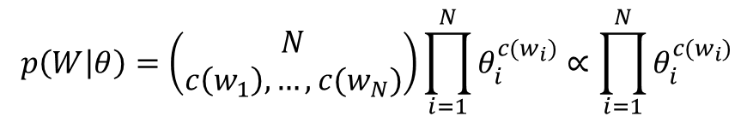

Maximum likelihood estimation
Data: a collection of nouns, $w_{1},w_{2},…,w_{n}$
Model: multinomial distribution $p(W|t)$ with parameters $θ_{i}=p(w_{i}|t)$ for the emission probability
Maximum likelihood estimator: $\hat{θ}=argmax_{θ}p(W|θ)$
$$p\left(W | θ\right)=\left(\begin{matrix}N \\ c\left(w_{1}\right),…,c(w_{N})\end{matrix}\right)\prod_{i=1}^{N}{θ_{i}^{c(w_{i})}}∝\prod_{i=1}^{N}{θ_{i}^{c(w_{i})}}$$
$$\log{p\left(W | θ\right)}=\sum_{i=1}^{N}{c\left(w_{i}\right)\log{θ_{i}}}$$
$$L\left(W,θ\right)=\sum_{i=1}^{N}{c\left(w_{i}\right)\log{θ_{i}}}+λ\left(\sum_{i=1}^{N}{θ_{i}}−1\right)$$
Using Lagrange multiplier approach, we’ll tune $θ_{i}$ to maximize $L(W,θ)$
$$\frac{∂L}{∂θ_{i}}=\frac{c\left(w_{i}\right)}{θ_{i}}+λ → θ_{i}=−\frac{c\left(w_{i}\right)}{λ}$$
Set partial derivatives to zero
$$λ=−\sum_{i=1}^{N}{c\left(w_{i}\right)}$$
Since
$\sum_{i=1}^{N}{θ_{i}}$=1
we have
Requirement from probability
$$θ_{i}=\frac{c\left(w_{i}\right)}{\sum_{i=1}^{N}{c\left(w_{i}\right)}}$$
ML estimate

Slide 24
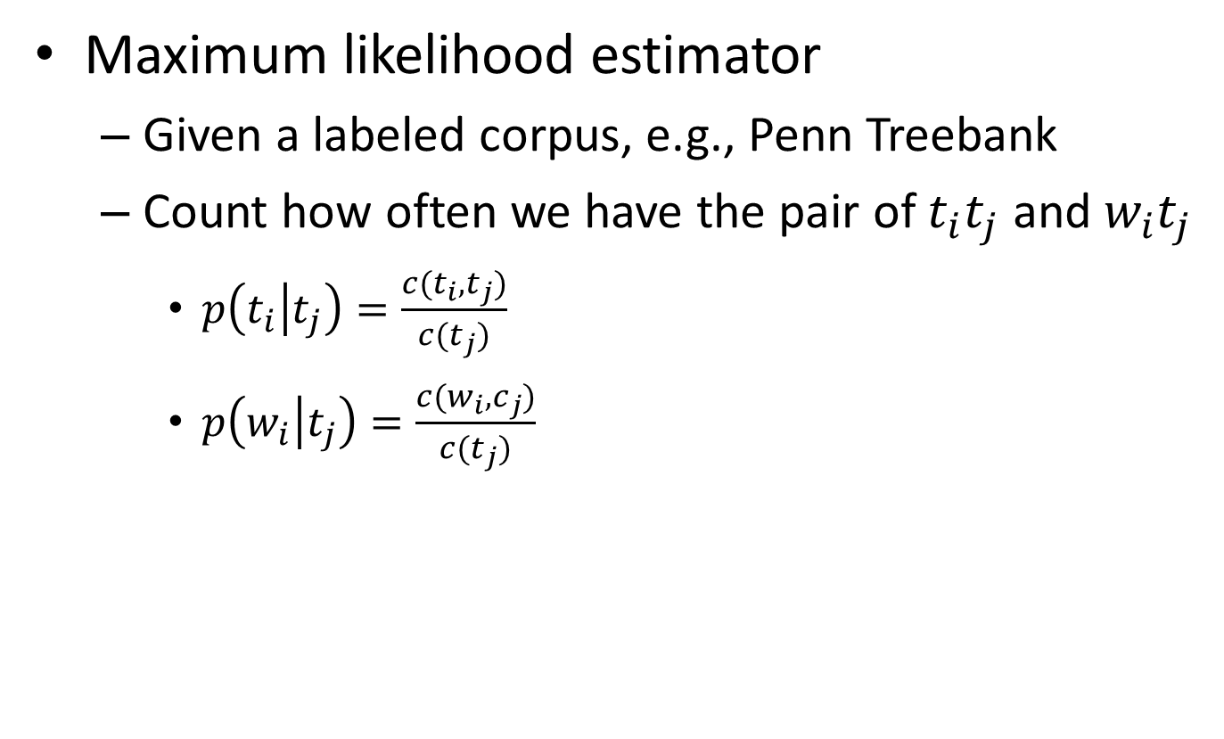
Train an HMMs Tagger
Maximum likelihood estimator
Given a labeled corpus, e.g., Penn Treebank
Count how often we have the pair of $t_{i}t_{j}$ and $w_{i}t_{j}$
$p\left(t_{i} | t_{j}\right)=\frac{c(t_{i},t_{j})}{c(t_{j})}$
$p\left(w_{i} | t_{j}\right)=\frac{c(w_{i},c_{j})}{c(t_{j})}$

Slide 25
Public POS taggers
Brill’s tagger
http://www.cs.jhu.edu/~brill/
TnT tagger
http://www.coli.uni-saarland.de/~thorsten/tnt/
Stanford tagger
http://nlp.stanford.edu/software/tagger.shtml
SVMTool
http://www.lsi.upc.es/~nlp/SVMTool/
GENIA tagger
http://www-tsujii.is.s.u-tokyo.ac.jp/GENIA/tagger/
More complete list at
http://www-nlp.stanford.edu/links/statnlp.html#Taggers

Slide 26
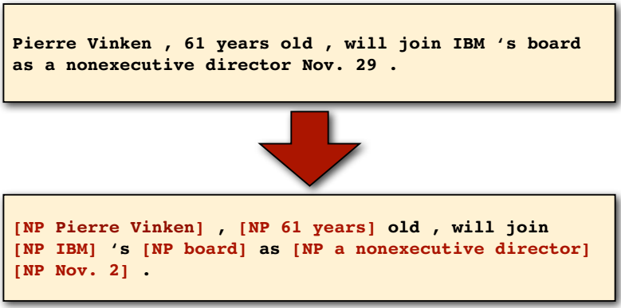
Let’s take a look at other NLP tasks
Noun phrase (NP) chunking
Task: identify all non-recursive NP chunks

Slide 27
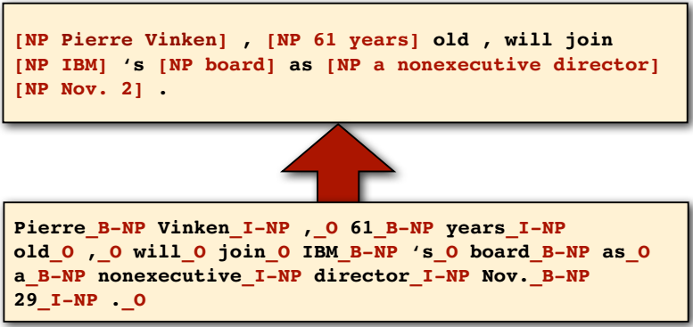
The BIO encoding
Define three new tags
B-NP: beginning of a noun phrase chunk
I-NP: inside of a noun phrase chunk
O: outside of a noun phrase chunk
POS Tagging with restricted Tagset

Slide 28
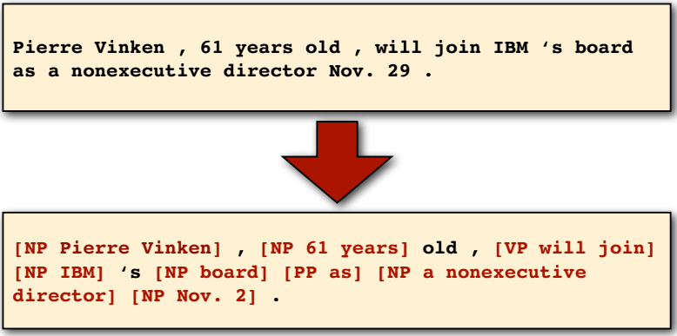
Another NLP task
Shallow parsing
Task: identify all non-recursive NP, verb (“VP”) and preposition (“PP”) chunks

Slide 29
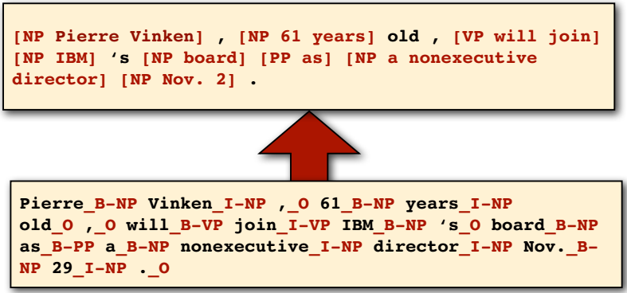
BIO Encoding for Shallow Parsing
Define several new tags
B-NP B-VP B-PP: beginning of an NP, “VP”, “PP” chunk
I-NP: inside of an NP, “VP”, “PP” chunk
O: outside of any chunk
POS Tagging with another Tagset

Slide 30
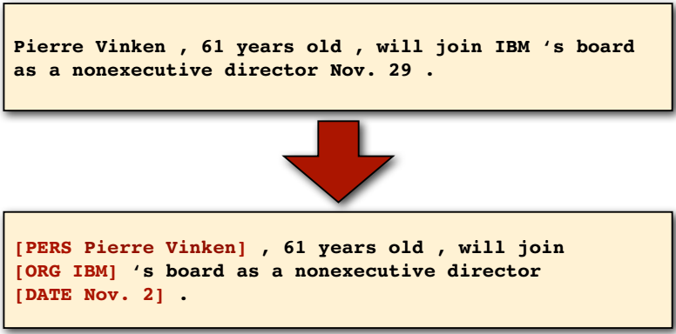
Yet Another NLP task
Named Entity Recognition
Task: identify all mentions of named entities (people, organizations, locations, dates)

Slide 31
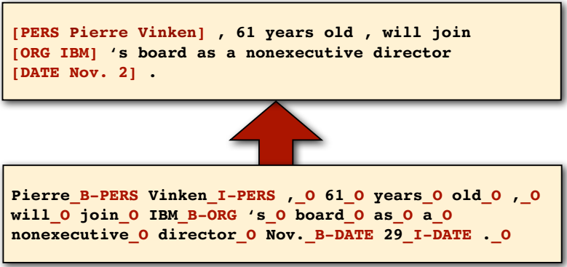
BIO Encoding for NER
Define many new tags
B-PERS, B-DATE,…: beginning of a mention of a person/date...
I-PERS, B-DATE,…: inside of a mention of a person/date...
O: outside of any mention of a named entity
POS Tagging with another Tagset

Slide 32
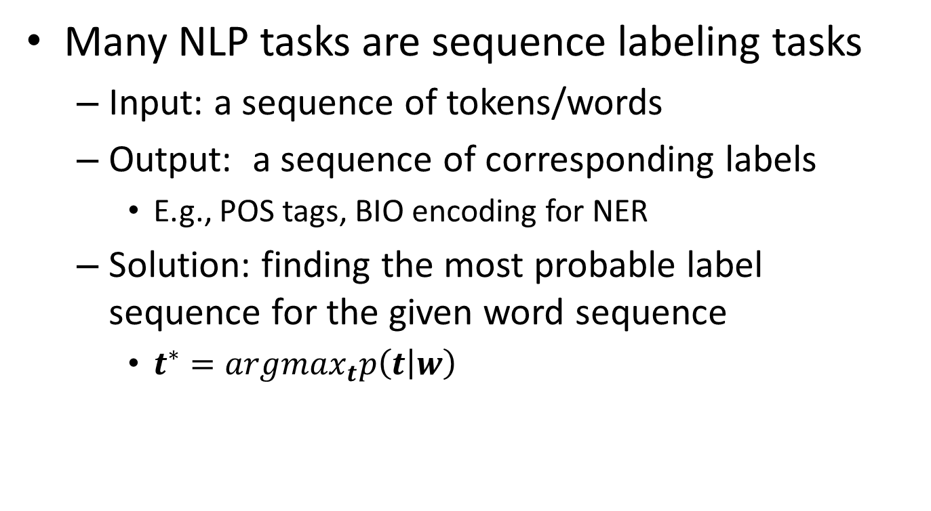
Sequence Labeling
Many NLP tasks are sequence labeling tasks
Input: a sequence of tokens/words
Output: a sequence of corresponding labels
E.g., POS tags, BIO encoding for NER
Solution: finding the most probable label sequence for the given word sequence
$t^{∗}=argmax_{t}p\left(t | w\right)$

Slide 33
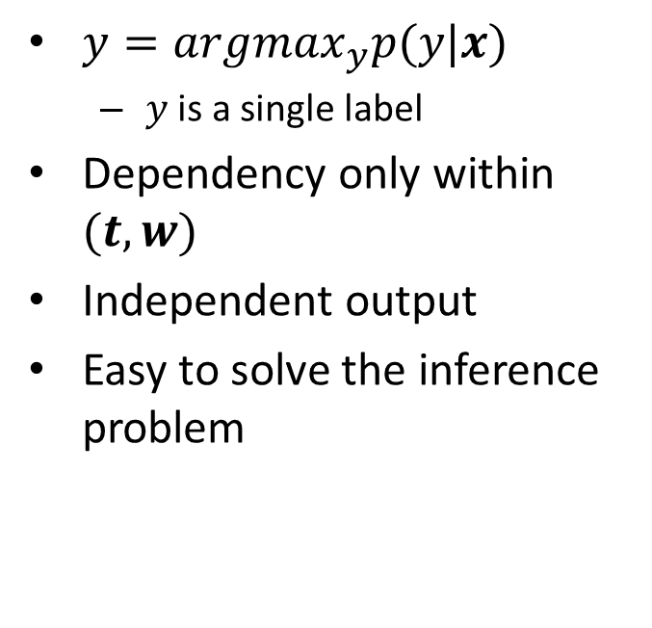
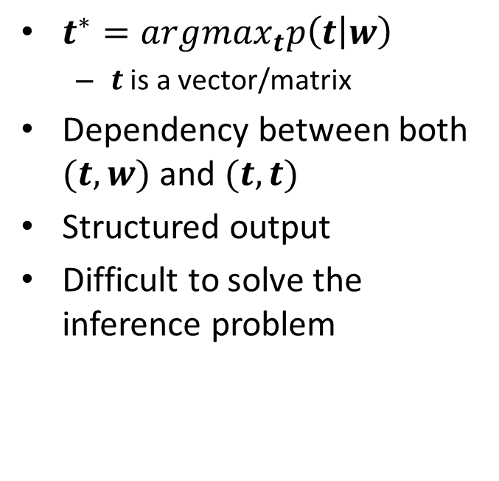
Comparing to Traditional Classification Problem
Sequence labeling
Traditional classification
$t^{∗}=argmax_{t}p\left(t | w\right)$
$t$ is a vector/matrix
Dependency between both $(t,w)$ and $(t,t)$
Structured output
Difficult to solve the inference problem
$y=argmax_{y}p(y|x)$
$y$ is a single label
Dependency only within $(t,w)$
Independent output
Easy to solve the inference problem

Slide 34
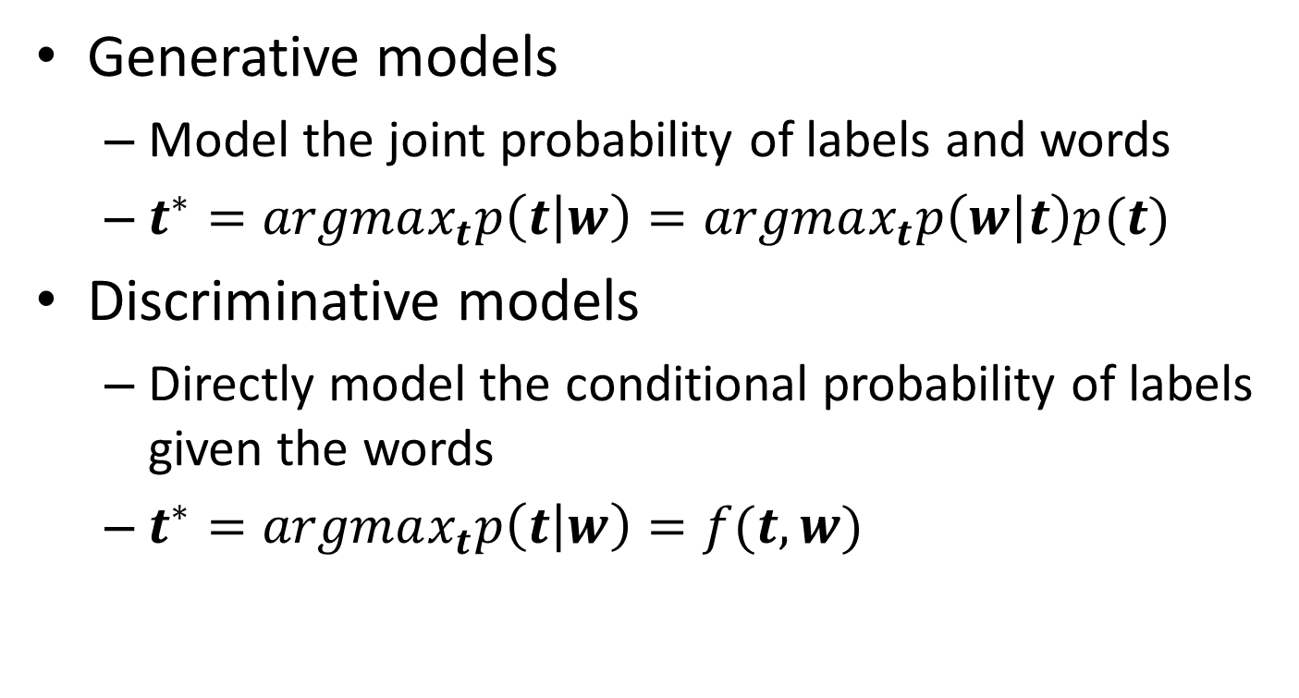
Two Modeling Perspectives
Generative models
Model the joint probability of labels and words
$t^{∗}=argmax_{t}p\left(t | w\right)=argmax_{t}p\left(w | t\right)p(t)$
Discriminative models
Directly model the conditional probability of labels given the words
$t^{∗}=argmax_{t}p\left(t | w\right)=f(t,w)$

Slide 35
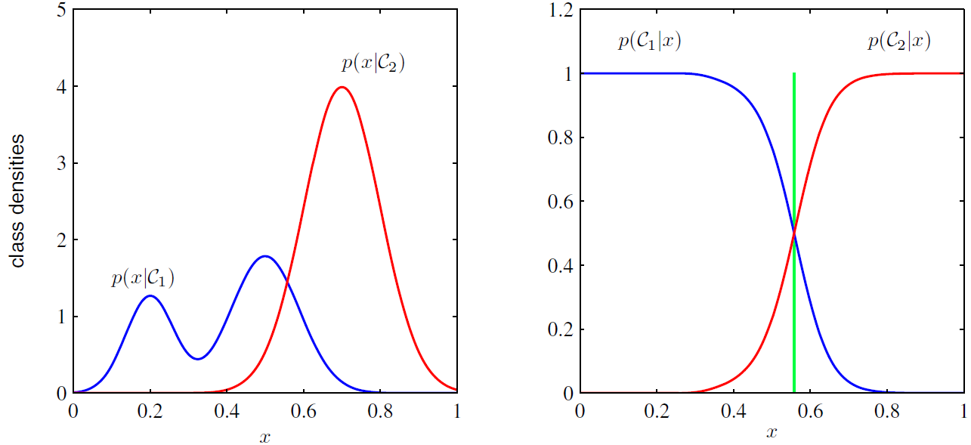
Generative V.S. Discriminative Models
Generative Model’s view
Discriminative Model’s view

Slide 36
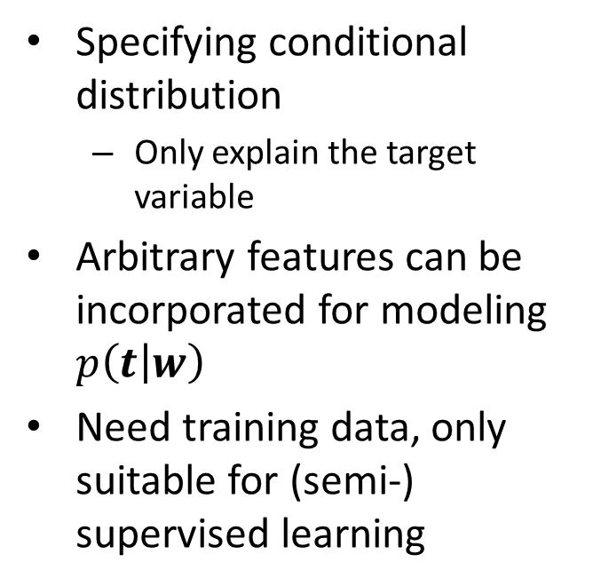
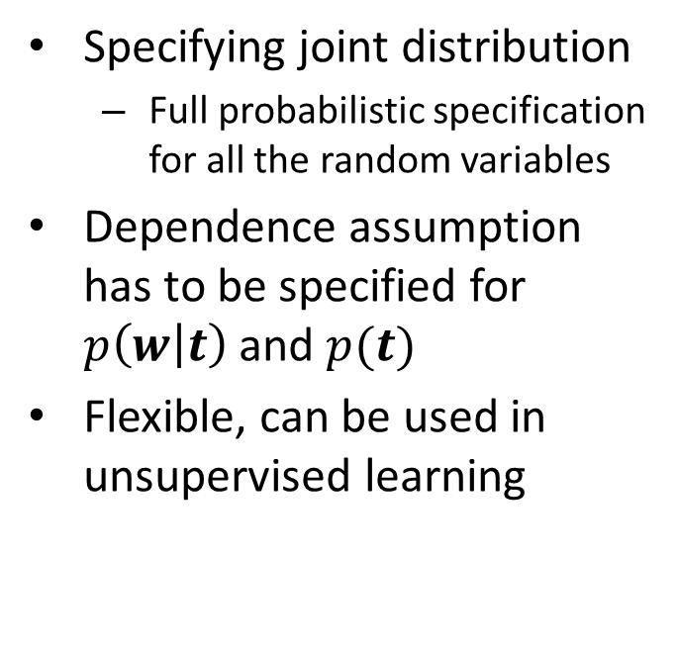
Generative V.S. Discriminative Models
Generative
Discriminative
Specifying joint distribution
Full probabilistic specification for all the random variables
Dependence assumption has to be specified for $p\left(w | t\right)$ and $p(t)$
Flexible, can be used in unsupervised learning
Specifying conditional distribution
Only explain the target variable
Arbitrary features can be incorporated for modeling $p\left(t | w\right)$
Need training data, only suitable for (semi-) supervised learning

Slide 37
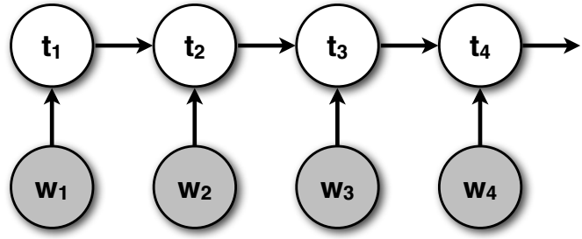

Maximum Entropy Markov Models
MEMMs are discriminative models of the labels $t$ given the observed input sequence $w$
$p\left(t | w\right)=\prod_{i}{p(t_{i}|w_{i},t_{i−1})}$

Slide 38
Design Features
VB
NNP
Emission-like features
Binary feature functions
f_{first-letter-capitalized-NNP}(China) = 1
f_{first-letter-capitalized-VB}(fly) = 0
Integer (or real-valued) feature functions
f_{number-of-vowels-NNP}(China) = 2
Transition-like features
Binary feature functions
ffirst-letter-capitalized-NNP-VB(China) = 1
fly
China
Not necessarily independent features!

Slide 39
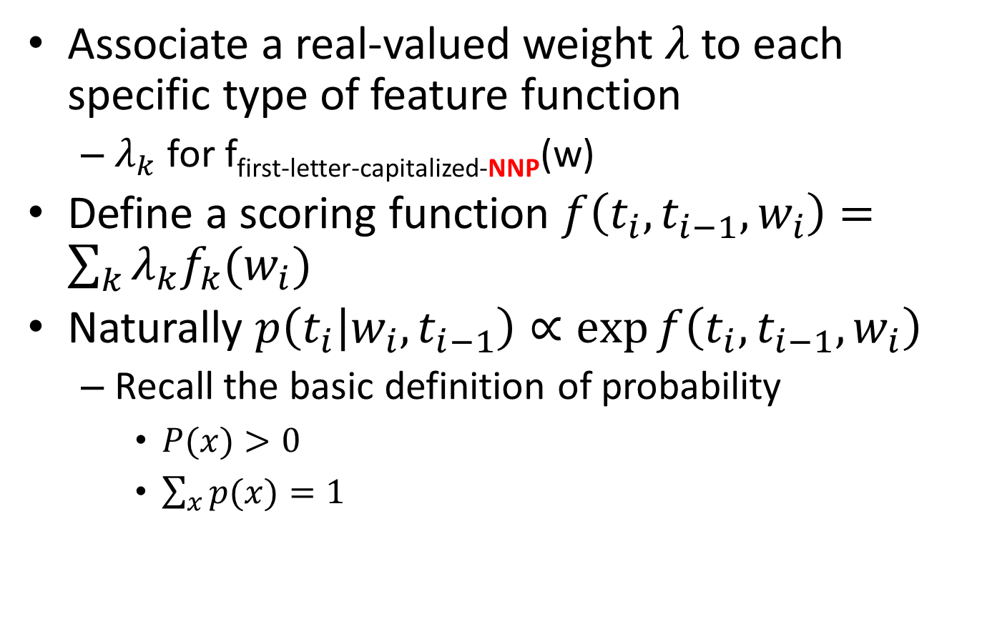
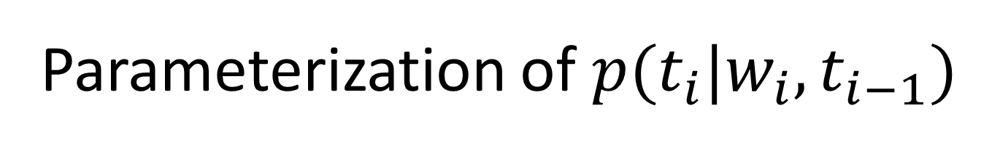
Parameterization of $p(t_{i}|w_{i},t_{i−1})$
Associate a real-valued weight $λ$ to each specific type of feature function
$λ_{k}$ for f_{first-letter-capitalized-NNP}(w)
Define a scoring function $f\left(t_{i},t_{i−1},w_{i}\right)=\sum_{k}{λ_{k}f_{k}(w_{i})}$
Naturally $p\left(t_{i} | w_{i},t_{i−1}\right)∝\exp{f\left(t_{i},t_{i−1},w_{i}\right)}$
Recall the basic definition of probability
$P(x)>0$
$\sum_{x}{p(x)}=1$

Slide 40
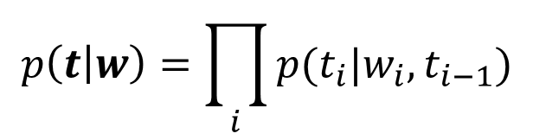
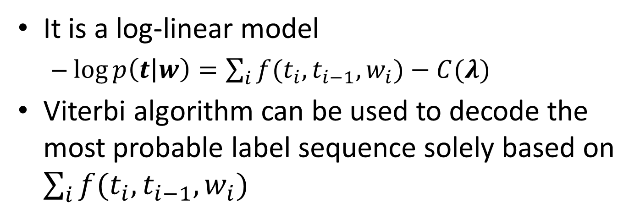

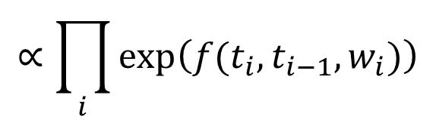
Parameterization of MEMMs
$$p\left(t | w\right)=\prod_{i}{p(t_{i}|w_{i},t_{i−1})}$$
$$∝\prod_{i}{\exp\left(f(t_{i},t_{i−1},w_{i})\right)}$$
It is a log-linear model
$\log{p\left(t | w\right)}=\sum_{i}{f(t_{i},t_{i−1},w_{i})}−C(λ)$
Viterbi algorithm can be used to decode the most probable label sequence solely based on $\sum_{i}{f(t_{i},t_{i−1},w_{i})}$
Constant only related to $λ$

Slide 41
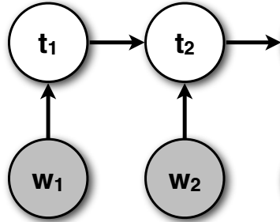
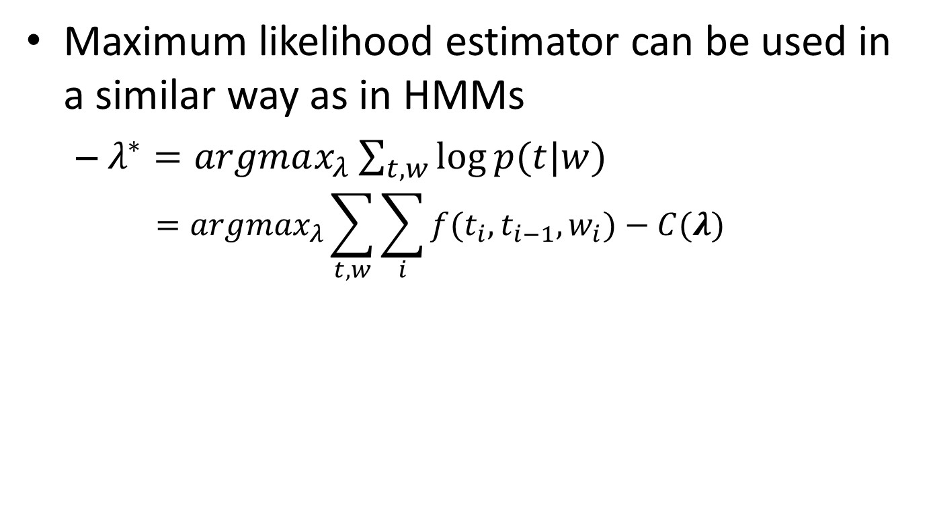
Parameter Estimation
Maximum likelihood estimator can be used in a similar way as in HMMs
$λ^{∗}=argmax_{λ}\sum_{t,w}{\log{p(t|w)}}$
$$=argmax_{λ}\sum_{t,w}{\sum_{i}{f(t_{i},t_{i−1},w_{i})}−C(λ) }$$
Decompose the training data into such units

Slide 42

Why Maximum Entropy?
We will explain this in detail when discussing the Logistic Regression models

Slide 43

A Little Bit More about MEMMs
Emission features can go across multiple observations
$f\left(t_{i},t_{i−1},w_{i}\right)=\sum_{k}{λ_{k}f_{k}(w_{i},w)}$
Especially useful for shallow parsing and NER tasks

Slide 44











Conditional Random Field
A more advanced model for sequence labeling
Model global dependency
$p\left(t | w\right)∝\prod_{i}{\exp{(\sum_{k}{{λ_{k}f}_{k}\left(t_{i},w\right)+\sum_{l}{η_{l}g_{l}(t_{i}, t_{i−1},w)}})}}$
Edge feature $g(t_{i},t_{i−1},w)$
$$t_{1}$$
$$t_{2}$$
$$t_{3}$$
$$t_{4}$$
Node feature $f(t_{i},w)$
$$w_{1}$$
$$w_{2}$$
$$w_{3}$$
$$w_{4}$$

