Slide 1
Visualization Tool for Sentiment over Space and Time
Danny Brady
Notes:
Fancy name for what I call Animated Heatmaps

Slide 2
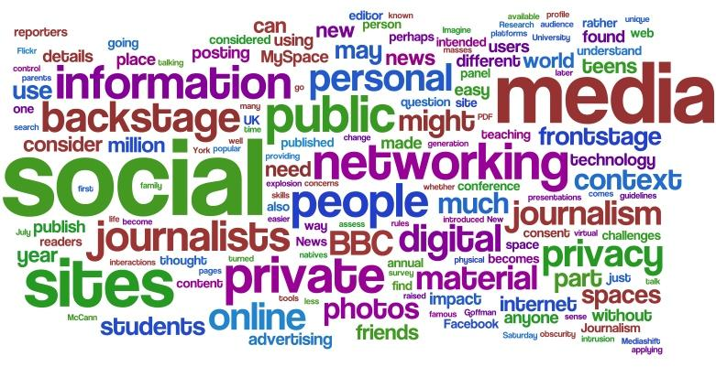
Notes:
When we think of text mining visualizations we think of this

Slide 3
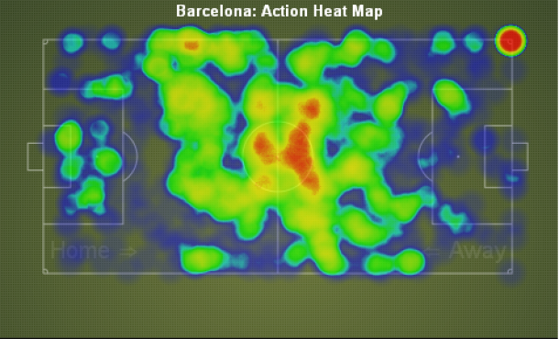
Notes:
Heatmap is great for spatial

Slide 4
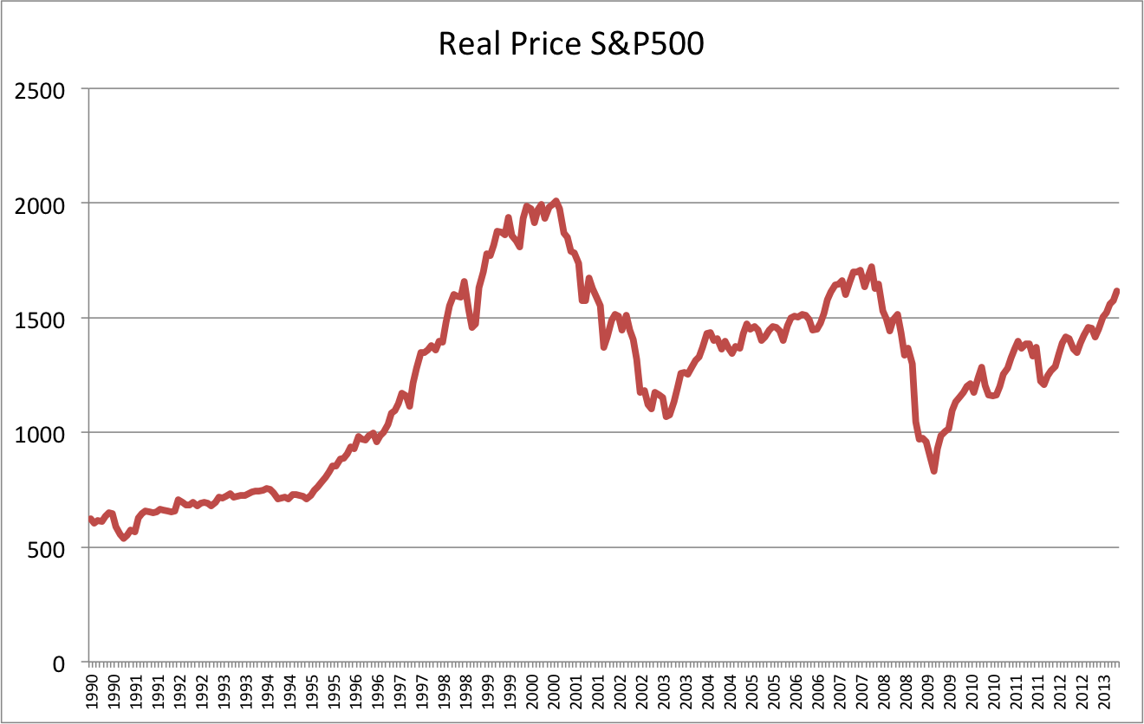
Notes:
Graphs great for over time

Slide 5
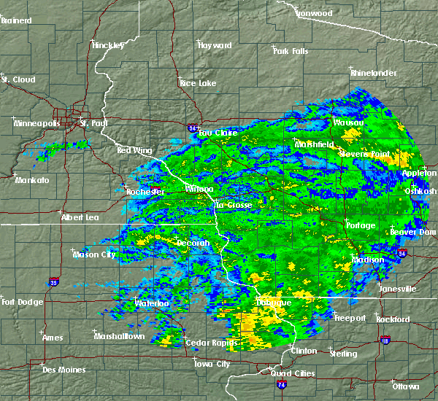
Notes:
Weather maps show animated heatmaps

Slide 6

http://timan100.cs.uiuc.edu:8080/ReviewMiner/querySuggestion

Slide 7




Powered By:

Slide 8
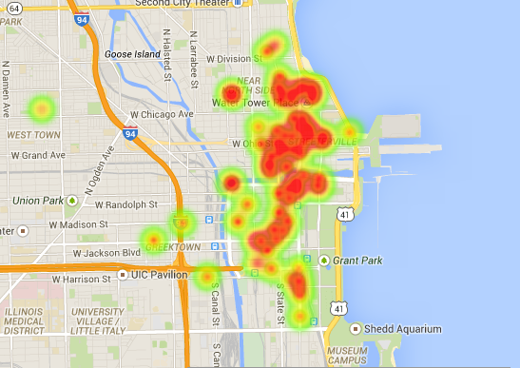
Notes:
Started with this

Slide 9
Time for a live Demo!
http://www.dannyjbrady.com

Slide 10
Thanks for Listening
Any Questions?

