Slide 1
Posterior Regularization on Topic Modeling
Md Mustafizur Rahman
mr4xb@virginia.edu

Slide 2
Outlines
Motivation
Findings
Research Question
Related Works
Methodologies
Experimental Setup
Evaluation
Future Works

Slide 3
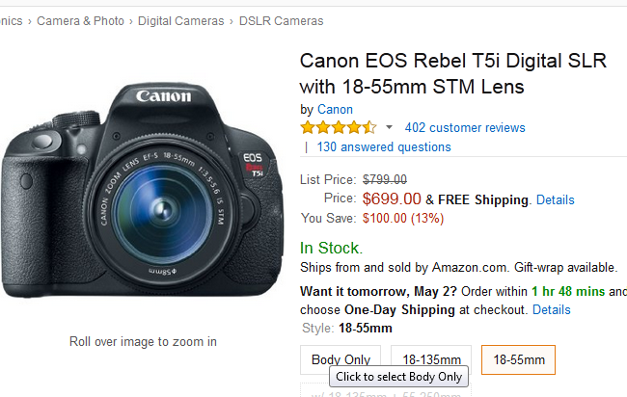
Reviews from Amazon.com
Is it possible to read
all those reviews?

Slide 4
What are we looking for?

Slide 5

Motivation
Cons: Focus
Cons: Picture Quality, USB
Cons: Memory Card

Slide 6

Pros: Menu features, ISO
Cons: No manual focus
Pros: Light Weight

Slide 7
What do we really need?

Slide 8
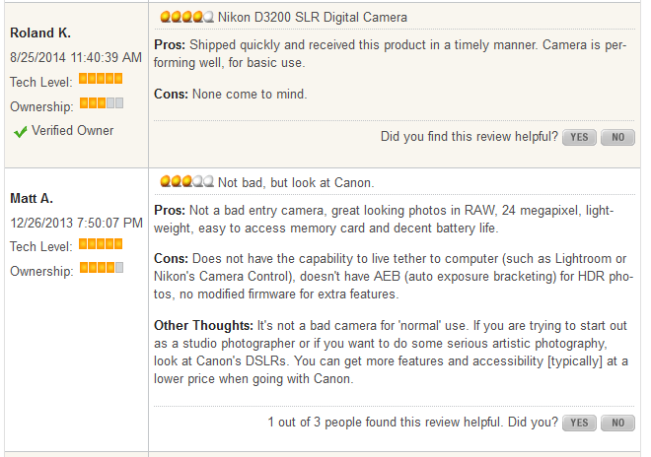

Slide 9
Findings
For each product
User writes about different aspects/topics
May also provide suggestions for improvement
Topics/Aspects
Can have multiple attributes
i.e. Pros, Cons
Attributes
Topic can contain only one attribute inside in each review i.e. picture quality (a topic) is either good or bad

Slide 10
Research Question
Is it possible to identify those topics along with their attributes?
Challenges
Users are giving completely free style reviews
So, data set is completely unstructured!!
Topics are unknown
Attributes are undefined

Slide 11
Related Works
Topic Models
PLSA [Hofmann 99]
LDA [Blei et al. 03]
Author-Topic [Steyvers et al. 04]
CPLSA [Mei & Zhai 06]
Unsupervised learning paradigm
Regularized topic model
Topic Modeling with Network Regularization-NetPLSA [Mei & Zhai 08]
None of these takes into consideration some sorts supervision from structured dataset

Slide 12
System Components
Topic Models
To identify topics from the unstructured data
We can use any topic modeling here, like PLSA, LDA, HTMM etc
Posterior Regularization
Regularize a topic so that it contains only one attribute
i.e. picture quality should either be in Pros or Cons in a review but not in both

Slide 13
Topic Models
Suppose you want to write an article
You have to make decisions about the following things
How many topics will you cover? (i.e. may be 2 topics)
What are those topics? (i.e. might be about sport and country)
What will be the proportion of those topics? (i.e. 60% - 40%)

Slide 14
Topic Models
Topics(z) | Proportion
Sports | 0.6
Country | 0.4
Sports
Basketball | 0.6
Game | 0.2
Popular | 0.1
Team | 0.1
Country
USA | 0.5
state | 0.5
Document
Basketball is one of the most popular game in USA.
Most of the state universities have Basketball team.

Slide 15
Probabilistic Latent Semantic Analysis
Generative Model
Each document is a mixture of topics
Document is a multinomial distribution over topics (z)
Topic is a multinomial distribution over words (w)
Doc
z1
z2
zK
w1
w2
wT

Slide 16
Parameter estimation in PLSA
E-Step:
Word w in doc d is generated
from topic j
from background
Posterior: application of Bayes rule
M-Step:
Re-estimate
mixing weights
word-topic distribution
Sum over all docs
in the collection
Fractional counts contributing to
using topic j in generating d
generating w from topic j

Slide 17
Running Example
Pros:
Battery life seems good. I took 200+ photos and it isn't complaining about low battery yet.
Also, zoom is pretty good, at 6x optical and 1x, 1.5x or 2x digital.
Cons:
The picture files are kind of huge, though you should expect that out of a 12 megapixel camera (by huge, I mean 2-3 megs on the low end, up to 8-9 on the "superfine" resolution). Basically, get a big flash card (I'd recommend 500 meg, at the very least).
Also, the catch on the battery/memory compartment cover isn't that great. When the batteries are installed, it can be a little bit of a chore to get the cover closed.

Slide 18
Topic Modeling
Topics(z) | Proportion
1 | 0.3
2 | 0.3
3 | 0.3
4 | 0.1
Topic 1
Battery 0.8
Life 0.2
Topic 2
Zoom 0.05
Optical 0.06
Topic 3
Flash
Megapixel
Topic 4
Cover 0.8
Battery 0.2
Pros:
Battery life seems good. I took 200+ photos and it isn't complaining about low battery yet.
Also, zoom is pretty good, at 6x optical and 1x, 1.5x or 2x digital.
Cons:
The picture files are kind of huge, though you should expect that out of a 12 megapixel camera (by huge, I mean 2-3 megs on the low end, up to 8-9 on the "superfine" resolution). Basically, get a big flash card (I'd recommend 500 meg, at the very least).
Also, the catch on the battery/memory compartment cover isn't that great. When the batteries are installed, it can be a little bit of a chore to get the cover closed.

Slide 19
Topic Modeling
Topic, z = 1 a = {pros, cons} = {1, 0}
Total Word, c(w, z=1) = 4
Total word in Pros, c(a=1, z = 1) = 3
Total word in Cons, c(a=0, z = 1)= 1
Pros:
Battery life seems good. I took 200+ photos and it isn't complaining about low battery yet.
Also, zoom is pretty good, at 6x optical and 1x, 1.5x or 2x digital.
Cons:
The picture files are kind of huge, though you should expect that out of a 12 megapixel camera (by huge, I mean 2-3 megs on the low end, up to 8-9 on the "superfine" resolution). Basically, get a big flash card (I'd recommend 500 meg, at the very least).
Also, the catch on the battery/memory compartment cover isn't that great. When the batteries are installed, it can be a little bit of a chore to get the cover closed.
Topic 1 is violating the domain knowledge.
It appears both in Pros and Cons!!

Slide 20
Topic Modeling
Topic, z = 2 , a = {pros, cons} = {1, 0}
Total Word, c(w, z=2) = 2
Total word in Pros, c(a=1, z = 2) = 2
Total word in Cons, c(a=0, z = 2)= 0
Pros:
Battery life seems good. I took 200+ photos and it isn't complaining about low battery yet.
Also, zoom is pretty good, at 6x optical and 1x, 1.5x or 2x digital.
Cons:
The picture files are kind of huge, though you should expect that out of a 12 megapixel camera (by huge, I mean 2-3 megs on the low end, up to 8-9 on the "superfine" resolution). Basically, get a big flash card (I'd recommend 500 meg, at the very least).
Also, the catch on the battery/memory compartment cover isn't that great. When the batteries are installed, it can be a little bit of a chore to get the cover closed.
Topic 2 appears only in Pros. It does not violate the domain knowledge

Slide 21
Topic Modeling
Topic, z = 3, a = {pros, cons} = {1, 0}
Total Word, c(w, z=3) = 2
Total word in Pros, c(a=1, z = 3) = 0
Total word in Cons, c(a=0, z = 3)= 2
Pros:
Battery life seems good. I took 200+ photos and it isn't complaining about low battery yet.
Also, zoom is pretty good, at 6x optical and 1x, 1.5x or 2x digital.
Cons:
The picture files are kind of huge, though you should expect that out of a 12 megapixel camera (by huge, I mean 2-3 megs on the low end, up to 8-9 on the "superfine" resolution). Basically, get a big flash card (I'd recommend 500 meg, at the very least).
Also, the catch on the battery/memory compartment cover isn't that great. When the batteries are installed, it can be a little bit of a chore to get the cover closed.
Topic 3 appears only in Cons. It does not violate the domain knowledge

Slide 22
Running Example
Topics(z) | Proportion
1 | 0.3
2 | 0.3
3 | 0.3
4 | 0.1
Topic 1
Battery 0.08
Life 0.02
Topic 2
Zoom 0.05
Optical 0.06
Topic 3
Flash
Megapixel
Topic 4
Cover 0.8
Battery 0.2
Topic, z = 1 a = {pros, cons} = {1, 0}
Total Word, c(w, z=1) = 4
Total word in Pros, c(a=1, z = 1) = 3
Total word in Cons, c(a=0, z = 1)= 1
Topic, z = 2 , a = {pros, cons} = {1, 0}
Total Word, c(w, z=2) = 2
Total word in Pros, c(a=1, z = 2) = 2
Total word in Cons, c(a=0, z = 2)= 0
Basic topic modeling (i.e. PLSA) is not helpful
Topic 1 is violating the domain knowledge, so we have to regularize the Topic 1
Topic, z = 3, a = {pros, cons} = {1, 0}
Total Word, c(w, z=3) = 2
Total word in Pros, c(a=1, z = 3) = 0
Total word in Cons, c(a=0, z = 3)= 2
Topic, z = 4, a = {pros, cons} = {1, 0}
Total Word, c(w, z=4) = 2
Total word in Pros, c(a=1, z = 4) = 0
Total word in Cons, c(a=0, z = 4)= 2

Slide 23
What can we do?
Topics(z) | Proportion
1 | 0.2
2 | 0.3
3 | 0.3
4 | 0.2
Topic 1
Battery 0.8
Life 0.2
Topic 2
Zoom 0.05
Optical 0.06
Topic 3
Flash
Megapixel
Topic 4
Cover 0.8
Battery 0.2
Pros:
Battery life seems good. I took 200+ photos and it isn't complaining about low battery yet.
Also, zoom is pretty good, at 6x optical and 1x, 1.5x or 2x digital.
Cons:
The picture files are kind of huge, though you should expect that out of a 12 megapixel camera (by huge, I mean 2-3 megs on the low end, up to 8-9 on the "superfine" resolution). Basically, get a big flash card (I'd recommend 500 meg, at the very least).
Also, the catch on the battery/memory compartment cover isn't that great. When the batteries are installed, it can be a little bit of a chore to get the cover closed.
Now All topics satisfy the domain knowledge

Slide 24
What have we done?
Intuition
Redistribute the topic proportion in the review document
Penalizing the topic 1 and also rewards the topic 4
How?

Slide 25
Redistributing the topic proportion
Inside a document
Each topic should satisfy some constraint functions
If all the constraints are not satisfied by the topic, penalize it and reduce its proportion in the document
 | Topic 1 | Topic 2 | Topic 3 | Topic 4
Proportion | 0.3 | 0.3 | 0.3 | 0.1

Slide 26
Posterior Regularization
Requirements
Need some knowledge from the domain
Domain Knowledge
A topic can contain only one attributes inside in a documents
Outputs
Constraint functions
Constraint Function
E[c(a=1, z)*c(a=0,z)]
E[c(a=1, z)-c(a=0,z)]²
Used a small labeled corpus
from newegg.com

Slide 27
Design of Constraint function
Constrain Function I
E[c(a=1, z)*c(a=0,z)] should be close to zero (0)
Why?
Take a look at topic 1 again
Topic, z = 1 a = {pros, cons} = {1, 0}
Total Word, c(w, z=1) = 4
Total word in Pros, c(a=1, z = 1) = 3
Total word in Cons, c(a=0, z = 1)= 1
E[c(a=1, z)*c(a=0,z)] = 3*1 = 3
But we need either one of the c(a=1, z = 1) or c(a=0, z = 1) to be zero i.e. either in Pros or in Cons but not both. That means multiplication should be zero
Higher values of E[c(a=1, z)*c(a=0,z)] indicate higher penalty of the topic 1

Slide 28


Posterior Regularization with EM Algorithm
EM can be expressed as:
But for Posterior Regularization we have to modify the E steps (only add the constraints) as follows:
Constraint Function

Slide 29
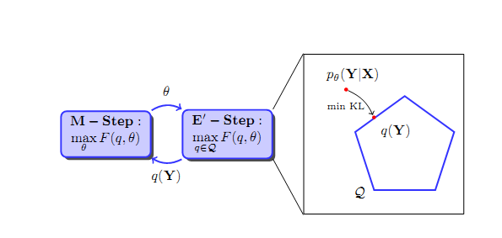
EM for Posterior Regularization

Slide 30
Computational Complexity
We have to compute posterior regularizer
Posterior Regularizer is a constraint optimization problem as follows
We can solve it in its dual form using Lagrangian multiplier and convexity of KLdivergence
Constraint Set
Slack Variable

Slide 31


Computational Complexity
Dual Form of the Regularizer
If optimal solution for Dual, then we get the primal solution using
Modified E -step

Slide 32
System Overview
Two different set of Corpus
Unstructured Corpus (Amazon Review Dataset)
Structured Corpus (newEgg Review Dataset)
Use PLSA to estimate the topics
E-step:
Calculate the expectation
If the review is from newEgg
Perform posterior regularization
Else if the review is from Amazon
No regularization
M-step: Perform the maximization

Slide 33
Experimental Setup
Dataset
222736 unstructured reviews about Camera from Amazon.com
2690 structured reviews about Camera from newEgg.com
Baseline Method
Probabilistic Latent Semantic Analysis (PLSA)
Our Method
Posterior Regularized Probabilistic Latent Semantic Analysis (PR-PLSA)

Slide 34
Evaluation
Performance Metrics
Likelihood
Perplexity
Input parameter variations
Number of topics
Constraint function variations

Slide 35
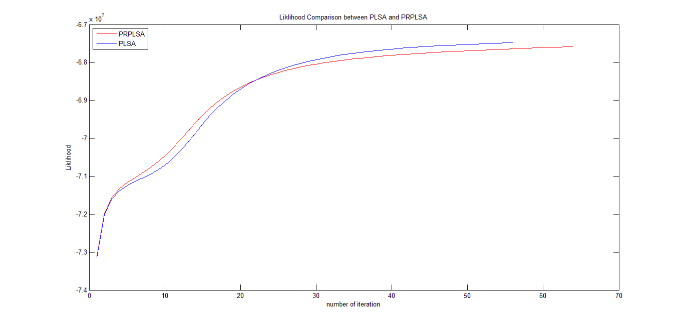
Likelihood for 30 topics (Constraint-I)
Constraint function
E[c(a=1, z)*c(a=0,z)]

Slide 36
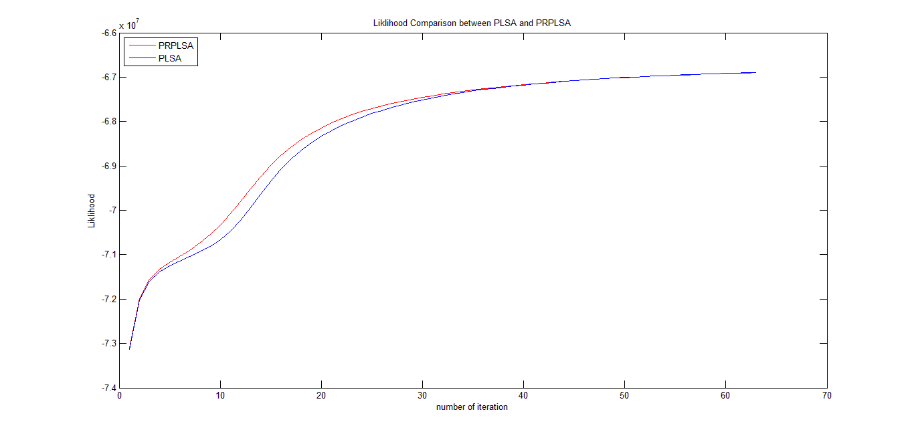
Likelihood for 40 topics (Constraint-I)
Constraint function
E[c(a=1, z)*c(a=0,z)]

Slide 37
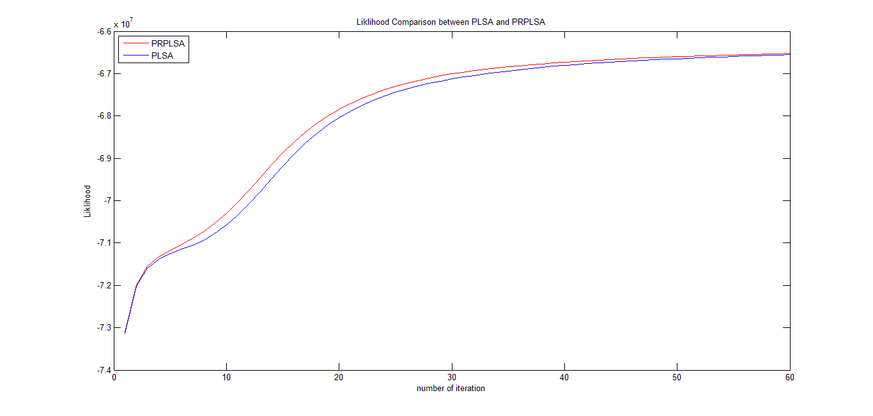
Likelihood for 50 topics (Constraint-I)
Constraint function
E[c(a=1, z)*c(a=0,z)]

Slide 38
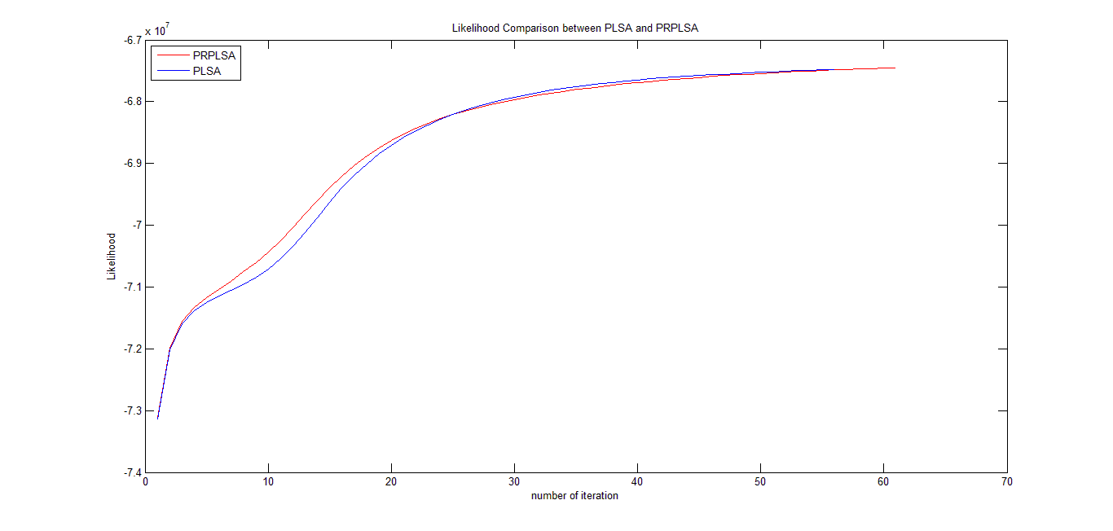
Likelihood for 30 topics (Constraint-II)
Constraint function
E[c(a=1, z) -c(a=0,z)]²

Slide 39
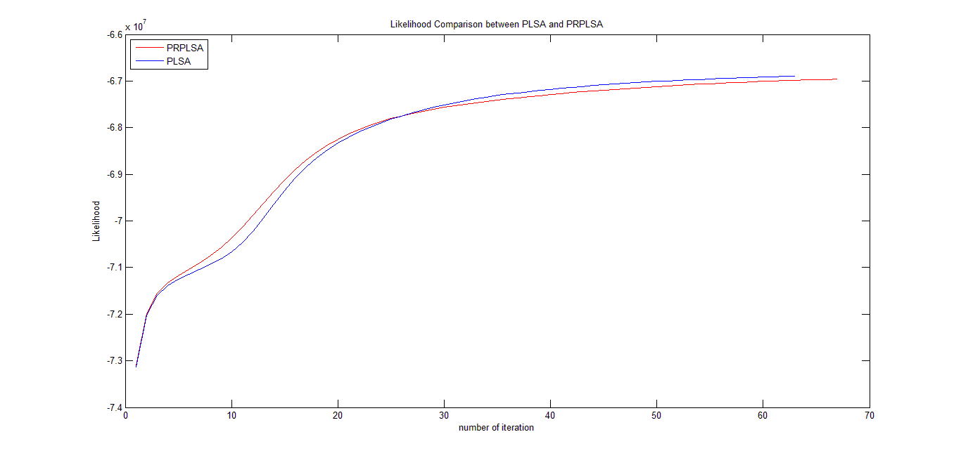
Likelihood for 40 topics (Constraint-II)
Constraint function
E[c(a=1, z) -c(a=0,z)]²

Slide 40
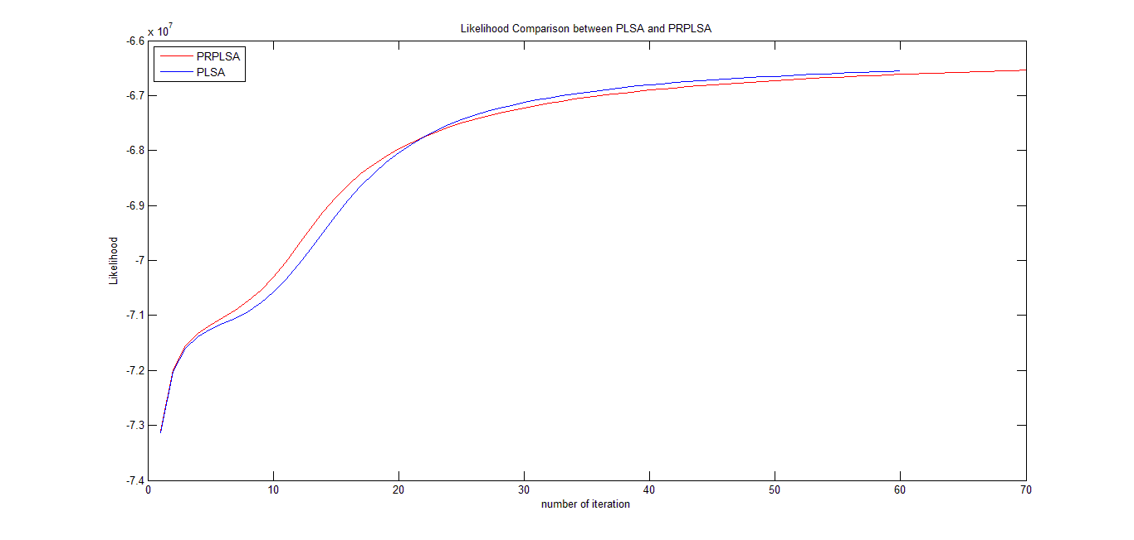
Likelihood for 50 topics (Constraint-II)
Constraint function
E[c(a=1, z) -c(a=0,z)]²

Slide 41
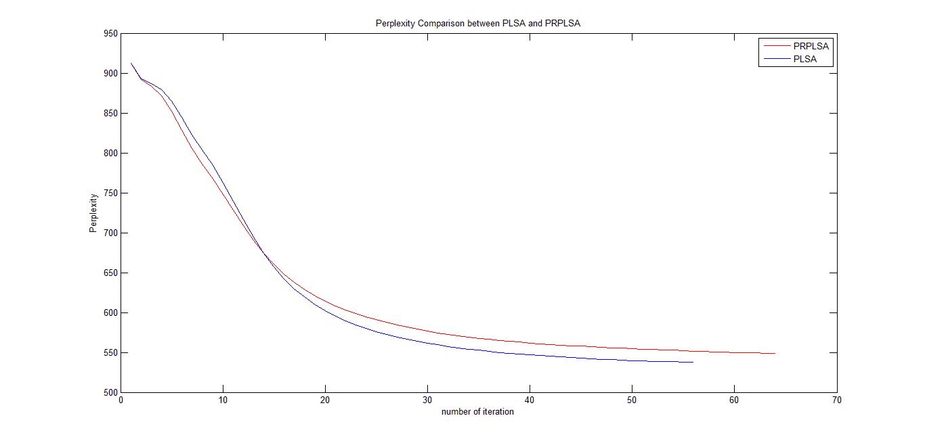
Perplexity for 30 topics (Constraint-I)
Constraint function
E[c(a=1, z)*c(a=0,z)]

Slide 42
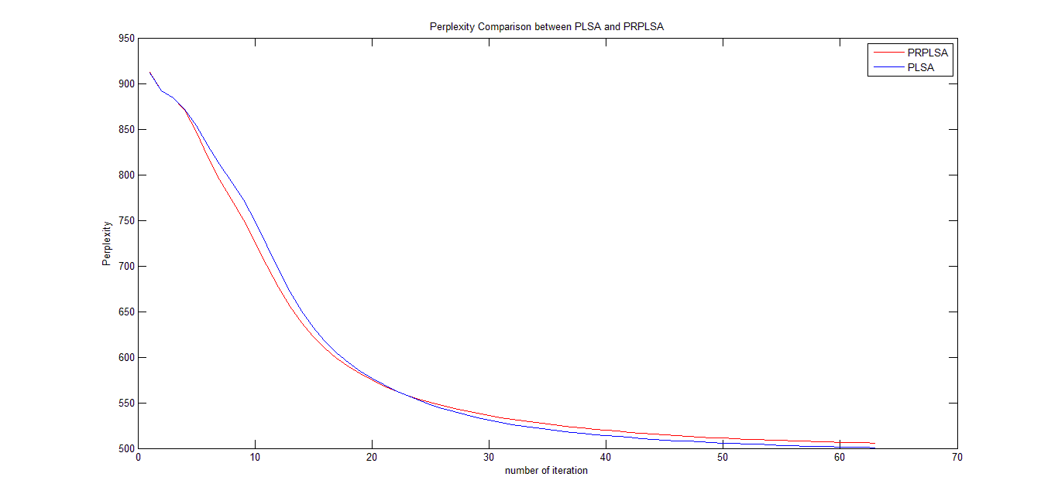
Perplexity for 40 topics (Constraint-I)
Constraint function
E[c(a=1, z)*c(a=0,z)]

Slide 43
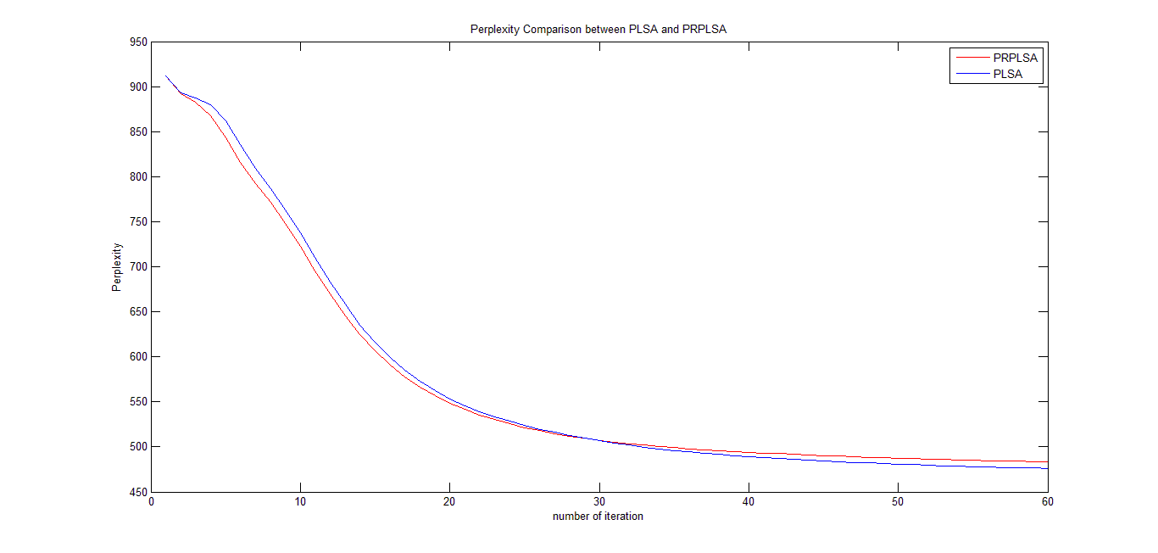
Perplexity for 50 topics (Constraint-I)
Constraint function
E[c(a=1, z)*c(a=0,z)]

Slide 44
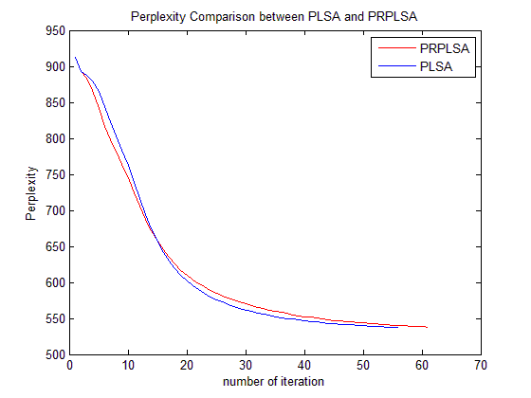
Perplexity for 30 topics (Constraint-II)
Constraint function
E[c(a=1, z) -c(a=0,z)]²

Slide 45
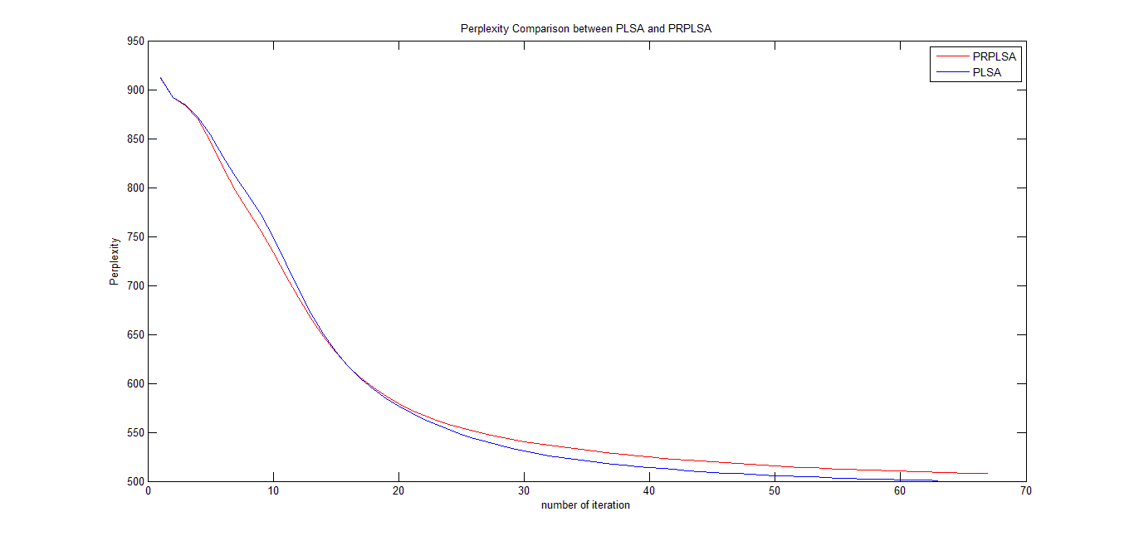
Perplexity for 40 topics (Constraint-II)
Constraint function
E[c(a=1, z) -c(a=0,z)]²

Slide 46
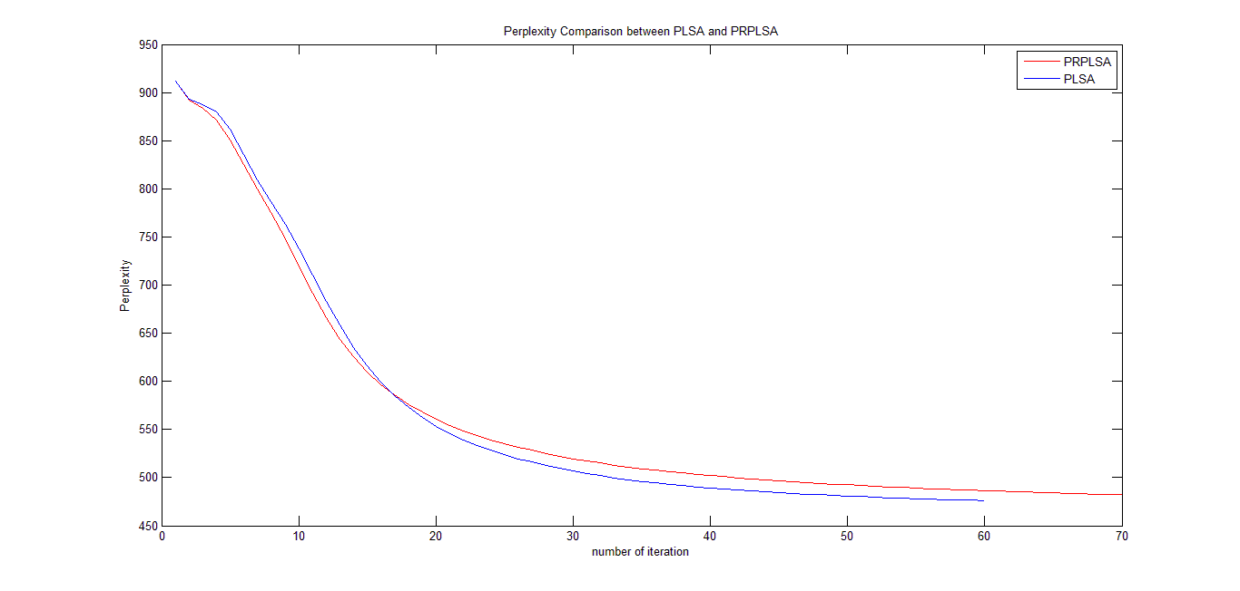
Perplexity for 50 topics (Constraint-II)
Constraint function
E[c(a=1, z) -c(a=0,z)]²

Slide 47
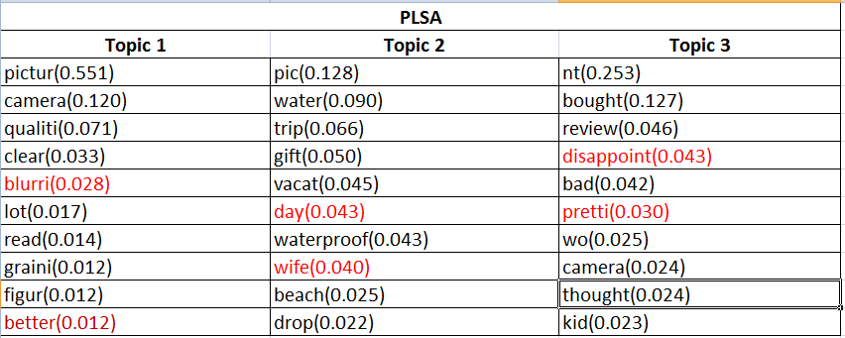
Topics by PLSA

Slide 48
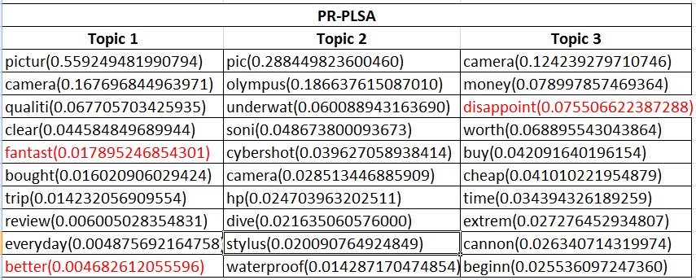
Topics by PR-PLSA

Slide 49
Observation from experiments
Likelihood increases as the number of topic increases
Perplexity of our model is almost as good as PLSA but not better
Constraint-I is performing better than constraint-II

Slide 50
Future Works
Introduce more attributes
Labeling unstructured data using knowledge from the trained posterior regularized topic model

Slide 51


Slide 52
Notations
Topic – z
Attribute – a {a=1 means pros, a=0 means cons}
E[x] - Expectation of x
c(a=1,z) – number of pros attributes under topic z
c(a=0,z) – number of cons attributes under topic z

Slide 53
What can we do?
Current topics and their proportion
New topics and their proportion
Topics(z) | Proportion
1 | 0.3
2 | 0.3
3 | 0.3
4 | 0.1
Topic 1
Battery 0.08
Life 0.02
Topic 2
Zoom 0.05
Optical 0.06
Topic 3
Flash
Megapixel
Topic 4
Cover 0.8
Battery 0.2
Topics(z) | Proportion
1 | 0.2
2 | 0.3
3 | 0.3
4 | 0.2
Topic 1
Battery 0.08
Life 0.02
Topic 2
Zoom 0.05
Optical 0.06
Topic 3
Flash
Megapixel
Topic 4
Cover 0.8
Battery 0.2

