Slide 1
Social Theory Driven Operational Forecasting of Civil Unrest Event Outbreaks
Final Project Presentation
Peter Wu
Apr 30, 2015

Slide 2
Outline
Introduction
Political conflict prediction
Protest participation theory
Methodology
Feature design
Ground truth labels
Modeling
Findings

Slide 3
Political conflict prediction
Crisis early warning
Nature: strategic
Predictand: future state of intra-national conflict or international relations
Predictor: Social-economic indices and historical crisis records
Civil unrest event forecasting
Nature: operational
Predictand: occurrence of concrete civil unrest events on a future day
Predictor:
GDELT (Global Database of Events, Location and Tone) event counts; retweet cascade lengths on Twitter (Ramakrishnan et al, 2014)
Topic proportions and hashtag counts on Twitter (Boecking et al, 2014)
Notes:
Civil unrest event forecasting: → important
predictand: → harder (unit of analysis);
Predictor → problem

Slide 4
“While we have a pretty good track record using event data for political forecasting using statistical methods, typically guided by a considerable amount of theory, the jury is probably out with respect to theoretical Big Data methods......Big Data approaches appear to work fairly reliably if you have something specific in mind that is invariant to noise and you are looking for a specific pattern, which is to say, at least in some sense you have a theory……But generally if you expect the data simply to "speak to you", you are going to be disappointed.” (Schrodt, 2015)

Slide 5
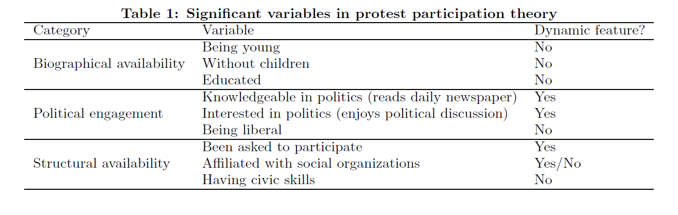
Protest participation theory (Verba et al 1995; Schussman & Soule, 2005; Van Laer, 2011)

Slide 6

Metric development
Where to measure?
Questionnaire → Online social media (Twitter)
Specifically, a data set containing all the tweets created by Cairo Twitter users from 12/1/2010 to 3/1/2011
Notes:
Also the user volume

Slide 7
Metric development (cont’d)
What to measure?
Interested in politics (enjoys political discussion)
→ Daily volume of political tweets
Been asked to participate
→ Daily volume of tweets that present future protest information
Knowledgeable in politics (reads daily newspaper)
→ Daily volume of political tweets @-ing popular news media
Affiliated with social organization
→ Daily volume of tweets @-ing salient political activists

Slide 8
Metric development (cont’d)
How to measure?
Volume of political tweets
Keyword match with TF-IDF based query term expansion
Volume of “future protest” tweets
Keyword matching rule: simultaneous occurrence of protest related words and “future day” words in English or Arabic
Volume of @-ing
Manually identify news media and political activists from the list of most frequently @-ed usernames by political tweets.
Notes:
Aggregated daily

Slide 9
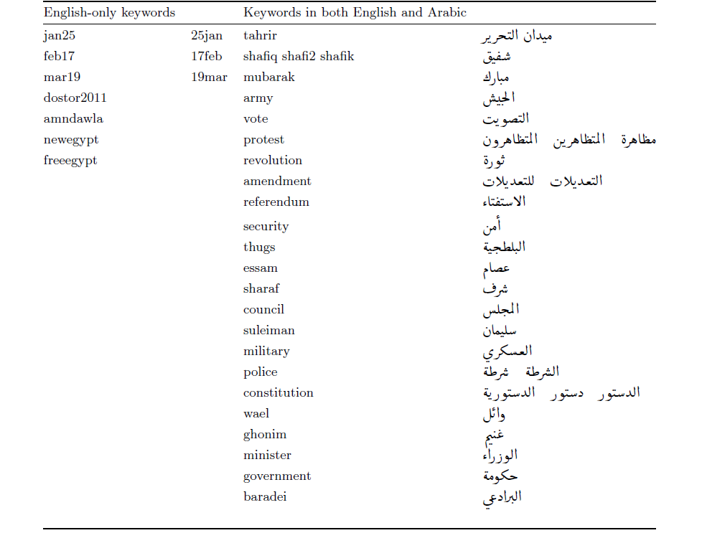

Slide 10
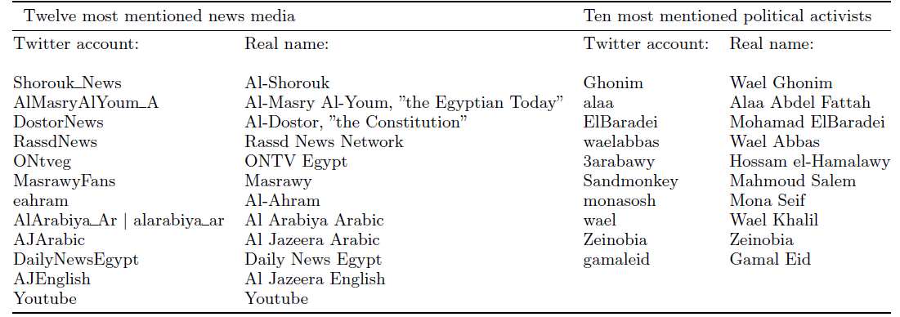

Slide 11
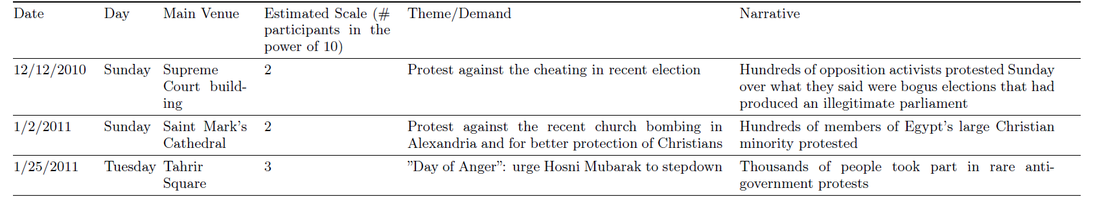
Ground truth labels
Protest outbreaks in Cairo during 12/1/2010-3/31/2011
Manually curated through Google news search
15 protest outbreaks identified
Example:
Notes:
Although in a lot of existing works GDELT

Slide 12
Research question
A change in the value of a protest participation metric of Cairo over a base period of the M past days (M=1,2,3) is significantly correlated with a protest event outbreak that happens within a predicting horizon of the N upcoming days (N=1,2,3).

Slide 13
Modeling & prediction
Logistic regression with backward stepwise selection based on Akaike information criterion (AIC) for each configuration of base period M and predicting horizon N.
Leave-one-out cross validation to evaluate prediction.
Performance compared against baseline models built using GDELT event count features.

Slide 14
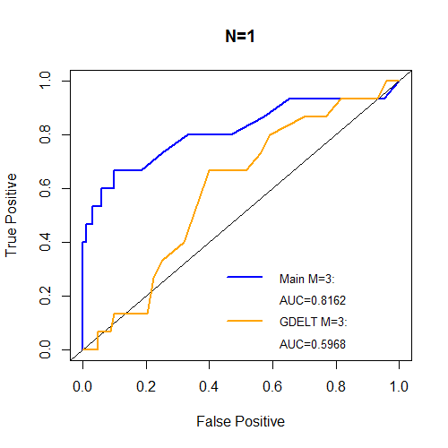
Highlight of findings
Daily volume of tweets that present future protest information has a significant positive correlation with future protest outbreaks under all configurations of M and N.
Daily volume of political tweets (percentage) is only significant under M=3 and N=1,2 and surprisingly has a negative effect.
To predict protest outbreaks 1 or 2 days into the future, choosing a base period M=3 gives the best performance; while when N=3, the best model is obtained at M=1.
The selected main model achieves an AUC of 0.816 under N=1, outperforming the baseline model the most, by 36.8%.
Notes:
Final words: an effort to bridge the gap between social science and data mining

Slide 15
Highlight of findings (cont’d)

Slide 16
Questions?

