Slide 1
Support Vector Machines
Hongning Wang
CS@UVa

Slide 2
Today’s lecture
Support vector machines
Max margin classifier
Derivation of linear SVM
Binary and multi-class cases
Different types of losses in discriminative models
Kernel method
Non-linear SVM
Popular implementations

Slide 3





Review: Bayes risk minimization
Risk – assign instance to a wrong class
$y^{∗}=argmax_{y}P(y|X)$
*Optimal Bayes decision boundary
$$p(X,y)$$
We have learned multiple ways to estimate this, e.g. Naïve Bayes, kNN, Logistic regression
$$\hat{y}=0$$
$$\hat{y}=1$$
$$p\left(X | y=0\right)p(y=0)$$
$$p\left(X | y=1\right)p(y=1)$$
$$X$$
False negative
False positive

Slide 4
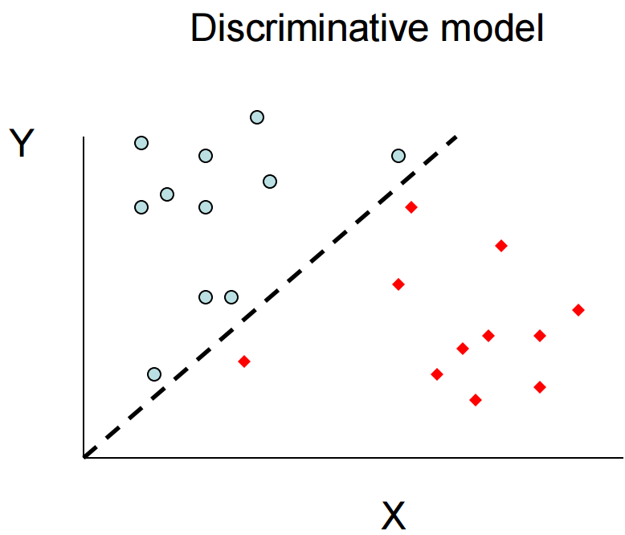
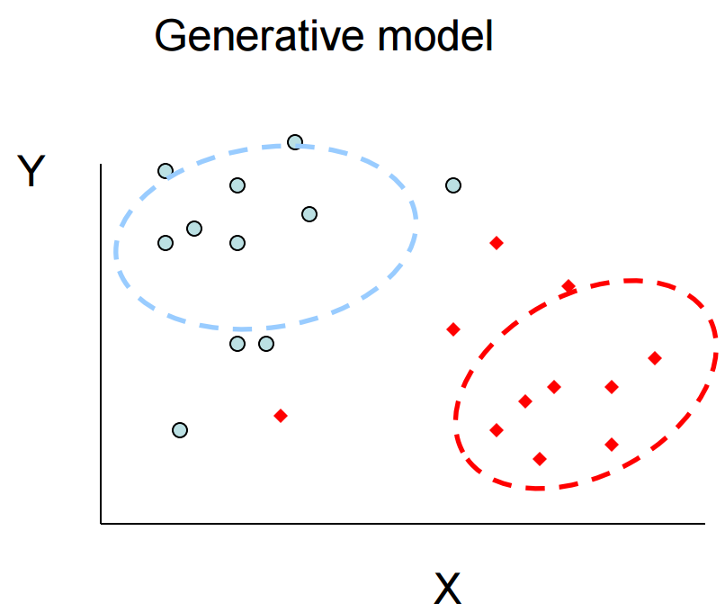

Discriminative v.s. generative models
How about directly estimating this?
All instances are considered for probability density estimation
$$y=f(x)$$
More attention will be put onto the boundary points

Slide 5


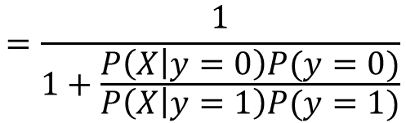


Logistic regression
Summary
$P\left(y=1 | X\right)=\frac{P\left(X | y=1\right)P(y=1)}{P\left(X | y=1\right)P\left(y=1\right)+P\left(X | y=0\right)P(y=0)}$
$$=\frac{1}{1+\frac{P\left(X | y=0\right)P(y=0)}{P\left(X | y=1\right)P(y=1)}}$$
Binomial
P(y|x)
$$P\left(y=1\right)=α$$
1.00
0.75
$$P\left(X | y=1\right)=N(μ_{1},δ^{2})$$
$$P\left(X | y=0\right)=N(μ_{0},δ^{2})$$
0.50
0.25
Normal with identical variance
0.00
x

Slide 6







Logistic regression
Decision boundary for binary case
$\hat{y}=\left\{\begin{aligned}1, p\left(y=1 | X\right)>0.5 \\ 0, otherwise\end{aligned}\right.$
$\hat{y}=\left\{\begin{aligned}1, w^{T}x>0 \\ 0, otherwise\end{aligned}\right.$
$$w^{T}x>0$$
$$p\left(y=1 | X\right)=\frac{1}{1+\exp{(−w^{T}X)}}>0.5$$
$$w^{T}x<0$$
i.f.f.
$$\exp\left(−w^{T}X\right)<1$$
i.f.f.
$$w^{T}X>0$$
A linear model!

Slide 7
Recap: parameter estimation for logistic regression
Maximum likelihood estimation
$L\left(w\right)=\sum_{d∈D}{y_{d}\log{p(y_{d}=1|X_{d})}+(1−y_{d})\log{p(y_{d}=0|X_{d})}}$
Take gradient of $L\left(w\right)$ with respect to $w$
$$\frac{∂L\left(w\right)}{∂w}=\sum_{d∈D}{y_{d}\frac{∂\log{p(y_{d}=1|X_{d})}}{∂w}+(1−y_{d})\frac{∂\log{p(y_{d}=0|X_{d})}}{∂w}}$$
$$=\sum_{d∈D}{y_{d}\left(1−p\left(y_{d}=1 | X_{d}\right)\right)X_{d}+\left(1−y_{d}\right)\left(0−p\left(y_{d}=1 | X_{d}\right)\right)X_{d}}$$
Good news: neat format, concave function for $w$
$$=\sum_{d∈D}{\left(y_{d}−p\left(y=1 | X_{d}\right)\right)X_{d}}$$
Bad news: no close form solution
Can be easily generalized to multi-class case

Slide 8
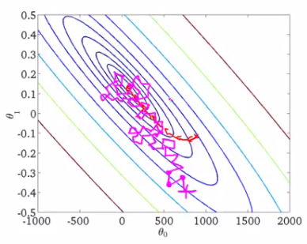
Recap: parameter estimation for logistic regression
Stochastic gradient descent
while not converge
randomly choose $d∈D$
$$∇L_{d}\left(w\right)=[\frac{∂L_{d}\left(w\right)}{∂w_{0}},\frac{∂L_{d}\left(w\right)}{∂w_{1}},…,\frac{∂L_{d}\left(w\right)}{∂w_{V}}]$$
$$w^{(t+1)}=w^{(t)}−η^{\left(t\right)}∇L_{d}\left(w\right)$$
$$η^{(t+1)}=aη^{\left(t\right)}$$
Gradually shrink the step-size

Slide 9
Recap: model regularization in logistic regression
L2 regularized logistic regression
Assume the model parameter $w$ is drawn from Gaussian: $w∼N(0,σ^{2})$
$p\left(y_{d},w | X_{d}\right)∝p\left(y_{d} | X_{d},w\right)p(w)$
$L\left(w\right)=\sum_{d∈D}{[y_{d}\log{p(y_{d}=1|X_{d})}}$
$$+(1−y_{d})\log{p\left(y_{d}=0 | X_{d}\right)}]−\frac{w^{T}w}{2σ^{2}}$$
L2-norm of $w$

Slide 10
Recap: Naïve Bayes V.S. Logistic regression
Naive Bayes
Logistic Regression
Conditional independence
$p\left(X | y\right)=\prod_{i}{p(x_{i}|y)}$
Distribution assumption of $p(x_{i}|y)$
# parameters
$k(V+1)$
Model estimation
Closed form MLE
Asymptotic convergence rate
$ε_{NB,n}≤ε_{NB,∞}+O(\sqrt{\frac{\log{V}}{n}})$
No independence assumption
Functional form assumption of $p\left(y | X\right)∝\exp{(w_{y}^{T}X)}$
# parameters
$(k−1)(V+1)$
Model estimation
Gradient-based MLE
Asymptotic convergence rate
$ε_{LR,n}≤ε_{LR,∞}+O(\sqrt{\frac{V}{n}})$
Need more training data

Slide 11




Which linear classifier do we prefer?
Choose the one with maximum separation margin
Linear classifier $y=sgn\left(w^{T}x\right)$
Y
$$f\left(x\right)=w_{0}^{T}x$$
$$f\left(x\right)=w_{1}^{T}x$$
Instances are linearly separable
$$f\left(x\right)=w_{2}^{T}x$$
X

Slide 12









Parameterize the margin
Margin = $\min_{i}{\frac{y_{i}w^{T}x_{i}}{\sqrt{w^{T}w}}}$
Distance from a point to a line
$$\frac{|w^{T}x|}{\sqrt{w^{T}w}}$$
Since $y=sgn\left(w^{T}x\right)$
Y
$$w_{}^{T}x>0$$
The distance can be written as
$$\frac{yw^{T}x}{\sqrt{w^{T}w}}$$
$$w_{}^{T}x=0$$
$$w_{}^{T}x<0$$
X

Slide 13


Max margin classifier
$w^{∗}=\underset{w}{argmax}{\min_{i}{\frac{y_{i}w^{T}x_{i}}{\sqrt{w^{T}w}}}}$
$$s.t. ∀i, y_{i}w^{T}x_{i}≥0$$
Y
$$w_{}^{T}x>0$$
Distance can be written as
$$\frac{yw^{T}x}{\sqrt{w^{T}w}}$$
$$w_{}^{T}x=0$$
$$w_{}^{T}x<0$$
X

Slide 14
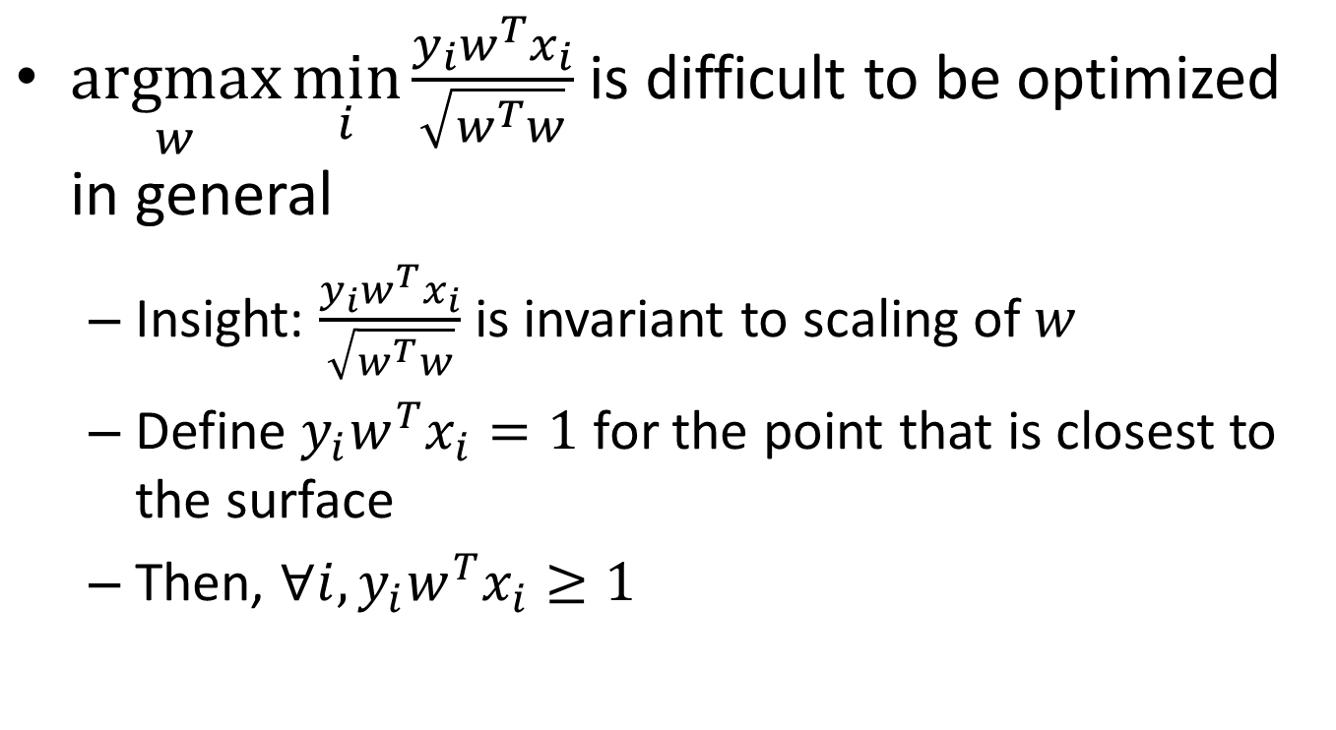
Max margin classifier
$\underset{w}{argmax}{\min_{i}{\frac{y_{i}w^{T}x_{i}}{\sqrt{w^{T}w}}}}$ is difficult to be optimized in general
Insight: $\frac{y_{i}w^{T}x_{i}}{\sqrt{w^{T}w}}$ is invariant to scaling of $w$
Define $y_{i}w^{T}x_{i}=1$ for the point that is closest to the surface
Then, $∀i,y_{i}w^{T}x_{i}≥1$

Slide 15






Max margin classifier
$$argmax_{w}\frac{1}{\sqrt{w^{T}w}}$$
$$argmin_{w}w^{T}w$$
Quadratic programming!
Easy to solve!
$$s.t. ∀i,y_{i}w^{T}x_{i}≥1$$
Y
$$w_{}^{T}x=0$$
That’s why it is called Support Vector Machines
Active constraints
No contribution in deciding the decision boundary
Support vectors
Inactive constraints
Classification confidence $\min_{i}y_{i}w^{T}x_{i}$
X

Slide 16






What if the instances are not linearly separable?
Maximize the margin while minimizing the number of errors made by the classifier?
Linear classifier $y=sgn\left(w^{T}x\right)$
trade-off parameter
manually set
Y
$$f\left(x\right)=w_{2}^{T}x$$
$$argmin_{w}w^{T}w+C\#error$$
$$f\left(x\right)=w_{1}^{T}x$$
$$s.t. ∀i,y_{i}w^{T}x_{i}≥1$$
No longer a QP!
No idea how to optimize!
X

Slide 17
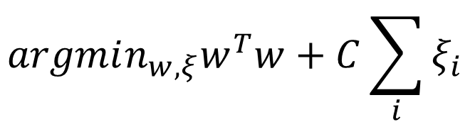





Soft-margin SVM
Relax the constraints and penalize the misclassification error
Linear classifier $y=sgn\left(w^{T}x\right)$
Y
$$argmin_{w,ξ}w^{T}w+C\sum_{i}{ξ_{i}}$$
Separable cases $ξ=0$
$$f\left(x\right)=w_{1}^{T}x$$
$$s.t. ∀i,y_{i}w^{T}x_{i}≥1−ξ_{i}$$
$$ξ_{i}≥0$$
$$ξ_{2}$$
$$ξ_{1}$$
Introduce slack variables
Still a QP!
Easy to optimize!
X

Slide 18
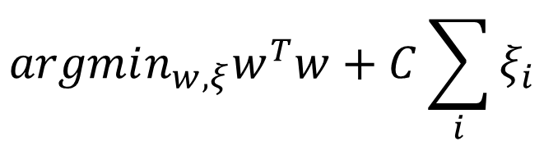

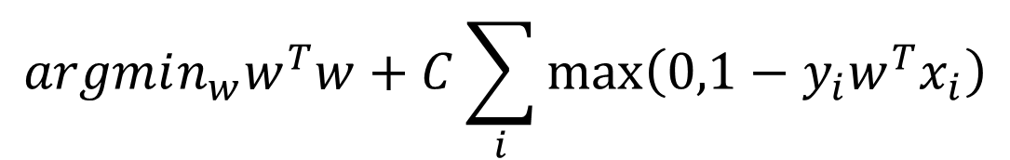

What kind of loss is SVM optimizing?
$$argmin_{w,ξ}w^{T}w+C\sum_{i}{ξ_{i}}$$
$$s.t. ∀i,y_{i}w^{T}x_{i}≥1−ξ_{i}$$
$$ξ_{i}≥0$$
$$argmin_{w}w^{T}w+C\sum_{i}{\max\left(0,1−y_{i}w^{T}x_{i}\right)}$$

Slide 19

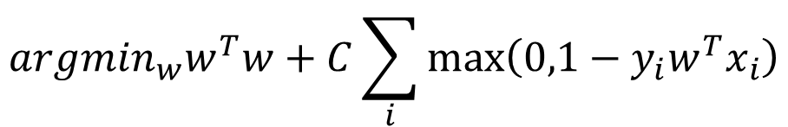


What kind of error is SVM optimizing?
Hinge loss
regularization
classification loss
$$argmin_{w}w^{T}w+C\sum_{i}{\max\left(0,1−y_{i}w^{T}x_{i}\right)}$$
$$E(x,y)$$
0/1 loss
1
Hinge loss
$$argmin_{w}w^{T}w+C\#error$$
-1
0
1
$$yw^{T}x$$

Slide 20
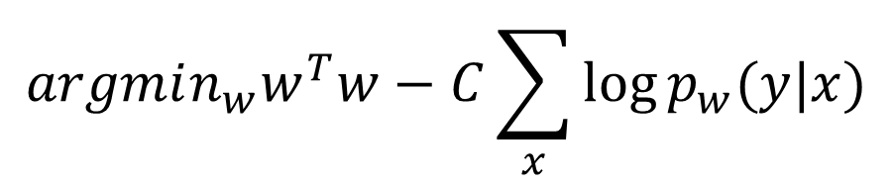



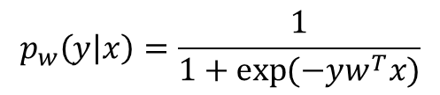
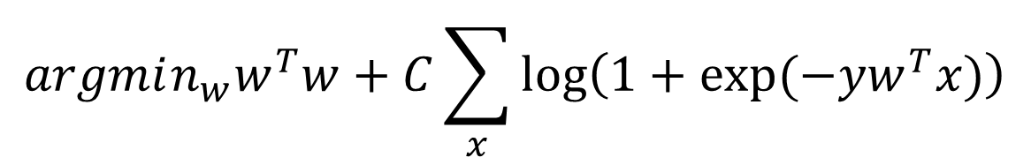
Think about logistic regression
Optimized by maximum a posterior estimator
$argmax_{w}\sum_{x}{\log{p_{w}(y|x)}}−\frac{w^{T}w}{2σ^{2}}$
Note: $y=\{−1,+1\}$
$$argmin_{w}w^{T}w−C\sum_{x}{\log{p_{w}(y|x)}}$$
Note: $C=2σ^{2}$
$$p_{w}\left(y | x\right)=\frac{1}{1+\exp{(−yw^{T}x)}}$$
$$argmin_{w}w^{T}w+C\sum_{x}{\log\left(1+\exp{(−yw^{T}x)}\right)}$$
Regularization
Logistic loss

Slide 21
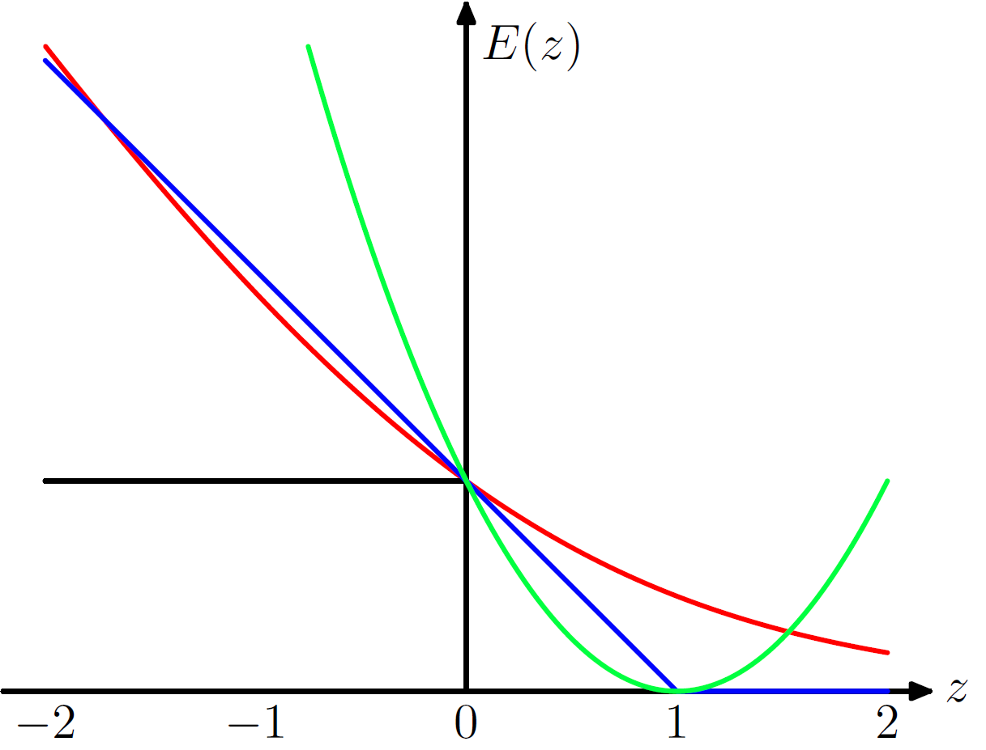

Different types of classification loss
Discriminative classifiers aim at optimizing those losses
Hinge loss: SVM
Symmetric loss for false positive and false negative!
Logistic loss: Logistic Regression
Square loss: linear regression, Least square SVM
0/1 loss: no classifier yet
$$=yw^{T}x$$
Pattern Recognition and Machine Learning, p337

Slide 22
Recap: max margin classifier
$$argmin_{w}w^{T}w$$
Quadratic programming!
Easy to solve!
$$s.t. ∀i,y_{i}w^{T}x_{i}≥1$$
Y
$$w_{}^{T}x=0$$
That’s why it is called Support Vector Machines
Active constraints
No contribution in deciding the decision boundary
Support vectors
Inactive constraints
Classification confidence $\min_{i}y_{i}w^{T}x_{i}$
X

Slide 23
Recap: soft-margin SVM
Relax the constraints and penalize the misclassification error
Linear classifier $y=sgn\left(w^{T}x\right)$
Y
$$argmin_{w,ξ}w^{T}w+C\sum_{i}{ξ_{i}}$$
Separable cases $ξ=0$
$$f\left(x\right)=w_{1}^{T}x$$
$$s.t. ∀i,y_{i}w^{T}x_{i}≥1−ξ_{i}$$
$$ξ_{i}≥0$$
$$ξ_{2}$$
$$ξ_{1}$$
Introduce slack variables
Still a QP!
Easy to optimize!
X

Slide 24
Recap: different types of classification loss
Discriminative classifiers aim at optimizing those losses
Hinge loss: SVM
Symmetric loss for false positive and false negative!
Logistic loss: Logistic Regression
Square loss: linear regression, Least square SVM
0/1 loss: no classifier yet
$$=yw^{T}x$$
Pattern Recognition and Machine Learning, p337

Slide 25





What about multi-class classification?
One v.s. All
Simultaneously learn a set of classifiers
$$w_{2}^{T}x=0$$
Classification decision: $y=argmax_{y}w_{y}^{T}x$
Y
$$w_{0}^{T}x=0$$
We need to make sure the scales are consistent across classes
Classification confidence
How about this region?
$$w_{y}^{T}x−\max_{\tilde{y}≠y}{w_{\tilde{y}}^{T}x}$$
$$w_{1}^{T}x=0$$
difference between the most confusing classes
X

Slide 26
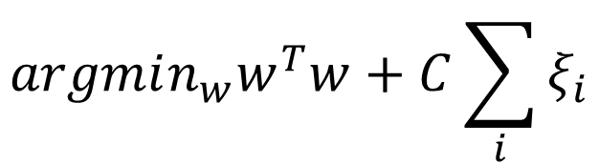


What about multi-class classification?
One v.s. All
Simultaneously learn a set of classifiers
For binary classification, we have:
$$argmin_{w}w^{T}w+C\sum_{i}{ξ_{i}}$$
$$s.t. ∀i,y_{i}w^{T}x_{i}≥1−ξ_{i}$$
$$ξ_{i}≥0$$
Generalize it!

Slide 27
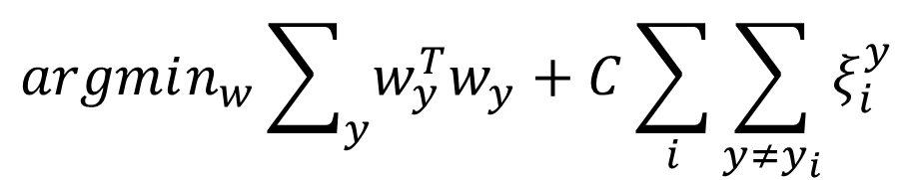

What about multi-class classification?
One v.s. All
Simultaneously learn a set of classifiers
$$argmin_{w}\sum_{y}{w_{y}^{T}w_{y}}+C\sum_{i}{\sum_{y≠y_{i}}{ξ_{i}^{y}}}$$
$$s.t. ∀i,y≠y_{i},w_{y_{i}}^{T}x_{i}≥w_{y}^{T}x_{i}+1−ξ_{i}^{y}$$
$$ξ_{i}^{y}≥0$$
Scale the margin by the rest classes

Slide 28
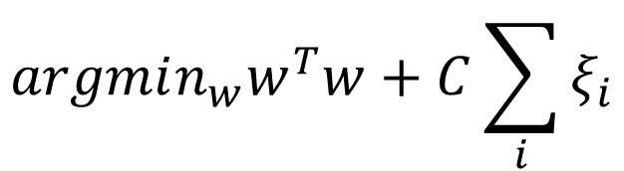

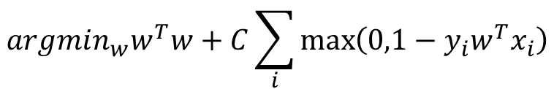

Parameter estimation
A constrained optimization problem
Can be directly optimized with gradient-based method
Chapelle, Olivier. "Training a support vector machine in the primal." Neural Computation 19.5 (2007): 1155-1178.
$$argmin_{w}w^{T}w+C\sum_{i}{ξ_{i}}$$
$$s.t. ∀i,y_{i}w^{T}x_{i}≥1−ξ_{i}$$
$$ξ_{i}≥0$$
$$argmin_{w}w^{T}w+C\sum_{i}{\max\left(0,1−y_{i}w^{T}x_{i}\right)}$$
piece-wise linear

Slide 29
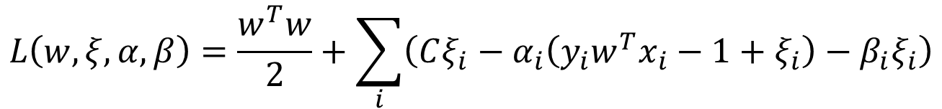
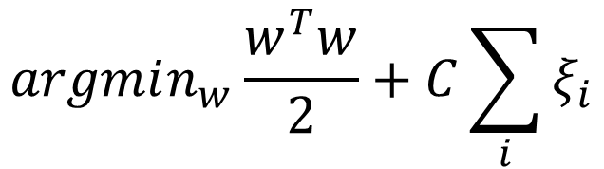



Dual form of SVM
Just to simplify the follow-up derivations
A constrained optimization problem
$$argmin_{w}\frac{w^{T}w}{2}+C\sum_{i}{ξ_{i}}$$
Primal
Lagrangian multipliers
$$s.t. ∀i,y_{i}w^{T}x_{i}≥1−ξ_{i}$$
$$α_{i}$$
$$ξ_{i}≥0$$
$$β_{i}$$
Lagrangian dual
$$L\left(w,ξ,α,β\right)=\frac{w^{T}w}{2}+\sum_{i}{\left(Cξ_{i}−α_{i}\left(y_{i}w^{T}x_{i}−1+ξ_{i}\right)−β_{i}ξ_{i}\right)}$$
$$s.t. ∀i,α_{i}≥0,β_{i}≥0$$

Slide 30
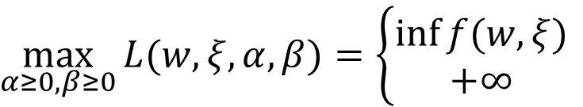

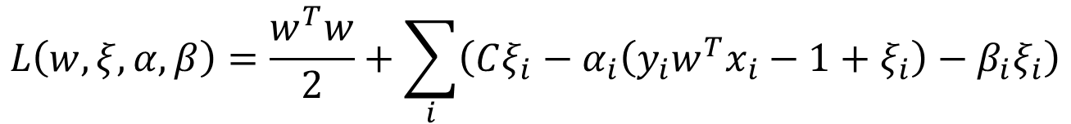
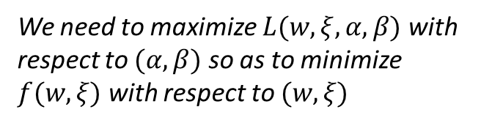

Dual form of SVM
Lagrangian dual
$$L\left(w,ξ,α,β\right)=\frac{w^{T}w}{2}+\sum_{i}{\left(Cξ_{i}−α_{i}\left(y_{i}w^{T}x_{i}−1+ξ_{i}\right)−β_{i}ξ_{i}\right)}$$
$$s.t. ∀i,α_{i}≥0,β_{i}≥0$$
Lemma
$\max_{α≥0,β≥0}{L(w,ξ,α,β)}=\left\{\begin{aligned}\inf{f(w,ξ)} \\ +∞\end{aligned}\right.$
if $(w,ξ)$ is feasible
otherwise
We need to maximize $L(w,ξ,α,β)$ with respect to $(α,β)$ so as to minimize $f(w,ξ)$ with respect to $(w,ξ)$

Slide 31
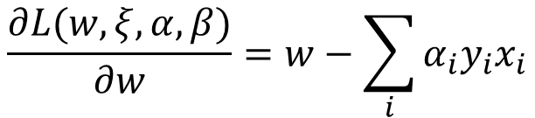


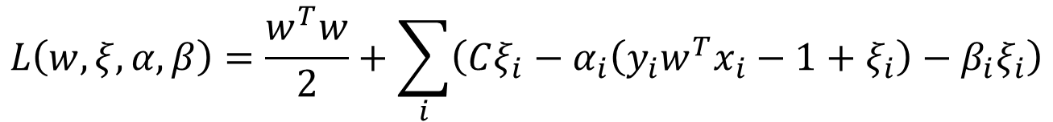
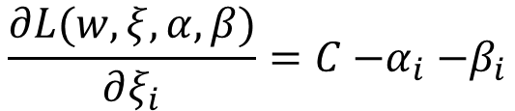
Dual form of SVM
Lagrangian dual
$$L\left(w,ξ,α,β\right)=\frac{w^{T}w}{2}+\sum_{i}{\left(Cξ_{i}−α_{i}\left(y_{i}w^{T}x_{i}−1+ξ_{i}\right)−β_{i}ξ_{i}\right)}$$
$$s.t. ∀i,α_{i}≥0,β_{i}≥0$$
Set it to zero
take them back to dual form
$$\frac{∂L(w,ξ,α, β)}{∂w}=w−\sum_{i}{α_{i}y_{i}x_{i}}$$
$$w=\sum_{i}{α_{i}y_{i}x_{i}}$$
$$\frac{∂L(w,ξ,α, β)}{∂ξ_{i}}=C{−α}_{i}−β_{i}$$
$$α_{i}+β_{i}=C$$

Slide 32
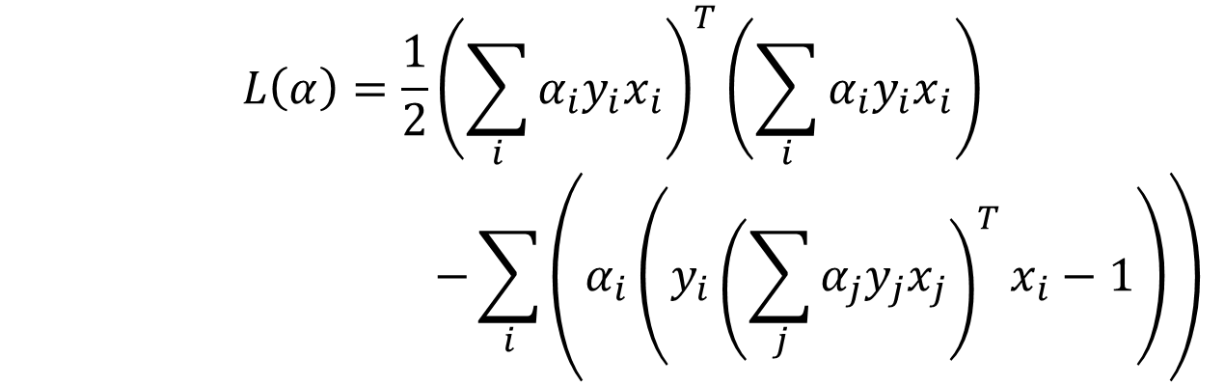

Dual form of SVM
Lagrangian dual
$$L\left(α\right)=\frac{1}{2}{\left(\sum_{i}{α_{i}y_{i}x_{i}}\right)}^{T}\left(\sum_{i}{α_{i}y_{i}x_{i}}\right)$$
$$−\sum_{i}{\left(α_{i}\left(y_{i}{\left(\sum_{j}{α_{j}y_{j}x_{j}}\right)}^{T}x_{i}−1\right)\right)}$$
$$s.t. ∀i,{0≤α}_{i}≤C$$

Slide 33
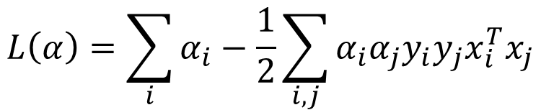


Dual form of SVM
Lagrangian dual
In dual form, we need to maximize it!
$$L\left(α\right)=\sum_{i}{α_{i}}−\frac{1}{2}\sum_{i,j}{α_{i}{α_{j}y}_{i}y_{j}x_{i}^{T}x_{j}}$$
$$s.t. ∀i,{0≤α}_{i}≤C$$
QP again!
Easy to optimize!
Complementary slackness
In the optimal solution: $α_{i}\left(y_{i}w^{T}x_{i}−1+ξ_{i}\right)=0$
which means $α_{i}=0$ if the constraint is satisfied (correct classification)
$α_{i}>0$ if the constraint is not satisfied (misclassification)

Slide 34



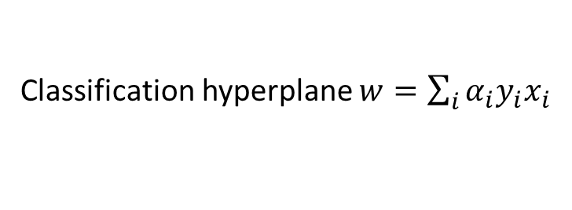


Sparsity in dual SVM
Only a few $αs$ can be non-zero
Classification hyperplane $w=\sum_{i}{α_{i}y_{i}x_{i}}$
Y
That’s why it is called Support Vector Machines
$$w_{}^{T}x=0$$
Active constraints $α>0$
No contribution in deciding the decision boundary
Support vectors
Inactive constraints
$$α=0$$
$$α_{i}\left(y_{i}w^{T}x_{i}−1+ξ_{i}\right)=0$$
X

Slide 35
Why dual form SVM?
Primal SVM v.s. dual SVM
Primal: QP in feature space
Dual: QP in instance space
If we have a lot more features than training instances, dual optimization will be more efficient
More importantly, the kernel trick!

Slide 36




Non-linearly separable cases
Non-linear mapping to linearly separable case
$$x_{2}$$
$$x_{2}=x_{1}^{2}$$
$$x_{1}$$
$$x_{1}$$
Polynomial mapping

Slide 37




Non-linearly separable cases
Non-linear mapping to linearly separable case
$$x_{2}$$
$$θ$$
polar coordinates
$$x_{1}$$
$$r$$

Slide 38

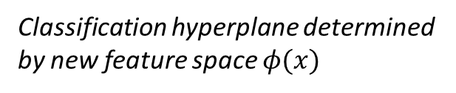



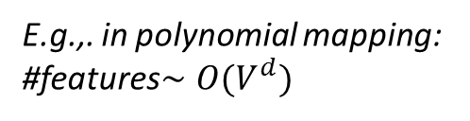
Non-linearly separable cases
Explore new features
Use features of features of features….
Classification hyperplane determined by new feature space $φ(x)$
$$x_{2}$$
$$(x_{1},x_{2})$$
feature mapping $φ(x)$
$$x_{1}$$
$$φ\left(x\right)=\left(x_{1},x_{2},x_{1}^{2},x_{2}^{2},x_{1}x_{2},…,\exp\left(x_{1}x_{2}\right)\right)$$
E.g.,. in polynomial mapping: #features$∼O(V^{d})$
Feature space explodes very quickly!

Slide 39

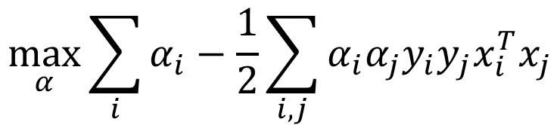


Rethink about dual form SVM
$$\max_{α}{\sum_{i}{α_{i}}−\frac{1}{2}\sum_{i,j}{α_{i}{α_{j}y}_{i}y_{j}x_{i}^{T}x_{j}}}$$
$$s.t. ∀i,{0≤α}_{i}≤C$$
What we need is only the inner product between instances!
Take order 2 polynomial as an example:
$$φ\left(x,y\right)=(x^{2},y^{2},\sqrt{2}xy)$$
If we take the feature mapping first and then compute the inner product:
$$φ{\left(x_{a},y_{a}\right)}^{T}φ\left(x_{b},y_{b}\right)=x_{a}^{2}x_{b}^{2}+y_{a}^{2}y_{b}^{2}+2x_{a}x_{b}y_{a}y_{b}$$
If we compute the inner product first:
No need to take feature mapping at all!
$${\left[{\left(x_{a},y_{a}\right)}^{T}\left(x_{b},y_{b}\right)\right]}^{2}=x_{a}^{2}x_{b}^{2}+y_{a}^{2}y_{b}^{2}+2x_{a}x_{b}y_{a}y_{b}$$

Slide 40
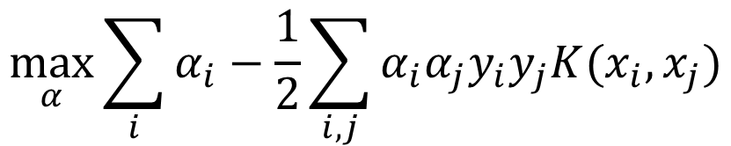
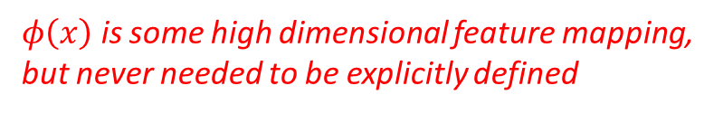

Rethink about dual form SVM
Kernel SVM
Kernel function
$$\max_{α}{\sum_{i}{α_{i}}−\frac{1}{2}\sum_{i,j}{α_{i}{α_{j}y}_{i}y_{j}K(x_{i},x_{j})}}$$
$$s.t. ∀i,{0≤α}_{i}≤C$$
$$K\left(x_{i},x_{j}\right)=φ{\left(x_{i}\right)}^{T}φ(x_{j})$$
$φ\left(x\right)$ is some high dimensional feature mapping, but never needed to be explicitly defined

Slide 41
Recap: multi-class classification with SVM
One v.s. All
Simultaneously learn a set of classifiers
$$w_{2}^{T}x=0$$
Classification decision: $y=argmax_{y}w_{y}^{T}x$
Y
$$w_{0}^{T}x=0$$
We need to make sure the scales are consistent across classes
Classification confidence
$$w_{y}^{T}x−\max_{\tilde{y}≠y}{w_{\tilde{y}}^{T}x}$$
How about this region?
$$w_{1}^{T}x=0$$
difference between the most confusing classes
X

Slide 42
Recap: dual form of SVM
Lagrangian dual
In dual form, we need to maximize it!
$$L\left(α\right)=\sum_{i}{α_{i}}−\frac{1}{2}\sum_{i,j}{α_{i}{α_{j}y}_{i}y_{j}x_{i}^{T}x_{j}}$$
$$s.t. ∀i,{0≤α}_{i}≤C$$
QP again!
Easy to optimize!
Complementary slackness
In the optimal solution: $α_{i}\left(y_{i}w^{T}x_{i}−1+ξ_{i}\right)=0$
which means $α_{i}=0$ if the constraint is satisfied (correct classification)
$α_{i}>0$ if the constraint is not satisfied (misclassification)

Slide 43
Recap: sparsity in dual SVM
Only a few $αs$ can be non-zero
Classification hyperplane $w=\sum_{i}{α_{i}y_{i}x_{i}}$
Y
That’s why it is called Support Vector Machines
$$w_{}^{T}x=0$$
Active constraints $α>0$
No contribution in deciding the decision boundary
Support vectors
Inactive constraints
$$α=0$$
$$α_{i}\left(y_{i}w^{T}x_{i}−1+ξ_{i}\right)=0$$
X

Slide 44
Recap: non-linearly separable cases
Explore new features
Use features of features of features….
Classification hyperplane determined by new feature space $φ(x)$
$$x_{2}$$
$$(x_{1},x_{2})$$
feature mapping $φ(x)$
$$x_{1}$$
$$φ\left(x\right)=\left(x_{1},x_{2},x_{1}^{2},x_{2}^{2},x_{1}x_{2},…,\exp\left(x_{1}x_{2}\right)\right)$$
E.g.,. in polynomial mapping: #features$∼O(V^{d})$
Feature space explodes very quickly!

Slide 45


Rethink about dual form SVM
Kernel SVM
Decision boundary
$f\left(x\right)=w^{T}φ\left(x\right)=\sum_{i}{α_{i}y_{i}φ{\left(x_{i}\right)}^{T}φ\left(x\right)}$
$$=\sum_{i}{α_{i}y_{i}K(x_{i},x})$$
$$\max_{α}{\sum_{i}{α_{i}}−\frac{1}{2}\sum_{i,j}{α_{i}{α_{j}y}_{i}y_{j}K(x_{i},x_{j})}}$$
$$s.t. ∀i,{0≤α}_{i}≤C$$
We still don’t need this explicit feature mapping!
Similarity between a testing case and support vectors!

Slide 46
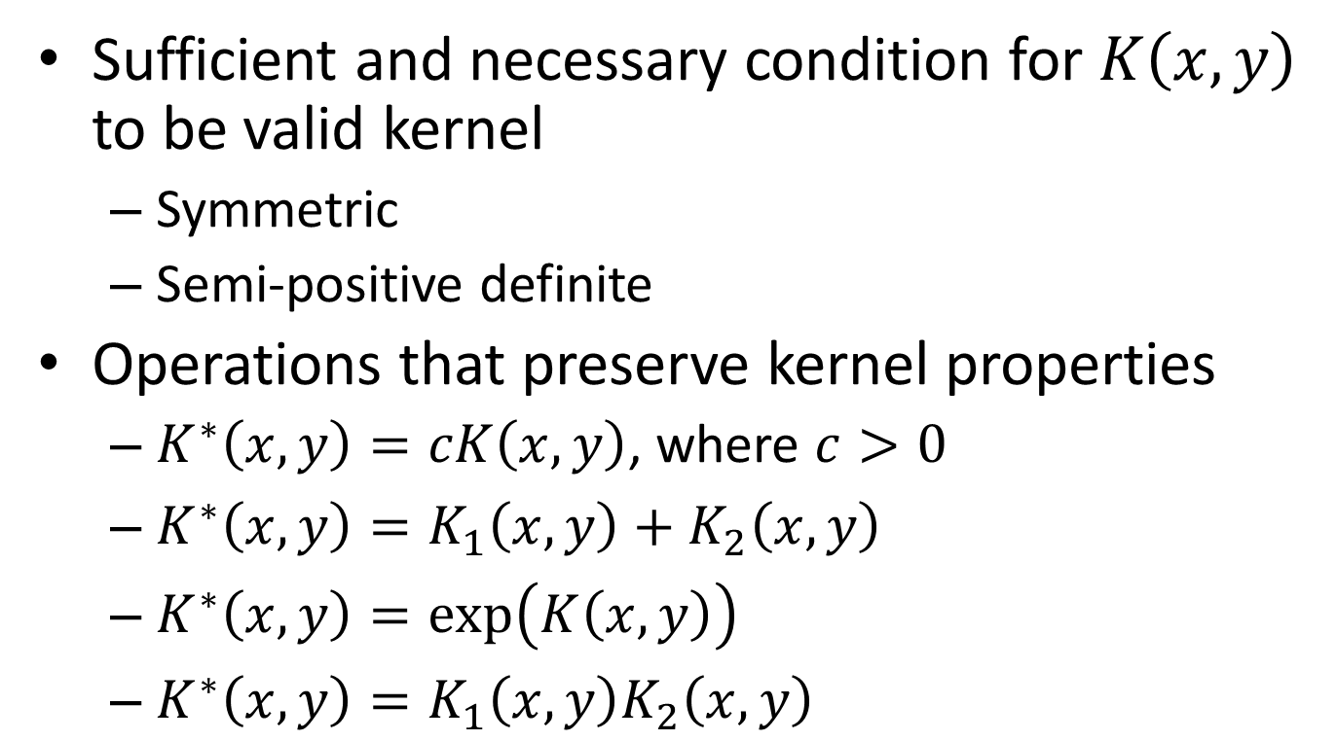
How to construct a kernel
Sufficient and necessary condition for $K\left(x,y\right)$ to be valid kernel
Symmetric
Semi-positive definite
Operations that preserve kernel properties
$K^{∗}\left(x,y\right)=cK\left(x,y\right)$, where $c>0$
$K^{∗}\left(x,y\right)=K_{1}\left(x,y\right)+K_{2}\left(x,y\right)$
$K^{∗}\left(x,y\right)=\exp\left(K\left(x,y\right)\right)$
$K^{∗}\left(x,y\right)=K_{1}\left(x,y\right)K_{2}\left(x,y\right)$
Just like the requirement for a distance metric

Slide 47
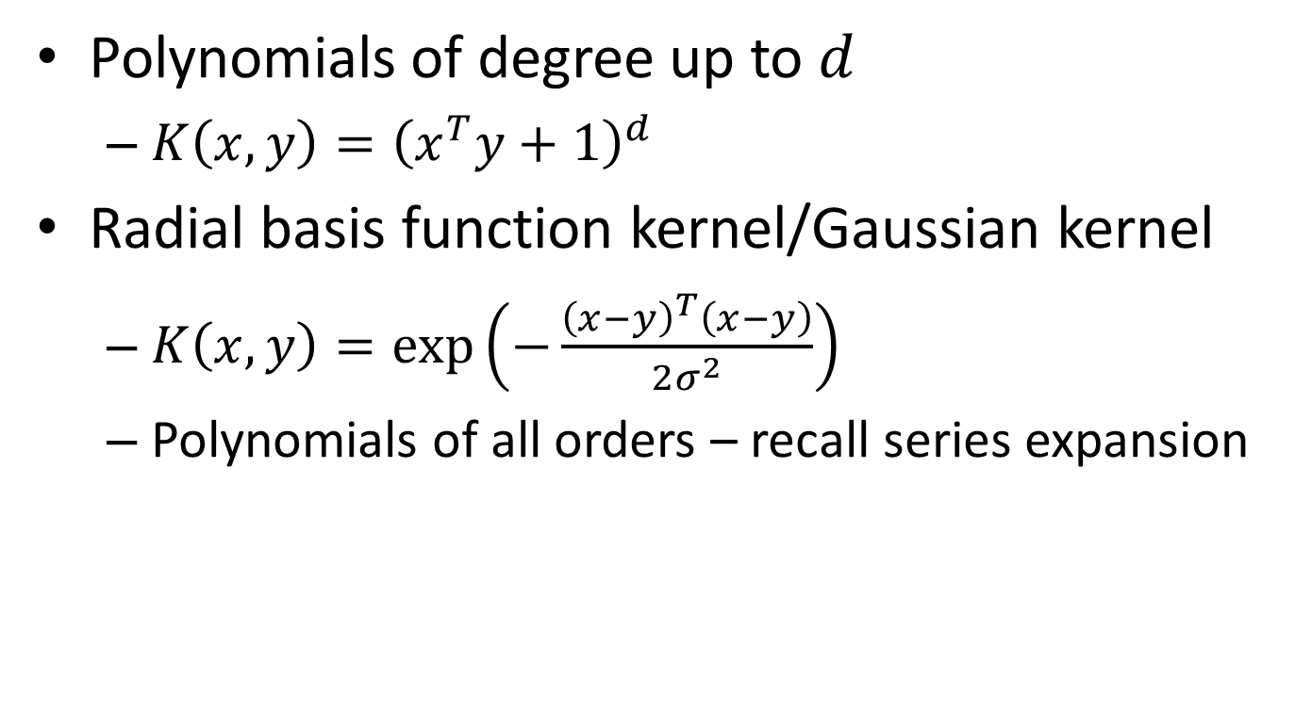
Common kernels
Polynomials of degree up to $d$
$K\left(x,y\right)={\left(x^{T}y+1\right)}^{d}$
Radial basis function kernel/Gaussian kernel
$K\left(x,y\right)=\exp\left(−\frac{{\left(x−y\right)}^{T}\left(x−y\right)}{2σ^{2}}\right)$
Polynomials of all orders – recall series expansion

Slide 48


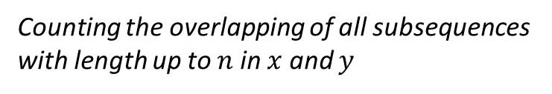


Special kernels for text data
String kernel
$x$ and $y$ are two text sequences
$K\left(x,y\right)=\sum_{n}{\sum_{u∈A^{n}}{\sum_{i:u=x[i]}{\sum_{j:u=y[j]}{1}}} }$
where A is an finite alphabet of symbols
N-gram kernel (length n substrings)
All character sequence of length $n$
All occurrences of sequence $u$ in $y$
All occurrences of sequence $u$ in $x$
Insight of string kernel:
Counting the overlapping of all subsequences with length up to $n$ in $x$ and $y$
Lodhi, Huma, et al. "Text classification using string kernels." The Journal of Machine Learning Research 2 (2002): 419-444.

Slide 49
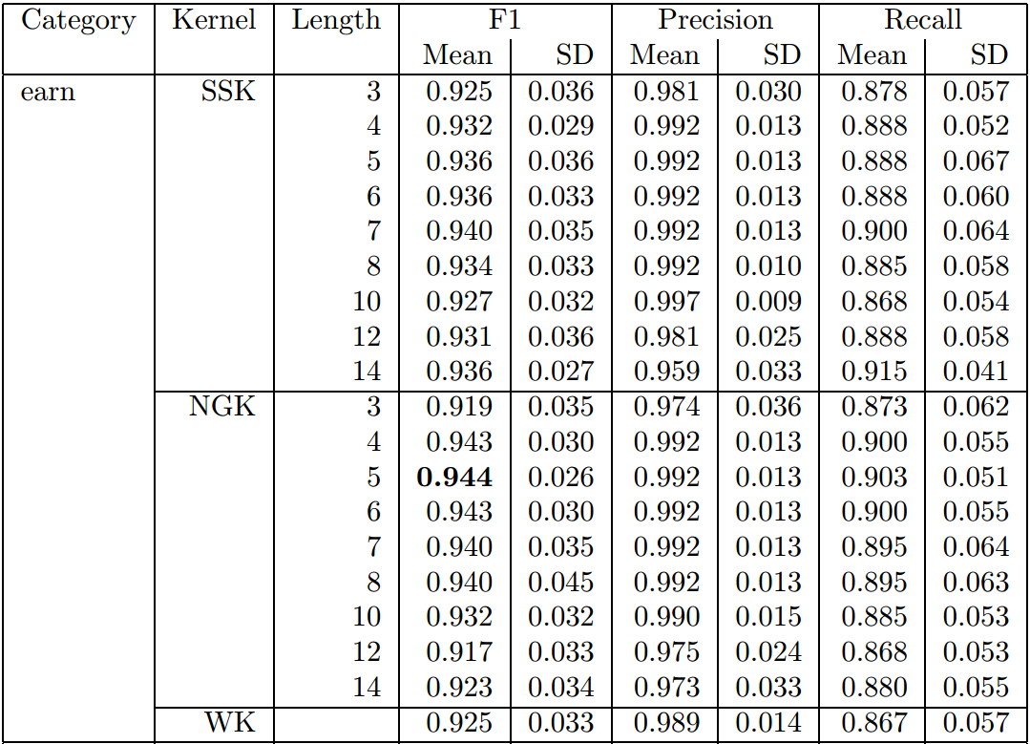
Special kernels for text data
String kernel v.s. Ngram kernel v.s. word kernel
SVM classification performance on Reuters categories

Slide 50
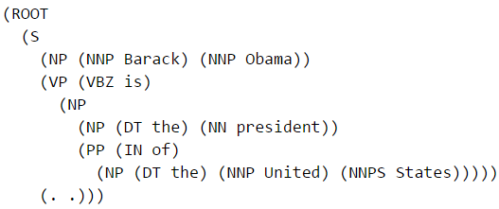

Special kernels for text data
Tree kernel
Similar?
Barack Obama is the president of the United States.
Elon Musk is the CEO of Tesla Motors.
Almost identical in their dependency parsing tree!

Slide 51



Special kernels for text data
Can be relaxed to allow subsequent computation under unlatching nodes
Tree kernel
$K\left(x,y\right)=\left\{\begin{aligned}0 \\ 1+K\left(x[r_{1}],y[r_{2}]\right)\end{aligned}\right.$
If $r_{1}=r_{2}$
otherwise
Search through all the sub-trees starting from root node $r$
Culotta, Aron, and Jeffrey Sorensen. "Dependency tree kernels for relation extraction." Proceedings of the ACL. P423-429, 2004.

Slide 52


Special kernels for text data
Can be relaxed to allow subsequent computation under unlatching nodes
Tree kernel
$K\left(x,y\right)=\left\{\begin{aligned}0 \\ 1+K\left(x[r_{1}],y[r_{2}]\right)\end{aligned}\right.$
If $r_{1}=r_{2}$
otherwise
Search through all the sub-trees starting from root node $r$
Relation classification performance

Slide 53
Popular implementations
General SVM
SVM^{light} (http://svmlight.joachims.org)
libSVM (http://www.csie.ntu.edu.tw/~cjlin/libsvm)
SVM classification and regression
Various types of kernels

Slide 54
Popular implementations
Linear SVM
LIBLINEAR (http://www.csie.ntu.edu.tw/~cjlin/liblinear)
Just for linear kernel SVM (also logistic regression)
Efficient optimization by dual coordinate descent

Slide 55

Popular implementations
LIBLINEAR v.s. general SVM
Fan, Rong-En, et al. "LIBLINEAR: A library for large linear classification." The Journal of Machine Learning Research 9 (2008): 1871-1874.

Slide 56
What you should know
The idea of max margin
Support vector machines
Linearly separable v.s. non-separable cases
Slack variable and dual form
Kernel method
Different types of kernels
Popular implementations of SVM

Slide 57
Today’s reading
Introduction to Information Retrieval
Chapter 15: Support vector machines and machine learning on documents
Chapter 14: Vector space classification
14.4 Linear versus nonlinear classifiers
14.5 Classification with more than two classes

