Slide 1
Mining the Peanut Gallery: Opinion Extraction and Semantic Classification of Product Reviews K. Dave et al, WWW 2003, 1480+ citations
Presented by
Sarah Masud Preum
April 14, 2015

Slide 2

Peanut gallery?
General audience response
From amazon, e-bay, C|Net, IMDB
About products, books, movies
Notes:
peanut gallery used to be a nickname for the cheapest (and ostensibly rowdiest) seats in the theater.
The least expensive snack served at the theatre would often be peanuts, which the patrons would sometimes throw at the performers on stage to show their disapproval.

Slide 3
Motivation: Why mine peanut gallery?
Get an overall sense of product review automatically
Is it good/bad? (product sentiment)
Why it is good/bad? (product features: price, delivery time, comfort)
Solution
Filtering: find the reviews
Classification: positive or negative
Separation: identify and rate specific attributes

Slide 4
Related works
Objectivity classification: Separate reviews from other contents
Best features: Relative frequency of POS in a doc [Finn 02]
Word classification: Polarity & intensity
Colocation [Turney & Littman 02] [Lin 98, Pereira 93]
Sentiment classification
Classify movie review: different domain, larger review [Pang 2002]
Commercial opinion mining tools: template based models [Satoshi 2002, Terveen 1997]
Notes:
In the perspective of the paper, may be there are more advanced works that were done after it was published
Rel. freq: better than bag-of-words

Slide 5
Goals: Build a classifier and classify unknown reviews
Semantic classification: given some review, are they positive / negative?
Opinion extraction: identify and classify review sentences from web (by using semantic classification)
Notes:
Application oriented paper, does not involve heavy theory
Use combination of existing approaches to solve an important problem
Mostly reports results from Cnet data set.

Slide 6
Approach: Feature selection
Substitution to generalize
numbers, product names, product type-specific words and low frequency words to some common tokens
Use synsets from WordNet
Stemming and negation
N-grams and proximity*: Tri-grams outperforms the rests
Substring (n-gram): using Church’s suffix array algorithm
Thesholds on frequency counting: limit number of features
Smoothing: address the unseen (add-one smoothing)
Notes:
*NEAR operator by putting together words that occur within words n of each other in to a single feature

Slide 7
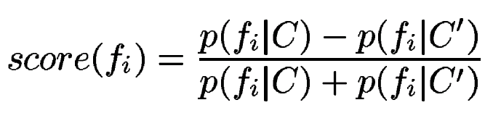
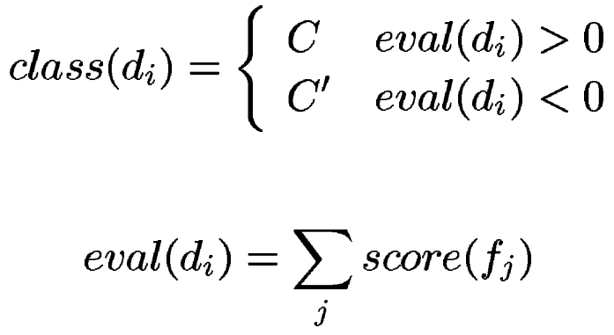
Approach: Feature scoring & classification
Give each feature a score ranging –1 to 1
C and C' are the sets of positive and negative reviews
Score of an unknown document = sum of scores of the words [Sign as the class]
Notes:
P(fi|C): normalized term frequency by taking the number of times a feature fi occurs in C and dividing it by the total number of tokens in C
..but they didn't show significant improvements over the baseline.

Slide 8
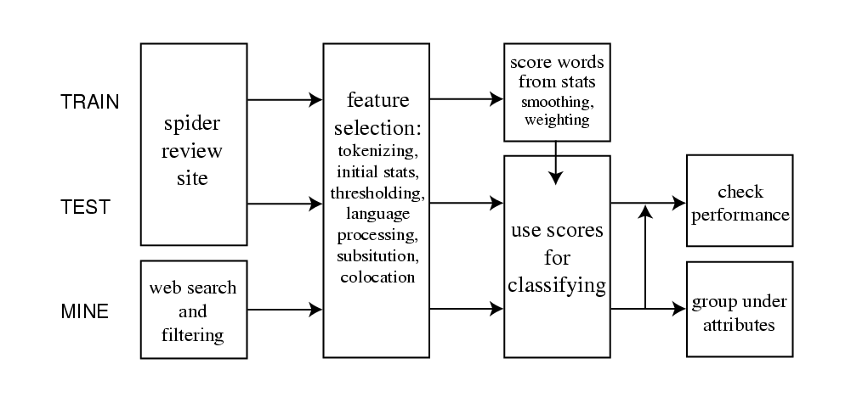
Approach: System architecture and flow
Corpus from Amazon and CNet
Labeled data
Notes:
Use a table here

Slide 9
Approach: System architecture and flow

Slide 10
Approach: System architecture and flow

Slide 11
Evaluation:
Baseline: Unigram model
Use review data from Amazon and C|Net
Test | No of sets/ folds | No of product category | Positive: negative
Test 1 | 7 | 7 | 5:1
Test 2 | 10 | 4 | 1:1

Slide 12
Summary of Results
88.5% accuracy for test set 1 and 86% accuracy for test 2
Extraction on web data: at most 76% accuracy
Use of WordNet not useful
explosion in feature size and more noise than signal
Use of stemming, colocation, negation: not quite useful
Trigrams performed better than bigram
The use of lower order n-grams for smoothing didn't improve the results
Notes:
Gaussian weighting scheme, Where weights decrease polynomially with distance from a certain
Mean frequency. This decreases the importance of both infrequent
And too-frequent terms. Though the mean and variance must be
Picked arbitrarily (since the actual frequencies are in a Zipf distribution),some of the parameters we tried seemed to work

Slide 13
Summary of Results
Naive Bayes classifier with Laplace smoothing outperformed the ML approaches:
SVM, EM, Maximum entropy
Various scoring methods: no significant improvement
odds ratio, Fisher discriminant, information gain
Gaussian weighing scheme : marginally better than other weighing schemes (log, sqrt, inverse, etc.)
Notes:
Gaussian weighting scheme, Where weights decrease polynomially with distance from a certain
Mean frequency. This decreases the importance of both infrequent
And too-frequent terms. Though the mean and variance must be
Picked arbitrarily (since the actual frequencies are in a Zipf distribution),some of the parameters we tried seemed to work

Slide 14
Discussion: domain specific challenges
Inconsistent rating: Users sometimes give a 1 star instead of 5 due to misunderstanding the rating system.
Ambivalence: “The only problem is…”;
Lack of semantic understanding
Sparse data: Most of the reviews are very short, unique words→ Zipf’s law, more than 2/3 words appear in less than 3 documents
Skewed distribution:
Predominant +ve reviews
Some products have so many +ve reviews that they are listed as +ve feature: “camera”

Slide 15
Future Works
Larger, more finely-tagged corpus
Increase efficiency: run-time + memory
Regularization to avoid over-fitting
Customized features for extraction

Slide 16
Lessons learned
Conduct tests using larger number of sets (volume and variety of data): address variability of unseen test data
There is no short-cut to success: combination of parameters (e.g., scoring metric, threshold values, n-gram variation, smoothing methods)
Unsuccessful experiments often lead to useful insights: pointer to future work
Select performance according to end goal: results for various metrics and heuristics vary depending on the testing situation

Slide 17
References:
Church’s suffix tree: http://www.cs.jhu.edu/~kchurch/wwwfiles/CL_suffix_array.pdf
Pang, B., L. Lee, and S. Vaithyanathan. 2002. Thumbs up?: sentiment classification using machine learning techniques. In Proceedings of the ACL-02 conference on Empirical methods in natural language processing-Volume 10, 79–86.
Turney, P. D. 2002. Thumbs up or thumbs down? Semantic orientation applied to unsupervised classification of reviews. In Proceedings of the 40th annual meeting of the Association for Computational Linguistics, 417–424.

Slide 18
Thanks!

Slide 19
Back ups:
How to identify product reviews in a webpage: set of heuristics to discard some pages, paragraphs that are unlikely to be review

Slide 20
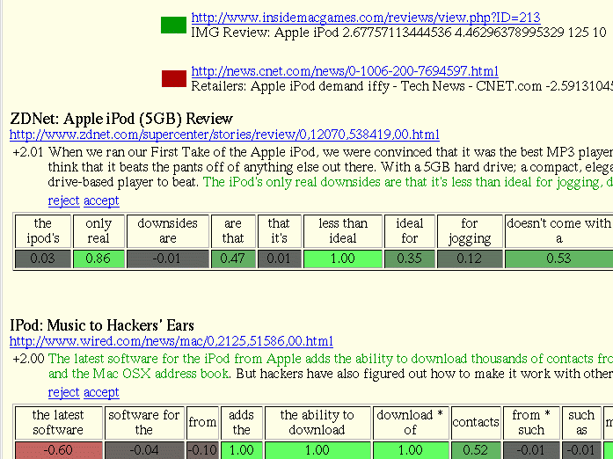

Slide 21
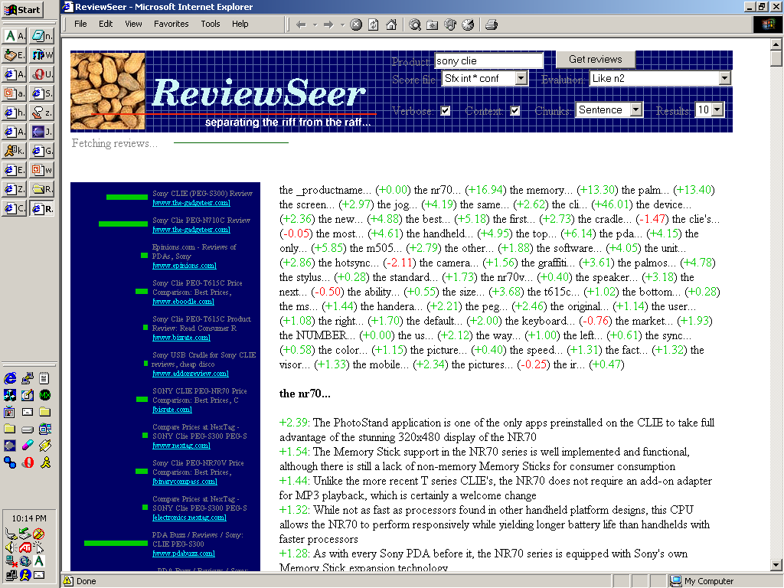

Slide 22
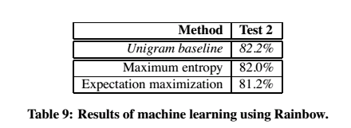
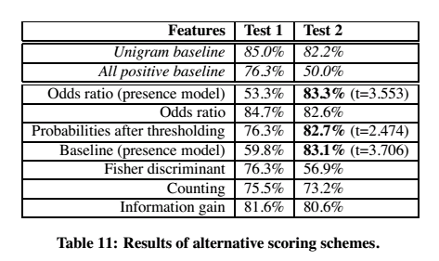
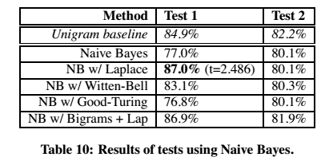
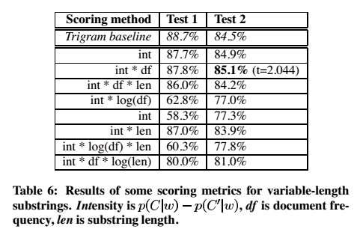

Slide 23
