Slide 1
Feeler: Emotion Classification of Text Using Vector Space Model
Presenter: Asif Salekin

Slide 2

Sentiment Analysis
Sentiment=feelings
Emotions
Opinions

Slide 3






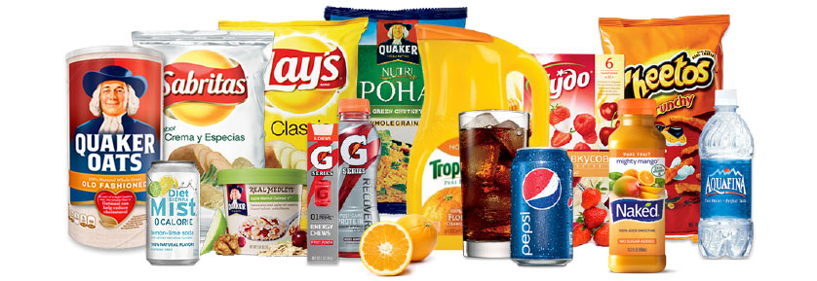
Opinion mining

Slide 4

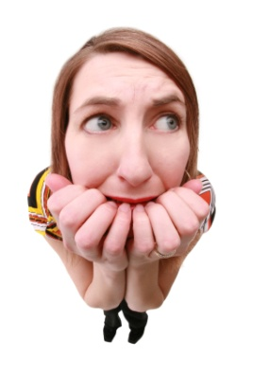


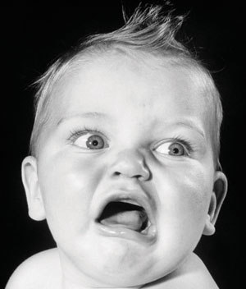
Emotion analysis
Primary Emotions:
Secondary Emotions:
appear after primary emotions.
-> Emotion analysis limited to primary emotions

Slide 5
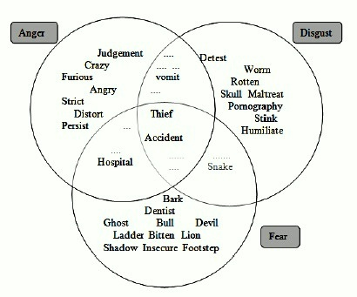
Does words indicate emotions?
Words
Specific to Disgust
Words
Specific to Anger
Words
Specific to Fear

Slide 6
Vector Space model
Document
Query
Cosine similarity

Slide 7

Document
D_{i}=(w_{1i},w_{2i},…..,w_{ni})
W_{ki}=
N number of term in document
Idf_{w}=log(N/n_{w})
N total number of document in dataset
n_{w} number of document containing the word

Slide 8
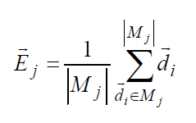
Emotion Model Vector
For each emotion j:
M_{j} ={d₁,d₂,d₃,….,d_{c}}
M_{j} set of documents with Emotion J

Slide 9


Similarity
Most
similar
Model vector for Joy
Model vector for Anger
Model vector for disgust
Model vector for Sad
Model vector for fear
Document vector
Q: test document, E_{j} emotion j model vector

Slide 10
Dataset
ISEAR
7666 sentences
Valance value
Example: What a nice day!!
Valance Values: Joy: 40 Anger -20 Sad -20 Disgust: -40 fear: -30
Wordnet-affect
WPARD
Emotional words

Slide 11
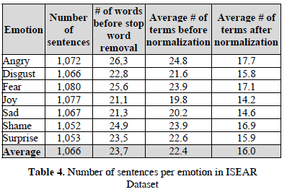
Pre-Precessing
Some Stop words contain emotions
Example: very, not
Some entry are
incomplete

Slide 12
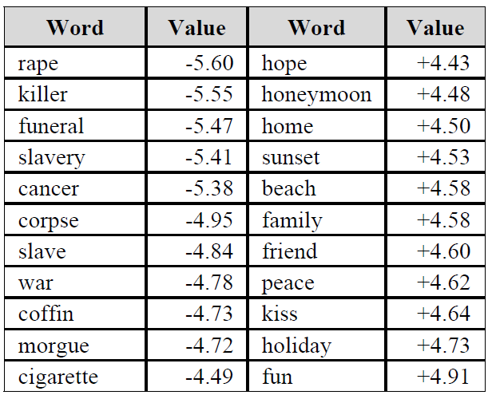
Add data for high intensive emotion
WPARD and WordNet-affects (polarity dataset)
Example pseudo sentence:
Fun fun fun fun fun fun fun fun fun
fun fun fun fun fun fun fun
Coffin coffin coffin coffin coffin
coffin coffin coffin coffin coffin
coffin coffin coffin coffin coffin
coffin

Slide 13
Label data (ISEAR)
Valance value
Sentence
Joy +N₁, Anger –N₂, Sad –N₃, Fear –N₄, Disgust – N₅
I am too happy
Joy: +80 ,anger: -70 ,Sad: -50 ,Fear: -60 ,Disgust :-40
I am fine
Joy: +40 ,anger: -50 ,Sad: -40 ,Fear: -10 ,Disgust :-10
Threshold for joy: 50
Threshold for joy: 30
Joy
Not Joy
Joy

Slide 14
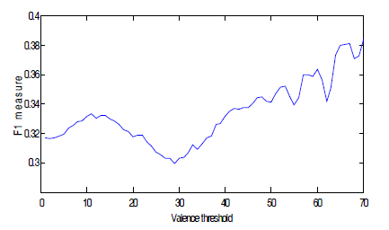
Experiment 1

Slide 15

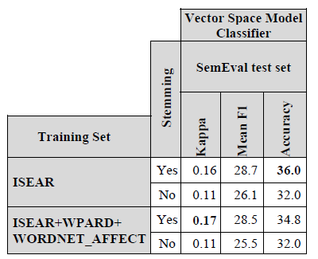

Experiment 2
Effect of stemmer
Conflict: Marry:
Marry
Married:

Slide 16
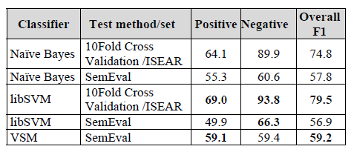
Experiment 3
Positive: Joy
Negative: anger, disgust, fear, sad

Slide 17
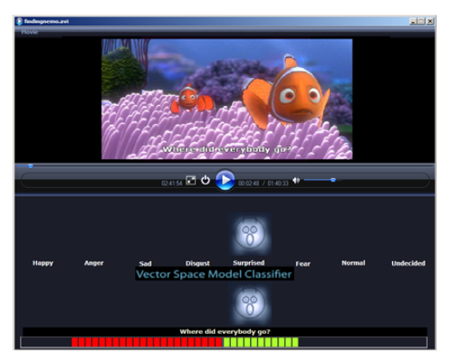
Implementation

Slide 18
Question?

