Slide 1
Robotic Printer Development Plan
Date: 03-Jun-2019
Version: 1.0

Slide 2
Contents
Milestones & Deliverables summary
Milestone 1 Description
Laser based Distance Measurement PoC Approach
Milestone 2 Description
Laser Beacon Unit Integration
Corner Marking & Layout Squaring Approach
Milestone 3 Description
XY Gantry system with Mecanum Wheels, Linear Actuators
Milestone 4 Description
XY Gantry with Printing Head Added
Printing Robot Covered with Enclosure
Milestone 5 Description
Fully Functional Priniting Robot
BoM Procurement Plan

Slide 3
Milestones, Effort & Deliverables Summary
Milestone
Description
Target
Date
Effort (PersonHours)
Deliverable & Features
Milestone
Cummulative
M1
Laser based distance measurement PoC
10-Jun-19
220
220
Laser distance measurement confidence building PoC
M2
Corner marking & squaring subsystem PoC
15-Aug-19
654
874
Corner marking & squaring subsystem
Mark the four corners of the layout
Square the layout
Distance measurement
Corner devices with laser line markimg
M3
XY-gantry customization for wheels & printing head subsystem
29-Aug-19
1562
2436
Customized XY-gantry for layout printing
Gantry (3'x2') with mecanum wheels
Gantry with mobility control
Distance measurement capability
Printing head fixing mechanism
M4
Printing head subsystem integration with XY-gantry
04-Nov-19
2662
5098
Printing robot subsystem
Printing head attached to the gantry
Print the given small test prints
Basic user interface to load plans
M5
System integration – Final printing robot with layout navigation
20-Dec-19
2952
8050
Fully functional printing robot
Print the layout in segemented form
Internet connectivity through GSM
Web based user interface
Performance metrics to the cloud
Notes:

Slide 4
Milestone M1
Laser based Distance Measurement PoC
Objectives:
Test the measurement accuracy, resolution, range & speed of the laser unit
Material Requirement:
Laser measuring units: 2 units (India), 1 unit (US)
nRF52840 MCU: 2 units (India), 1 unit (US)
Reflectors: 2 units (India), 1 unit (US)
Rechargeable Battery packs: 2 units (India), 1 unit (US)
Tasks:
Program MCU to receive commands from mobile app
Program MCU to trigger measurement on receiving command
MCU to send the measured distance value to mobile app over BT terminal
Perform measurement, tabulate the results and generate report
Deliverable:
Laser based distance measurement performance report

Slide 5
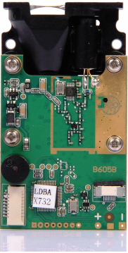
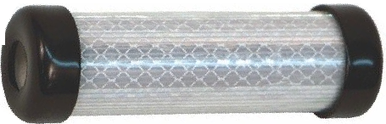
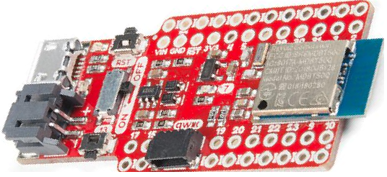
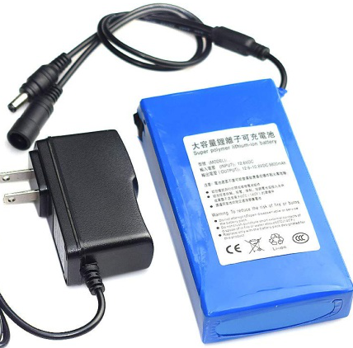
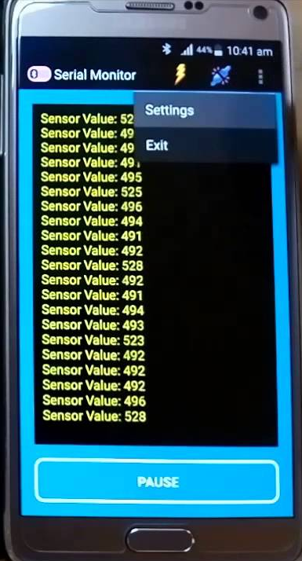
Laser based Distance Measurement PoC Approach
Step1:
Reflector @3' dist.
Measure with laser
Step2:
Reflector @50' dist.
Measure with laser
Step3:
Reflector @120' dist.
Measure with laser
...
StepN:
Reflector @500' dist.
Measure with laser
Measurement Laser
BT MCU Board
Battery Pack
3' 50' 120' ... 500' ...

Slide 6
Milestone M2
Corner Marking & Layout Squaring Subsystem PoC
Objectives:
Laser beacon with distance measurement laser, laser reflector, base plate.
Mobile robotic platform with mecanum wheels for marking corner points.
Corner marking & squaring subsystem.
Material Requirement:
Laser measuring units: 6 units (India), 2 units (US)
nRF52840 MCU: 6 units (India), 2 units (US)
Reflectors: 6 units (India), 2 units (US)
Stepper motors with drives: 6 units (India), 2 units (US)
Rechargeable Battery packs: 6 units (India), 2 units (US)
Compass Q2 mobile platform: 3 units (India)
Tasks:
Integrate mechanical, electronics hardware & software into laser beacon
Mount laser beacon on mobile platform for corner marking
Perform corner marking & squaring experiment and performance evaluation
Deliverable:
Corner marking & layout squaring subsystem with laser beacons

Slide 7
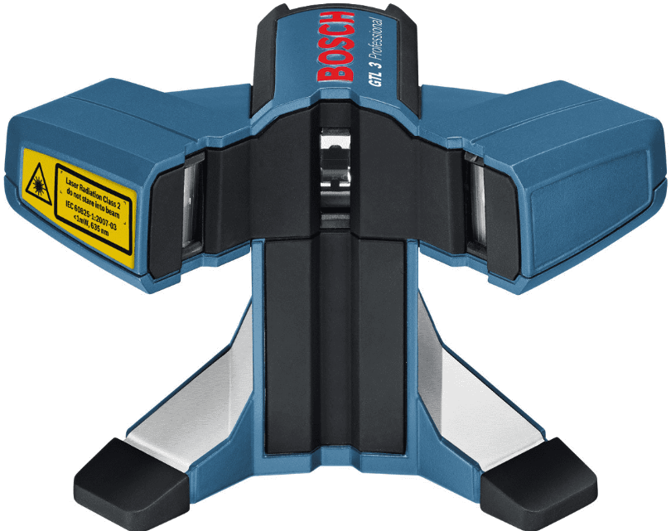
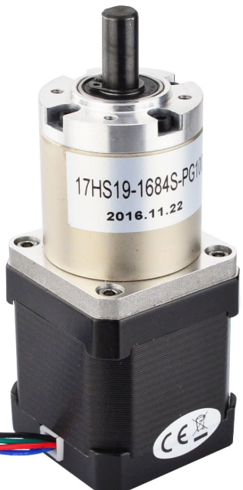
Laser Beacon Unit
(Measurement & Tracking Laser, Snapline laser & Reflector)
Parts of Laser Beacon
Laser Beacon
Laser Reflector
Measurement Laser
Line Laser
Stepper Motor
Integrated as
Laser Beacon
In a proper housing
Battery
Bluetooth MCU Board
Battery
Base Plate
MCU Board

Slide 8
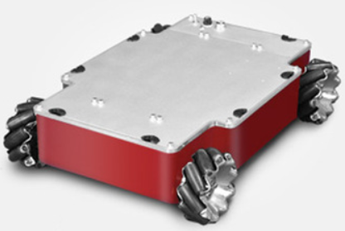
Corner Marking & Squaring Approach
Step1:
Manually place a laser beacon at 1st corner of the layout
Step2:
Place the robot at 2nd corner
Instruct it to measure width and mark the 2nd corner point
Place one laser beacon at the 2nd corner point
Step3:
Robot will move automatically to 3rd corner
Mark the 3rd corner point as shown by robot
Place one laser beacon at the 3rd corner point
Step4:
Robot will move automatically to 4th corner
Mark the 4th corner point as shown by robot
Place one laser beacon at the 4th corner point
Corner marking & squaring of the layout
after completion

Slide 9
Milestone M3
XY Gantry Customization for Wheels & Printing Head
Objectives:
Customized mechanical fixtures for mounting mecanum. wheels, printing head, liner belt drives and laser beacon on the XY gantry.
Material Requirement:
XY gantry with linear actuators: 2 units (India)
Xaar128 printing head & assembly unit: 4 units (India)
Windows tablet PCs: 1 units (India)
Tasks:
Integrate mechanical hardware into mobile robotic platform
Develop mobile platform & printing head mobility control software
Integrate software into cusmozed gantry system
Test mobility control by dry run and performance evaluation
Deliverable:
Robotic mobile platform with printing head mobility control
(Cannot perform any printing job)

Slide 10
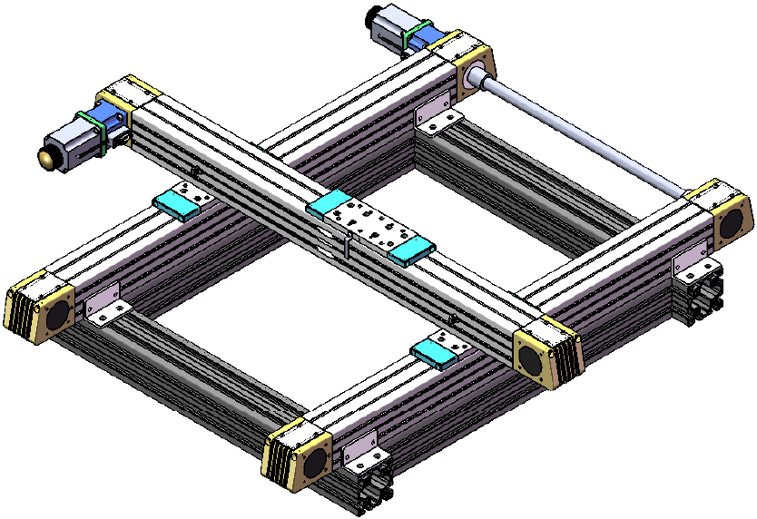
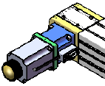
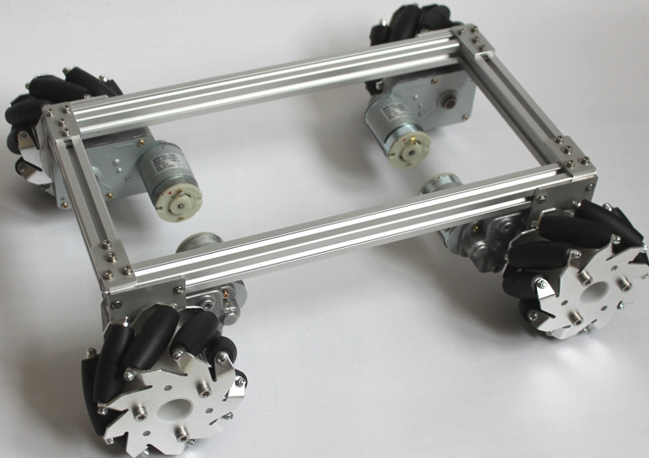

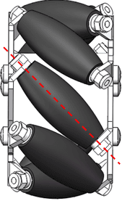
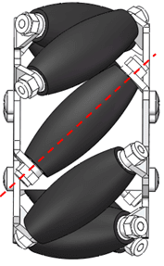
XY Gantry System with Mecanum Wheels & Linear Actuators
XY Gantry
XY Gantry with Mecanum Wheels
&
Linear Actuators
Mecanum Wheels

Slide 11
Milestone M4
Printing Subsystem Integration with Gantry
Objectives:
Mobile robotic platform with printing subsystem & internet connectivity
Material Requirement:
SIM900A GSM Module: 2 units (India)
IMU (MPU9250) Module: 6 units (India)
Tasks:
Develop software for
  GUI
  Navigating the robot, positioning the print head to the desired location
  Conversion of layout (.dwg) files to printer friendly format
  Logging of all activities to the logfile.
  Obstacles detection, avoiding and log info to server
Integrate software
Perform testing with test prints & evaluate performance
Deliverable:
Robotic mobile platform with printing head mobility control
(Can perform simple test print jobs)
Test printing performance report

Slide 12
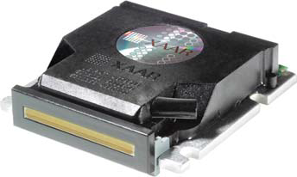
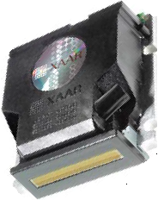
XY Gantry System with Mecanum Wheels, Linear Actuators & Printing Head
Xaar128 Print Head
XY Gantry With
Mecanum Wheels, Linear Actuators
&
Printing Head

Slide 13
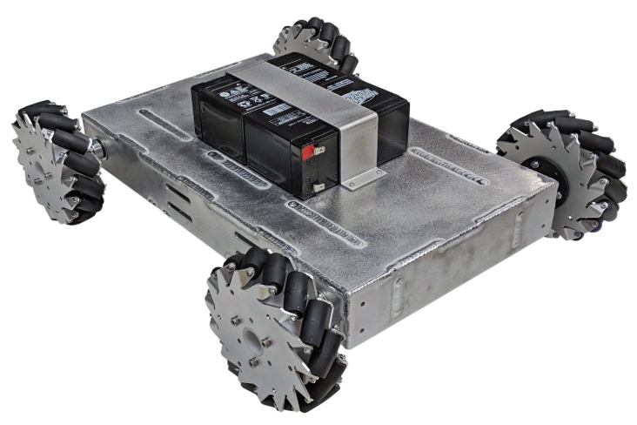
Integrated Robotic Printer System

Slide 14
Milestone M5
System Integration – Functional Printing Robot
Objectives:
Fully functional printing robot with layout navigation
Material Requirement:
Any miscellaneous items
Tasks:
Develop software for
  Loading layout plan from server
  Printing on the floor autonomously
  Estimate performance & log performance metrics to server
  Identify obstacles positions and update building plan
  System health monitoring & sending alerts
Integrate software
Perform printing tests with true layout plans & evaluate performance
Prepare user manual document
Deliverable:
Fully functional printing robot (Can perform full-fledged print jobs)
User manual documents & performance reports

Slide 15
Robotic Printer Functional System
Print Head

Slide 16
BoM Procurement Plan
S# | Item | Sourcce | Total Qty. | Qty. For India Team | Qty. For US Team | Required By Date | Milestone
1 | B707C laser device | https://www.alibaba.com/trade/search? fsb=y&IndexArea=product_en&CatId=190403&SearchText=707c | 3 | 2 | 1 | 7-Jun-19 | M1
2 | Laser reflector | https://www.amazon.com/LASER-REFLECTOR/dp/B0741V5WCY/ref=pd_rhf_dp_p_img_7? _encoding=UTF8&refRID=GEK0SSTQJTR4QE2AKVZB | 3 | 2 | 1
3 | Pro nRF52840 Mini Bluetooth Module | https://www.sparkfun.com/products/15025 | 3 | 2 | 1
4 | Rechargeable battery pack | https://www.amazon.com/Polymer-Rechargeable-20000mAh-Lithium-ion- DC122000/dp/B074MQ1Q3V/ref=sr_1_8? keywords=lithium+ion+battery+12v&qid=1556214325&s=gateway&sr=8-8ay&sr=8-6 | 3 | 2 | 1
5 | Pro nRF52840 Mini Bluetooth Module | https://www.sparkfun.com/products/15025 | 8 | 6 | 2 | 30-Jun-19 | M2
6 | B707C laser device | https://www.alibaba.com/trade/search? fsb=y&IndexArea=product_en&CatId=190403&SearchText=707c | 8 | 6 | 2
7 | Stepper motor (17HS19-1684S-PG100) | Torque/dp/B00QEWAL98/ref=pd_rhf_dp_p_img_5? _encoding=UTF8&psc=1&refRID=GEK0SSTQJTR4QE2AKVZB | 8 | 6 | 2
8 | Stepper motor driver (Tb6600) | https://www.amazon.com/Stepper-WAM-Direct-Controller-Segments/dp/B07DPMMFT6/ref=sr_1_15? crid=32PYVN66QR65H&keywords=tb6600+stepper+motor+driver&qid=1559220932&s=gateway&spr efix=tb6600%2Caps%2C336&sr=8-15 | 12 | 9 | 3
9 | 5mm flange shaft couplings | https://www.amazon.com/Coupling-Support-Hardness-Fittings- Connector/dp/B07L1FMBBC/ref=sr_1_3? crid=1ZP91GJPTZRFP&keywords=5mm+flange+shaft+coupling&qid=1559223563&s=gateway&spref ix=5mm+flange%2Caps%2C322&sr=8-3 | 12 | 9 | 3
10 | Compass Q2 robotic chassis | https://www.alibaba.com/product-detail/20kg-payload-Compass-Q2-industry- AUTO_60753270152.html?spm=a2700.7724838.2017115.13.14b13804p9NfyP | 3 | 3
11 | Cross line laser (VLM-650-29 LPT) | https://www.amazon.com/VLM-650-29-LPT-Line-width-optimizedistance/ dp/B00BP42YMW/ref=pd_rhf_dp_p_img_9? _encoding=UTF8&psc=1&refRID=XABZ6FPETERG1ZTJFKT3 | 3 | 3
12 | Rechargeable battery pack | https://www.amazon.com/Polymer-Rechargeable-20000mAh-Lithium-ion- DC122000/dp/B074MQ1Q3V/ref=sr_1_8? keywords=lithium+ion+battery+12v&qid=1556214325&s=gateway&sr=8-8ay&sr=8-6 | 8 | 6 | 2
13 | 12V to 5V regulator | https://www.amazon.com/EPBOWPT-Converter-Regulator-Supply- Transformer/dp/B01M03288J/ref=sr_1_2_sspa? keywords=12v+to+5v+regulator&qid=1559228291&s=gateway&sr=8-2- spons&psc=1&smid=A3GYM455B71YGR | 12 | 9 | 3
14 | Xaar128 print head | https://www.miamisignssupply.com/product/xaar-printhead-128-80pl-4-2khz-nw-128200/ | 4 | 4 |  | 31-Jul-19 | M3
15 | Xaar128 print head control electronics | To be custom built | 2 | 2
16 | XY gantry | In discussions with www.bjwn.cn/ www.winneroptics.com | 2 | 2
17 | SIM900A GSM module | https://www.amazon.com/Asiawill-SIM900A-Wireless-Transmission- Antenna/dp/B07S9FF7M4/ref=sr_1_5? crid=NL2OHAL8Q3FF&keywords=sim900a+gsm+module&qid=1559233309&s=gateway&sprefix=sim 900a%2Caps%2C340&sr=8-5 | 2 | 2 |  | 30-Aug-19 | M4
18 | IMU MPU9250 module | https://www.amazon.com/HiLetgo-Gyroscope-Acceleration-Accelerator-Magnetometer/dp/B01I1J0Z7Y/ref=pd_bxgy_328_2/131-8235650-1723505?_encoding=UTF8&pd_rd_i=B01I1J0Z7Y&pd_rd_r=943dd17e-8622-11e9-aff7-7b8b27abc5ce&pd_rd_w=5CMov&pd_rd_wg=5lfPe&pf_rd_p=a2006322-0bc0-4db9-a08e-d168c18ce6f0&pf_rd_r=NNWWCXG0CGZGZVNH3NP4&psc=1&refRID=NNWWCXG0CGZGZVNH3NP4 | 6 | 6
|<End of the Presentation>|

