Slide 1
RISC-V oE自动化测试工具的开发
brsf11
2022.07.12

Slide 2
目录
mugen简介和安装使用
  mugen简介
  mugen的安装、配置和使用
mugen开发
  mugen基本测试原理
  mugen测试开发
RISC-V oE自动化测试工具开发的工作和计划

Slide 3
mugen简介
mugen是什么
  mugen是openEuler社区开放的测试框架
  mugen提供了
    丰富的openEuler测试代码
    一套编写测试代码的规范
    辅助编写测试的函数库
    一个能简化测试执行过程的执行程序

Slide 4
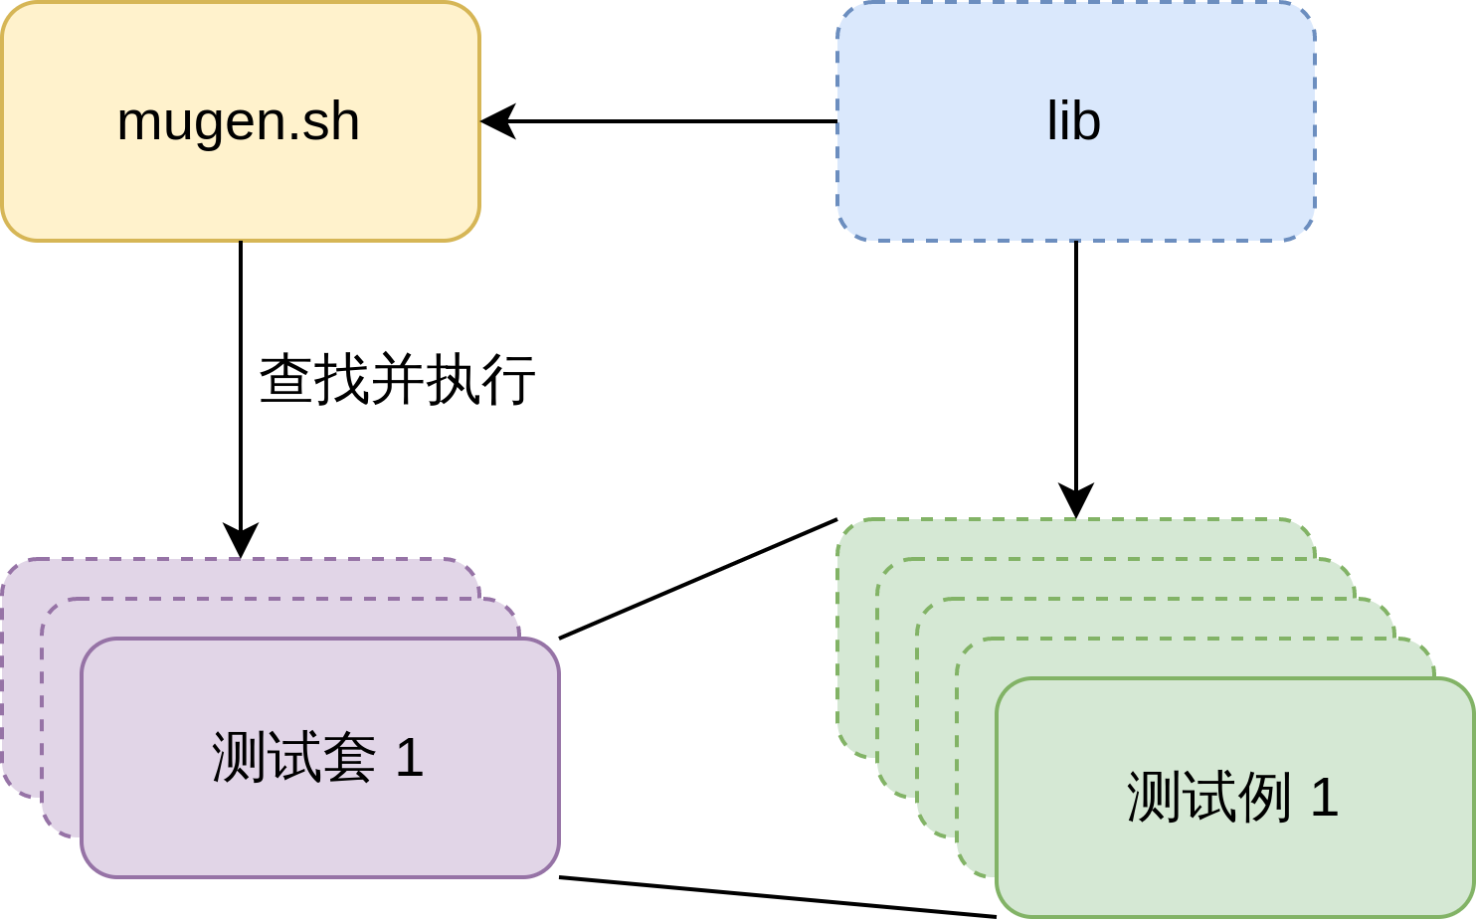
mugen结构

Slide 5
mugen项目的文件结构
根目录下脚本
  dep_install.sh 用于依赖安装
  mugen.sh mugen执行脚本

Slide 6
mugen项目的文件结构
suite2cases 测试套文件
  例如clang.json
{
"path": "$OET_PATH/testcases/cli-test/clang",
"cases": [
{
"name": "oe_test_clang_01"
},
{
"name": "oe_test_clang_02"
},
{
"name": "oe_test_clang_03"
}
]
}

Slide 7
mugen项目的文件结构
testcases 测试例代码
  cli-test
  doc-test
  embedded-test
  feature-test 特性测试
  security-test 安全测试
  smoke-test 冒烟测试
  system-test 系统功能测试
    os-basic
    os-storage
  testsuite 示例

Slide 8
mugen项目的文件结构
libs/locallibs
  mugen本体使用的库
  测试代码用库
  共用库

Slide 9
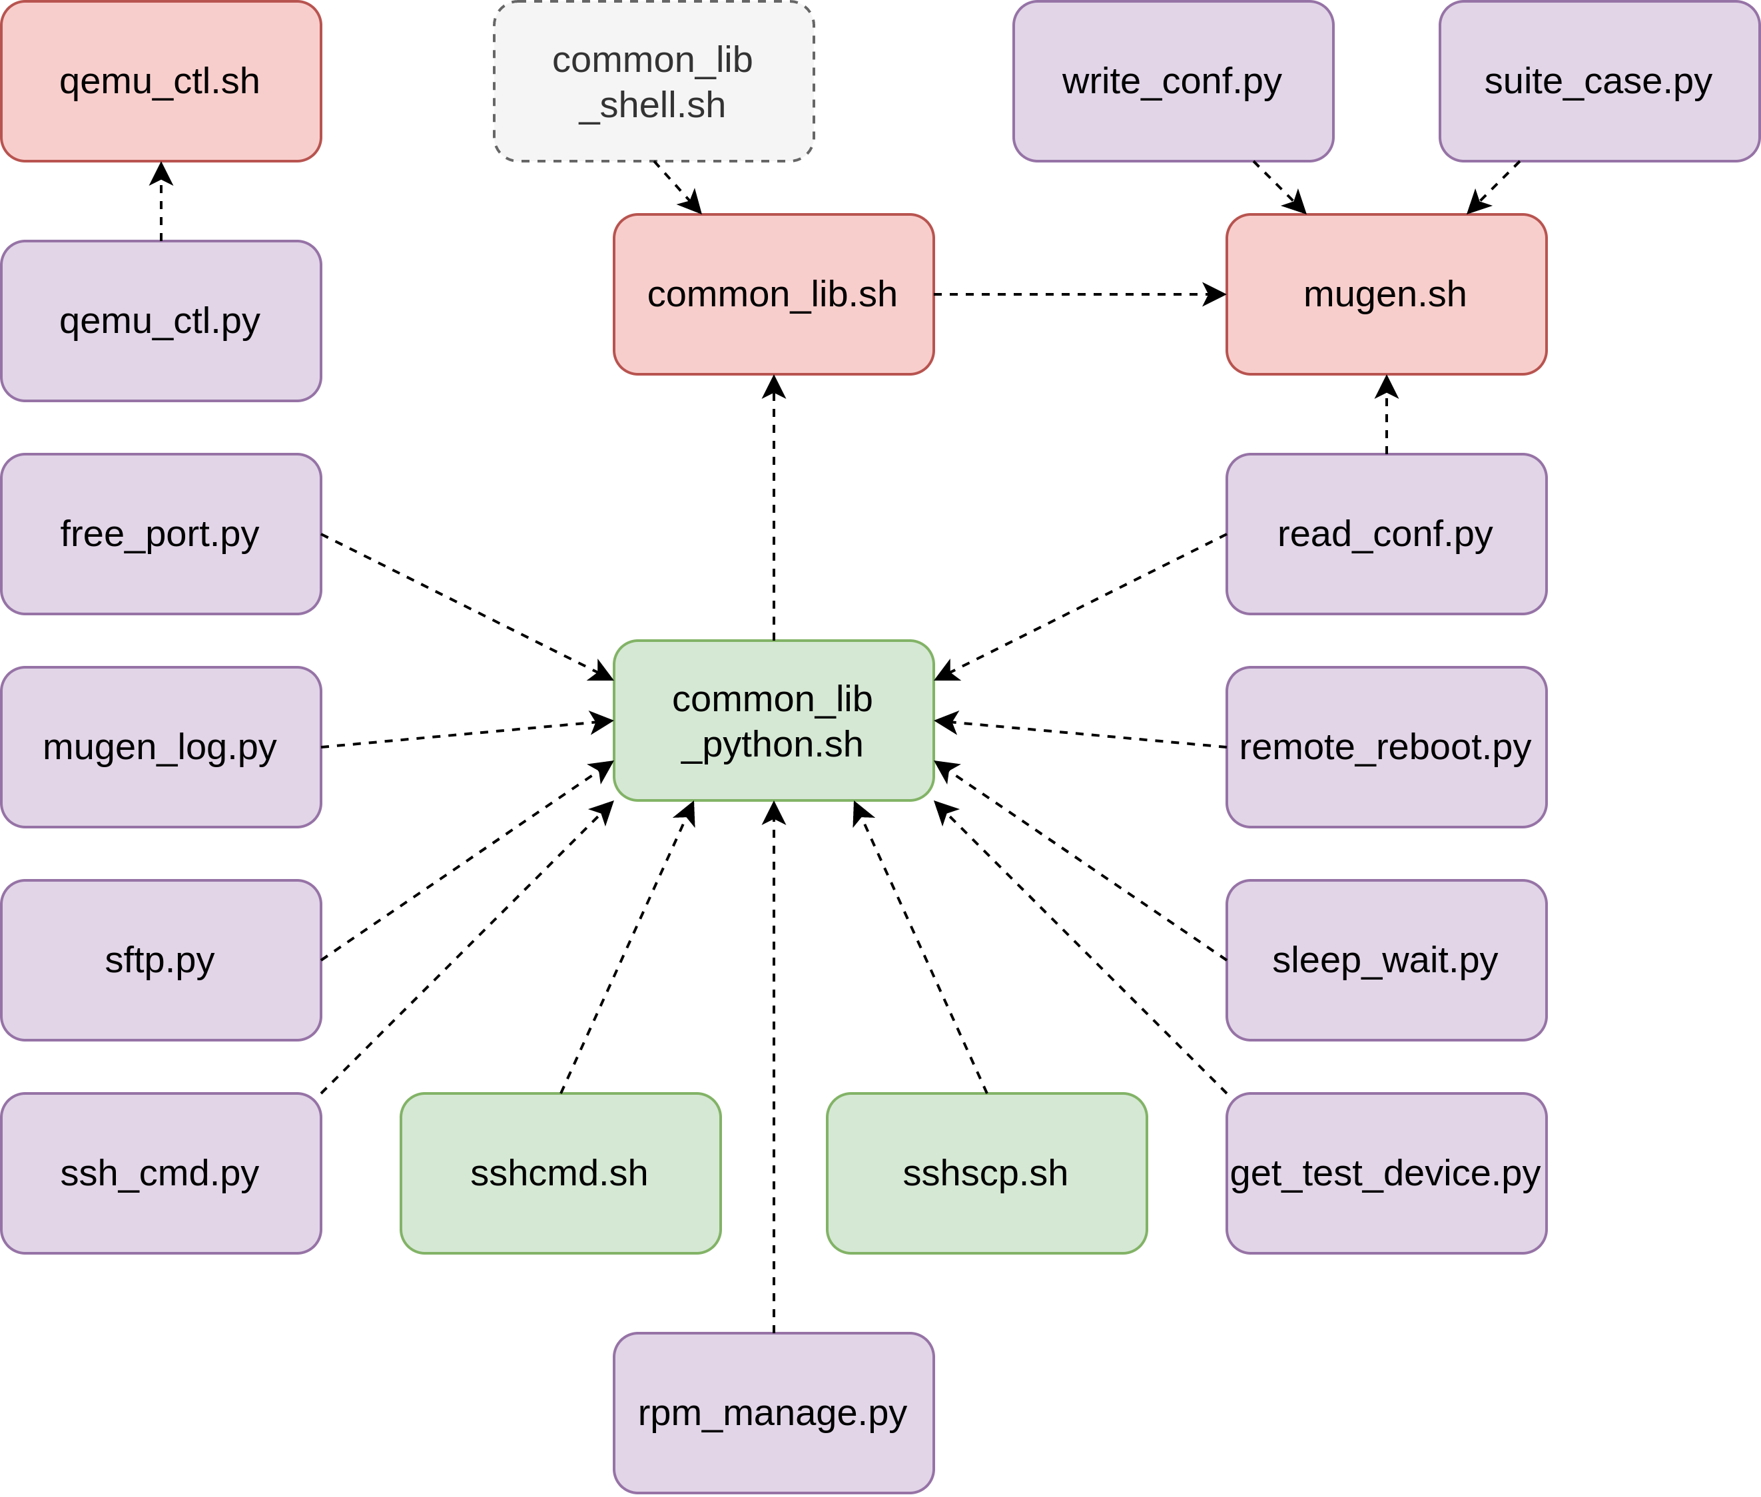
mugen项目的文件结构
库文件和各脚本
的依赖关系

Slide 10
mugen项目的文件结构
doc 测试用例规范，定义了编写测试的要求
License

Slide 11
mugen的安装和配置
安装
配置
git clone https://gitee.com/openeuler/mugen.git
cd mugen
sudo bash dep_install.sh
bash mugen.sh -c --ip 127.0.0.1 --password openEuler12#$ --user root --port 22

Slide 12
mugen的使用
clang
[root@openEuler-riscv64 mugen]# bash mugen.sh -f clang
Mon Jul 11 13:37:31 2022 - INFO - start to run testcase:oe_test_clang_03.
Mon Jul 11 13:38:18 2022 - INFO - The case exit by code 0.
Mon Jul 11 13:38:19 2022 - INFO - End to run testcase:oe_test_clang_03.
Mon Jul 11 13:38:20 2022 - INFO - start to run testcase:oe_test_clang_01.
Mon Jul 11 13:38:46 2022 - INFO - The case exit by code 0.
Mon Jul 11 13:38:47 2022 - INFO - End to run testcase:oe_test_clang_01.
Mon Jul 11 13:38:49 2022 - INFO - start to run testcase:oe_test_clang_02.
Mon Jul 11 13:39:13 2022 - INFO - The case exit by code 0.
Mon Jul 11 13:39:14 2022 - INFO - End to run testcase:oe_test_clang_02.
Mon Jul 11 13:39:15 2022 - INFO - A total of 3 use cases were executed, with 3 successes and 0 failures.

Slide 13
mugen的使用
dnf
[root@openEuler-riscv64 mugen]# bash mugen.sh -f dnf
...
Mon Jul 11 13:46:53 2022 - INFO - start to run testcase:oe_test_dnf_priority.
Mon Jul 11 13:47:13 2022 - ERROR - The case exit by code 2.
Mon Jul 11 13:47:14 2022 - INFO - End to run testcase:oe_test_dnf_priority.
Mon Jul 11 13:47:16 2022 - INFO - start to run testcase:oe_test_dnf_reinstall_repoinfo.
Mon Jul 11 13:50:39 2022 - ERROR - The case exit by code 4.
Mon Jul 11 13:50:40 2022 - INFO - End to run testcase:oe_test_dnf_reinstall_repoinfo.
Mon Jul 11 13:50:41 2022 - INFO - start to run testcase:oe_test_dnf_all-repos.
Mon Jul 11 13:51:29 2022 - ERROR - The case exit by code 6.
Mon Jul 11 13:51:29 2022 - INFO - End to run testcase:oe_test_dnf_all-repos.
...
Mon Jul 11 14:12:46 2022 - INFO - A total of 22 use cases were executed, with 11 successes and 11 failures.

Slide 14
mugen的使用
日志文件 logs/dnf/oe_test_dnf_all-repos/2022-07-12-00:29:34.log
Tue Jul 12 00:29:37 2022 - INFO - Start to run test.
Error: Unknown repo: 'OS'
Error: Unknown repo: 'everything'
Error: Unknown repo: 'EPOL'
Error: Unknown repo: 'debuginfo'
源配置
# just for test
[mainline]
name=mainline
baseurl=https://mirror.iscas.ac.cn/openeuler-sig-riscv/openEuler-RISC-V/testing>
enabled=1
gpgcheck=0
# just for test
[epol]
name=epol
baseurl=https://mirror.iscas.ac.cn/openeuler-sig-riscv/openEuler-RISC-V/testing>
enabled=1
gpgcheck=0
[extra]
name=extra
baseurl=https://mirror.iscas.ac.cn/openeuler-sig-riscv/openEuler-RISC-V/testing>
enabled=1
gpgcheck=0

Slide 15
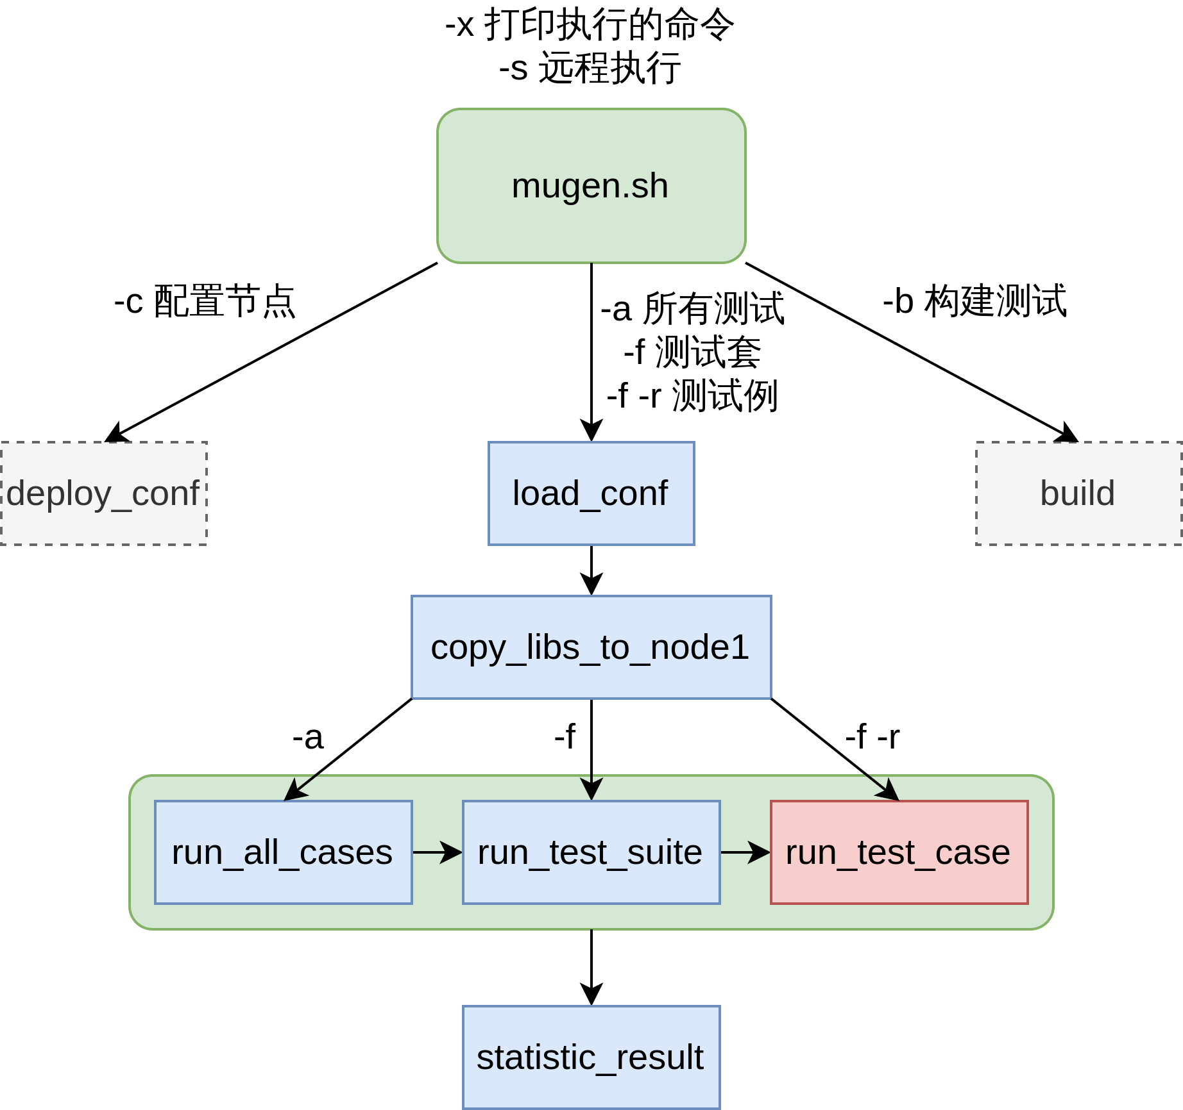
mugen基本测试原理
mugen.sh

Slide 16
mugen基本测试原理
Testcase
  testcase代码结构
source ${OET_PATH}/libs/locallibs/common_lib.sh #包含函数库
function config_params() {} #需要预加载的数据、参数配置
function pre_test() {} #测试对象、测试需要的工具等安装准备
function run_test() {} #测试点的执行
function post_test() {} #后置处理，恢复测试环境
main "$@" #运行测试

Slide 17
mugen基本测试原理
示例
source "../common/common_lib.sh"
function pre_test() {
LOG_INFO "Start environmental preparation."
DNF_INSTALL git-daemon
LOG_INFO "End of environmental preparation!"
}
function run_test() {
LOG_INFO "Start to run test."
test_execution git.socket
systemctl start git.socket
systemctl reload git.socket 2>&1 | grep "Job type reload is not applicable for unit git.socket"
CHECK_RESULT $?
systemctl status git.socket | grep "Active: active"
CHECK_RESULT $?
LOG_INFO "End of the test."
}
function post_test() {
LOG_INFO "start environment cleanup."
DNF_REMOVE
LOG_INFO "Finish environment cleanup!"
}
main "$@"

Slide 18
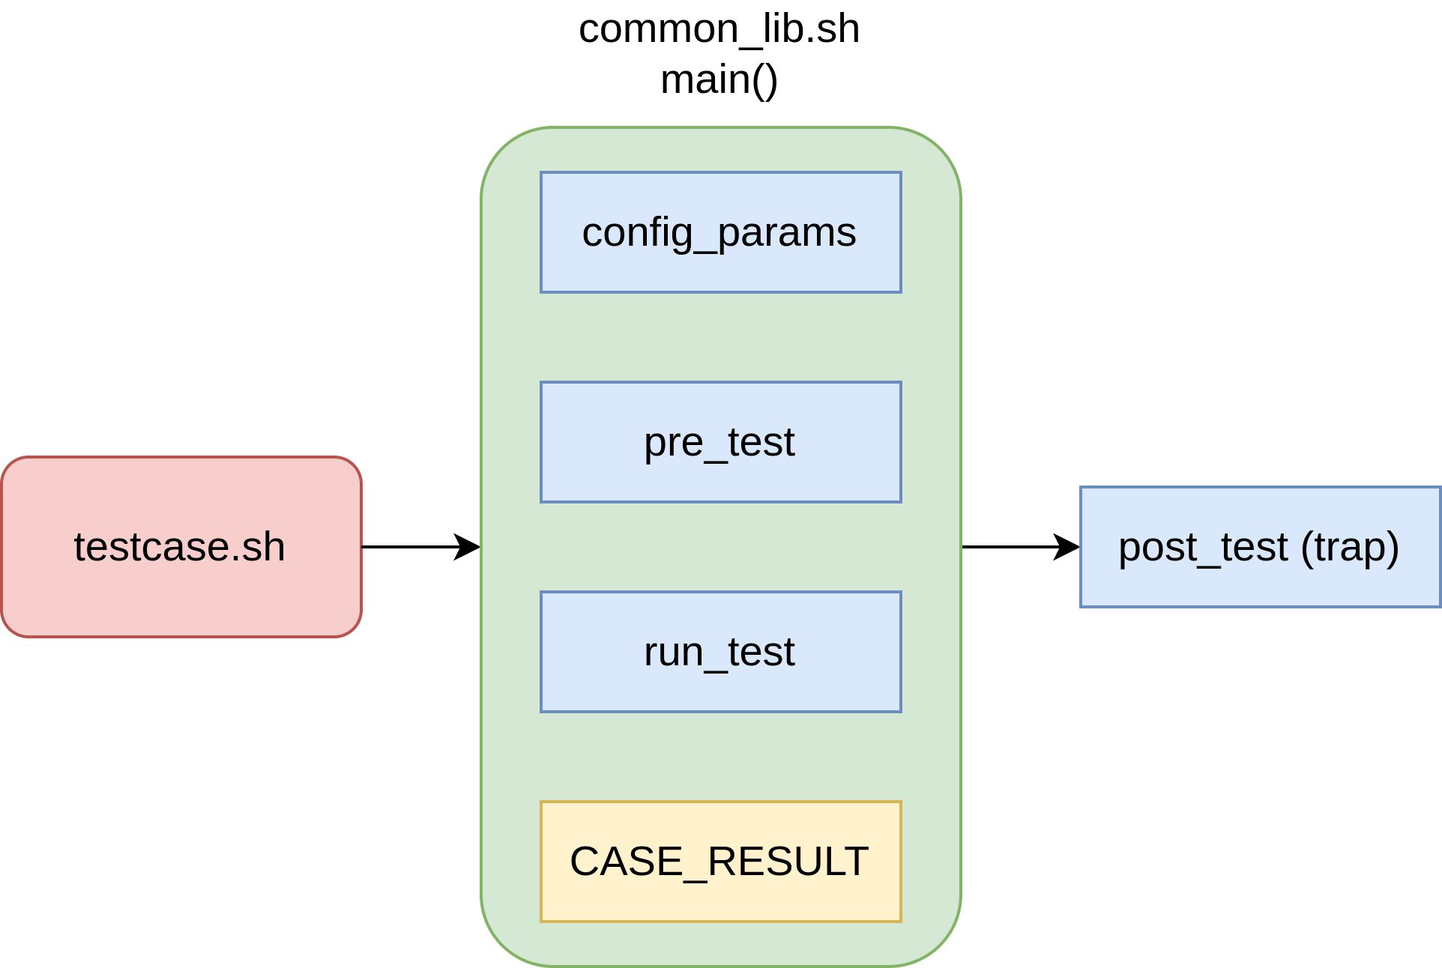
mugen基本测试原理
testcase执行函数调用过程

Slide 19
mugen测试的开发
开发测试需要编写的文件
  testcase文件
  common文件（可选）
  suite2cases文件
testcase编写
  参考其他测试例的编写
  注意使用定义好的方法
    LOG_ERROR
    CHECK_RESULTS

Slide 20
测试代码开发例（GCC）
Testcase主体
function pre_test() {
LOG_INFO "Start to prepare the test environment."
DNF_INSTALL gcc
cp -r ../common ./tmp
cd ./tmp
LOG_INFO "End to prepare the test environment."
}
function run_test() {
LOG_INFO "Start to run test."
gcc test.c -o test
CHECK_RESULT $?
./test | grep "Hello world!" > /dev/null
CHECK_RESULT $?
objdump -D ./test | grep "<main>" > /dev/null
CHECK_RESULT $?
LOG_INFO "End to run test."
}
function post_test() {
LOG_INFO "Start to restore the test environment."
rm -rf ./tmp
DNF_REMOVE
LOG_INFO "End to restore the test environment."
}

Slide 21
测试代码开发例（GCC）
common/test.c
testsuite
#include<stdio.h>
int main()
{
printf("Hello world!\n");
return 0;
}
{
"path": "$OET_PATH/testcases/cli-test/gcc",
"cases": [
{
"name": "oe_test_gcc"
}
]
}
结果
[root@openEuler-riscv64 mugen]# bash mugen.sh -f gcc
Tue Jul 12 11:52:46 2022 - INFO - start to run testcase:oe_test_gcc.
Tue Jul 12 11:53:03 2022 - INFO - The case exit by code 0.
Tue Jul 12 11:53:04 2022 - INFO - End to run testcase:oe_test_gcc.
Tue Jul 12 11:53:04 2022 - INFO - A total of 1 use cases were executed, with 1 successes and 0 failures.

Slide 22
RISC-V oE自动化测试脚本开发的工作和计划
目前工作产出
  初步整理了一部分可用于目前openEuler RISC-V镜像测试的测试套(7)和测试例(50)

