Slide 1
Feature Engineering and Selection… Chapter 1: Introduction
Bryan Shalloway
2019-08-13

Slide 2
Agenda
Navigating materials
Preface
Introduction
Simple Example
Important Concepts
More Complex Example
Feature Selection
Outline

Slide 3
Navigating materials
Online book: http://www.feat.engineering/
Teams page: LINK
See “Files” tab for ppt slides, see “Schedule & recordings links” for links to recordings
Feel free to add materials directly! (Do not delete other’s materials)
Code: https://github.com/topepo/FES (also cloned to Teams page)

Slide 4
Preface
When you model has poor performance…
“…lack of performance may be due to a simple to explain, but difficult to pinpoint, cause: relevant predictors that were collected are represented in a way that models have trouble achieving good performance.”
“Adjusting and reworking the predictors to enable models to better uncover predictor-response relationships has been termed feature engineering.”

Slide 5
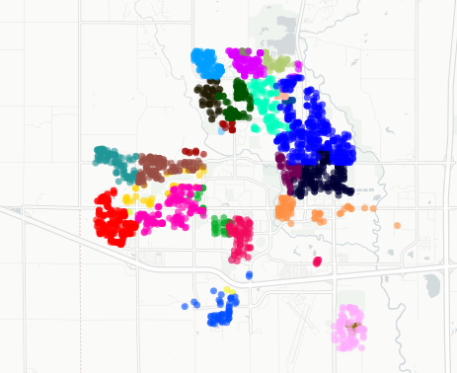
Introduction
Nomenclature:
Thing you are predicting:
Target/outcome/response/dependent variable
Thing you use to predict:
Predictors/features/independent variables/inputs
“Features” often represent artificial predictors that may be composites or "engineered" versions of initial variables
2 uses for a model:
Inference/explanation
Prediction/estimation
Parsimony/simplicity of model is usually preferred
Easier to trust easier + easier to understand
HOWEVER, “accuracy should not be seriously sacrificed for simplicity…”
Is a balance
Help your stakeholders define where this balance is in the problem at hand…
Training/testing datasets
Target: Sale price of home
Predictors: # bathrooms; # of bedrooms; … ;
# bathrooms / # bedrooms
How could you encode location?
How might a model for inference be useful?
Notes:
How could you encode location?
Zipcode might be a proxy, but latitude and longitude convey more information…
Image from feat.engineering

Slide 6

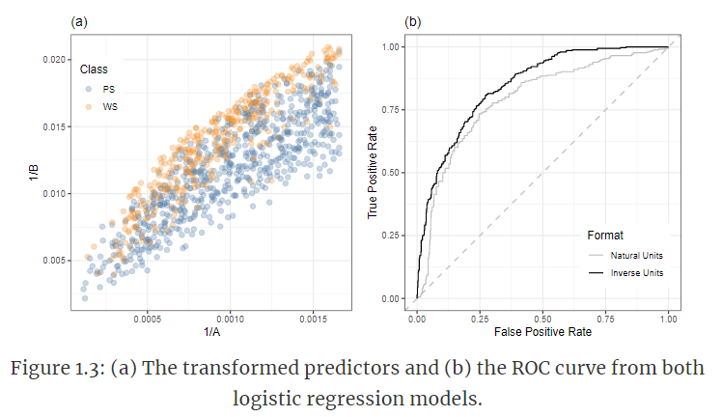
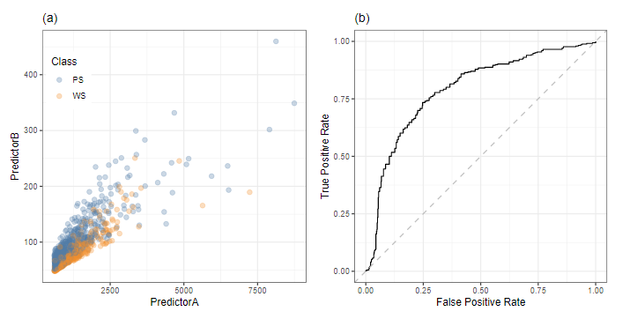
A simple example
What can be some some problems with using prediction accuracy?
Perform inverse transformation of variables (via Box-cox)
AUC: 0.848
AUC: 0.794
Neural network to this model, which is not necessarily sensitive to this skewness, will get an AUC roughly equivalent to logistic regression (after transformation)… neural nets have other drawbacks
Notes:
ROC curve:
Graph of true positive rate vs false positive rate as you increase your cut-off value
Area Under the ROC curve:
Probability PS
Is a measure of how well the model orders observations, i.e. does the model tend to give higher probabilities to those items that are TRUE vs. those that are FALSE.
My AUC interpretation: The likelihood the model gave a higher probability to a TRUE value than a FALSE value
(Typically prefer to using strictly accuracy or confusion matrix)
Images from feat.engineering

Slide 7
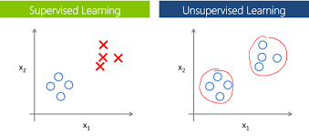
Important concepts
Supervised and Unsupervised Procedures
“Supervised data analysis involves identifying patterns between predictors and an identified outcome that is to be modeled or predicted, while unsupervised techniques are focused solely on identifying patterns among the predictors.”
https://lakshaysuri.wordpress.com/2017/03/19/machine-learning-supervised-vs-unsupervised-learning/
Notes:
https://www.google.com/url?sa=i&source=images&cd=&ved=2ahUKEwi816LKh6LkAhUMVN8KHfxVA3AQjRx6BAgBEAQ&url=https%3A%2F%2Flakshaysuri.wordpress.com%2F2017%2F03%2F19%2Fmachine-learning-supervised-vs-unsupervised-learning%2F&psig=AOvVaw3vfhURDWRTUihwTs5K6Hgj&ust=1566961149862643

Slide 8
Important concepts
No Free Lunch
“Without any specific knowledge of the problem or data at hand, no one predictive model can be said to be the best.”
“It is wise to try a number of disparate types of models to probe which ones will work well with your particular data set.”

Slide 9
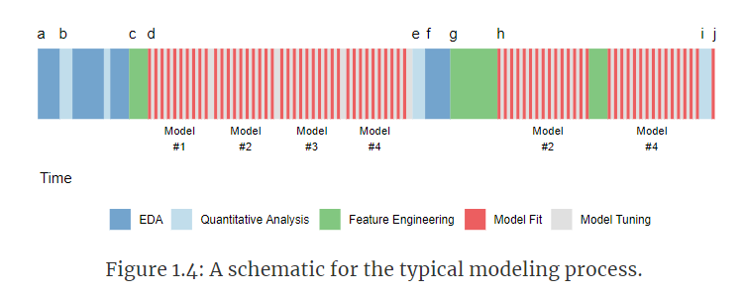
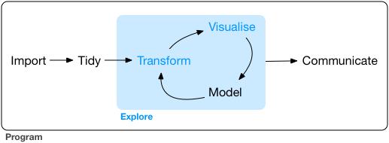
Important concepts
Should you split your data into a training dataset before or after performing exploratory data analysis?
The model versus the modeling process
https://r4ds.had.co.nz/
Notes:
Images from feat.engineering and
R for data science

Slide 10
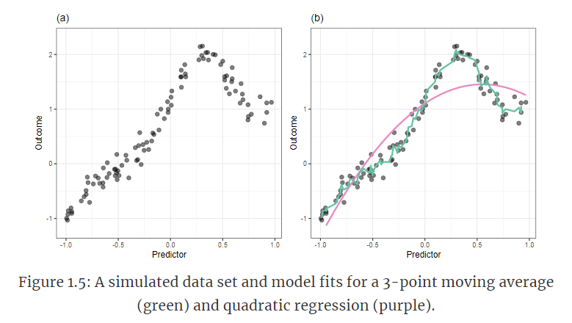
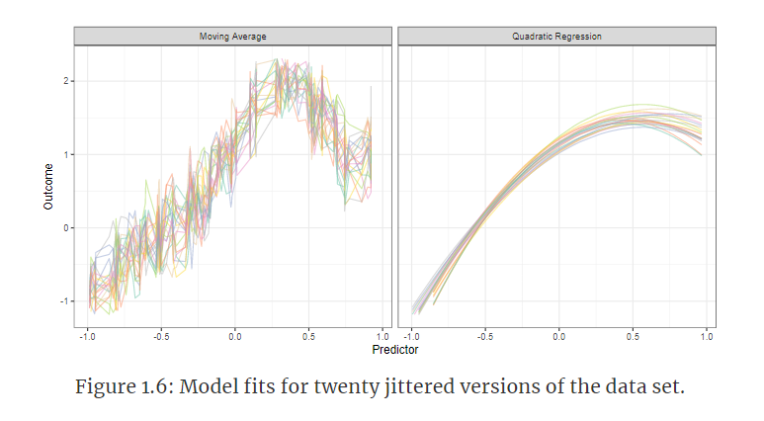
Important concepts
Which of the below models does a better job in this case?
Model Bias and Variance
Variance: How much would f would change if we estimated it with a different training dataset. (Associated with overfitting.)
Bias: Error introduced by approximating a real-life problem (complicated) by a much simpler model. (Associated with underfitting)
Notes:
Images from feat.engineering

Slide 11
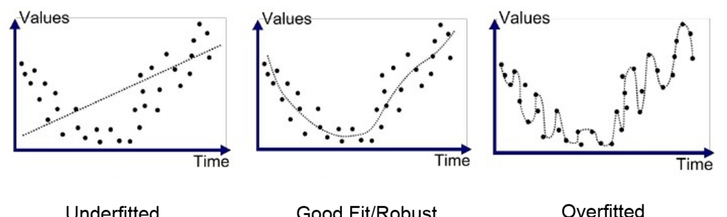
Important concepts
Underfitting and Overfitting
https://medium.com/greyatom/what-is-underfitting-and-overfitting-in-machine-learning-and-how-to-deal-with-it-6803a989c76
Notes:
https://www.google.com/url?sa=i&source=images&cd=&ved=2ahUKEwjT7Mnkh6LkAhVPU98KHR5EDpsQjRx6BAgBEAQ&url=https%3A%2F%2Fmedium.com%2Fgreyatom%2Fwhat-is-underfitting-and-overfitting-in-machine-learning-and-how-to-deal-with-it-6803a989c76&psig=AOvVaw2dMIbNar3HK7a5cc4lfZlL&ust=1566961276841125

Slide 12
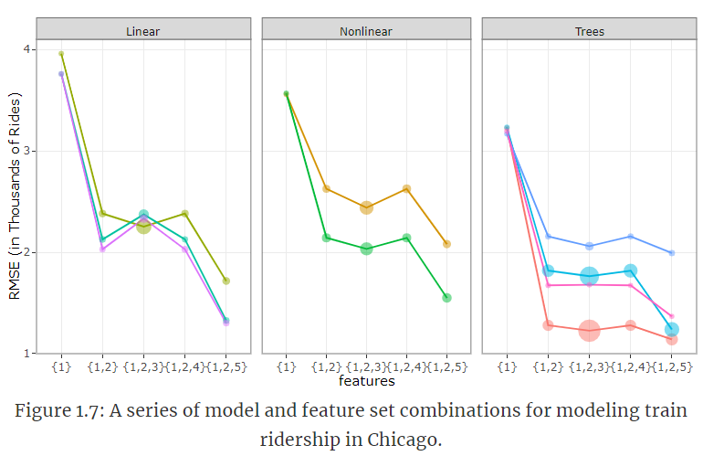
A more complex example
What are other factors to consider other than performance?
When modeling data, there is almost never a single model fit or feature set that will immediately solve the problem. The process is more likely to be a campaign of trial and error to achieve the best results.
The effect of feature sets can be much larger than the effect of different models.
The interplay between models and features is complex and somewhat unpredictable.
With the right set of predictors, is it common that many different types of models can achieve the same level of performance. Initially, the linear models had the worst performance but, in the end, showed some of the best performance
Notes:
Images from feat.engineering

Slide 13
Feature Selection
Wrapper methods
E.g. stepwise / recursive feature selection techniques; genetic algorithms
Embedded methods
E.g. splits in decision trees; lasso penalty
Unsupervised selection
E.g. remove rare levels if dummy encoding

Slide 14
Model types by interpretability vs flexibility
High
Subset Selection Lasso
Least Squares
Generalized Additive Models Trees
Interpretability
Bagging, Boosting
Support Vector Machines
Neural Nets
Low
Low
High
Flexibility
Introduction to Statistical Learning with Applications in R, http://faculty.marshall.usc.edu/gareth-james/ISL/
Notes:
Image from Introduction to Statistical Learning

