Slide 1
Feature Engineering Chapter 11 Greedy Search methods
Bryan Shalloway
2019-12-04

Slide 2
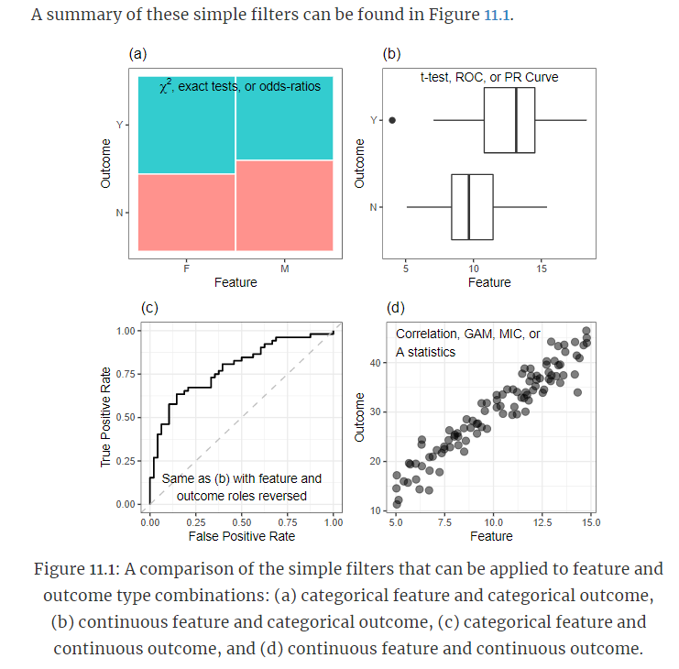
Ranking and selecting features
Simple filters
Screen predictors by testing if there is a relationship before including them
Ranked and keep either top p or based on some threshold
Mix of predictor types can mean converting everything to a p-value can be appropriate
**Can be done individually or using all features at once (e.g. importance scores from random forests)**

Slide 3
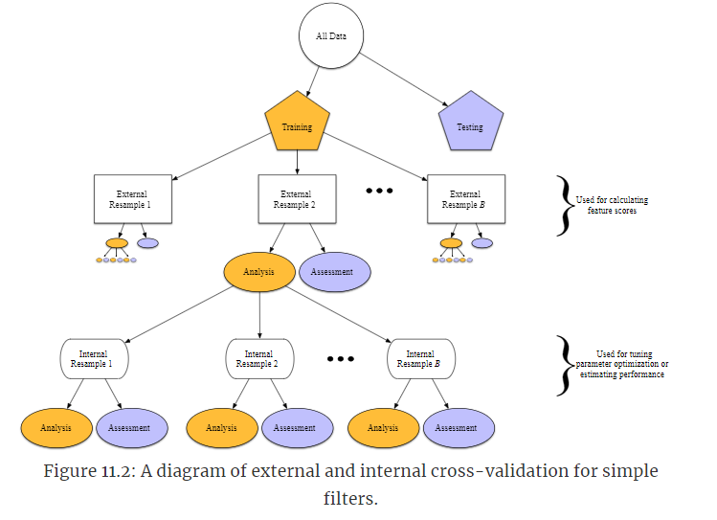
Prevent false positives
Simple filters
Consider adjusting p-values to account for number
As usual… use appropriate resampling methods
“When using simple screening filters, selecting both the subset of features and model tuning parameters cannot be done in the same layer of cross-validation, since the filtering must be done independently of the model tuning. Instead, we must incorporate another layer of cross-validation. The first layer, or external layer, is used to filter features. Then the second layer (the “internal layer”) is used to select tuning parameters.”

Slide 4
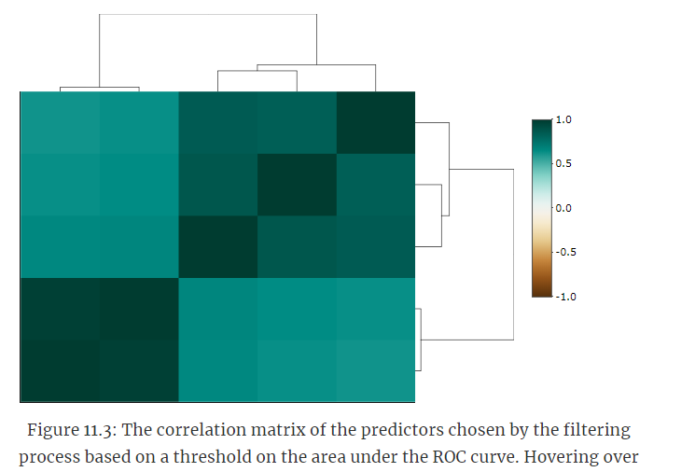
Dealing with multicollinearity
Simple filters
Can use methods like Partial least squares that will handle multi-collinearity
Can set-up a collinearity filter
How would collinearity filter look?

Slide 5
Testing if there was improvement
Simple filters
E.g. use t-test of performance of cross-validated samples against model built w/o filter
Build lots of models with p components (selecting p randomly) and test difference in performance

Slide 6
Recursive feature elimination
AKA backwards selection
“begins by building a model on the entire set of predictors and computing an importance score for each predictor. The least important predictor(s) are then removed, the model is re-built, and importance scores are computed again.”
Often used with linear models as well as Random Forest models…
Note: Subset size is a tuning parameter …

Slide 7
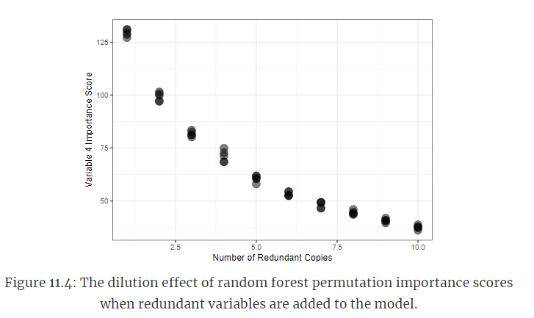
Reasons for RFE with random forest
“When many irrelevant predictors are included in the data and the RFE process is paired with random forest, a wide range of subset sizes can exhibit very similar predictive performances.”
“One notable issue with measuring importance in trees is related to multicollinearity. If there are highly correlated predictors in a training set that are useful for predicting the outcome, then which predictor is chosen for partitioning the samples is essentially a random selection. ”

Slide 8
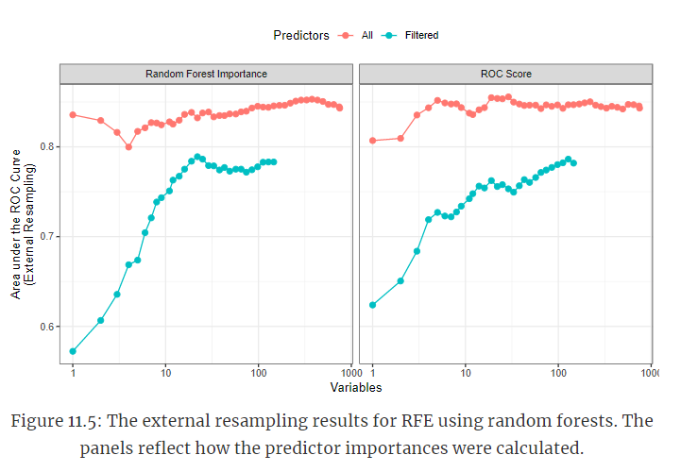
Random Forests and filtering techniques
Two things:
Performance was better without a “correlation filter” applied (in both cases)
Using the simultaneous feature importance scores performed better than the individual importance scores

Slide 9
Stepwise Selection
(generally used with linear models)
“The process begins by creating p linear regression models, each of which uses exactly one of the features.⁸⁷ The importance of the features are then ranked by their individual ability to explain variation in the outcome. The amount of variation explained can be condensed into a p-value for convenience. If no features have a p-value less than 0.15, then the process stops. However, if one or more features have p-value(s) less than 0.15, then the one with the lowest value is retained.”
Generally use AIC or resampled performance (rather than p-values) when using
“Our recommendation is to avoid this procedure altogether. Regularization methods, such as the previously discussed glmnet model, are far better at selecting appropriate subsets in linear models. If model inference is needed, there are a number of Bayesian methods that can be used (Mallick and Yi 2013; Piironen and Vehtari 2017b, 2017a).”
Is “less greedy”

Slide 10
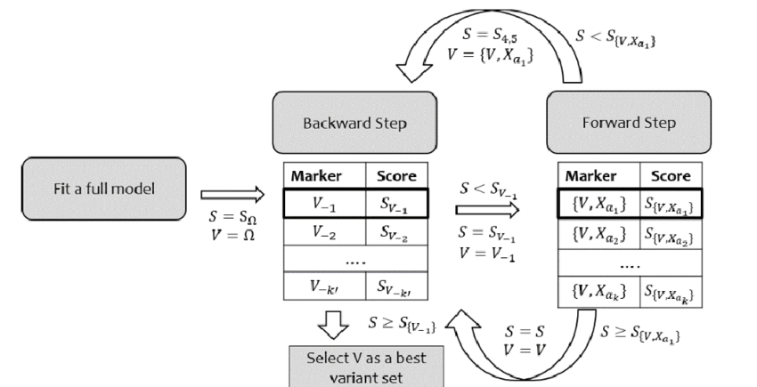
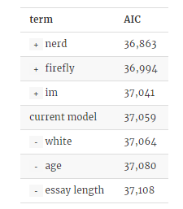
Stepwise Selection
https://www.researchgate.net/profile/Hyunsoo_Kim39/publication/309182017/figure/fig6/AS:667069779542021@1536053237412/Stepwise-selection-B-F-Stepwise-selection-with-backward-to-forward-selects-prediction.png
Notes:
https://www.researchgate.net/profile/Hyunsoo_Kim39/publication/309182017/figure/fig6/AS:667069779542021@1536053237412/Stepwise-selection-B-F-Stepwise-selection-with-backward-to-forward-selects-prediction.png

