Slide 1
Feature Engineering and Selection… Chapter 3: A Review of the Predictive Modeling Process pt. 1
Bryan Shalloway
2019-08-26

Slide 2
Agenda
3.2 Evaluation metrics
Regression metrics
Robust metrics
Classification (hard -- class prediction)
Classification (soft – class probabilities)
3.3 Data splitting
Training/testing
Stratified sampling
3.4 Resampling
V-fold cross-validation; Monte Carlo; Bootstrap
Independence in sampling
Bias – variance of evaluation metrics
Information leakage

Slide 3
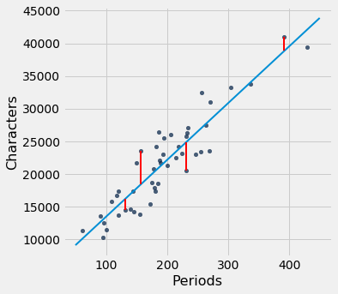
3.2 Evaluation metrics
“Regression” (continuous target)
RMSE (Root Mean Square Error)
“Average distance of a sample from its observed value to its predicted value.” (essentially)
https://www.inferentialthinking.com/chapters/15/3/Method_of_Least_Squares.html
Notes:
Image:
https://www.google.com/url?sa=i&source=images&cd=&ved=2ahUKEwjDkoL-hqLkAhUnhuAKHfrSCOQQjRx6BAgBEAQ&url=https%3A%2F%2Fwww.inferentialthinking.com%2Fchapters%2F15%2F3%2FMethod_of_Least_Squares.html&psig=AOvVaw0Pf9GJhTtvvahxnve_sOhK&ust=1566960436066556

Slide 4
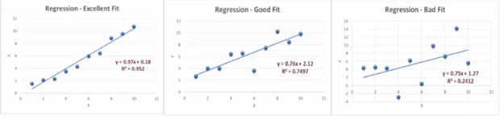

3.2 Evaluation metrics
“Regression” (continuous target)
$R^{2}$ (R squared / coefficient of determination)
“standard correlation between the observed and predicted values (a.k.a. R) and squares it.”
“Proportion of the total variability in the outcome that can be explained by the model.”
https://www.myaccountingcourse.com/financial-ratios/r-squared
Notes:
https://www.google.com/url?sa=i&source=images&cd=&ved=2ahUKEwirrL3FiKLkAhVpiOAKHad9AuUQjRx6BAgBEAQ&url=https%3A%2F%2Fwww.myaccountingcourse.com%2Ffinancial-ratios%2Fr-squared&psig=AOvVaw3vt7FL8o8oiaWskSIyxSrL&ust=1566961370780832

Slide 5
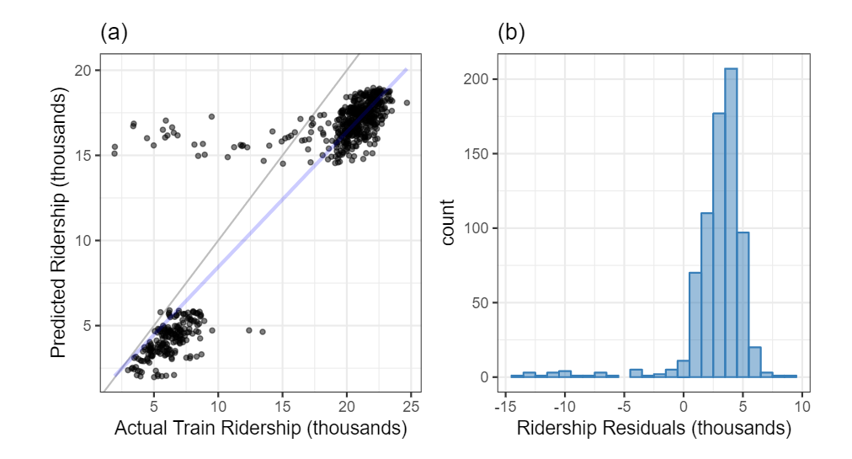

3.2 Evaluation metrics
WARNING:
“Unfortunately, $R^{2}$can be a deceiving metric. The main problem is that it is a measure of correlation and not accuracy.”
“Regression” (continuous target)
$R^{2}$ (R squared / coefficient of determination)
“standard correlation between the observed and predicted values (a.k.a. R) and squares it.”
“Proportion of the total variability in the outcome that can be explained by the model.”
Notes:
Image from feat.engineering

Slide 6
3.2 Evaluation metrics
WARNING:
“Unfortunately, $R^{2}$can be a deceiving metric. The main problem is that it is a measure of correlation and not accuracy.”
“Regression” (continuous target)
$R^{2}$ (R squared / coefficient of determination)
“standard correlation between the observed and predicted values (a.k.a. R) and squares it.”
“Proportion of the total variability in the outcome that can be explained by the model.”
CCC (Concordance Correlation Coefficient)
“Product of the usual correlation coefficient and a measure of bias from the line of agreement… can be thought of as penalized version of the correlation coefficient… if the relationship between the observed and predicted values is far from the line of agreement”
Notes:
Image from feat.engineering
(CCC). This metric provides a measure of correlation relative to the line of agreement and is defined as the product of the usual correlation coefficient and a measure of bias from the line of agreement. The bias coefficient ranges from 0 to 1, where a value of 1 indicates that the data falls on the line of agreement. The further the data deviates from the line of agreement, the smaller the bias coefficient. Therefore, the CCC can be thought of as penalized version of the correlation coefficient. The penalty will apply if the data exhibits poor correlation between the observed and predicted values or if the relationship between the observed and predicted values is far from the line of agreement.

Slide 7
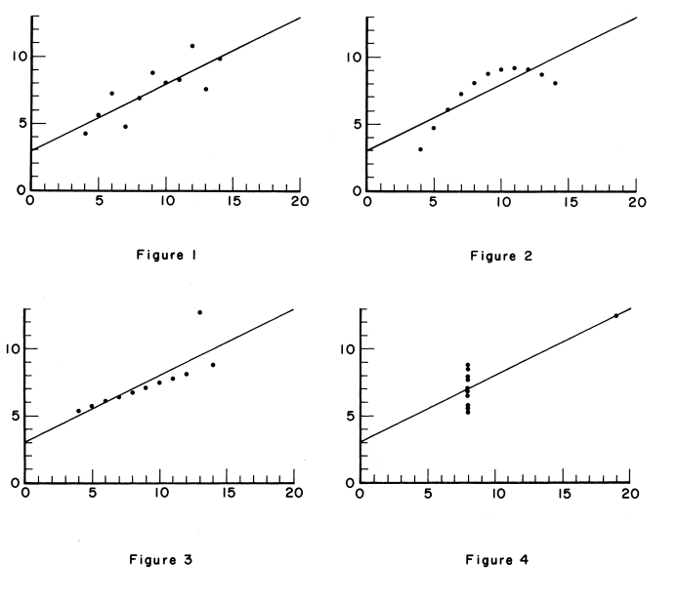
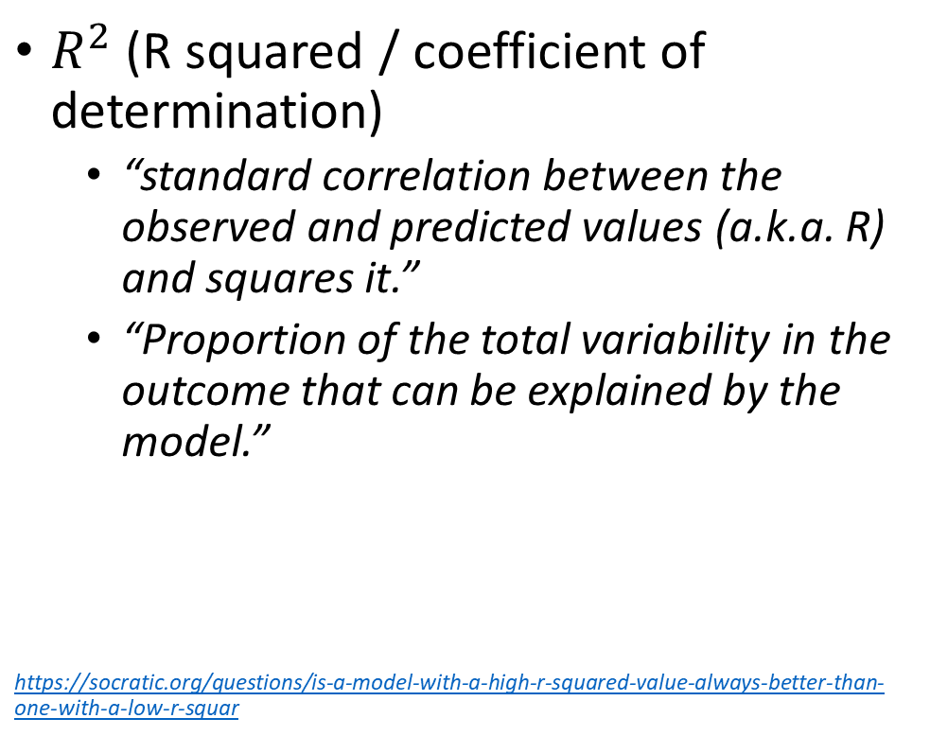
3.2 Evaluation metrics
Which of these has the highest correlation?
“Regression” (continuous target)
$R^{2}$ (R squared / coefficient of determination)
“standard correlation between the observed and predicted values (a.k.a. R) and squares it.”
“Proportion of the total variability in the outcome that can be explained by the model.”
https://socratic.org/questions/is-a-model-with-a-high-r-squared-value-always-better-than-one-with-a-low-r-squar
Notes:
https://www.google.com/url?sa=i&source=images&cd=&ved=2ahUKEwjan-HpiaLkAhWImeAKHVmuC2sQjRx6BAgBEAQ&url=https%3A%2F%2Fsocratic.org%2Fquestions%2Fis-a-model-with-a-high-r-squared-value-always-better-than-one-with-a-low-r-squar&psig=AOvVaw3vt7FL8o8oiaWskSIyxSrL&ust=1566961370780832
Around 0.67

Slide 8
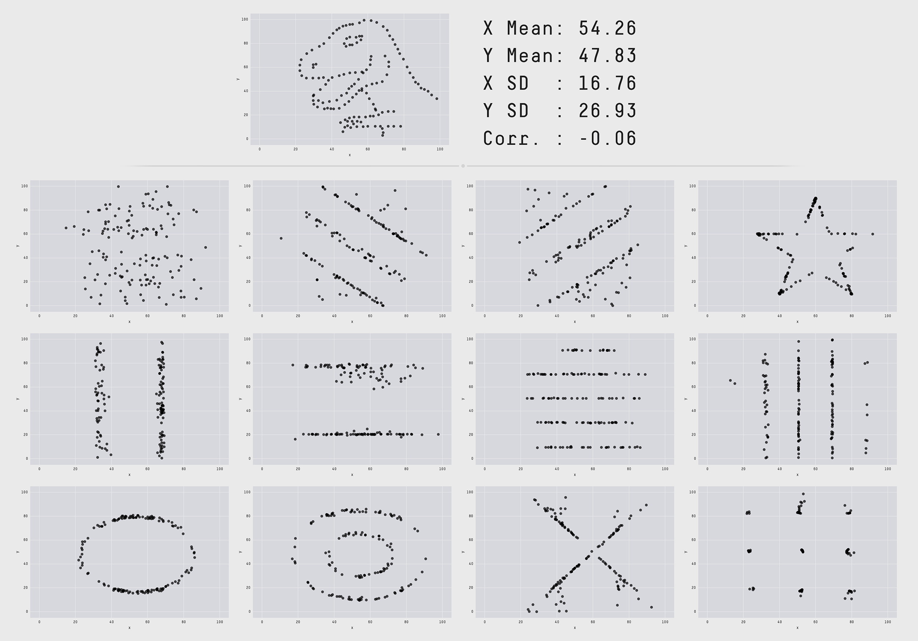

3.2 Evaluation metrics
Which of these has the highest correlation?
“Regression” (continuous target)
$R^{2}$ (R squared / coefficient of determination)
“standard correlation between the observed and predicted values (a.k.a. R) and squares it.”
“Proportion of the total variability in the outcome that can be explained by the model.”
Common tips:
Visualize your data, as well as your residuals
Use multiple metrics
Consider robust metrics…
https://rweekly.org/2017-19.html
Notes:
https://www.google.com/url?sa=i&source=images&cd=&cad=rja&uact=8&ved=2ahUKEwjPr_bSi6LkAhVrUt8KHSyoC-EQjRx6BAgBEAQ&url=https%3A%2F%2Frweekly.org%2F2017-19.html&psig=AOvVaw1pjPRpgC6KOT2HpJMh_c-P&ust=1566962184508693

Slide 9
3.2 Evaluation metrics
“Regression” (continuous target)
“Both RMSE and R-squared are very sensitive to extreme values because each are based on the squared value of the individual samples’ residuals. Therefore a sample with a large residual will have an inordinately large effect on the resulting summary measure.”
Robust Techniques
Try to be insensitive to outliers and extreme values. “Robust techniques seek to find numerical summaries for the majority of the data.”
Approaches may…
Down-weight extreme values
Focus on rank (correlation)
Some other metrics…
MAD (Median Absolute Deviation)
MAE (Mean Absolute Error) Similar interpretation to RMSE (actually more straightforward) – though less popular (math → tougher ; historical reasons)
Notes:
If we only care about rank order – then we don’t care about this skewness so much – but if we actually want to predict the value we do care…

Slide 10
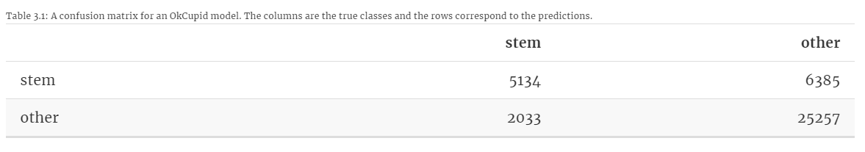
3.2 Evaluation metrics
(Warning: some software flips rows & columns)
“Classification” (categorical target); class predictions
Confusion Matrix (many metrics are just ways of combining these outcomes)
TRUTH
True Positive
False Positive
PREDICTED
False Negative
True Negative

Slide 11
3.2 Evaluation metrics
“Classification” (categorical target); class predictions
Confusion Matrix (many metrics are just ways of combining these outcomes)
ACCURACY: Proportion of events and non-events predicted correctly.
TRUTH
True Positive; 5134
False Positive; 6385
PREDICTED
True Positive; 5134
False Negative; 2033
True Negative; 25257
True Negative; 25257
Cohen’s Kappa: (Range: -1 to 1) Accuracy metric normalized to chance rate (to account for potential class imbalances). -1: worse than chance, 0: chance, 1: perfect

Slide 12
3.2 Evaluation metrics
“Classification” (categorical target); class predictions
Confusion Matrix (many metrics are just ways of combining these outcomes)
Sensitivity/Recall: Proportion of events and non-events predicted correctly.
TRUTH
True Positive; 5134
False Positive; 6385
True Positive; 5134
PREDICTED
False Negative; 2033
True Negative; 25257

Slide 13
3.2 Evaluation metrics
“Classification” (categorical target); class predictions
Confusion Matrix (many metrics are just ways of combining these outcomes)
Specificity: Proportion of events and non-events predicted correctly.
TRUTH
True Positive; 5134
False Positive; 6385
PREDICTED
False Negative; 2033
True Negative; 25257

Slide 14
3.2 Evaluation metrics
“Classification” (categorical target); class predictions
Confusion Matrix (many metrics are just ways of combining these outcomes)
Specificity: Proportion of events and non-events predicted correctly.
TRUTH
True Positive; 5134
False Positive; 6385
PREDICTED
False Negative; 2033
True Negative; 25257
True Negative; 25257

Slide 15
3.2 Evaluation metrics
“Classification” (categorical target); class predictions
Confusion Matrix (many metrics are just ways of combining these outcomes)
Precision: proportion of events that are predicted correctly out of the total number of predicted events.
TRUTH
True Positive; 5134
False Positive; 6385
PREDICTED
False Negative; 2033
True Negative; 25257

Slide 16
3.2 Evaluation metrics
“Classification” (categorical target); class predictions
Confusion Matrix (many metrics are just ways of combining these outcomes)
Precision: proportion of events that are predicted correctly out of the total number of predicted events.
TRUTH
True Positive; 5134
False Positive; 6385
PREDICTED
True Positive; 5134
False Negative; 2033
True Negative; 25257
Positive Predictive Value (PPV): Equal to precision if you determine “prevalence” based on your sample data… (though typically measure separately)
Assuming this, Negative Predictive Value (NPV) is TN / (TN + FN)

Slide 17
3.2 Evaluation metrics
“Classification”; class probabilities
“The metrics discussed so far depend on having a hard prediction (e.g., STEM or other). Most classification models can produce class probabilities as soft predictions that can be converted to a definitive class by choosing the class with the largest probability. There are a number of metrics that can be created using the probabilities.”

Slide 18
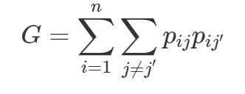
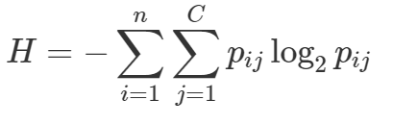
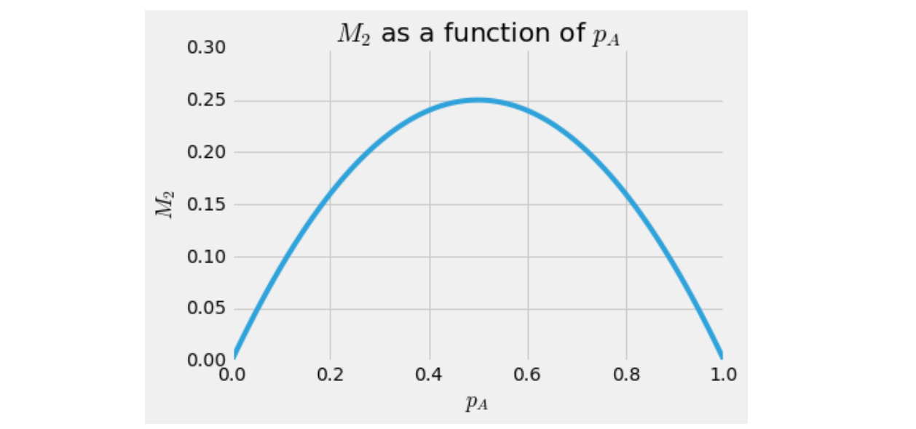
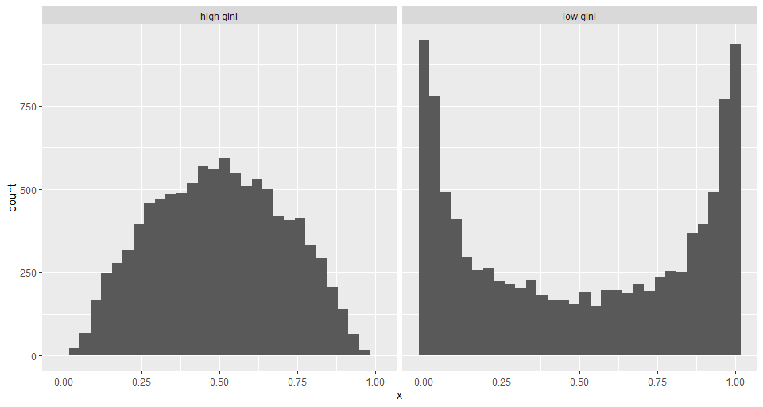
3.2 Evaluation metrics
Plugging in more extreme probabilities (greater separation / purity) → smaller values
Want to minimize these metrics
“Classification”; class probabilities
Purity metrics
Unsupervised method – is strictly a measure of the separation in your probabilities (does not vary depending on their accuracy) (e.g. Gini; Entropy)
https://www.quora.com/What-is-the-interpretation-and-intuitive-explanation-of-Gini-impurity-in-decision-trees
Notes:
https://www.google.com/url?sa=i&source=images&cd=&cad=rja&uact=8&ved=2ahUKEwjOlrDux6LkAhUoheAKHa5WBl4QjRx6BAgBEAQ&url=https%3A%2F%2Fwww.quora.com%2FWhat-is-the-interpretation-and-intuitive-explanation-of-Gini-impurity-in-decision-trees&psig=AOvVaw33vitgL0q04a9RsBl8gYrI&ust=1566978442200251

Slide 19

3.2 Evaluation metrics
Example:
2 observations and predicted probabilities:
x_1 = 1
P_11 = 0.8
P_10 = 0.2
x_2 = 0
p_21 = 0.6
p_20 = 0.4
(PLUG IN and SUM)
“Classification”; class probabilities
Log-likelihood
Supervised method – considers actual target classes in scoring
Goal → maximize
Magnitude of predicted probabilities matter not just class predicted
“maximized if all samples are predicted with high probability to be in the correct class”
More extreme misses are penalized more (on a log scale)
https://www.quora.com/What-is-the-interpretation-and-intuitive-explanation-of-Gini-impurity-in-decision-trees
Notes:
https://www.google.com/url?sa=i&source=images&cd=&cad=rja&uact=8&ved=2ahUKEwjOlrDux6LkAhUoheAKHa5WBl4QjRx6BAgBEAQ&url=https%3A%2F%2Fwww.quora.com%2FWhat-is-the-interpretation-and-intuitive-explanation-of-Gini-impurity-in-decision-trees&psig=AOvVaw33vitgL0q04a9RsBl8gYrI&ust=1566978442200251

Slide 20
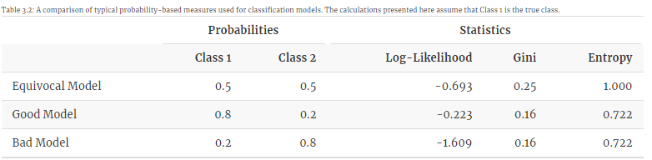
Supervised vs unsupervised metrics performance
Purity metrics only penalize “equivocal” model

Slide 21
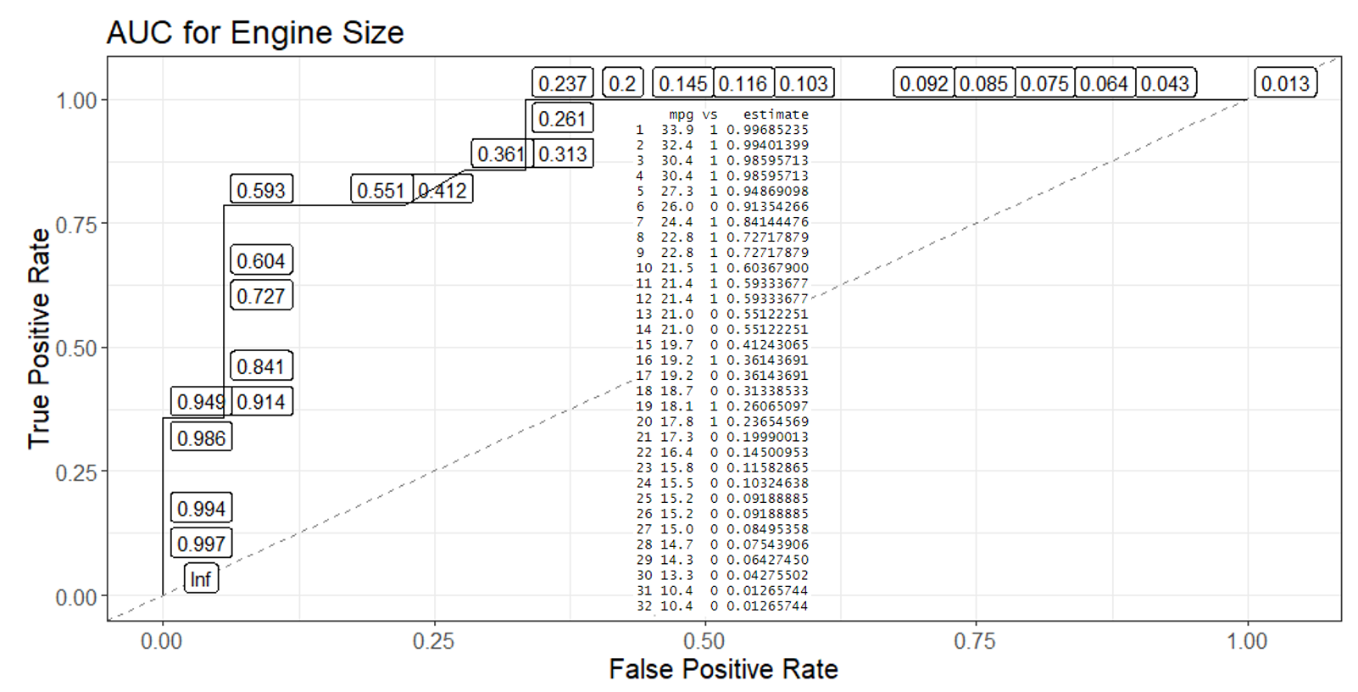
3.2 Evaluation metrics
“Classification”; class probabilities
AUC (Area Under ROC curve):
Supervised method – considers actual target classes in scoring
ORDER of predicted probabilities matters not just class predicted (magnitude of differences does not matter)
More extreme misses are penalized more (on a log scale)
https://www.quora.com/What-is-the-interpretation-and-intuitive-explanation-of-Gini-impurity-in-decision-trees
Notes:
https://www.google.com/url?sa=i&source=images&cd=&cad=rja&uact=8&ved=2ahUKEwjOlrDux6LkAhUoheAKHa5WBl4QjRx6BAgBEAQ&url=https%3A%2F%2Fwww.quora.com%2FWhat-is-the-interpretation-and-intuitive-explanation-of-Gini-impurity-in-decision-trees&psig=AOvVaw33vitgL0q04a9RsBl8gYrI&ust=1566978442200251

Slide 22
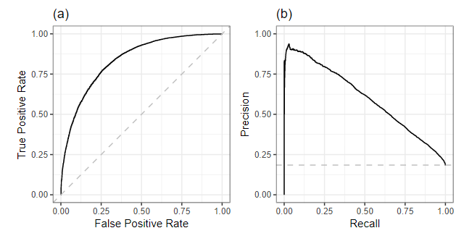
Other notes on classification
1. Start w/ high-level “soft” metrics based on predicted probabilities (e.g. log-likelihood; AUC)
2. Use visualizations of model performance to review subtleties of model (e.g. ROC curve; precision-recall curve
3. Use metrics that investigate “hard” class predictions
Context specific metrics
Frequently will need to design your own metrics
Or modify an existing metric by applying custom weights

