Slide 1
Feature Engineering and Selection… Chapter 3: A Review of the Predictive Modeling Process pt. 3
Bryan Shalloway
2019-09-10

Slide 2
Agenda
3.5 Tuning Parameters and Overfitting
3.6 Model Optimization and Tuning
3.7 Comparing Models Using the Training Set
3.8 Feature Engineering Without Overfitting

Slide 3
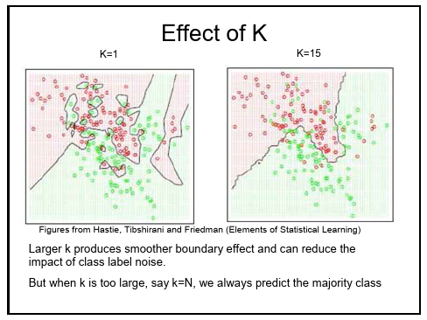
3.5 Tuning parameters and overfitting
Tuning parameters (AKA hyperparameters): “Many models include parameters that, while important, cannot be directly estimated from the data.”
E.g. K in KNN (K Nearest Neighbors)
https://cse3521.artifice.cc/images/effect-of-k.png
Notes:
https://cse3521.artifice.cc/images/effect-of-k.png

Slide 4
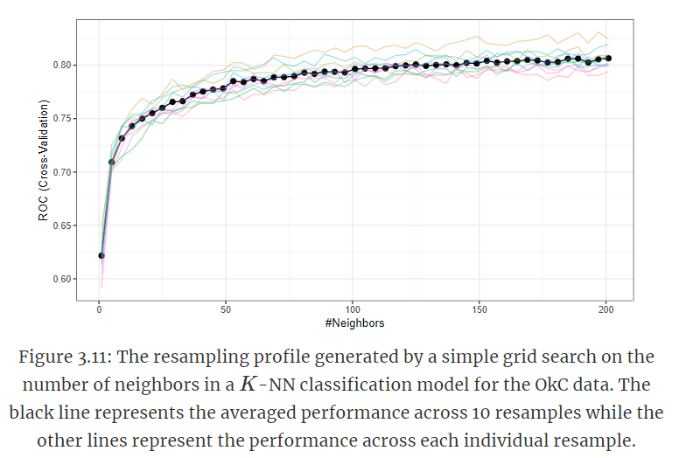
3.6 Model Optimization and Tuning
Tune K = 1, 3, … 201
Using 10-fold cross-validation (colored: individual folds; black : average)

Slide 5
3.6 Model Optimization and Tuning
Tune K = 1, 3, … 201
Using 10-fold cross-validation (colored: individual folds; black : average)
Can have lots of hyper parameters…
What problems might this cause?

Slide 6
3.6 Model Optimization and Tuning
Tune K = 1, 3, … 201
Using 10-fold cross-validation (colored: individual folds; black : average)
Can have lots of hyper parameters…
2 main search strategies
Predefine
Incrementally determine

Slide 7
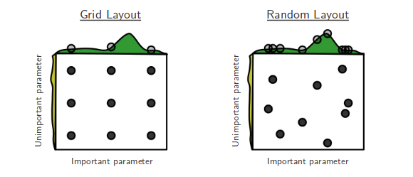
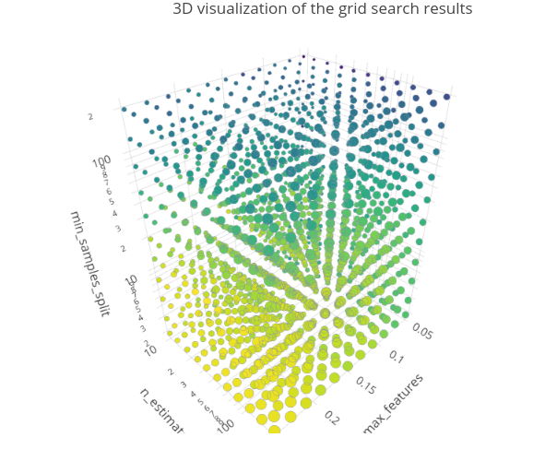
3.6 Model Optimization and Tuning
Grid Search & Random Search (predefine)
Grid search: “a multidimensional grid search can be conducted where candidate parameter combinations and the grid of combinations are evaluated… this can be very inefficient.”
Random search: “Define a range of possible values for each parameter and to randomly sample the multidimensional space enough times to cover a reasonable amount…” of the parameter space
As # of parameters grows, search space grows exponentially.
* https://medium.com/@senapati.dipak97/grid-search-vs-random-search-d34c92946318
* https://towardsdatascience.com/using-3d-visualizations-to-tune-hyperparameters-of-ml-models-with-python-ba2885eab2e9

Slide 8
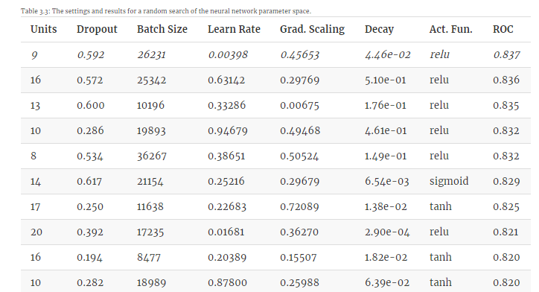
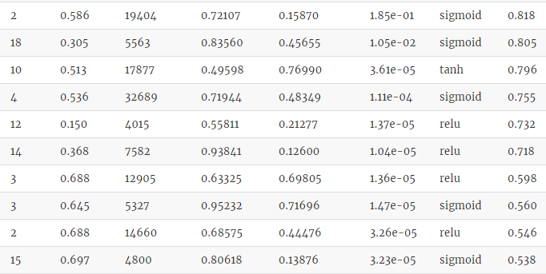
3.6 Model Optimization and Tuning
Example random search in simple feed forward neural network

Slide 9
3.6 Model Optimization and Tuning
Incremental search strategies
Bayesian optimization: “initial pool of samples are evaluated using grid or random search. The optimization procedure creates a separate model to predict performance as a function of the tuning parameters and can then make a recommendation as to the next candidate set to evaluate.”
Nelder-Mead simplex search procedure
Simulated annealing
Genetic algorithms
Chapter 12 will go into in more depth…

Slide 10
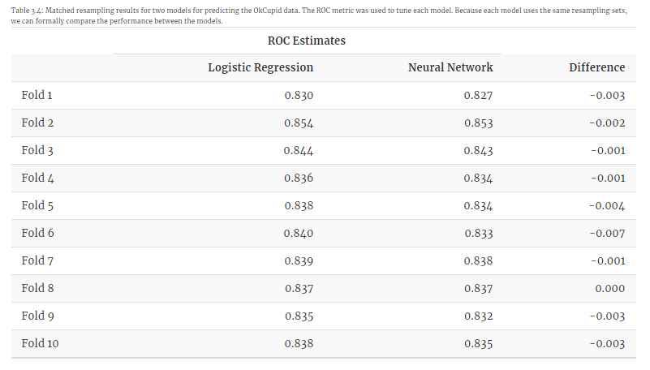
3.7 Comparing Models Using the Training Set
“When multiple models are in contention, there is often the need to have formal evaluations between them to understand if any differences in performance are above and beyond what one would expect at random.”
Logistic Regression vs. Neural Network
Performance on each of 10-fold cross validation
What are scenarios you might want a formal performance test?
Notes:
May have a logistic regression model already in production with a lot of things already set-up and facilitating a Neural Network may entail additional work or additional training costs…
Maybe you are testing out datasets and determining whether it is worth incorporating the new data into your model…

Slide 11
3.7 Comparing Models Using the Training Set
Simple approach:
one-sample or paired t-test between ROC estimates
It prevents the test set from being used during the model development process and
Many evaluations (via assessment sets) are used to gauge the differences.
“estimated difference in the ROC values is -0.003 with 95% confidence interval (-0.004, -0.001)”
(See refs in book to Bayesian hierarchical model or repeated measures model if comparing > 2 models)

Slide 12
3.8 Feature Engineering Without Overfitting
When tuning models: “The crux of this approach was to evaluate a parameter value on data that were not used to build the model.”
“ the same idea should be applied to any other feature-related activity, such as engineering new features/encodings or when deciding on whether to include a new term into the model. There should always be a chance to have an independent piece of data evaluate the appropriateness of the design choice.”

