Slide 1
Feature Engineering and Selection… Chapter 5: Encoding Categorical Variables, pt 1
Bryan Shalloway
2019-09-24

Slide 2
Agenda
Encoding Categorical Predictors
“The approach to including the predictors depends on the type of model. A large majority of models require that all predictors be numeric.”
5.1 Creating Dummy Variables for Unordered Categories
5.5 Encodings for Ordered Data
5.7 Factors versus Dummy Variables in Tree-Based Models
5.2 Encoding Predictors with Many Categories
5.3 Approaches for Novel Categories
5.4 Supervised Encoding Methods
Next week will cover 5.6 Creating Features from Text Data

Slide 3
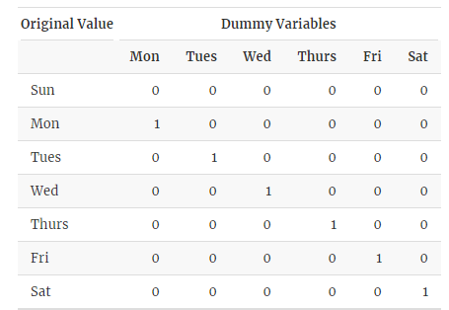
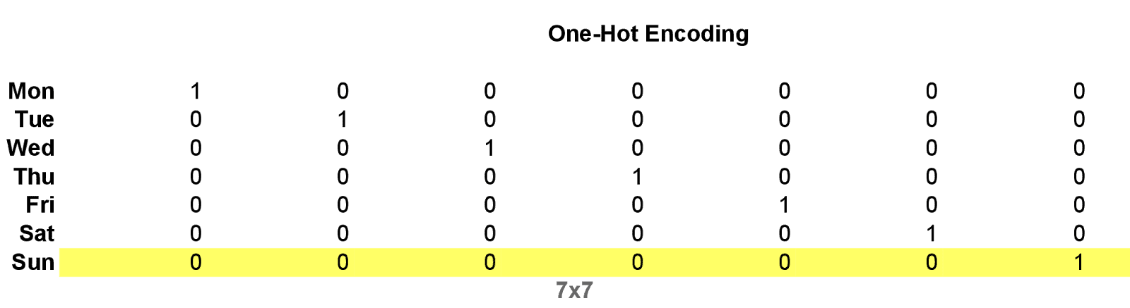
5.1 Creating Dummy Variables for Unordered Categories
“The mathematical function required to make the translation is often referred to as a contrast or parameterization function. An example of a contrast function is called the “reference cell” or “treatment” contrast, where one of the values of the predictor is left unaccounted for in the resulting dummy variables. Using Sunday as the reference cell, the contrast function would create six dummy variables”
Sometimes called design variables
One-hot encoding is similar, but has value for each level
https://2.bp.blogspot.com/-r9EY2uYSTjY/Wnn-nNbw1cI/AAAAAAAAAN4/DXj8ZmaJm3IivJp_imEG7JtbQ7UvvgcygCLcBGAs/s1600/Untitled%2B1%25281%2529.png
Notes:
Linear based models typically require one less design variable than level in the variable or will break model
Could remove intercept or use method that does not have this constraint
https://2.bp.blogspot.com/-r9EY2uYSTjY/Wnn-nNbw1cI/AAAAAAAAAN4/DXj8ZmaJm3IivJp_imEG7JtbQ7UvvgcygCLcBGAs/s1600/Untitled%2B1%25281%2529.png

Slide 4
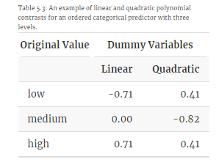
5.5 Encodings for Ordered Data
With “polynomial contrasts, we can investigate multiple relationships (linear, quadratic, etc.) simultaneously by including these in the same model.”
… regular dummy encoding would not capture the “order” of a variable with categories such as {“low”, “medium”, “high”}
Alternatives to polynomial contrasts:
Just use “unordered” factors
“Translate the ordered categories into a single set of numeric scores based on context-specific information” (e.g. 1, 2, … 10 for ordering things from bad to great)

Slide 5
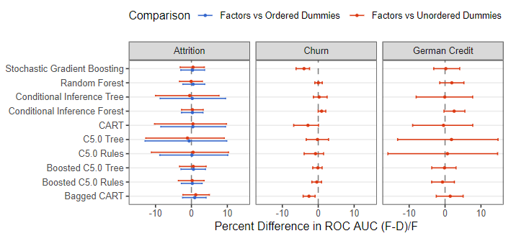

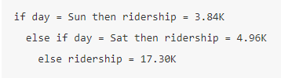
5.7 Factors versus Dummy Variables in Tree-Based Models
Performance comparison across different models and datasets:
Not huge differences in performance, though is still data & model specific
(in R) many models do not require conversion to dummy variables, and can handle factors (tree-based methods especially) E.g.
If given factor:
If given set of dummy’s:
Recommendation:
Usually prefer using factors where possible
Computation is faster
Things like variable importance are more intuitive and easier to measure

Slide 6
5.2 Encoding Predictors with Many Categories
Zero-variance predictor: variable or level that contains a single value
Approaches:
Create full dummy set, remove zero-variance predictors or near-zero variance predictors
Pool together into “other” category
The “hashing trick”
Near zero variance:
19:1 is common ratio to call something NZV
Note: for rarely occurring levels, is possible something is not zero-variance on ENTIRE dataset, but is zero-variance (or NZV) on individual samples
Notes:
Need to do more research on “hashing trick” in order to explain it more fully

Slide 7
5.3 Approaches for Novel Categories
Matters more during deployment (when new levels may come-up)
Approaches:
Assign to “other” category
Retrain model
(if using hashing trick) “hash” in same with other levels

Slide 8
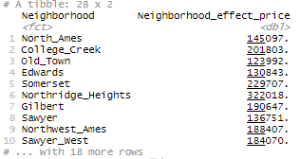
5.4 Supervised Encoding Methods
Regression example
Effect/likelihood encoding: “the effect of the factor level on the outcome is measured and this effect is used as the numeric encoding”
“For example, for the Ames housing data, we might calculate the mean or median sale price of a house for each neighborhood from the training data and use this statistic to represent the factor level in the model.”

Slide 9
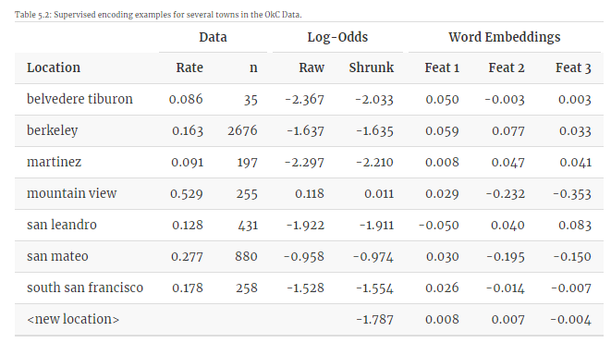
5.4 Supervised Encoding Methods
Classification example
Effect/likelihood encoding (examples from OkC data)
“If the outcome event occurs with rate p, the odds of that event is defined as p/(1−p)p/(1−p). As an example, with the OkC data, the rate of STEM profiles in Mountain View California is 0.53 so that the odds would be 1.125.”
“Logistic regression models the log-odds of the outcome as a function of the predictors.”
Shrinkage methods: “if the quality of the data within a factor level is poor, then this level’s effect estimate can be biased towards an overall estimate that disregards the levels of the predictor. “Poor quality” could be due to a small sample size or, for numeric outcomes, a large variance within the data for that level. Shrinkage methods can also move extreme estimates towards the middle of the distribution.”
Bayesian and empirical Bayesian methods can be used… (as can regularization techniques)

Slide 10
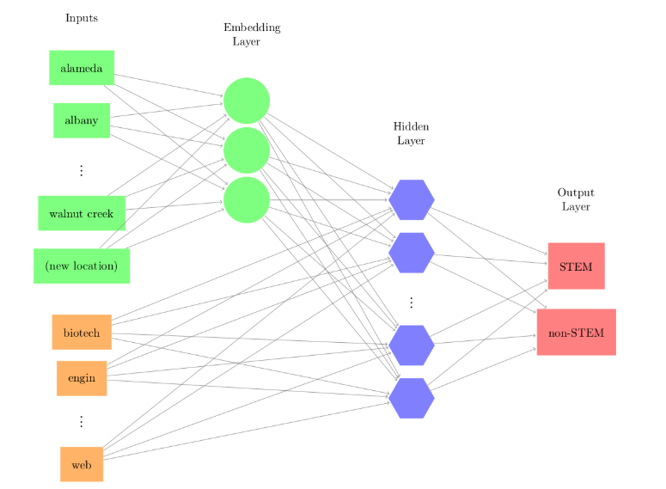
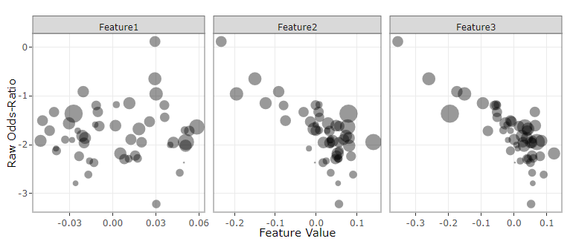
5.4 Supervised Encoding Methods
Classification example, word/entity embedding approaches
“Similar to the dimension reduction methods described in the next chapter, the idea is to estimate a smaller set of numeric features that can be used to adequately represent the categorical predictors”
Represent something with fewer dimensions…

Slide 11
5.4 Supervised Encoding Methods
caution
(like everything) be careful of over-fitting when using supervised encodings methods
“it is strongly recommended that either a different data sets be used to estimate the encodings and the predictive model or that their derivation is conducted inside resampling so that the assessment set can measure the overfitting (if it exists).”

