Slide 1
Feature Engineering and Selection… Chapter 5: Encoding Categorical Variables, pt 2
Bryan Shalloway
2019-10-01

Slide 2
Agenda
Encoding Categorical Predictors
5.6 Creating Features from Text Data
Simple text features
Keywords
Sentiment

Slide 3
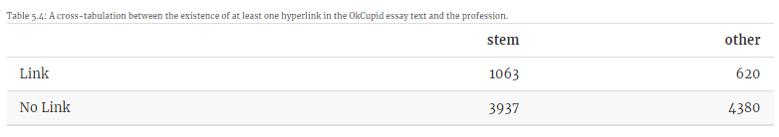
5.6 Creating Features from Text Data
Simple text features
OkC data – does open text predict STEM?
Profile contains simple text features, e.g. hyperlinks; mentions; other specific items
Odds ratios:
Odds : p / 1 - p
Odds ratio: ratio of two quantities of odds
Odds hyperlink in STEM: 0.21 / 0.79 = 0.27
Odds hyperlink non-STEM: 0.142
Odds ratio {hyperlink STEM} : {hyperlink non-STEM}: 0.27 / 0.142 = 1.9
Should ask is it significant?
95% confidence interval gives a lower bound of 1.7
because lower-bound does not overlap with 1 → is significant
(remember odds ratio of 1 equates to equal ratios of hyperlinks in STEM and non-STEM profiles)

Slide 4
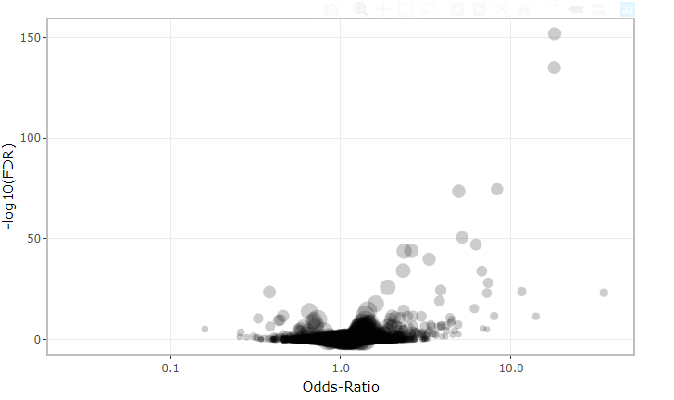
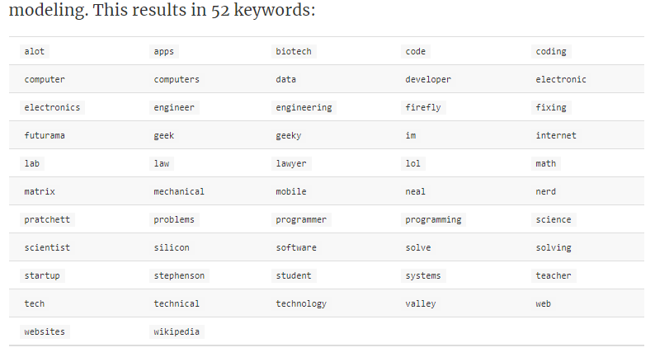
5.6 Creating Features from Text Data
Keyword analysis
63,440 words → cut-down to 4,918 (>50 occurrences)
Calculate odds ratios on the occurrence of these terms in profiles
Limitations of p-values:
P-value answers “is there a difference” does not tell magnitude, i.e. “how much”
If you test many p-values, will get False Discovery Rate (will use correction to account for this)
http://www.feat.engineering/text-data.html

Slide 5
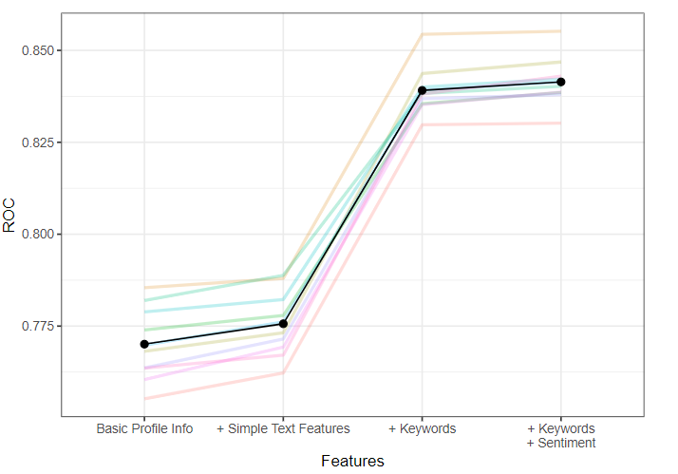
Performance with features included
Basic set of profile characteristics (160 predictors) w/o open-text, AUC: 0.77
Basic set + simple text features, e.g. hyperlinks (173 predictors), AUC: 0.776
Basic set + keywords, AUC: 0.839
Above + sentiment/language features, AUC: 0.841

Slide 6
5.6 Creating Features from Text Data
Common processing steps
removing commonly used stop words, such as “is”, “the”, “and”, etc.
stemming the words so that similar words, such as the singular and plural versions, are represented as a single entity.
For example, these 7 words are fairly similar: "teach", "teacher", "teachers", "teaches", "teachable", "teaching", "teachings". Stemming would reduce these to 3 unique values: "teach", "teacher", "teachabl“
Stemming would reduce unique word count in OkC data from 62,928 → 45,486

Slide 7
5.6 Creating Features from Text Data
Term frequency – inverse document frequency
As an example, suppose the term frequency of the word “feynman” in a specific profile was 2. In the sample of profiles used to derive the features, this word occurs 55 times out of 10,000.
Compare the frequency of a word in a doc against it’s frequency in the corpus of docs
In production – need to specify the corpus of docs for comparison ahead of time (likely using training set)

Slide 8
Other…
N-grams…
Sophisticated embedding techniques…
Etc.

