Slide 1
Feature Engineering and Selection… Chapter 7: Detecting Interaction Effects
Bryan Shalloway
2019-10-22

Slide 2
Interactions
“For many problems, additional variation in the response can be explained by the effect of two or more predictors working in conjunction with each other. As a simple conceptual example of predictors working together, consider the effects of water and fertilizer on the yield of a field corn crop. With no water but some fertilizer, the crop of field corn will produce no yield since water is a necessary requirement for plant growth. Conversely, with a a sufficient amount of water but no fertilizer, a crop of field corn will produce some yield. However, yield is best optimized with a sufficient amount of water and a sufficient amount of fertilizer. Hence water and fertilizer, when combined in the right amounts, produce a yield that is greater than what either would produce alone.”
Use expert knowledge if possible… (will not be discussing though)

Slide 3
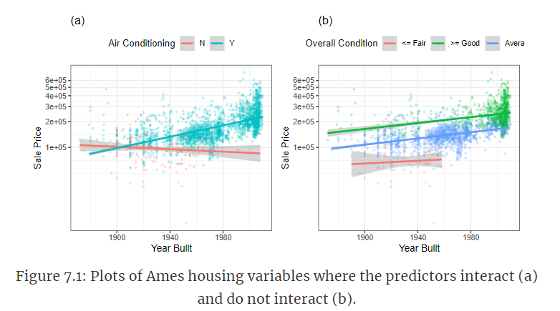
Detecting Interaction Effects
Continuous x categorical

Slide 4
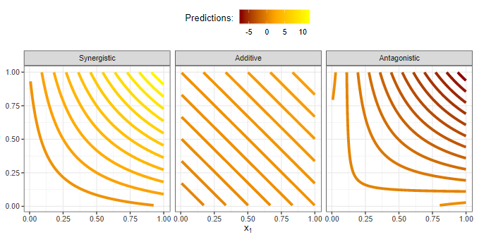

Detecting Interaction Effects
Continuous x continuous
Encoding interaction effect:

Slide 5
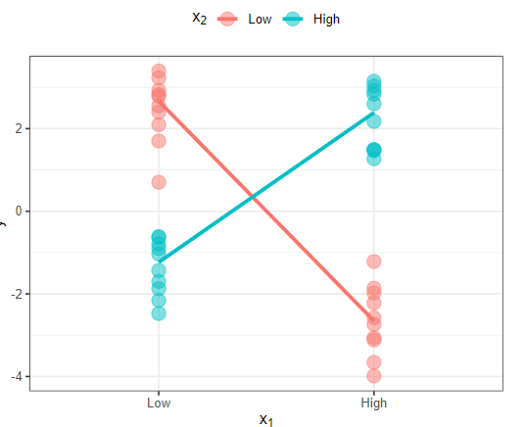
Detecting Interaction Effects
Categorical x categorical

Slide 6
Why not just use trees?
“ These findings prompt the question that if sophisticated predictive modeling techniques are indeed able to uncover the predictive information from interactions, then why should we spend any time or effort in pinpointing which interactions are important? The importance comes back to the underlying goal of feature engineering, which is to create features that improve the effectiveness of a model by containing predictively relevant information. By identifying and creating relevant interaction terms, the predictive ability of models that have better interpretability can be improved.”

Slide 7
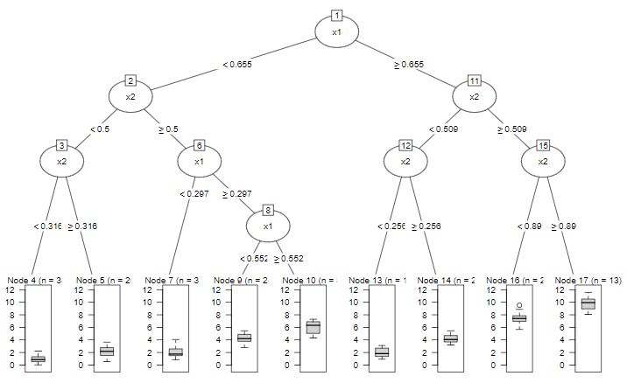
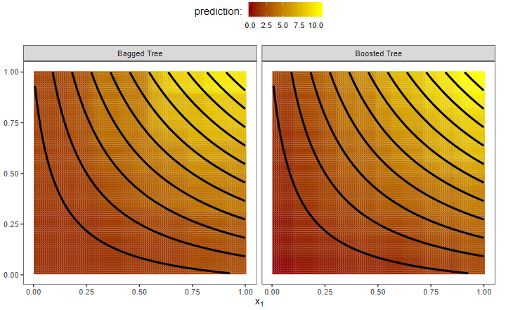
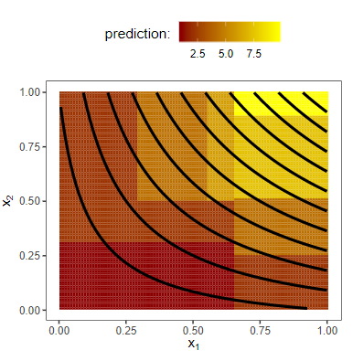
Why not just use trees?
Decision tree; bagged tree; boosted tree
Also, if an interaction exists, will not capture it quite as granularly. More work to interpret. Though will come back to…

Slide 8
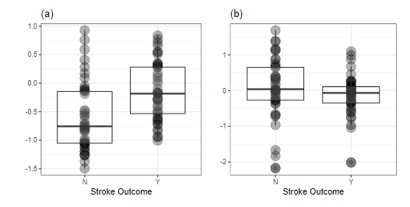
Preprocess before or after?
“For these data, the preprocessing steps were centering, scaling, and individually transformed… the interactive predictive signal is almost completely lost when the original predictors are preprocessed prior to creating the interaction term.”

Slide 9
Some principles / heuristics in search
“The interaction hierarchy principle states that the higher degree of the interaction, the less likely the interaction will explain variation in the response.”
“The second principle, effect sparsity, contends that only a fraction of the possible effects truly explain a significant amount of response variation”
PROBLEM: possible interactions increases exponentially
“With as few as 100 original predictors, complete enumeration requires a search of 4,950 terms. A moderate increase to 500 predictors requires us to evaluate nearly 125,000 pairwise terms!”

Slide 10
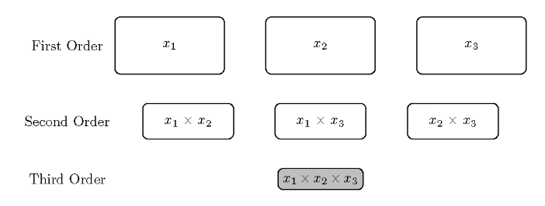
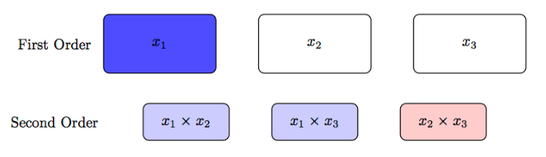
Some principles / heuristics in search
Example of “weak” hereditary principle

Slide 11
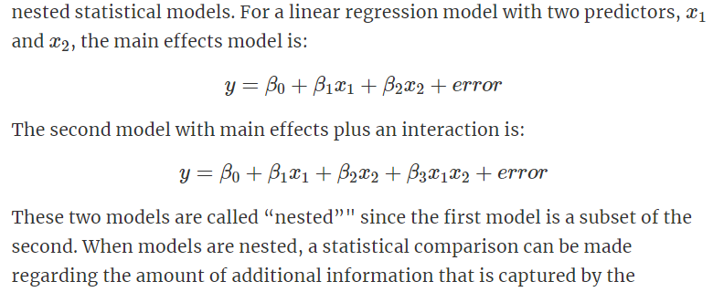
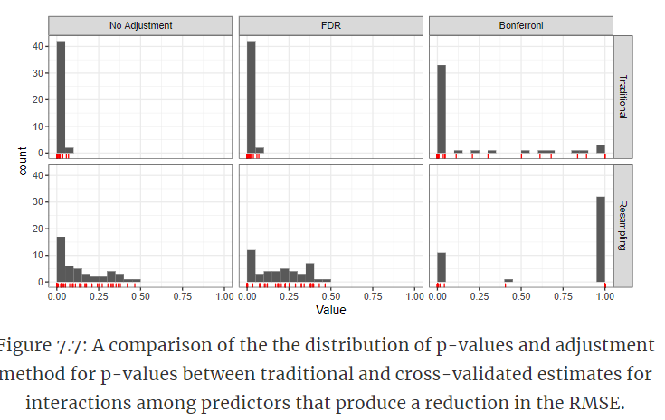
Brute force approach
Simple screening
False discovery rate is also major concern.
P-value; False Discovery Rate adjustment; Bonferroni adjustment
Ideally, use resampling techniques

Slide 12
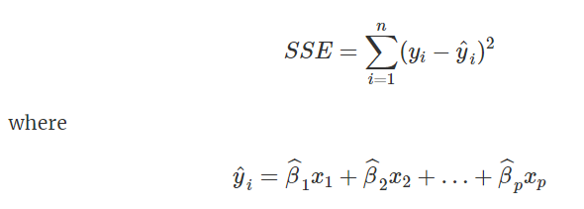



Penalized Regression
Regular linear regression:
Penalized regression:

Slide 13
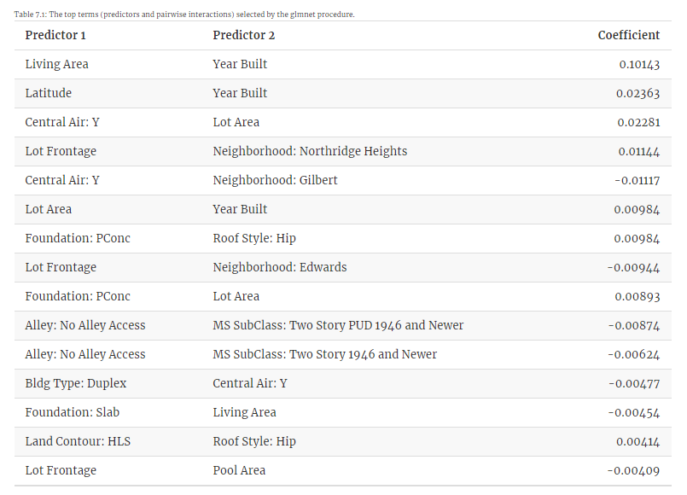
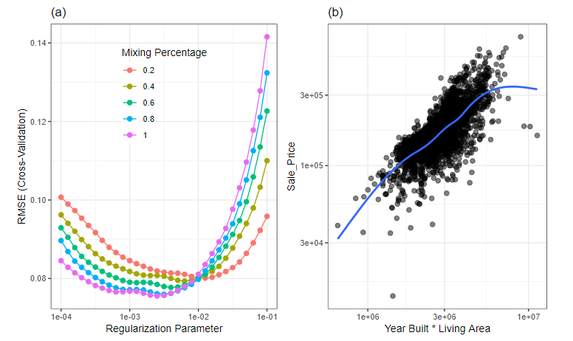
Penalized regression example
1033 predictors, 115 terms selected in best model
Bonus: interpretable, and coefficients are more meaningful

Slide 14
Two-stage modeling
Example
Use hereditary and SPARSITY principles to limit size of investigation, steps:
Identify, using only base variables as inputs, which variables are important
Use either the weak or strong hierarchy principle to create all associated pairwise interactions
Build new model with base inputs and all interaction effects
For step 1, you might use any of the following:
Selected base variables from lasso (or elastic net) regression
Most “important” variables as found by Random Forest; gradient boosting; etc.
Any method that will do feature selection for you…
P.s. I was a little confused on a minor point here so opened up a question online: https://community.rstudio.com/t/two-stage-modeling-example-in-feature-engineering-kuhn-johnson/42889

Slide 15
Tree Based methods
Tree based models naturally produce interactions – however they are “local” interactions so require multiple of them to effectively capture an interaction effect and will be somewhat partitioned. Though random forests and gradient boosting can do a better job, an interaction (if captured properly) can be better (and more simply) explained in a linear model (see slide 7 for images)
However LOCALIZED interactions may be captured better or at least more simply with tree-based methods.

Slide 16
More notes on trees
Feature weighted random forests:
“The approach presented by Basu et al. (2018) uses a form of a random forest model (called feature weighted random forests) that randomly selects features based on weights that are determined by the features’ importance. After the ensemble is created, a metric for each co-occurring set of features is calculated which can then be used to identify the top interacting features.”
Method based on partial dependence:
“compares the joint effect of two (or more) predictors with the individual effect of each predictor in a model. If the individual predictor does not interact with any of the other predictors, the difference between the joint effect and the individual effect will be close to zero.”
Produces an H statistic
Feature Importance metrics can also be used to select “main effects”

Slide 17
Feasible solution algorithm
Forward and Backward selection algorithms can be used but suffer the challenge of not having consistent or necessarily optimal final predictor sets
The Feasible Solution algorithm is a method that should produce optimal (though potentially locally optimal) predictor sets

Slide 18
Other potentially useful tools
MARS/FDA (Flexible discriminant analysis)
Cubist (builds tree with each node having a linear model)

