Slide 1
Feature Engineering Chapter 9 Working with Profile Data, pt 1
Bryan Shalloway
2019-11-12

Slide 2
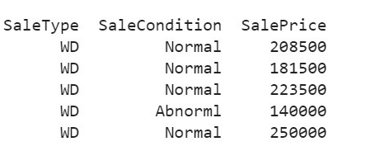
Simple example of “Unit of Prediction”
the price of a house in Iowa
“The data structure is straightforward: rows are houses and columns are fields describing them. There is one house per row and, for the most part, we can assume that these houses are statistically independent of one another. In statistical terms, it would be said that the houses are the independent experimental unit of data… the properties are the unit of prediction.”

Slide 3
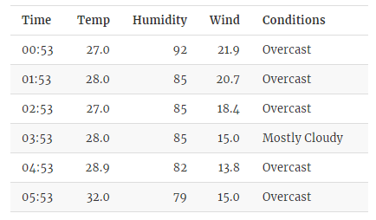
Ex. slightly more challenging data structure
Chicago train ridership data
“The data set has rows corresponding to specific dates and columns are characteristics of these days: holiday indicators, ridership at other stations a week prior, and so on. Predictions are made daily; this is the unit of prediction.”
Recall there is also weather measurements:
How does this complicate things?
“Since the goal is to make daily predictions, the profile of within-day weather measurements should be somehow summarized at the day level in a manner that preserves the potential predictive information.”
How could you do this?
Mean, median, range across data, % of day that was “clear”

Slide 4
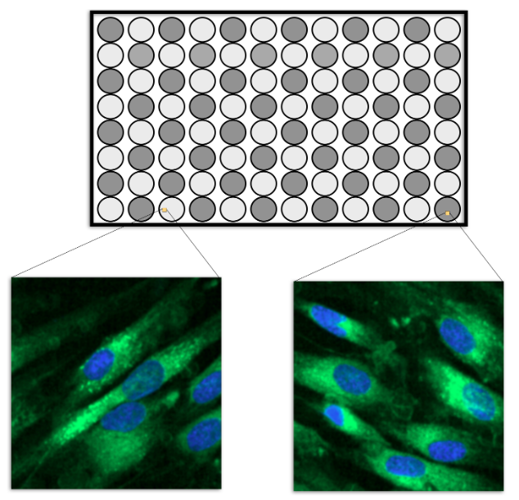
“Are there good and bad ways of summarizing profile data?”
YES
Ex. Testing drug treatments on batches of cells
Unit of measure: well;
measure characteristics of cells (cell-within-well)
Suppose calculating feature from X1 and X2 (e.g. cell length and width) “If an important feature of these two values is their difference, then there are two ways of performing the calculation.” (to get a well-level summary)
mean(x1 – x2)
mean(x1) – mean(x2)
Which seems more appropriate?
The problem with approach 2. is breaks correlational structure of data.

Slide 5
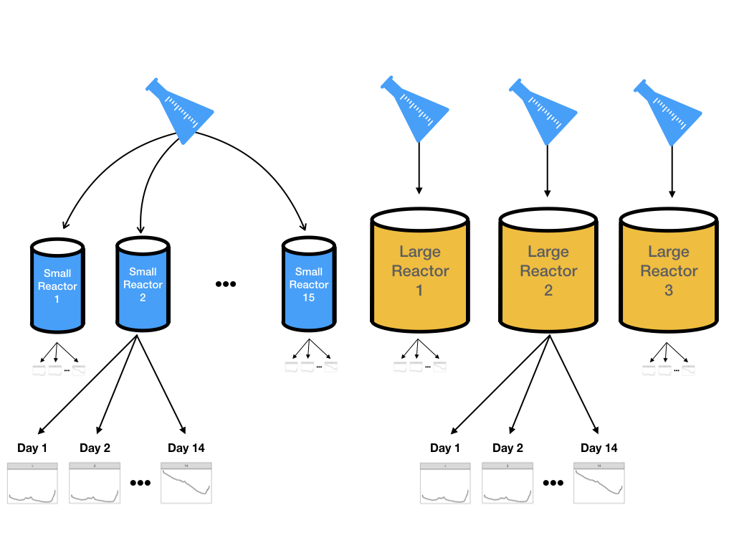
Example Pharmaceutical manufacturing
“Pharmaceutical companies use spectroscopy measurements to assess critical process parameters during the manufacturing of a biological drug… Models built on this process can be used with real-time data to recommend changes that can increase product yield.”
(spectroscopy is meant to give faster window to things like ammonia level, glucose level, etc.)

Slide 6
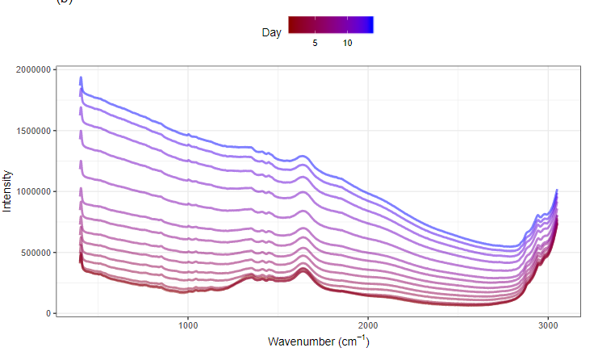
Example Pharmaceutical manufacturing
“Nearly 2600 wavelengths are measured each day for two weeks for each of 15 small-scale bioreactors. This type of data forms a hierarchical structure in which wavelengths are measured within each day and within each bioreactor. Another way to say this is that the wavelength measurements are nested within day which is further nested within bioreactor.”
“The use case for the model is to make a prediction for a bioreactor for a specific number of days that the cells have been growing. For this reason, the unit of prediction is day within bioreactor.”
HOWEVER THE EXPERIMENTAL UNIT IS AN INDIVIDUAL BIOREACTOR

Slide 7
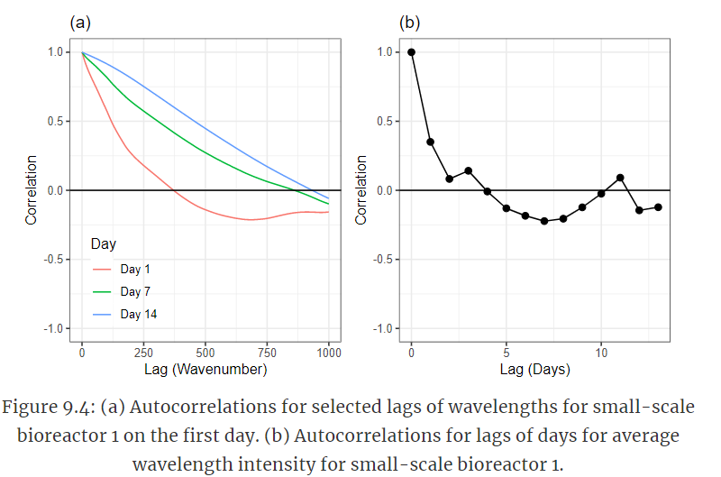
Correlation and understanding experimental unit
“Understanding the units will guide the selection of cross validation method and is crucial for getting an honest assessment of a model’s predictive ability on new days.”

Slide 8
Correlation and understanding experimental unit
“Consider, for example, if each day (within each bioreactor) was taken to be independent experimental unit and V-fold cross-validation was used as the resampling technique. In this scenario, days within the same bioreactor will likely be in both the analysis and assessment sets… Given the amount of correlated data within day, this is a bad idea since it will lead to artificially optimistic characterizations of the model.”

Slide 9
Feature Engineering Chapter 9 Working with Profile Data, pt 2
Bryan Shalloway
2019-11-19

Slide 10
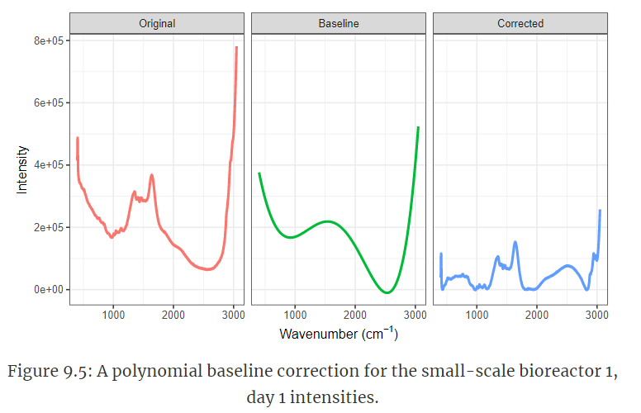
Reducing background noise
Some big differences are due to differences in background, rather than differences in molecules of interest (like glucose)
Smooth polynomial to LOWEST INTENSITY across spectra for each batch

Slide 11
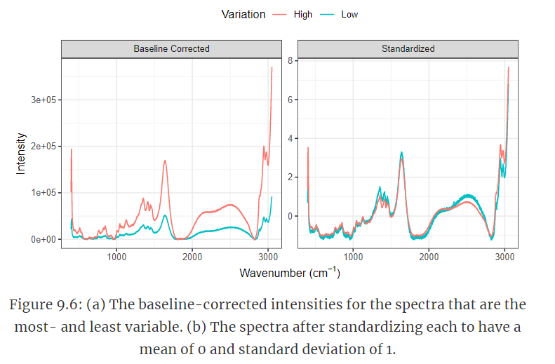
Reducing Other Noise
Standardize intensity (mean = 0, standard deviation = 1)
In this case, also trimmed extreme values to prevent this from skewing standardization

Slide 12
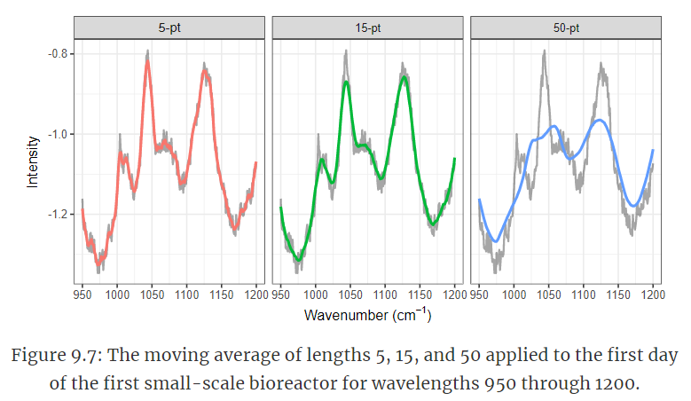
Reducing other noise
Can correct for jagged differences in data via moving average or smoothing spline

Slide 13
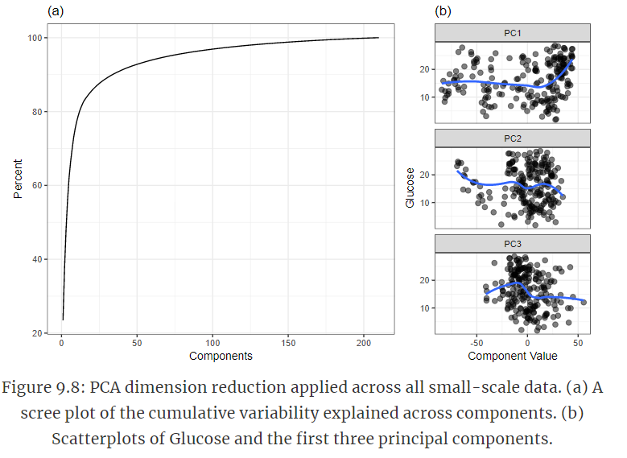
Exploiting correlation
“The previous steps of estimating and reducing baseline and reducing noise help to refine the profiles and enhance the true signal that is related to the response within the profiles. These steps, however, do not reduce the between-wavelength correlation within each sample which is still a problematic characteristic for many predictive models.”
Try PCA, kernel PCA, ICA, partial least squares… or other dimensionality reduction techniques…

Slide 14
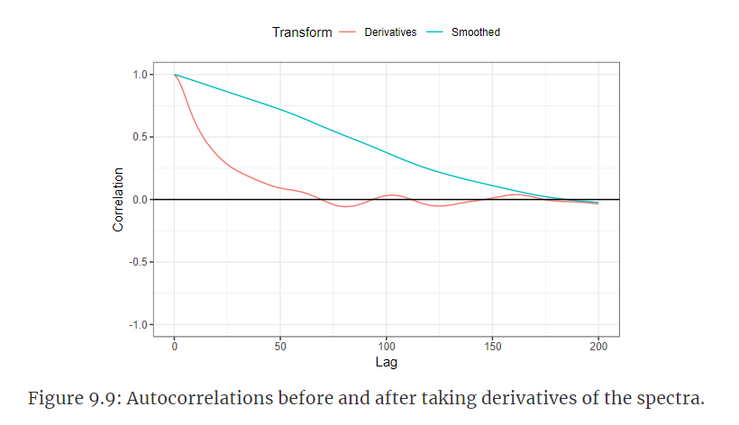
Exploiting correlation
Calculate differences (x_t) – (x_t-1)
Can substantially reduce autocorrelation
(Could also filter out highly correlated spectra wavelengths…)

Slide 15
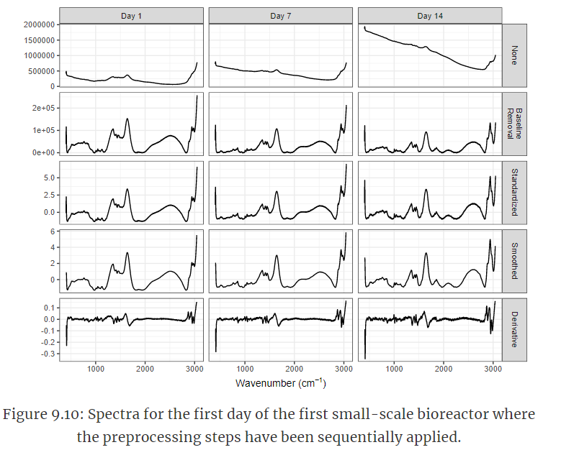
Exploiting correlation
“These steps shows how the within-spectra drift has been removed and most of the trends that are unrelated to the peaks have been minimized.”

Slide 16
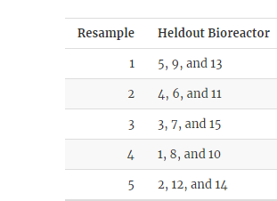
Sampling pre-processing
“The amount of preprocessing could be considered a tuning parameter.”
Want best model and best preprocessing
15 small bioreactors in training set
Leave one out cross validation
V-fold cross validation, e.g. 5-fold (would have 3 reactors in hold-out)
Repeated V-fold cross-validation

Slide 17
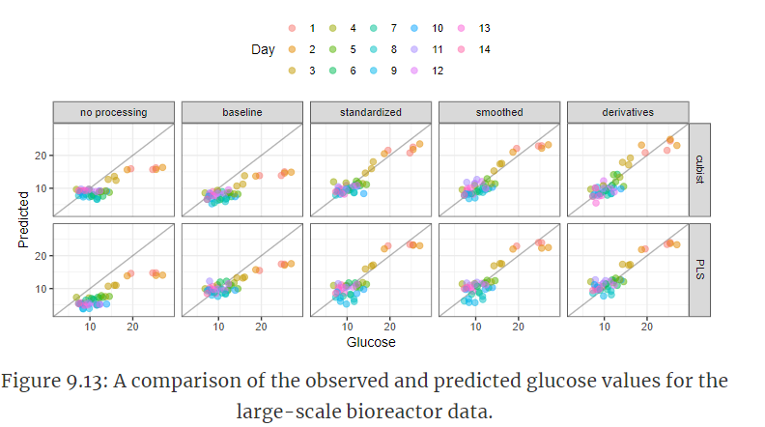
Impacts of Data Processing on Modeling
Notice systematic errors by day until preprocessing is completed

Slide 18
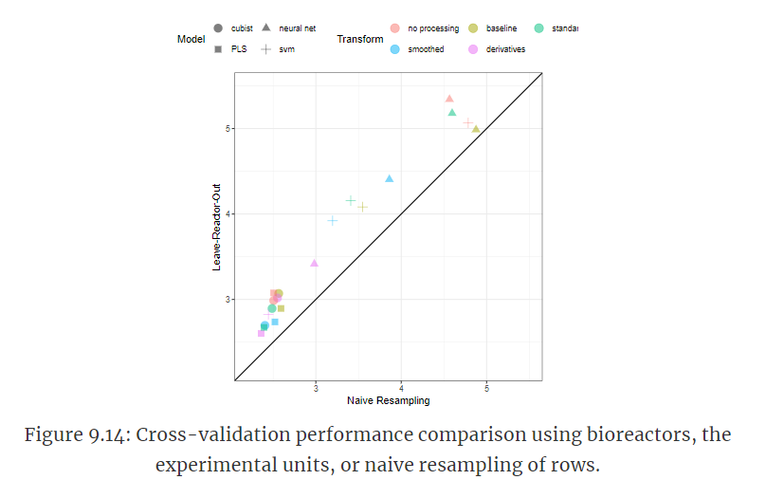
Impacts of Data Processing on Modeling
If had taken naïve assumption that each day-within-bioreactor were experimental unit, would have had naïve performance estimates

Slide 19
Summary
“the analyst needs to be keenly aware of what the experimental unit is. Understanding the unit informs decisions about how the profiles should be preprocessed, how samples should be allocated to training and test sets, and how samples should be allocated during resampling.”
“Basic preprocessing steps for profiled data can include reducing baseline effect, reducing noise across the profile, and harnessing the information contained in the correlation among predictors. An underlying goal of these steps is to remove the characteristics that prevent this type of data from being used with most predictive models while simultaneously preserving the predictive signal between the profiles and the outcome.”

