Slide 1
Feature Engineering
Chapter 10
Stephen Kimel

Slide 2
Feature Selection
There is a “desire to have a model that has the best predictive ability and is interpretable.”
“trade-off between predictive performance and model interpretability”
“A misunderstanding of this trade-off leads to the belief that simply filtering out uninformative predictors will help elucidate which factors are influencing the outcome.”
Some models are resistant to irrelevant and/or correlated predictors and some are not.
Goal is to “reduce the number of predictors as far as possible without compromising predictive performance.”

Slide 3
Methods of Feature Selection

Slide 4
Intrinsic/Implicit
Naturally incorporated into the modeling process
Tree-based models

Slide 5
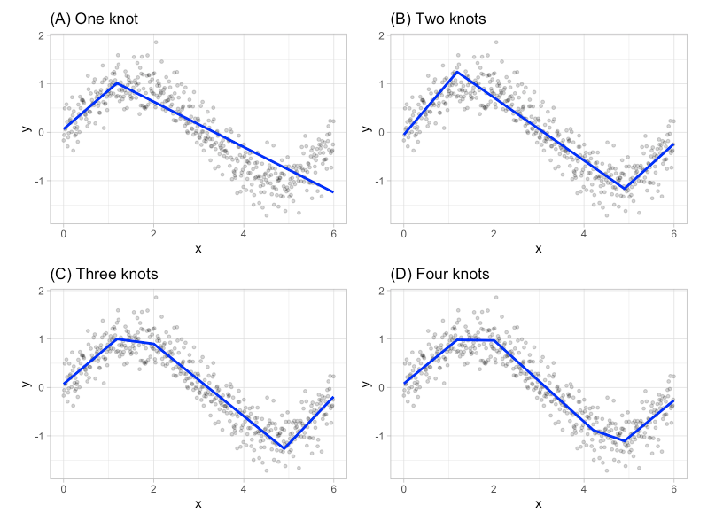
Intrinsic/Implicit
Naturally incorporated into the modeling process
Tree-based models
MARS Models (earth package in R)

Slide 6
Intrinsic/Implicit
Naturally incorporated into the modeling process
Tree-based models
MARS Models (earth package in R)
Lasso Regression (standardize and penalize)
Pros:
Easy
Fast (not as much preprocessing)
Connection between objective function (what we are trying to minimize or maximize) and feature selection
Cons:
Can only be used in the specific model

Slide 7
Filter
Single search to find important variables
Simple and fast
Odds-ratio threshold
More in Chapter 11

Slide 8
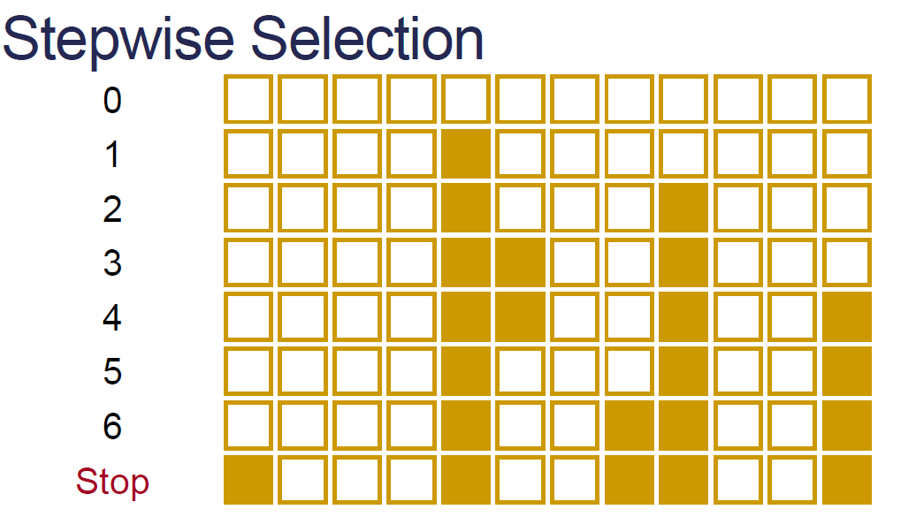
Wrapper
Multiple steps adding and/or removing variables
Greedy – What is the best decision right now?
Non-greedy – Look back at previous decision to determine if they are still the right ones
Tend to overfit the training set
More in chapters 11 and 12

Slide 9
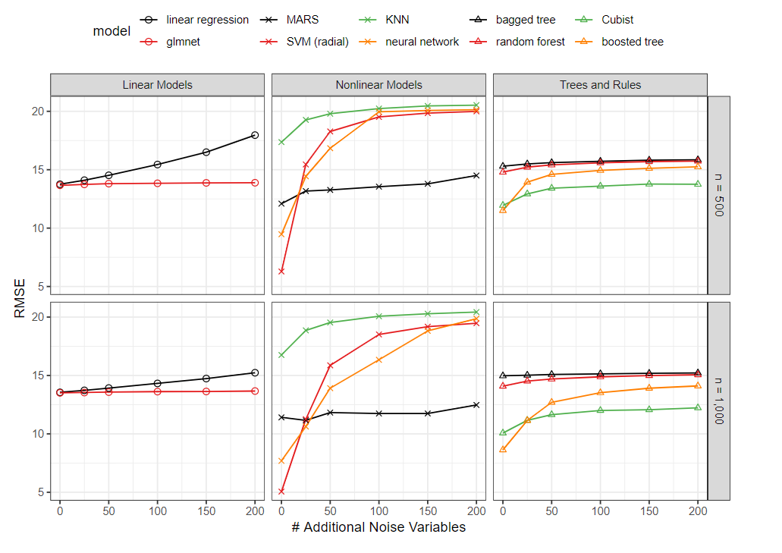
Effects of Irrelevant Predictors

Slide 10
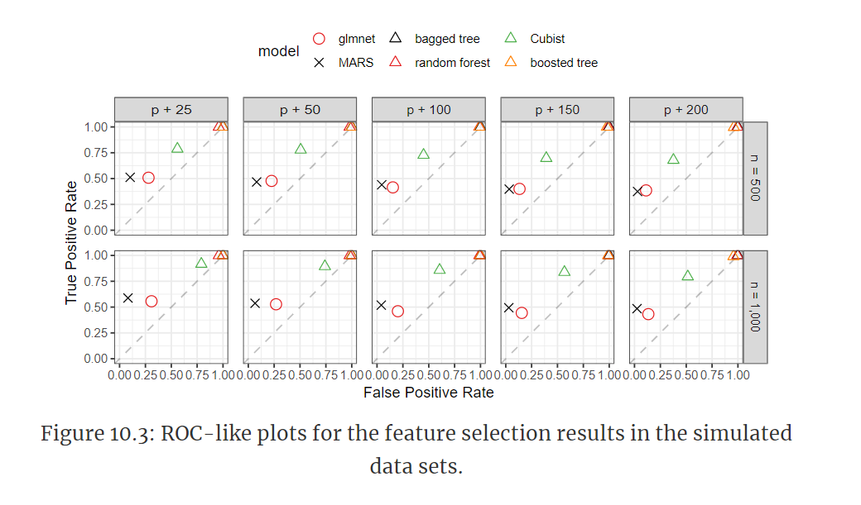
Did the Models Choose the Right Predictors?

Slide 11
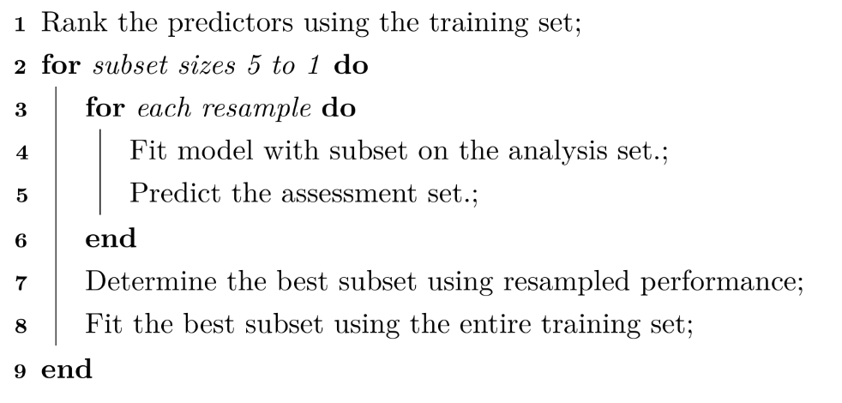
Cautions with Feature Selection
Notes:
Since the feature selection is external to the resampling, resampling cannot effectively measure the impact (good or bad) of the selection process. Here, resampling is not being exposed to the variation in the selection process and therefore cannot measure its impact.
The same data are being used to measure performance and to guide the direction of the selection routine. This is analogous to fitting a model to the training set and then re-predicting the same set to measure performance. There is an obvious bias that can occur if the model is able to closely fit the training data. Some sort of out-of-sample data are required to accurately determine how well the model is doing. If the selection process results in overfitting, there are no data remaining that could possibly inform us of the problem.

Slide 12
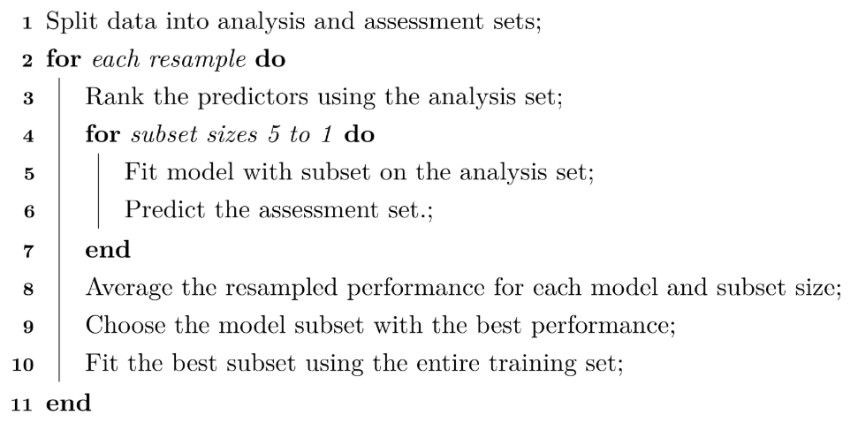
A Better Way
0 Split data into Train and Test

Slide 13
Case Study
“In this problem, a researcher had collected 75 samples from each of the two classes. There were approximately 10,000 predictors for each data point. The ultimate goal was to attempt to identify a subset of predictors that had the ability to classify samples into the correct response with an accuracy of at least 80%.”
“The researcher chose to use 70% of the data for a training set, 10-fold cross-validation for model training, and the implicit feature selection methods of the glmnet and random forest.”
Accuracy was under 60% ☹
“The logic was then to first identify and select predictors that had a univariate signal with the response. A t-test was performed for each predictors, and predictors were ranked by significance of separating the classes. The top 300 predictors were selected for modeling.”

Slide 14
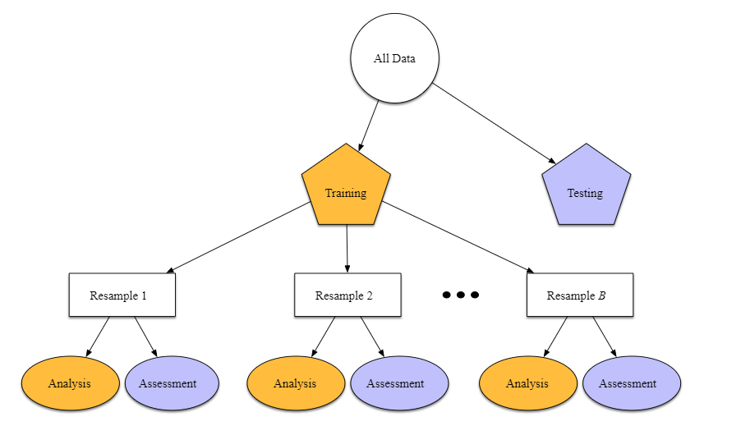
When Were the t-tests Done?

Slide 15
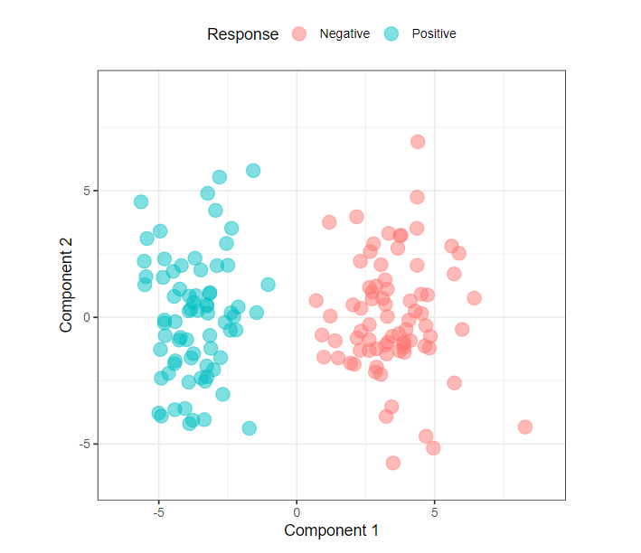
What What!?

Slide 16
What What!?
“Regrettably, because feature selection was performed outside of resampling, the apparent signal that was found was simply due to random chance.”

