Slide 1
Feature Engineering
Chapter 12
Stephen Kimel

Slide 2
Naïve Bayes

Slide 3
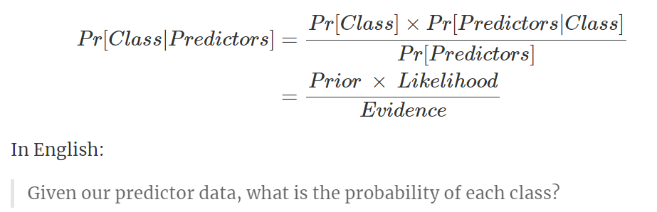
Naïve Bayes Models
Naïve = assumption that predictors are independent
Normalization function

Slide 4
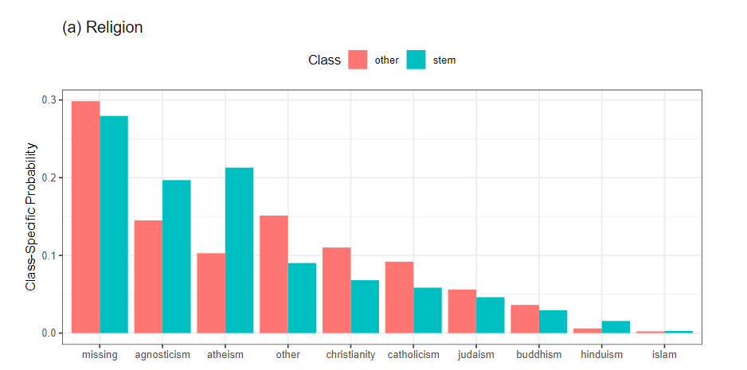

Categorical Variable

Slide 5
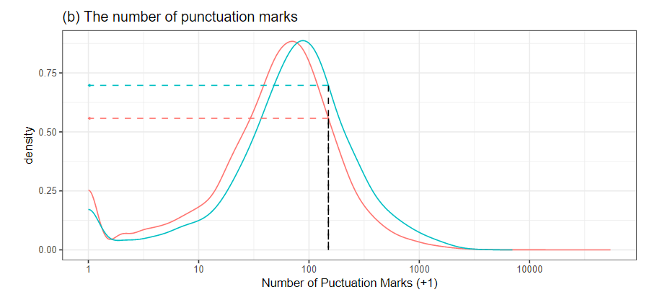
Continuous Variable
Notes:
compute a nonparametric density function on these data (with a log10 transformation)

Slide 6
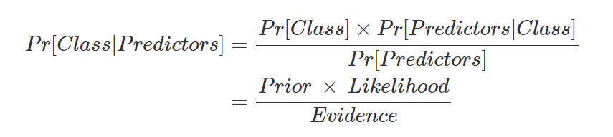
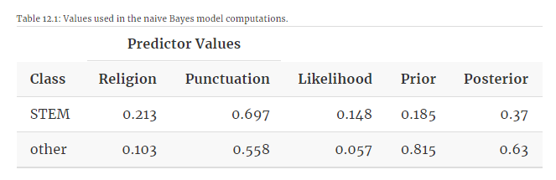
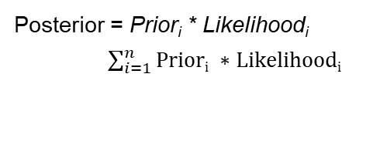
Calculations
Posterior = Prior_{i} * Likelihood_{i}
$\sum_{i=1}^{n}{Priori ∗Likelihoodi}$
*
=
*
.027
*
=
*
.046
Notes:
0.02738 0.046455
0.073835
0.370826844 0.629173156

Slide 7
Simulated Annealing

Slide 8
Simulated Annealing
Find Most Predictive Set of Features
Random Subset of Features
Chose Number of Iterations
Build Model
Calculate Performance
Randomly Include/Exclude 1-5% of Features
If the Model Improved Keep New Model and Repeat Process
If Model Did Not Improve…
Notes:
In the context of feature selection, a predictor is a particle, the collection of predictors is the material, and the set of selected features in the current arrangement of particles. To complete the analogy, time is represented by iteration number, and the change in the material’s energy is the change in the predictive performance between the current and previous iteration. This process is called simulated annealing

Slide 9
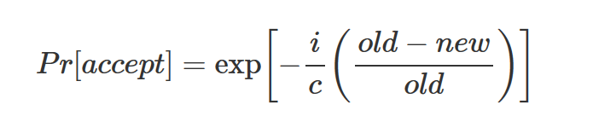
Model Did Not Improve
i = iteration
c = constant
Once the probability is calculated, randomly choose a number between 0 and 1 from a uniform distribution and compare to probability.
If random number is greater, the new feature set is rejected

Slide 10
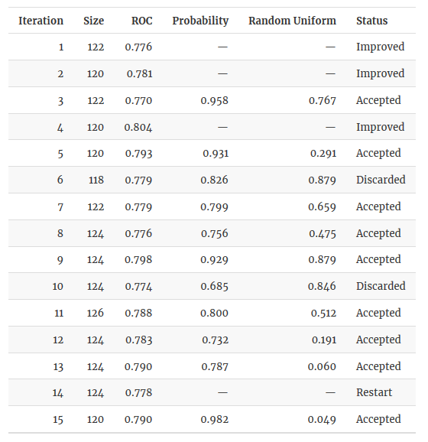
More on Simulated Annealing
If an optimal solution has not been found within I iterations, search resets to the last known optimal solution and proceeds again with I being the number of iterations since the restart
Notes:
SHOW BOOK

Slide 11
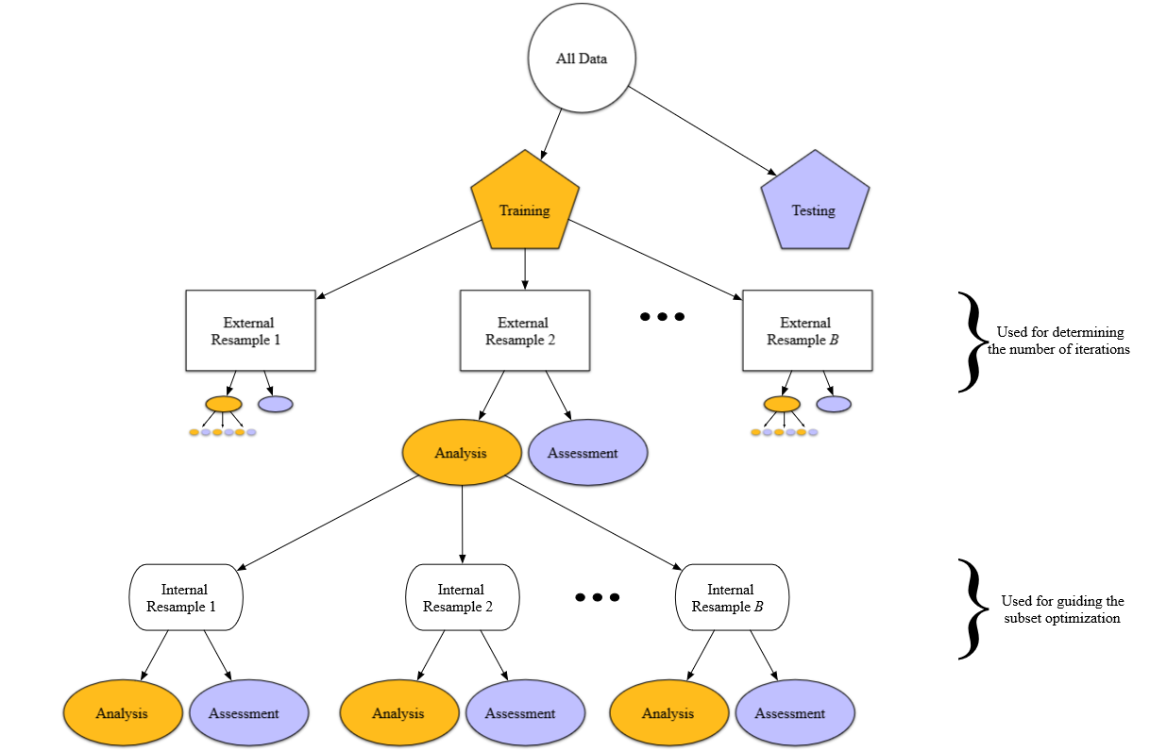
Resampling
Notes:
In smaller data sets, it is not uncommon for the internal performance estimates to continue to show improvements while the external estimates are flat or become worse. While the use of two levels of data splitting is less straightforward and more computationally expensive, it is the only way to understand if the selection process is overfitting.
Once the optimal number of search iterations is determined, the final simulated annealing search is conducted on the entire training set. As before, the same data set should not be used to create the model and estimate the performance. An internal split is still required.

Slide 12
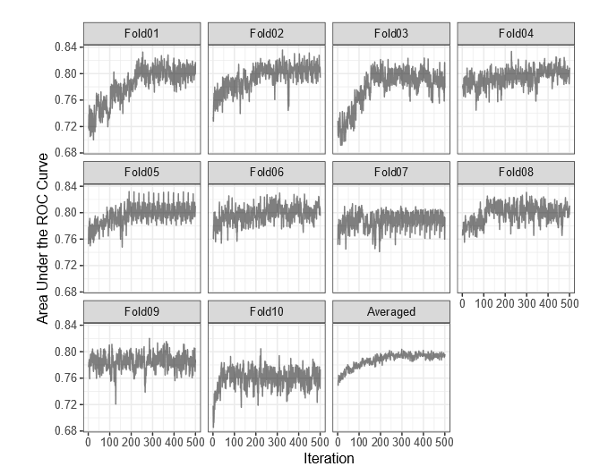
Looking at the Folds

Slide 13
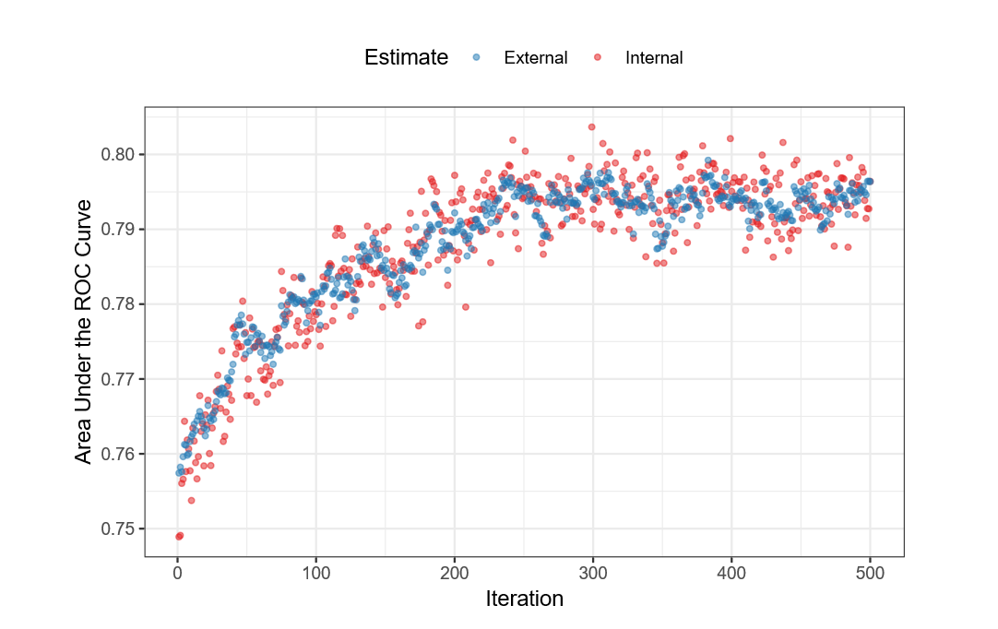
OkCupid

Slide 14
Final Check
A randomization approach was used to investigate if the 52 selected features contained good predictive information. For these data, 100 random subsets of size 66 were generated and used as input to naive Bayes models. The performance of the model from SA was better than 95% of the random subsets. This result indicates that SA selection process approach can be used to find good predictive subsets.

Slide 15
t-test
“For a SA search lasting 500 iterations, there should be roughly 250 subsets with and without each predictor and each of these has an associated area under the ROC curve computed from the external holdout set.”
Most significant variables from t-test: education level, software, keyword, income, the number of words, startup, solving, the number of characters/word, height, and the number of lower space characters

Slide 16
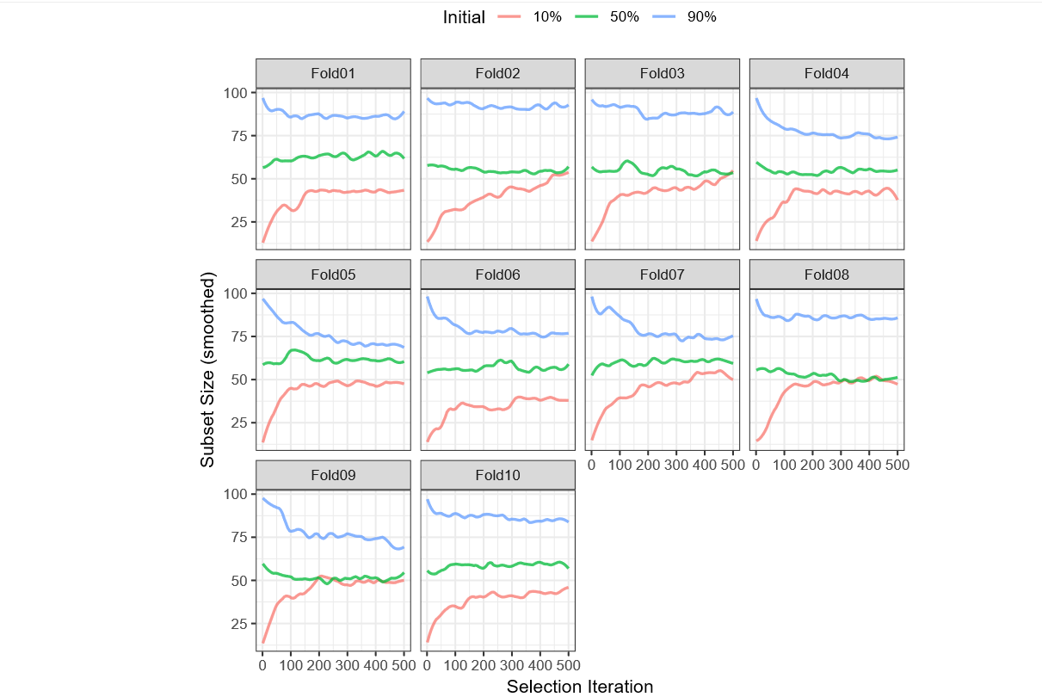
Final Notes on SA
Could dummy code categorical variables

Slide 17
Genetic Algorithms

Slide 18
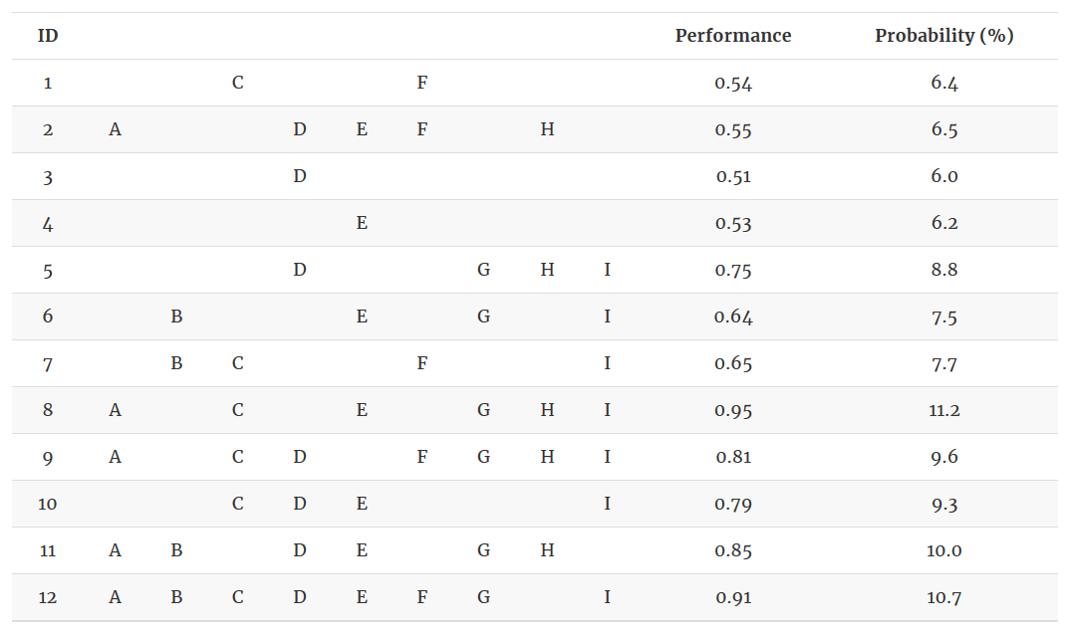
Example

Slide 19
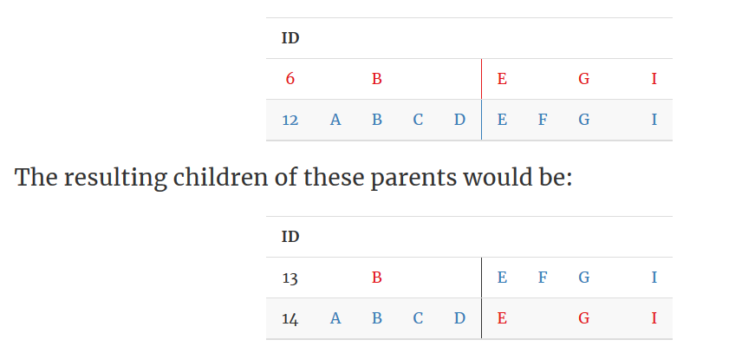
Babies
Mutation?

Slide 20
Natural Selection
A logical approach to selecting parents would be to choose the top-ranking features subsets as parents. However, this greedy approach often leads to lingering in a locally optimal solution. To avoid a local optimum, the selection of parents should be a function of the fitness criteria. The most common approach is to select parents is to use a weighted random sample with a probability of selection as a function of predictive performance.
Notes:
Unlike simulated annealing, the GA feature subsets are grouped into generations instead of considering one subset at a time. But a generation in a GAs is similar to an iteration in simulated annealing.
In practice, the initial population of feature subsets needs to be large enough to contain a sufficient amount of diversity across the feature subset space. Often 50 or more randomly selected feature subsets are chosen to seed the initial generation.

Slide 21
OkCupid
Generation size: 50,
Crossover probability: 80%,
Mutation probability: 1%,
Elitism: No,
Number of generations: 14
Notes:
hen elitism is used within a GA, the most fit solution across the observed generations will always be in the final generation. However, this process can cause the GA to linger longer in local optimums since the best chromosome will always have the highest probability of reproduction.

Slide 22
Jaccard similarity
This metric is the proportion of the number of predictors in common between two subsets divided by total number of unique predictors in both sets. For example, if there were five possible predictors, the Jaccard similarity between subsets ABC and ABE would be 2/4 or 50%. This value provides insight on how efficiently the generic algorithm is converging towards a common solution or towards potential overfitting.

Slide 23
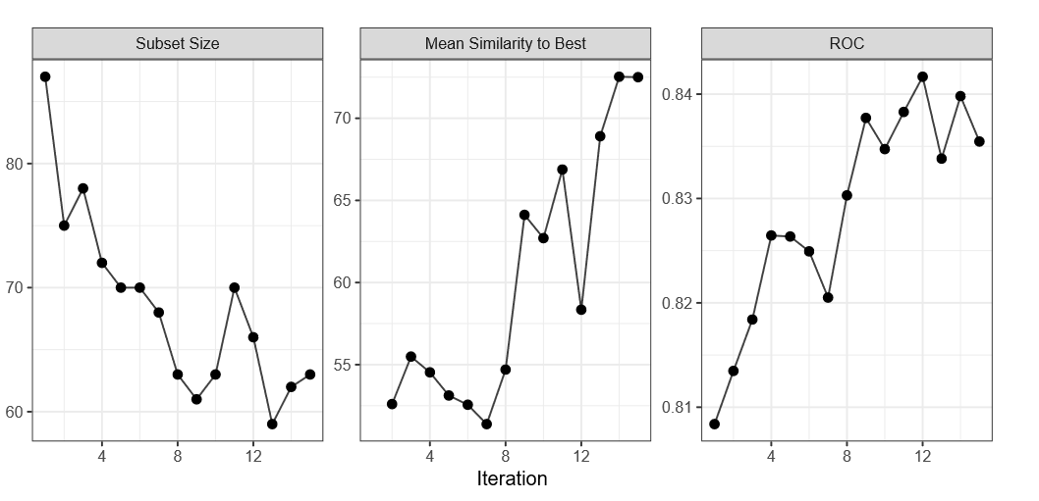
Results

Slide 24
GA Effectiveness
To gauge the effectiveness of the search, 100 random subsets of size 63 were chosen and a naive Bayes model was developed for each. The GA selected subset performed better than 100% of the randomly selected subsets. This indicates that the GA did find a useful subset for predicting the response.

Slide 25
Desirability Functions
A simple desirability function would be a line that has zero desirability when the AUC is less than or equal to 0.50 and is 1.0 when the AUC is 1.0. Conversely, a desirability function for the number of predictors in the model would be 0.0 when all of the predictors are in the model would be 1.0 when only one predictor is in the model.
Once all of the individual desirability functions are defined, the overall desirability statistic is created by taking the geometric mean of all of the individual functions.

