Slide 1
Feature Engineering
Chapter 4
Stephen Kimel

Slide 2
Chicago Train Ridership
“Two common mistakes of misunderstanding demand could be made. At one extreme, having too few cars on a line to meet weekday demand would delay riders from reaching their destination and would lead to overcrowding and tension. At the other extreme, having too many cars on the weekend would be inefficient leading to higher operational costs and lower profitability. Good forecasts of demand would help the CTA to get closer to optimally meeting demand.”
“Our illustration will narrow to predicting daily ridership at the Clark/Lake stop.”
Notes:
For these data, the ridership numbers for the other stations might be important to the models. However, since the goal is to predict future ridership volume, only historical data would be available at the time of prediction.
Other potential regional factors that may affect public transportation ridership are the weather, gasoline prices, and the employment rate.

Slide 3
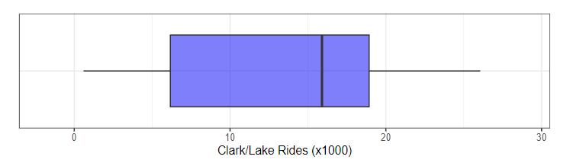
Boxplot
IQR
1.5 * IQR up to last point
25%
25%
Notes:
A drawback of the box plot is that it is not effective at identifying distributions that have multiple peaks or modes.

Slide 4
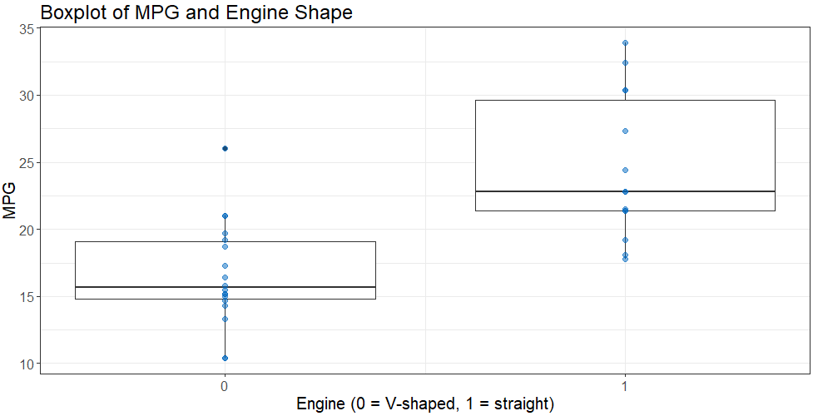

Slide 5
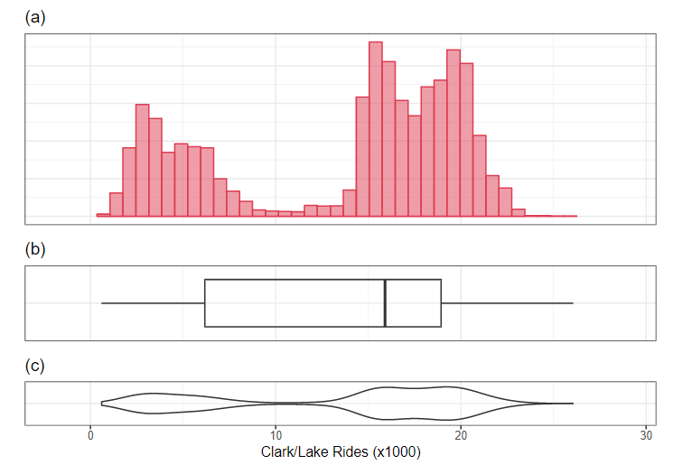
Histogram vs. Bloxplot vs. Violinplot

Slide 6
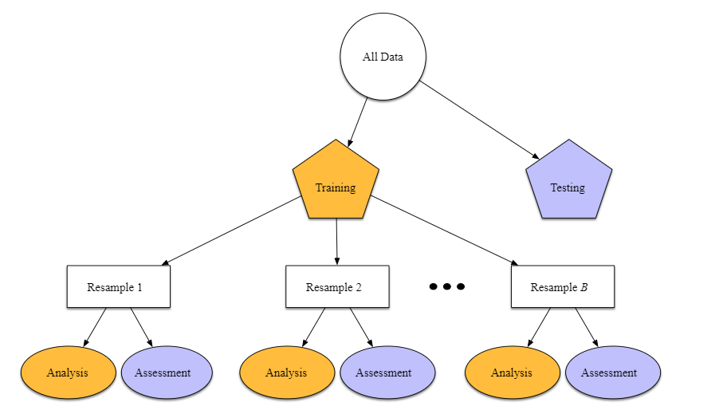
“Given the range of the daily ridership numbers, there was some question as to whether the outcome should be modeled in the natural units or on the log scale. On one hand, the natural units makes interpretation of the results easier since the RMSE would be in terms of riders. However, if the outcome were transformed prior to modeling, it would ensure that negative ridership could not be predicted. The bimodal nature of these data, as well as distributions of ridership for each year that have a longer tail on the right made this decision difficult. In the end, a handful of models were fit both ways to make the determination. The models computed in the natural units appeared to have slightly better performance and, for this reason, all models were analyzed in the natural units.”
Assessment1 RMSE | Analysis | Analysis | Analysis | Analysis
Analysis | Assessment2 RMSE | Analysis | Analysis | Analysis
Analysis | Analysis | Assessment3 RMSE | Analysis | Analysis
Analysis | Analysis | Analysis | Assessment4 RMSE | Analysis
Analysis | Analysis | Analysis | Analysis | Assessment5 RMSE
Overall Model Performance = mean(Assessment1 RMSE…Assessment5 RMSE)

Slide 7
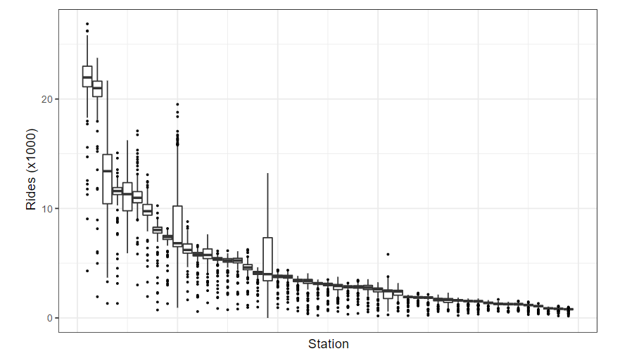
Observing Predictor Variables with Ridership

Slide 8
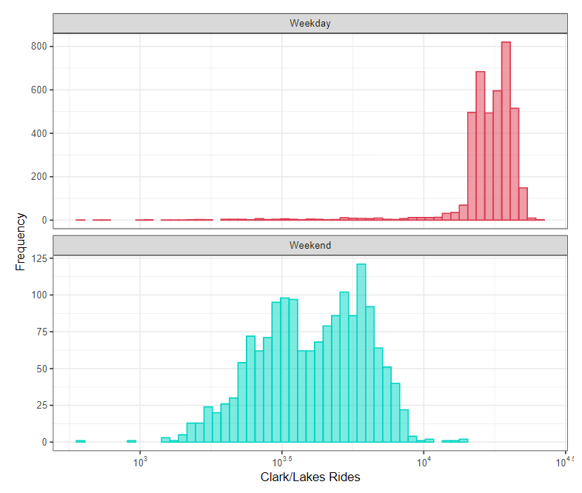
Faceting

Slide 9
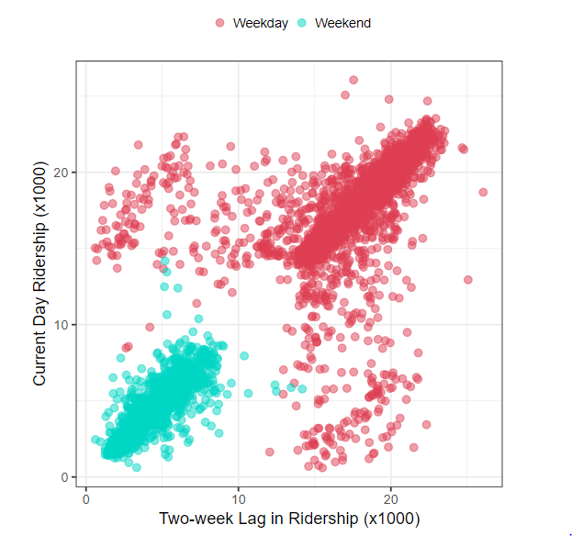
Scatterplots
Notes:
lags

Slide 10
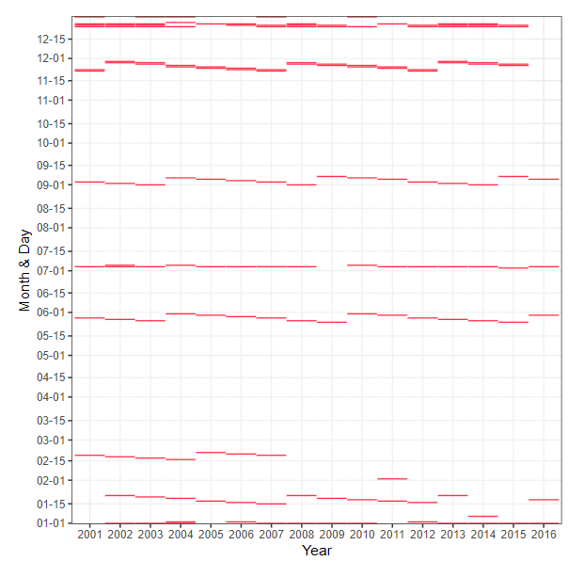
Heatmap

Slide 11
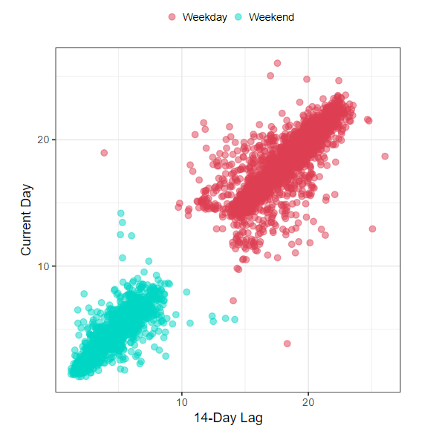
After Some Feature Engineering
Notes:
Correlation plots

Slide 12
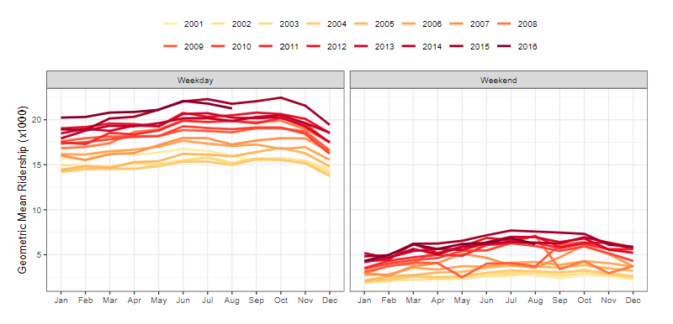
Line Charts

Slide 13
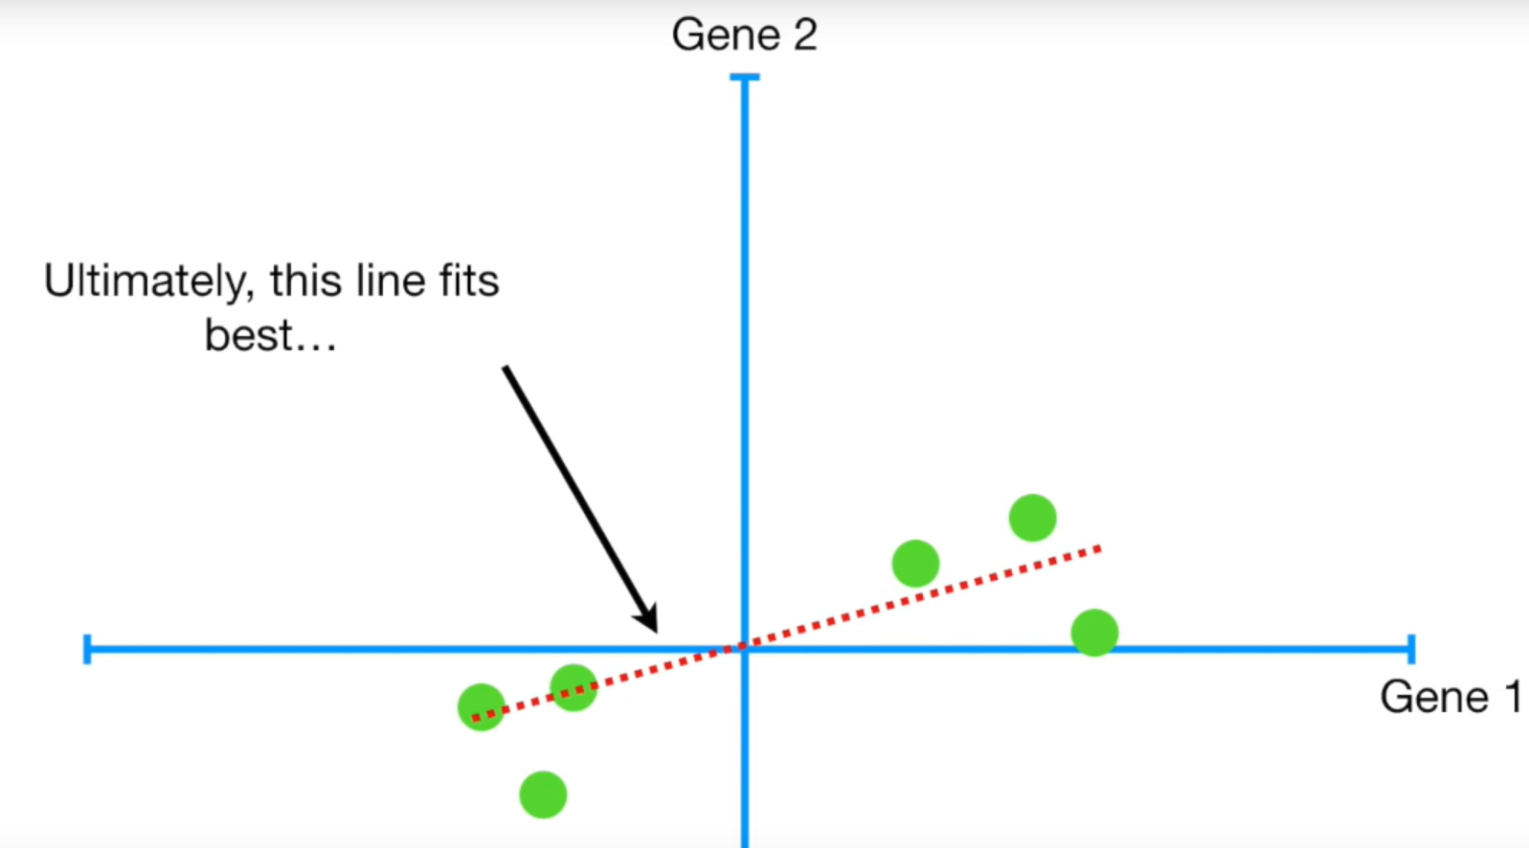

PCA
https://www.youtube.com/watch?v=FgakZw6K1QQ&vl=en
Goal: Retain the most information while reducing the number of dimensions

Slide 14
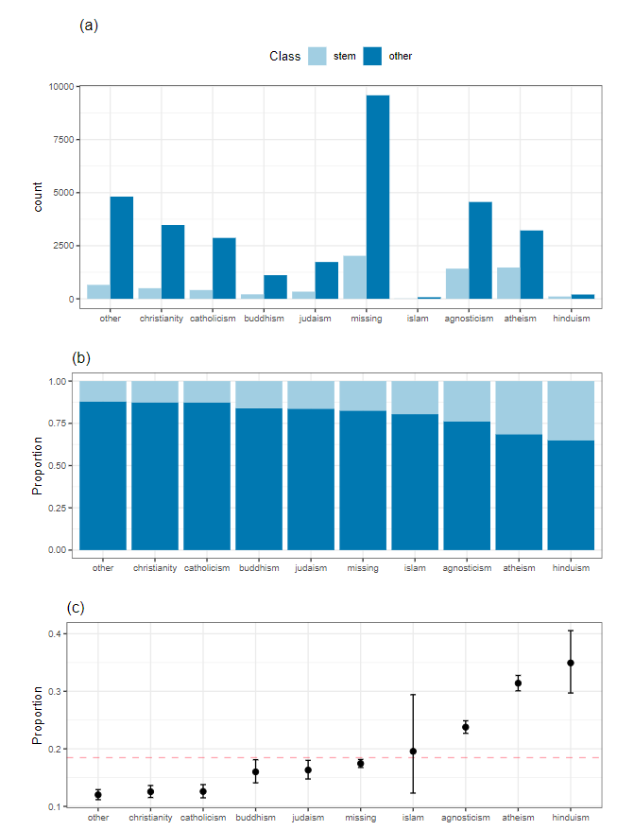
Are Proportions Different?

Slide 15
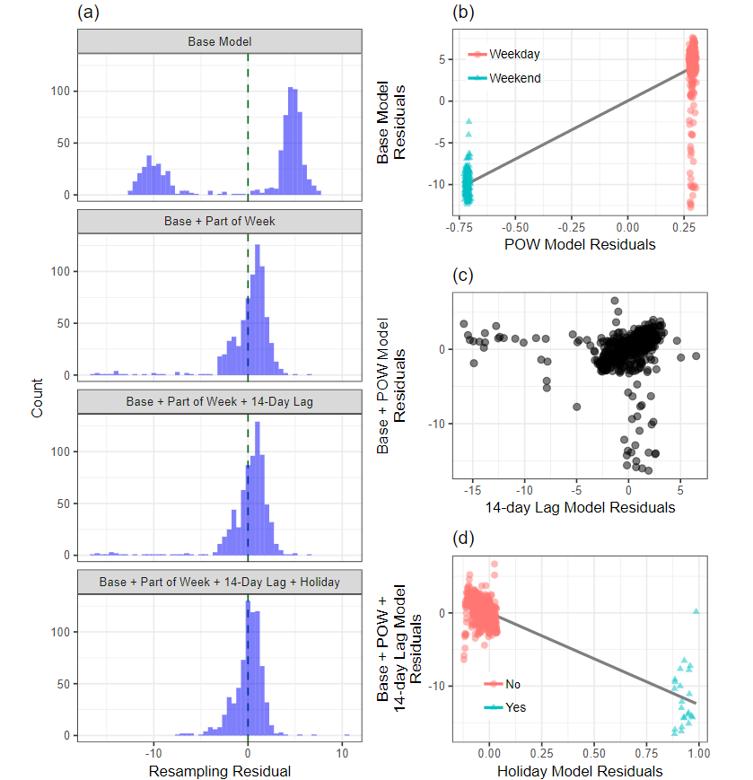
Post-Modeling Charts
weekday = month + year + week
Partial Regression Plots
Base Model is:
ridership = month + year + week

