Slide 1
Feature Engineering
Chapter 8
Stephen Kimel

Slide 2
Reasons for Missing Data
Structural issues
Random occurrences, or
Specific causes

Slide 3
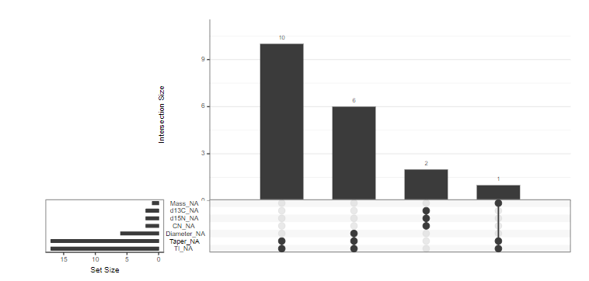
Visualizing Missing Data

Slide 4
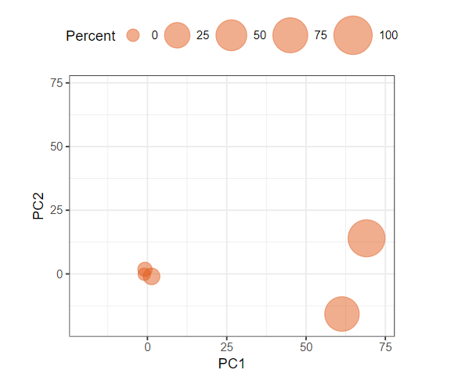
Using PCA to Identify Missing Data
0 is non-missing and 1 is missing

Slide 5
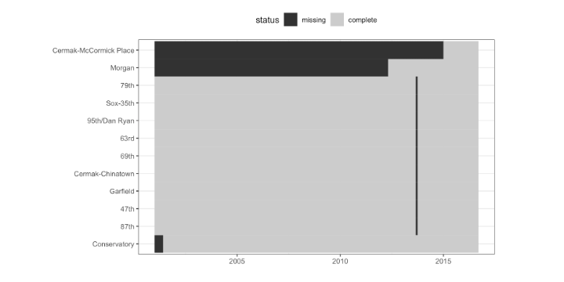
Visualizing Missing Data

Slide 6
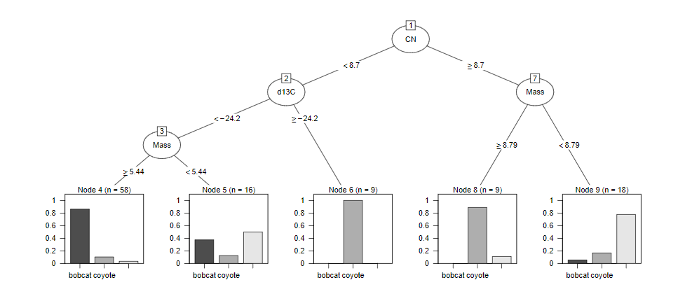
Models Resistant to Missing Data
Bolds are Variables
CART (Tree-based) surrogate split
Find variable highly correlated (Flat) with the variable you want to split on (CN)
If data point is missing (CN) for a certain observation, split on the highly correlated variable (Flat)
Flat
No
Yes

Slide 7
Can We Just Observations/Columns with Delete Missing Data?
Notes:
Might loose some information. Columns with a lot of missing data should probably be deleted.

Slide 8
Encode Missing Data for Categorical Variable
Create a category of “Missing”

Slide 9
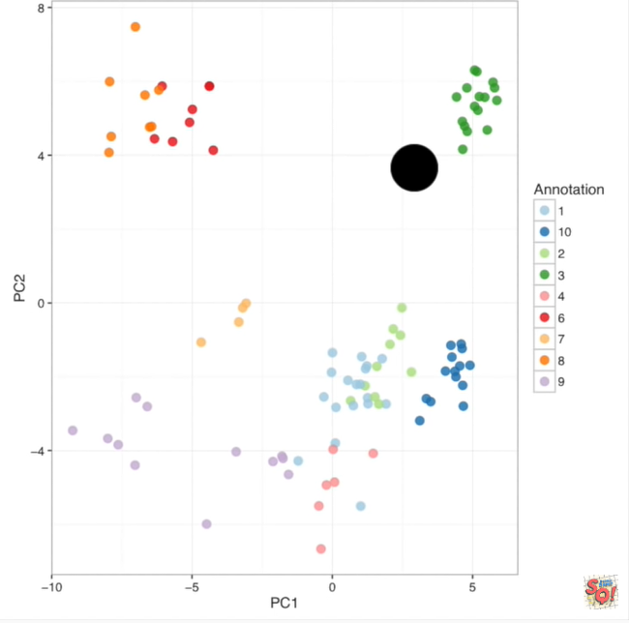
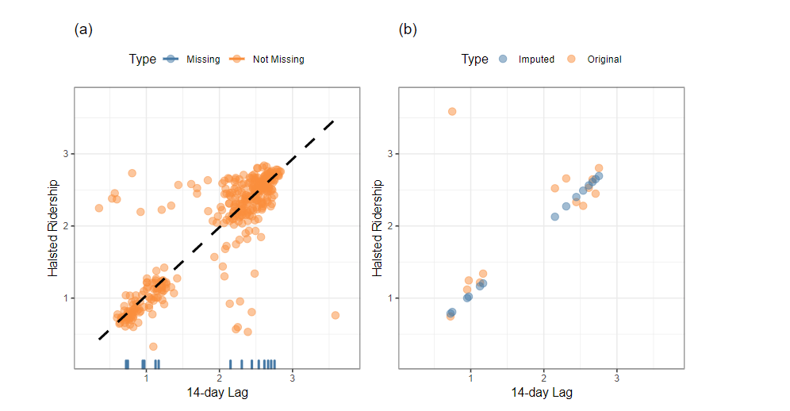
Imputation
“produce the most accurate prediction of the missing data point”
At what stage in the preprocess
should you impute?
20% missing rule-of-thumb
Replace with the mean/median/mode
K-Nearest Neighbors
Tree-based methods
Linear Method
Notes:
Computationally expensive?
Analysis Assessment check
Influenced by outlier
The primary approach in this scenario is to use multiple imputations; several variations of the data set are created with different estimates of the missing values. The variations of the data sets are then used as inputs to models and the test statistic replicates are computed for each imputed data set. From these replicate statistics, appropriate hypothesis tests can be constructed and used for decision making.s?

Slide 10
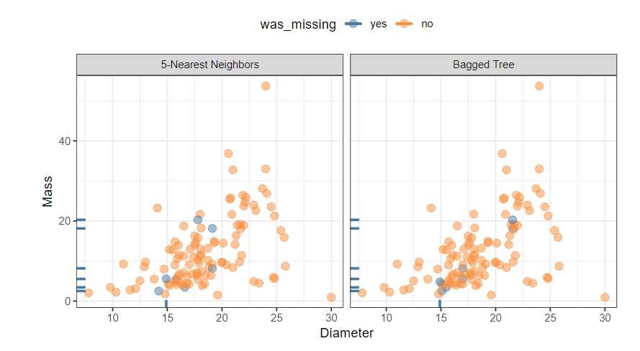
Imputation Method Comarisons

Slide 11
Adding a Missing Column for Continuous Variables
If imputing any values in a column, create a new column that indicates whether or not the value was imputed.

Slide 12
Special Cases
Time-based Variables
Data censoring
Durations are often right censored since the terminating value is not known.
Left censoring can occur. For example, laboratory measurements may have a lower limit of detection, which means that the measuring instrument cannot reliably quantify values below a threshold X.

