Slide 1
Feature Engineering
Chapter 2
Stephen Kimel

Slide 2
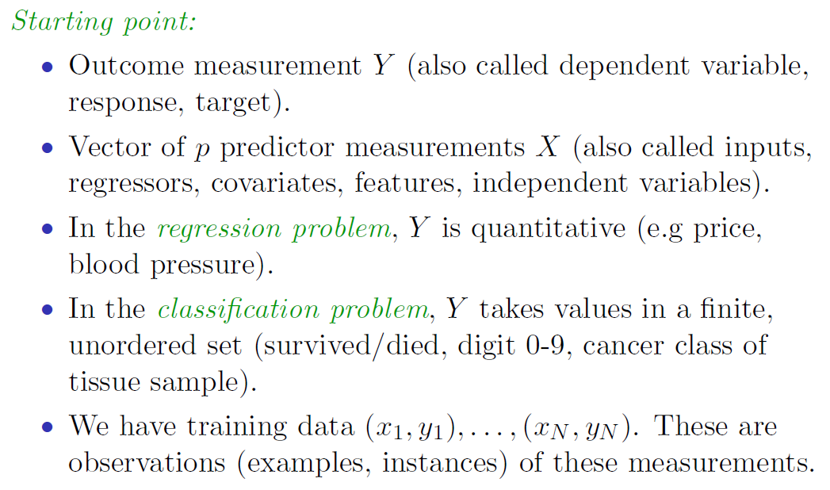
Source: ISLR http://faculty.marshall.usc.edu/gareth-james/ISL/

Slide 3
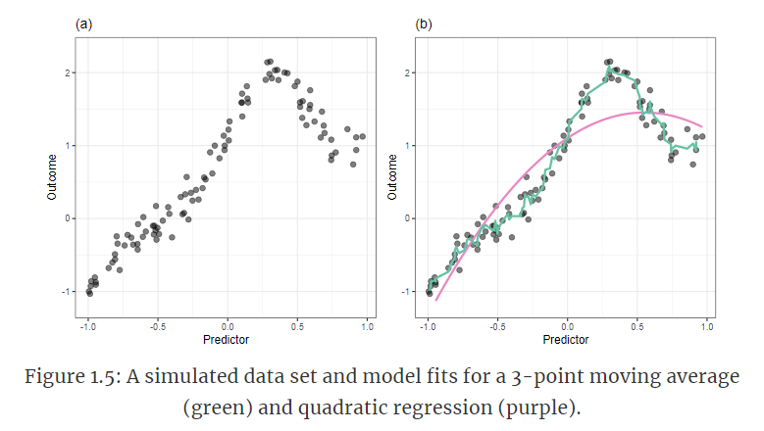
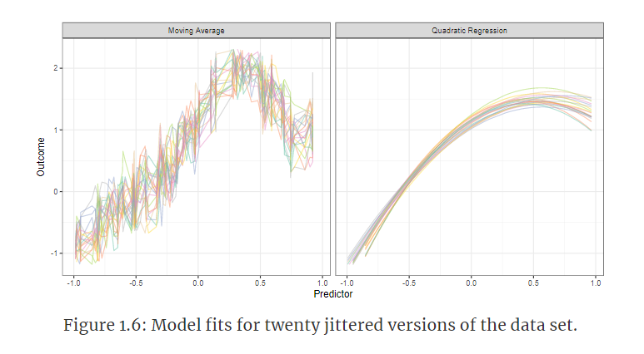
Important concepts
Which of the below models does a better job in this case?
Model Bias and Variance
Variance: How much would f would change if we estimated it with a different training dataset. (Associated with overfitting.)
Bias: Error introduced by approximating a real-life problem (complicated) by a much simpler model. (Associated with underfitting)

Slide 4
Logistic Regression

Slide 5
Logistic Regression Attributes
Used for classification (not regression!)
High Bias & Low Variance
Interpretable

Slide 6
Interpretable
Simple Equation
y = -8.8 + .43mpg
Thing we are interested in predicting. For logistic regression, this will measure how likely an observation is in a certain bucket of interest.

Slide 7
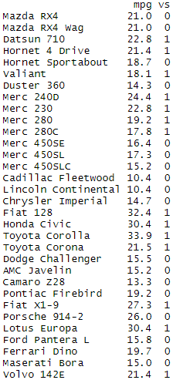
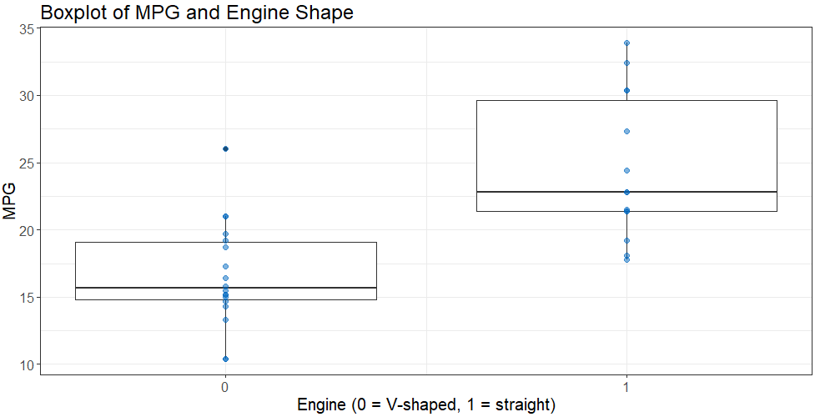
concordance
discordance

Slide 8
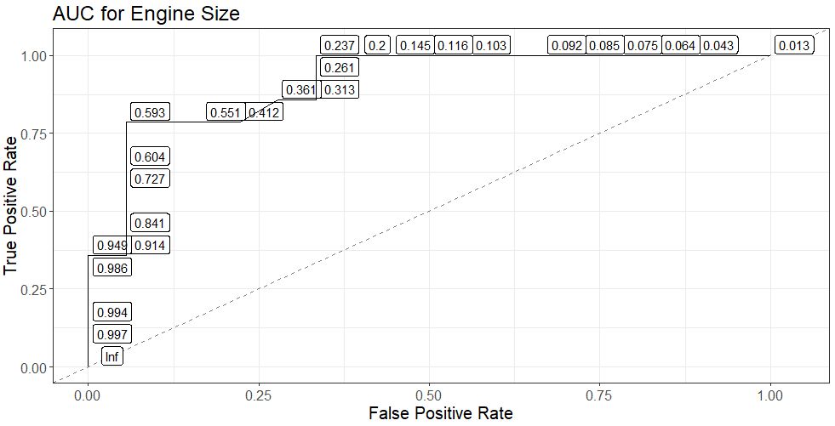
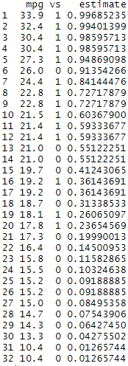
There are 14 1s (straight line engine) and 18 0s (V-shape engine)
.14
(1/14) .07
.056 (1/18)

Slide 9
Chapter 2

Slide 10
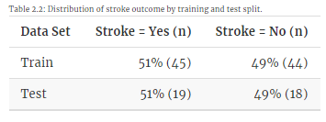
Example in Book
Predict patient risk for ischemic stroke
Historically just used size of blockage to predict
Shown to be a poor predictor
Perhaps the type of blockage will help the model
Splitting data

Slide 11
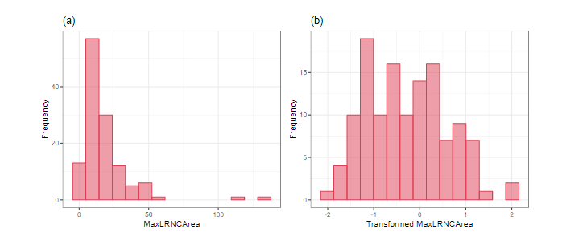
Preprocessing Data
Input distributions
Missing data (Chapter 8) – some models can handle missing data, some can’t
Unusual values (Chapter 6)
Should you remove them, transform them, or leave them?
Relationships between inputs
Relationship of inputs with response

Slide 12
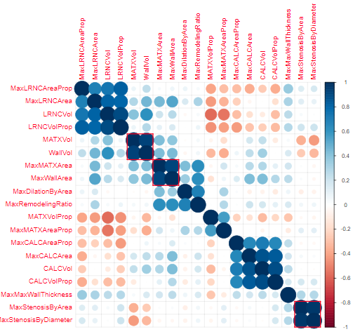

Slide 13
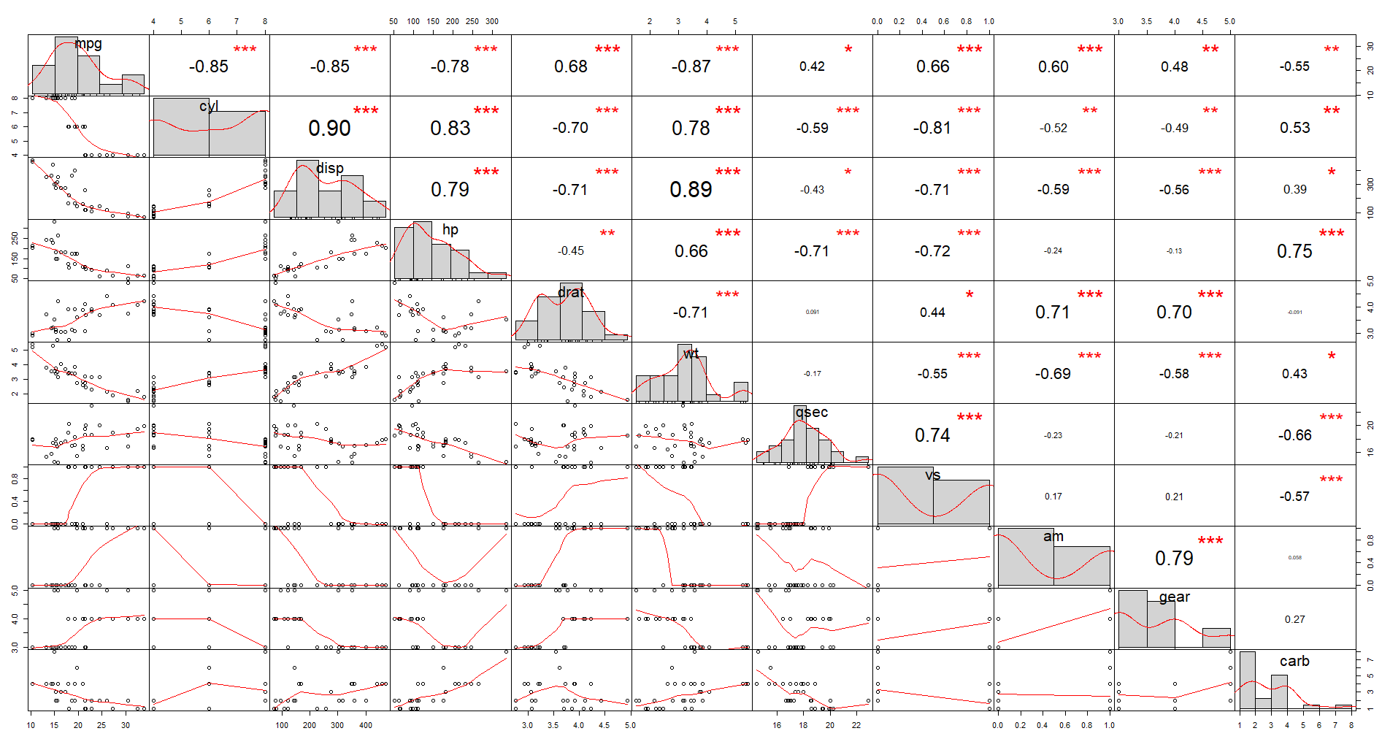

Slide 14
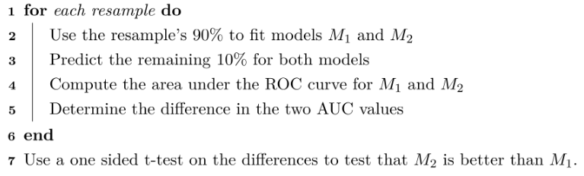
Exploration
Divide data into K roughly equal-sized parts (K = 5 here)
1 2 3 4 5
Should the procedure above happen before splitting the data or afterwards?
Validation | Train | Train | Train | Train
Train | Validation | Train | Train | Train
…

Slide 15
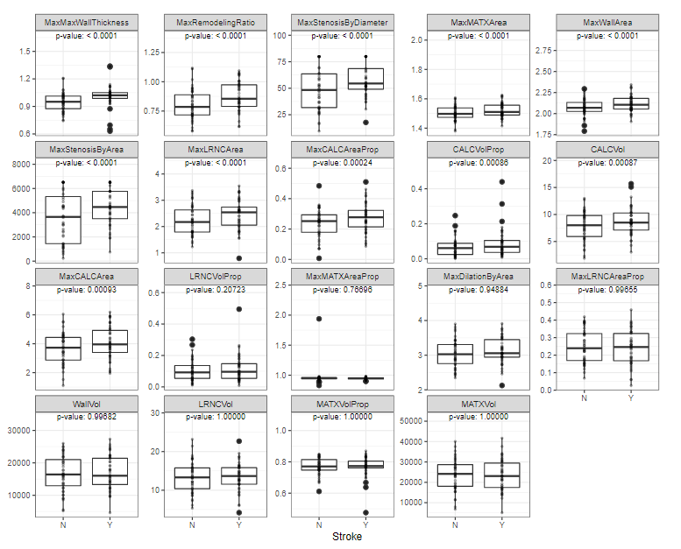
p-value = the probability that our assumption is true given the data we observed

Slide 16
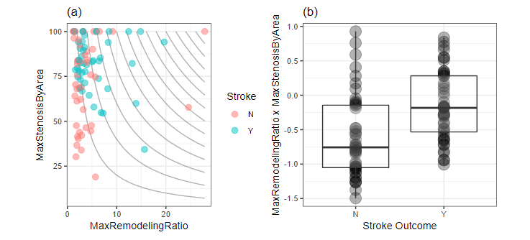
Interactions

Slide 17
Choosing Input Variables
Chapters 10 & 11
“Using this training set, we estimated that the filtered predictor set of 7 imaging predictors was our best bet.”
“How well did this predictor set do on the test set? The test set area under the ROC curve was estimated to be 0.69. This is less than the resampled estimate of 0.72 but is greater than the estimated 90% lower bound on this number (0.674).”
Is it a good idea to back and build more models and retest? Why?

