Slide 1
Feature Engineering
Chapter 3 Part 2
Stephen Kimel

Slide 2
Splitting Data
“The training set is used to develop models and feature sets…The test set is used only at the conclusion of these activities for estimating a final, unbiased assessment of the model’s performance. It is critical that the test set not be used prior to this point.”
How much should be set aside for testing?
Observation # | X-variable p1 | X-variable p2 | X-variable p3 | X-variable p4 | X-variable p5
n1
…
n100,000
Observation # | X-variable p1 | X-variable p2 | X-variable p3 | … | X-variable p1000
n1
…
n100

Slide 3
Sampling Methods
Determining which observations go into which buckets
Random
Stratified
“For classification models, this is accomplished by selecting samples at random within each class.”
“When the outcome is numeric, artificial strata can be constructed based on the quartiles of the data.”
Outcome = 1
Outcome = 0

Slide 4
Sampling Methods
Random
Stratified
“For classification models, this is accomplished by selecting samples at random within each class.”
“When the outcome is numeric, artificial strata can be constructed based on the quartiles of the data.”
Outcome = 1
Outcome = 0
= test
= train

Slide 5
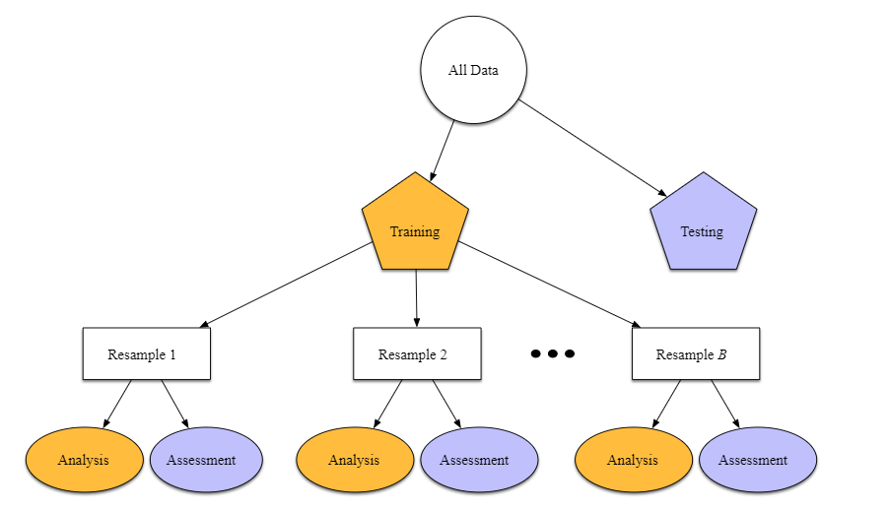
Resampling

Slide 6
V-Fold (or K-Fold) Cross-Validation
Divide data into K roughly equal-sized parts (K = 5 here)
1 2 3 4 5
Assessment1 RMSE | Analysis | Analysis | Analysis | Analysis
Analysis | Assessment2 RMSE | Analysis | Analysis | Analysis
Analysis | Analysis | Assessment3 RMSE | Analysis | Analysis
Analysis | Analysis | Analysis | Assessment4 RMSE | Analysis
Analysis | Analysis | Analysis | Analysis | Assessment5 RMSE
Overall Model Performance = mean(Assessment1 RMSE…Assessment5 RMSE)

Slide 7
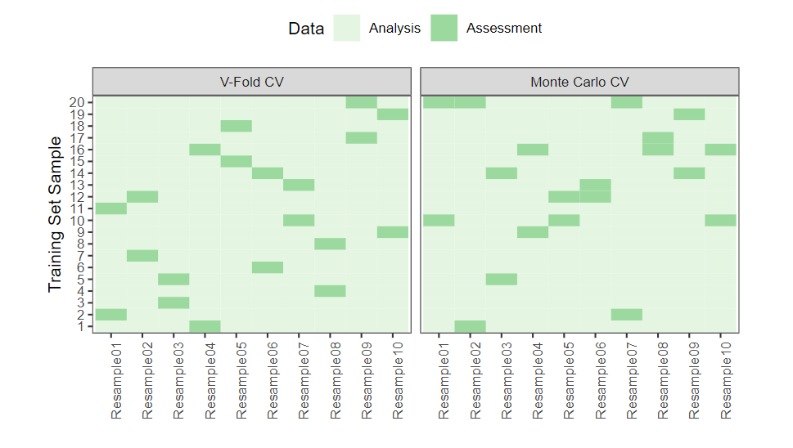
Cross-Validation
Example: 100 Observations
NOTE: For customer transactional data, it is recommended to keep all transactions of a customers entirely in the Analysis or Assessment group.

Slide 8
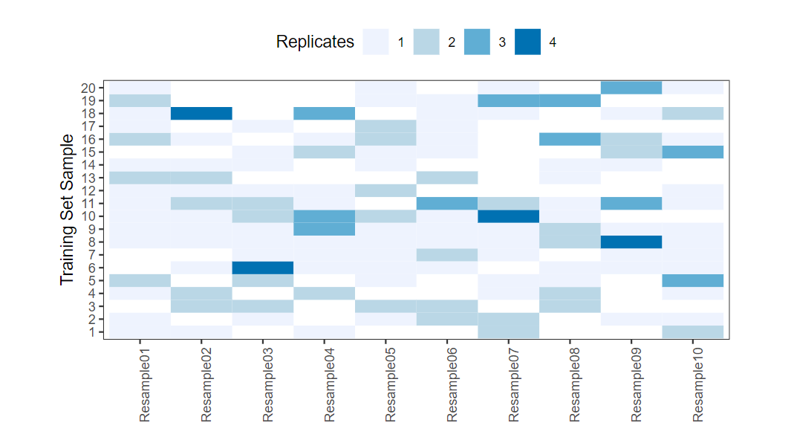
The Bootstrap
A bootstrap resample of the data is defined to be a simple random sample that is the same size as the training set where the data are sampled with replacement

Slide 9
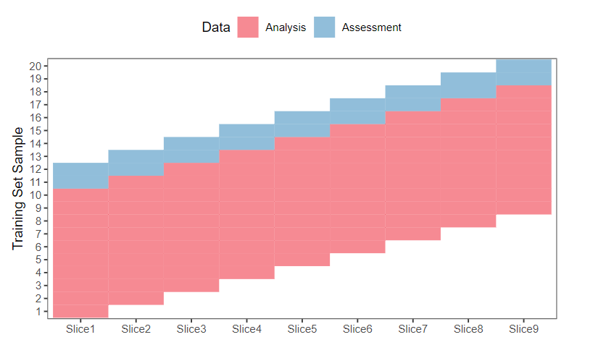
Rolling Forecasting

Slide 10
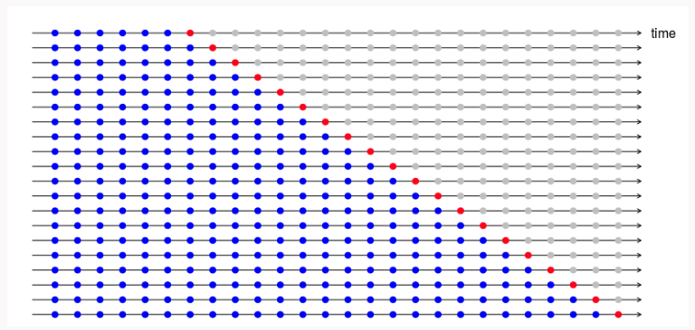
Forecasting Assessment (Time Series)
Source: https://robjhyndman.com/hyndsight/tscv/

Slide 11
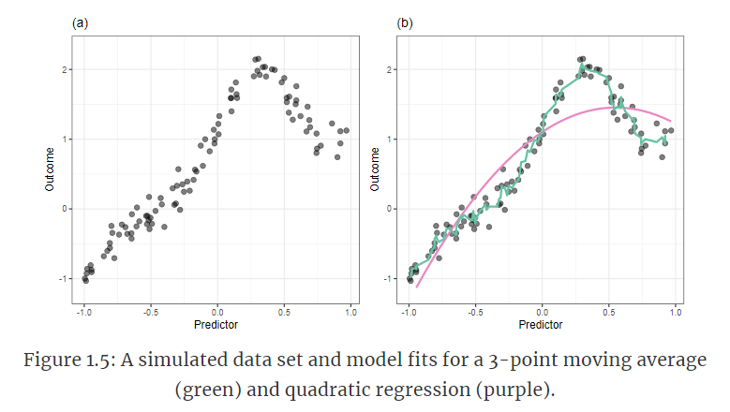
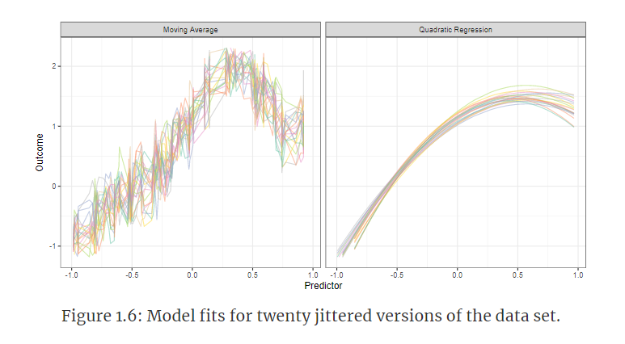
Important concepts
Model Bias and Variance
Variance: How much would f would change if we estimated it with a different training dataset. (Associated with overfitting.)
Bias: Error introduced by approximating a real-life problem (complicated) by a much simpler model. (Associated with underfitting)

Slide 12
Bias
“Bias is the ability of a particular resampling scheme to be able to hit the true underlying performance parameter (that we will never truly know). Generally speaking, as the amount of data in the analysis set shrinks, the resampling estimate’s bias increases. In other words, the bias in 10-fold cross-validation is smaller than the bias in 5-fold cross-validation.”

Slide 13
Variance
Divide data into K roughly equal-sized parts (K = 5 here)
1 2 3 4 5
Assessment1 RMSE | Analysis | Analysis | Analysis | Analysis
Analysis | Assessment2 RMSE | Analysis | Analysis | Analysis
Analysis | Analysis | Assessment3 RMSE | Analysis | Analysis
Analysis | Analysis | Analysis | Assessment4 RMSE | Analysis
Analysis | Analysis | Analysis | Analysis | Assessment5 RMSE
Overall Model Performance = mean(Assessment1 RMSE…Assessment5 RMSE)

Slide 14
Variance
Divide data into K roughly equal-sized parts (K = 5 here)
K1 K2 K3 K 4 K5
Ob1 Ob2 Ob3 Ob4 | Ob1 Ob2 Ob3 Ob4 | Ob1 Ob2 Ob3 Ob4 | Ob1 Ob2 Ob3 Ob4 | Ob1 Ob2 Ob3 Ob4
Ob5 Ob6 Ob7 Ob8 | Ob5 Ob6 Ob7 Ob8 | Ob5 Ob6 Ob7 Ob8 | Ob5 Ob6 Ob7 Ob8 | Ob5 Ob6 Ob7 Ob8
Ob9 Ob10 Ob11 Ob12 | Ob9 Ob10 Ob11 Ob12 | Ob9 Ob10 Ob11 Ob12 | Ob9 Ob10 Ob11 Ob12 | Ob9 Ob10 Ob11 Ob12
Ob13 Ob14 Ob15 Ob16 | Ob13 Ob14 Ob15 Ob16 | Ob13 Ob14 Ob15 Ob16 | Ob13 Ob14 Ob15 Ob16 | Ob13 Ob14 Ob15 Ob16
Ob17 Ob18 Ob19 Ob20 | Ob17 Ob18 Ob19 Ob20 | Ob17 Ob18 Ob19 Ob20 | Ob17 Ob18 Ob19 Ob20 | Ob17 Ob18 Ob19 Ob20
Overall Model Performance = mean(Assessment1 RMSE…Assessment5 RMSE)
OMP1 = 5.5

Slide 15
Variance
Divide data into K roughly equal-sized parts (K = 5 here)
K1 K2 K3 K 4 K5
Ob1 Ob12 Ob10 Ob20 | Ob1 Ob12 Ob10 Ob20 | Ob1 Ob12 Ob10 Ob20 | Ob1 Ob12 Ob10 Ob20 | Ob1 Ob12 Ob10 Ob20
Ob5 Ob9 Ob11 Ob18 | Ob5 Ob9 Ob11 Ob18 | Ob5 Ob9 Ob11 Ob18 | Ob5 Ob9 Ob11 Ob18 | Ob5 Ob9 Ob11 Ob18
Ob16 Ob2 Ob3 Ob6 | Ob16 Ob2 Ob3 Ob6 | Ob16 Ob2 Ob3 Ob6 | Ob16 Ob2 Ob3 Ob6 | Ob16 Ob2 Ob3 Ob6
Ob13 Ob17 Ob4 Ob19 | Ob13 Ob17 Ob4 Ob19 | Ob13 Ob17 Ob4 Ob19 | Ob13 Ob17 Ob4 Ob19 | Ob13 Ob17 Ob4 Ob19
Ob7 Ob8 Ob14 Ob15 | Ob7 Ob8 Ob14 Ob15 | Ob7 Ob8 Ob14 Ob15 | Ob7 Ob8 Ob14 Ob15 | Ob7 Ob8 Ob14 Ob15
Overall Model Performance = mean(Assessment1 RMSE…Assessment5 RMSE)
OMP1 = 5.5 OMP2 = 5.9 OMP3 = 4.2 … OMP100 = 5.0
OMP1 = 5.5 OMP2 = 5.9

Slide 16
Preprocessing
Preprocess the data for each iteration
Example: When imputing values for K1 with the median, use the median from the data in the Analysis set of data

Slide 17
Information Leakage
Can you predict the while observations are in the Analysis and Assessment buckets?
“Another, more overt path to information leakage, can sometimes be seen in machine learning competitions (Kaggle) where the training and test set data are given at the same time. While the test set data often have the outcome data blinded, it is possible to “train to the test” by only using the training set samples that are most similar to the test set data.”

Slide 18
Tuning Parameters (Hyperparameters) and Overfitting
Hyperparameters are model-specific knobs to turn
i.e. number of trees in a random forest or how many variables to consider at each split
Bias-Variance trade-off
http://www.r2d3.us/visual-intro-to-machine-learning-part-1/

