Slide 1
Feature Engineering
Chapter 6
Stephen Kimel

Slide 2
Continuous Variable Transformations
“The goal of all of these approaches is to convert the existing continuous predictors into a form that can be utilized by any model and presents the most useful information to the model.”
In my opinion (Stephen’s), the hardest model to mess up and the one where transformations are least likely to help is a Random Forest. Use RFs as a baseline.

Slide 3
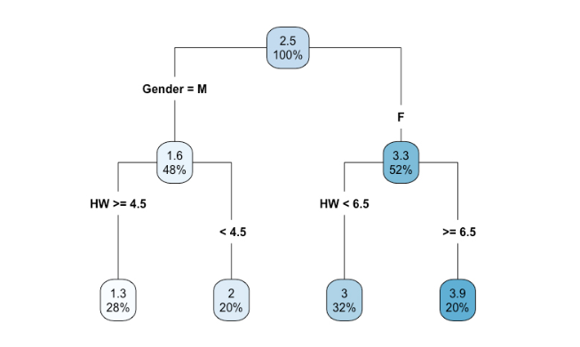
Decision Tree to Random Forest
A Random Forest is made up of a lot of decision trees
Bootstrapped sample
Not all variables are considered at each cut point. A hyperparameter of RFs is how many variables to consider at each cut point.

Slide 4
Continuous Variable Transformations
“The goal of all of these approaches is to convert the existing continuous predictors into a form that can be utilized by any model and presents the most useful information to the model.”
In my opinion (Stephen’s), the hardest model to mess up and the one where transformations are least likely to help is a Random Forest. Use RFs as a baseline.
RFs use cut points so scaling the data is not necessary and will not yield better results.
RFs are insensitive to outliers/extreme values.

Slide 5















1:1 Transformations & Random Forests
Example: Inverse Transformation
<=
$$\frac{1}{16}$$
$$\frac{2}{16}$$
$$\frac{3}{16}$$
$$\frac{4}{16}$$
$$\frac{5}{16}$$
$$\frac{6}{16}$$
$$\frac{7}{16}$$
$$\frac{8}{16}$$
$$\frac{9}{16}$$
$$\frac{10}{16}$$
$$\frac{11}{16}$$
$$\frac{12}{16}$$
$$\frac{13}{16}$$
$$\frac{14}{16}$$
$$\frac{15}{16}$$
1
1
2
3
4
5
6
7
8
9
10
11
12
13
14
15
16

Slide 6
Continuous Variable Transformations
“The goal of all of these approaches is to convert the existing continuous predictors into a form that can be utilized by any model and presents the most useful information to the model.”
In my opinion (Stephen’s), the hardest model to mess up and the one where transformations are least likely to help is a Random Forest. Use RFs as a baseline.
RFs use cut points so scaling the data is not necessary and will not yield better results.
RFs are insensitive to outliers/extreme values.
RFs can pick up on interactions even if you don’t specify these interactions before building the model.

Slide 7
Decision Tree to Random Forest
A Random Fest is made up of a lot of decision trees
Bootstrapped sample
Not all variables are considered at each cut point. A hyperparameter of RFs is how many variables to consider at each cut point.

Slide 8
Continuous Variable Transformations
“The goal of all of these approaches is to convert the existing continuous predictors into a form that can be utilized by any model and presents the most useful information to the model.”
In my opinion (Stephen’s), the hardest model to mess up and the one where transformations are least likely to help is a Random Forest. Use RFs as a baseline.
RFs use cut points so scaling the data is not necessary and will not yield better results.
RFs are insensitive to outliers/extreme values.
RFs can pick up on interactions even if you don’t specify these interactions before building the model.
RFs can handle lots of predictor variables (Chapter 10)
RFs don’t have assumptions about the data (other than that it is representative) or residuals
RFs can handle missing data (Chapter 8)
RFs can’t extrapolate
RFs are not good for time series data

Slide 9
Extrapolation
Outcome
Predictor

Slide 10
1:1

Slide 11
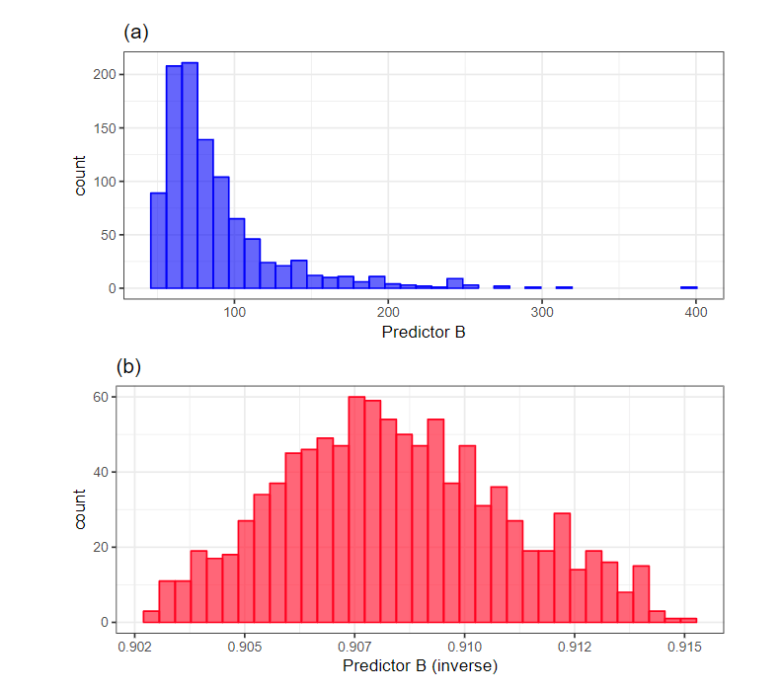
Box-Cox Transformation
Goal: Make data normalish
Outcome
Predictor

Slide 12
Box-Cox Transformation
Goal: Make data normalish
Outcome
Predictor

Slide 13
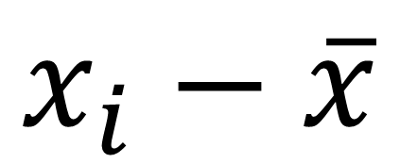
Centering a Variable
All variables that are centered will have a mean of 0
$$x_{i}−\overline{x}$$

Slide 14
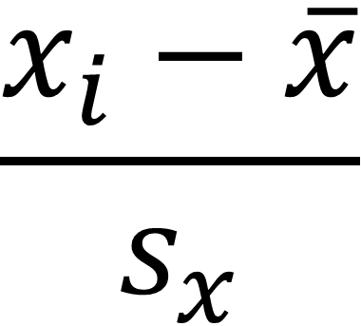
Scaling a Variable
All variables that are scaled will have a mean of 0 and a standard deviation of 1
Needed when using K-nearest neighbors or lasso/ridge regression.
$$\frac{x_{i}−\overline{x}}{s_{x}}$$
“Again, it is emphasized that the statistics required for the transformation (e.g., the mean) are estimated from the training set and are applied to all data sets (e.g., the test set or new samples).”

Slide 15
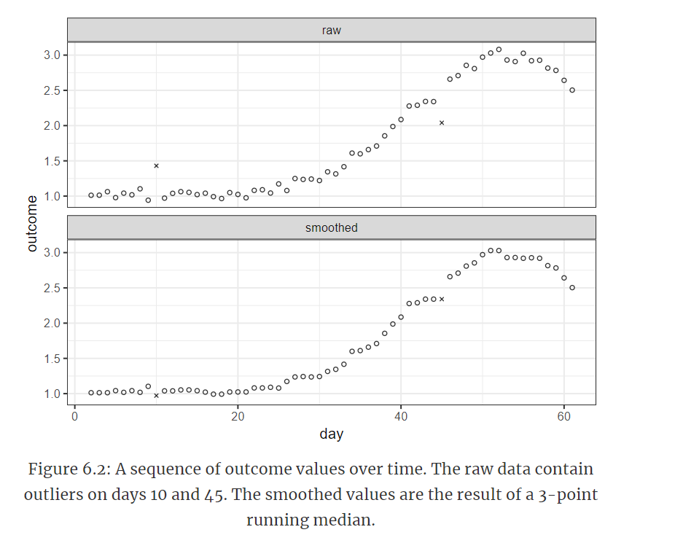
Smoothing Time Series Data

Slide 16
1:Many

Slide 17
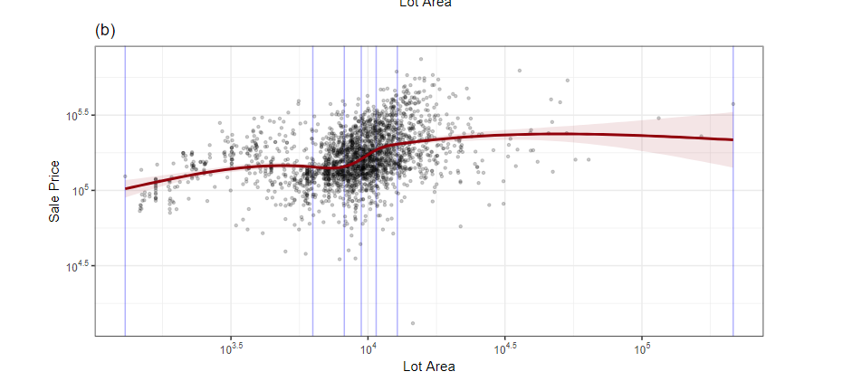
Natural Cubic Splines

Slide 18
Discretizing Continuous Variables
AKA Binning
Pros
Simplify analysis
Avoid specifying relationship between predictor and outcome
Cons
Unlikely that the actual trend is found with model
Removes some nuance to data
No objective cut-points
If there is no relationship between outcome and predictor, there is an increase in probability that and erroneous trend will be found

Slide 19
Many:Many

Slide 20
Principle Component Analysis (PCA)
“The objective of PCA is to find linear combinations of the original predictors such that the combinations summarize the maximal amount of variation in the original predictor space.”
“An important side benefit of this technique is that the resulting PCA scores are uncorrelated.”
Is NOT variable selection

Slide 21
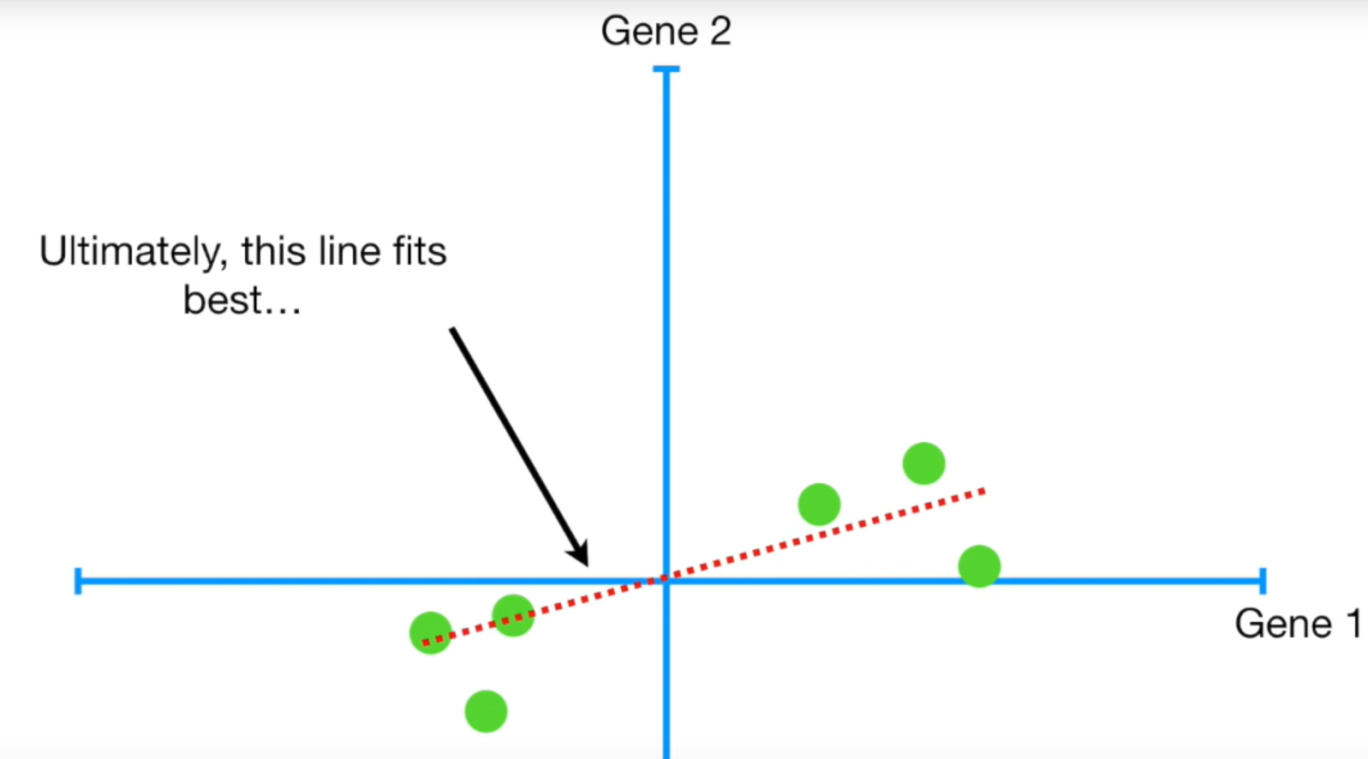

PCA
https://www.youtube.com/watch?v=FgakZw6K1QQ&vl=en
Goal: Retain the most information while reducing the number of dimensions

Slide 22
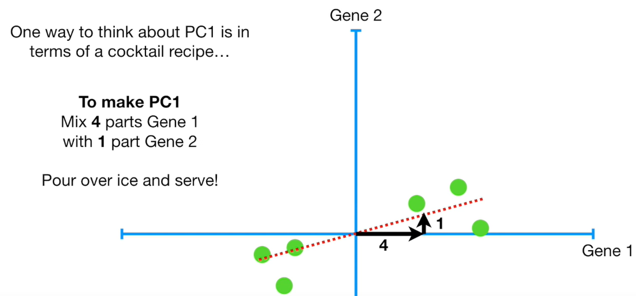
These can be referred to as loadings. The loading for Gene 1 is 4 times the loading for Gene 2.
These numbers get scaled, but the ratio comparison still holds.

Slide 23
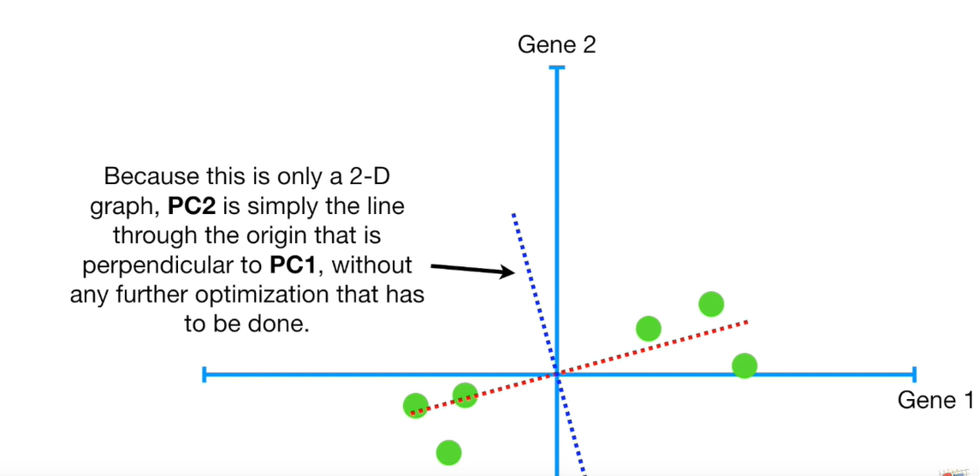
PC2 is Perpendicular (Orthogonal) to PC1
PC2

Slide 24
PC2 is Perpendicular (Orthogonal) to PC1
PC2

Slide 25
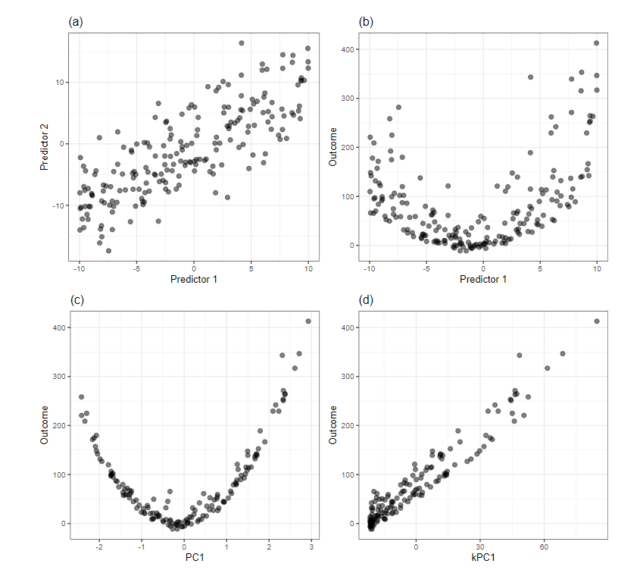
Kernel PCA
Use Kernel PCA when the x variables are not linearly related to outcome variable.
There are different kernels for different types of relationships
Polynomial
Radial
Etc.

Slide 26
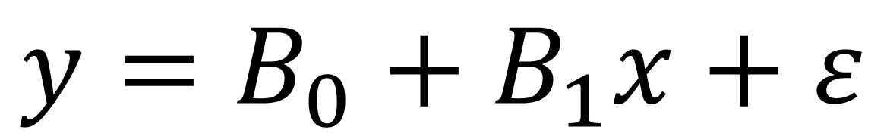
Linear Model
$$y=B_{0}+B_{1}x+ε$$

Slide 27
Other Unsupervised Methods
Independent Component Analysis
When relationship is not linear
Non-Negative Matrix Factorization
“Find the best set of coefficients that make the scores as “close” as possible to the original data with the constraint of non-negativity”
Features must be positive

Slide 28
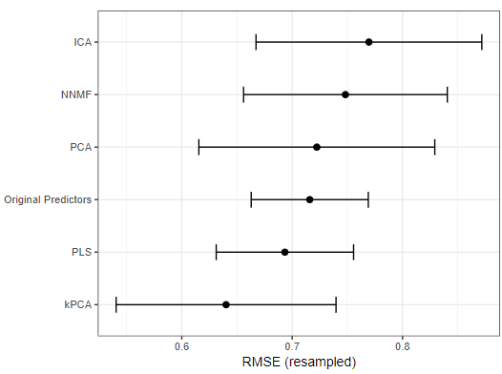
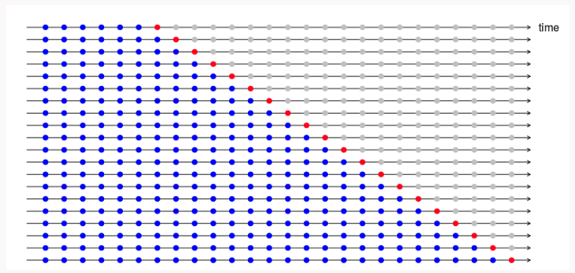
Partial Least Squares
Supervised version of PCA where components are optimally related to response variable
Each component (dimension) is uncorrelated like PCA
PLS can perhaps reduce dimensions better than PCA, but an assessment dataset must be used.

Slide 29
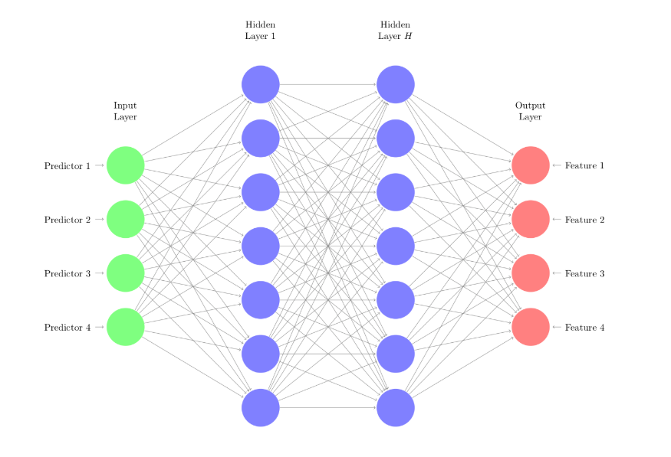
Autoencoders
https://www.3blue1brown.com/neural-networks
Non-linear function
Weights that are initially randomly assigned and then improved from information in the output layer

Slide 30
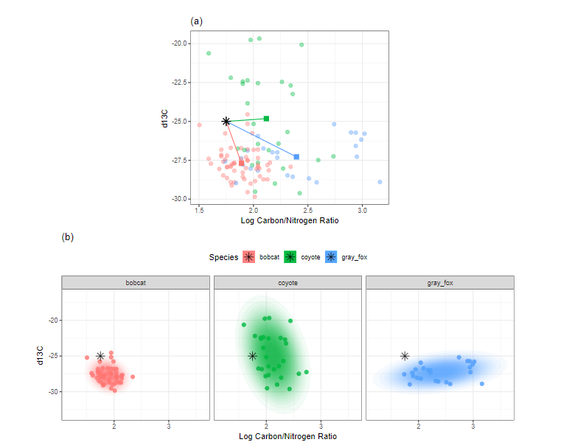
Other Techniques
Spatial Sign
Make data into a circle
Distance and Depth Features
Classification

