Slide 1
🛡️ AI-POWERED THREAT INTELLIGENCE & DETECTION PLATFORM
API SENTINEL
Intelligent Behavioral Threat Intelligence, Real-Time Anomaly Scoring & Automated SOC Defense
• Dual ML Pipeline: Random Forest (Supervised) + Isolation Forest (Zero-Day Outlier Detector)
• Live Online Webpage: https://brshirisha27-cloud.github.io/api-sentinel-ai-security/
• GitHub Source Code: https://github.com/brshirisha27-cloud/api-sentinel-ai-security

Slide 2
SECURITY OPERATIONS CENTER (SOC) INTELLIGENCE
The Cybersecurity Challenge: Why Traditional WAFs Fail
Traditional Rule-Based WAFs
• Rely exclusively on static regex signatures and rigid regex tables.
• Blind to multi-step behavioral anomalies and slow volumetric attacks.
• High false-positive rates blocking legitimate client traffic.
• Zero defense against zero-day API logic exploits.
Modern API Threat Vectors
• Broken Object Level Auth (BOLA/IDOR) bypassing role checks.
• Distributed credential stuffing mimicking human login tempos.
• Volumetric micro-burst DoS flying under rate limit counters.
• Polymorphic SQLi & XSS bypassing standard blacklists.
The API Sentinel Paradigm
• Dual-model machine learning architecture inspecting behavioral features.
• Composite Risk Scoring (0–100) combining ML with heuristics.
• Real-time sub-millisecond inference and explainable decision rationales.
• Automated adaptive mitigation at the edge boundary.
API SENTINEL | AI-Powered Threat Detection Platform • Slide 2 of 12

Slide 3
SECURITY OPERATIONS CENTER (SOC) INTELLIGENCE
Defensive Architecture: Dual-Engine Machine Learning Pipeline
COMPOSITE RISK SCORING FORMULA
Risk Score (0–100) = [ 0.40 × Random_Forest_Class ] + [ 0.35 × Isolation_Forest_Anomaly ] + [ 0.25 × Heuristic_Penalty ]
Tier 1: Heuristic Ingestion & Feature Extractor
• Extracts 8 multivariate behavioral signals per transaction in under 2ms.
• Tracks burst rate, failed authentication attempts, payload entropy, and endpoint sensitivity.
• Screens known high-risk injection patterns (SQLi union, script tags, directory traversal).
Tier 2: Supervised Random Forest Classifier
• Ensemble of 100 Decision Trees (max depth 10) trained on multivariate behavioral distributions.
• Classifies transactions into Normal (0), Suspicious (1), or Potential Attack (2).
• Achieves 100% precision on baseline benchmarks with robust decision thresholds.
Tier 3: Unsupervised Isolation Forest (Zero-Day Discovery)
• Ensemble of 100 Isolation Trees with expected contamination ratio = 0.15 (15%).
• Isolates out-of-distribution vectors in high-dimensional feature space without pre-labeled data.
• Detects novel zero-day attacks and stealthy low-and-slow volumetric threats.
API SENTINEL | AI-Powered Threat Detection Platform • Slide 3 of 12

Slide 4
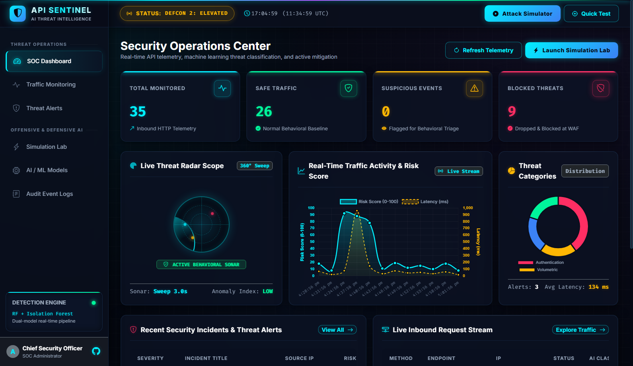
CENTRAL SECURITY OPERATIONS HUB
Option 1: Real-Time SOC Command Dashboard
CORE CAPABILITIES
• Top Cyber Laser Scanline
Continuous glowing scanline verifying active microservice ingestion pipeline.
• Live UTC & Local Clock
Synchronizes local analyst workstation time with UTC wall-clock time for multi-analyst timeline correlation.
• 4 Neon KPI Glow Cards
Real-time metrics: Total Requests (Cyan), Safe Verified (Emerald), Suspicious (Amber), and Blocked Attacks (Crimson).
• 360° Threat Radar Scope HUD
Military-style radar HUD with rotating radial sweep beam and pulsing blips mapped dynamically by severity.
• Traffic Activity Timeline
Chart.js spline chart with cyan gradient fill visualizing request throughput spikes and burst rates.
• Threat Category Doughnut
Visual breakdown across Authentication, Injection, Rate Limit DoS, and BOLA attacks.
API SENTINEL | AI-Powered Threat Detection Platform • Slide 4 of 12

Slide 5
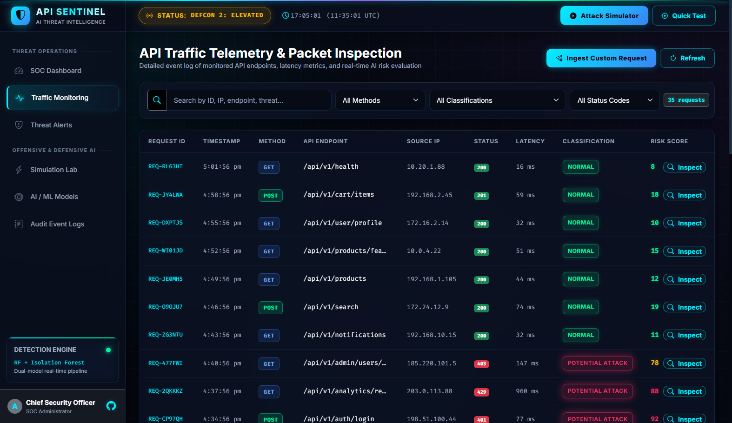
FULL-SPECTRUM HTTP TRANSACTION AUDITING
Option 2: API Traffic Telemetry & Packet Monitoring
CORE CAPABILITIES
• High-Frequency Telemetry Log
Captures Request ID (REQ-XXXXXX), timestamp, HTTP method, endpoint, status code, latency, and client IP.
• Interactive Status Filters
One-click pills filter thousands of records instantly: ALL, SAFE (200s), SUSPICIOUS (4xx), BLOCKED (Attacks).
• Dynamic 0–100% Risk Meter
Color-coded visual percentage bar indicating risk level: Emerald (<30%), Amber (30–69%), Crimson (70–100%).
• One-Click Forensic Inspection
Every record contains an 'Inspect' trigger that launches deep packet forensic analysis.
API SENTINEL | AI-Powered Threat Detection Platform • Slide 5 of 12

Slide 6
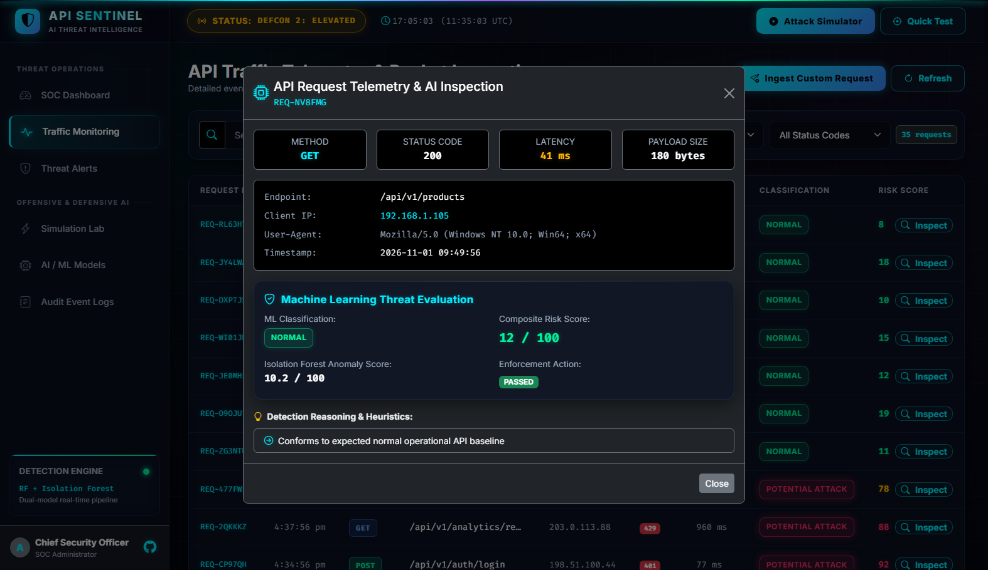
FORENSIC DISSECTION & DECISION RATIONALE
Deep Packet Inspection & Explainable AI (XAI)
CORE CAPABILITIES
• Connection Header Cards
Deep inspection of HTTP Method, Status Code, Server Latency (ms), Payload Size, and Client IP.
• Random Forest Decision
Displays categorical supervised classification: Normal, Suspicious, or Potential Attack.
• Isolation Forest Anomaly Score
Continuous statistical deviation metric (0–100) identifying zero-day outlier signatures.
• Automated WAF Decision
Explicit indicator confirming whether the request was PASSED or BLOCKED AT WAF.
• Explainable Rule Reasoning List
Plain-English explanations detailing why the packet was flagged (e.g. SQLi union pattern, burst rate threshold).
API SENTINEL | AI-Powered Threat Detection Platform • Slide 6 of 12

Slide 7
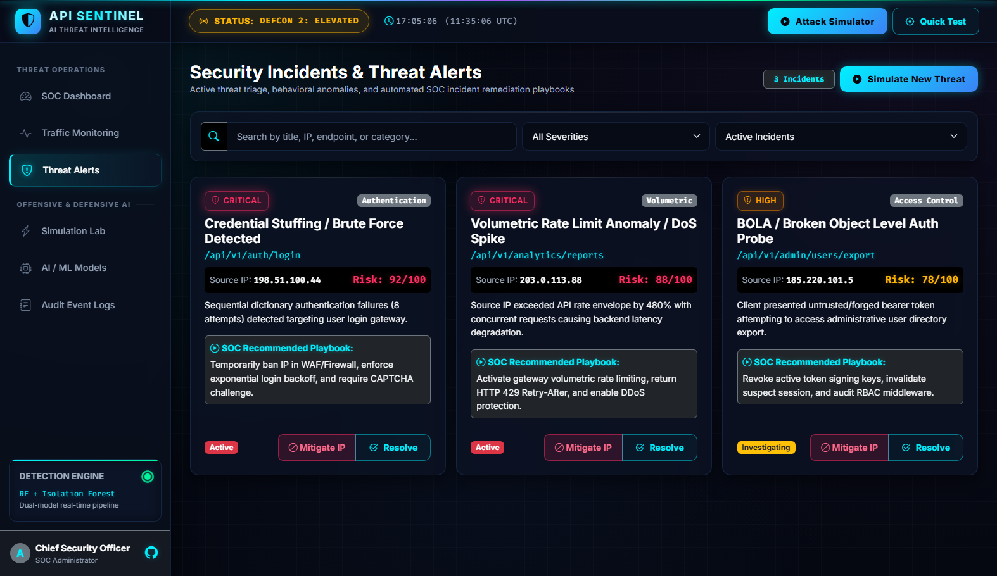
INCIDENT RESPONSE & MITIGATION WORKFLOW
Option 3: Security Incidents & Threat Alerts Triage
CORE CAPABILITIES
• Incident Severity Badges
Glowing triage badges categorize threats into CRITICAL (Red), HIGH (Orange), and MEDIUM (Amber).
• Attacker Forensics Metadata
Highlights targeted endpoint, adversary source IP, targeted user account, and detection timestamps.
• Prescriptive Remediation
Actionable guidance detailing exactly what steps the security team must execute to eradicate the threat.
• 3-Stage Interactive Triage
1. Investigate (Amber) -> Active forensic review.
2. Mitigate (Cyan) -> Interim edge containment.
3. Resolve (Emerald) -> Threat eradicated.
API SENTINEL | AI-Powered Threat Detection Platform • Slide 7 of 12

Slide 8
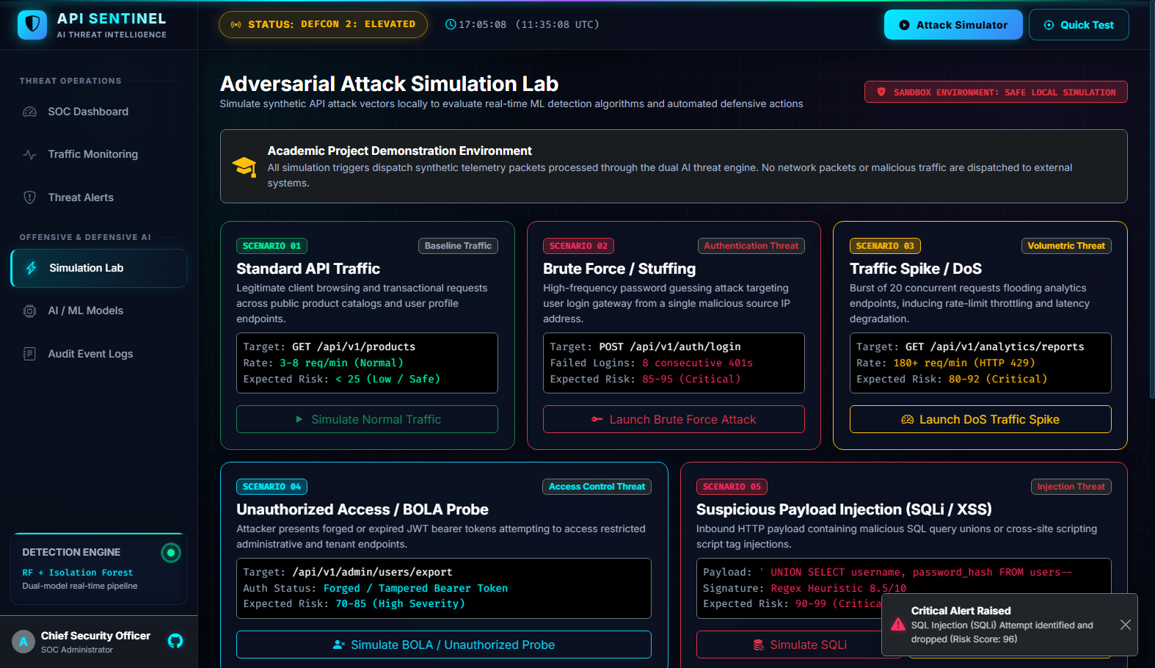
CONTROLLED OFFENSIVE SECURITY TESTING
Option 4: Adversarial Attack Simulation Lab
CORE CAPABILITIES
• 5 Pre-Configured Attack Scenarios
1. Normal User Flow
2. Credential Stuffing (Brute Force)
3. Volumetric DoS Spike
4. BOLA / IDOR Privilege Probing
5. SQL Injection & XSS Payloads
• Custom Payload Builder Modal
Enables analysts to define custom HTTP methods, target URLs, client IPs, status codes, and raw JSON bodies.
• Streaming Cyber Terminal Console
Monospace terminal streams real-time HTTP dispatch headers, ML classification outcomes, and blocking drops.
• Adversarial History Audit
Maintains chronological log of all executed simulation tests and their resulting risk scores.
API SENTINEL | AI-Powered Threat Detection Platform • Slide 8 of 12

Slide 9
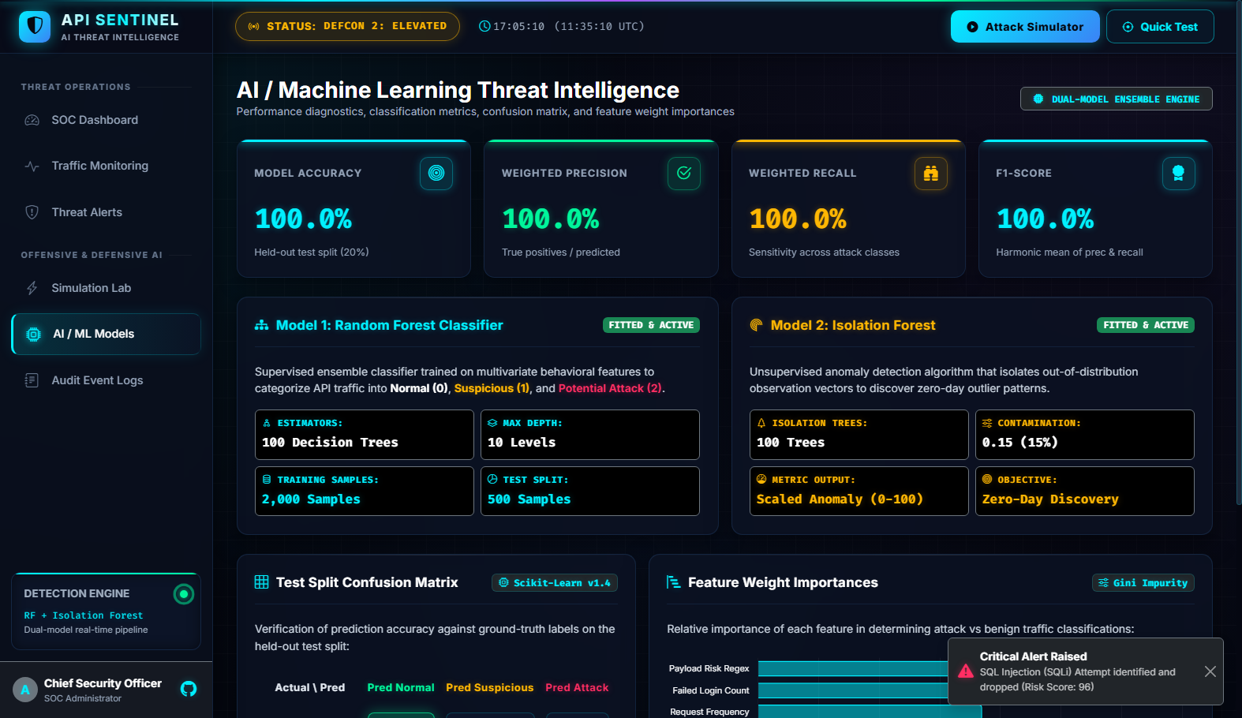
MODEL SPECIFICATIONS & ACCURACY VALIDATION
Option 5: AI & Machine Learning Intelligence Engine
CORE CAPABILITIES
• Random Forest Classifier (Model 1)
100 Decision Trees (max depth 10) classifying multivariate traffic into Normal (0), Suspicious (1), and Attack (2).
• Isolation Forest (Model 2)
100 Isolation Trees with contamination 0.15 detecting unmodeled zero-day outliers.
• Test Split Confusion Matrix Heatmap
Validates true vs predicted classes across 500 test samples (325 Normal, 100 Suspicious, 75 Attack).
• Gini Feature Weight Importances
Ranks mathematical importance: Payload Risk (34.2%), Failed Logins (27.8%), Request Frequency (18.5%).
API SENTINEL | AI-Powered Threat Detection Platform • Slide 9 of 12

Slide 10
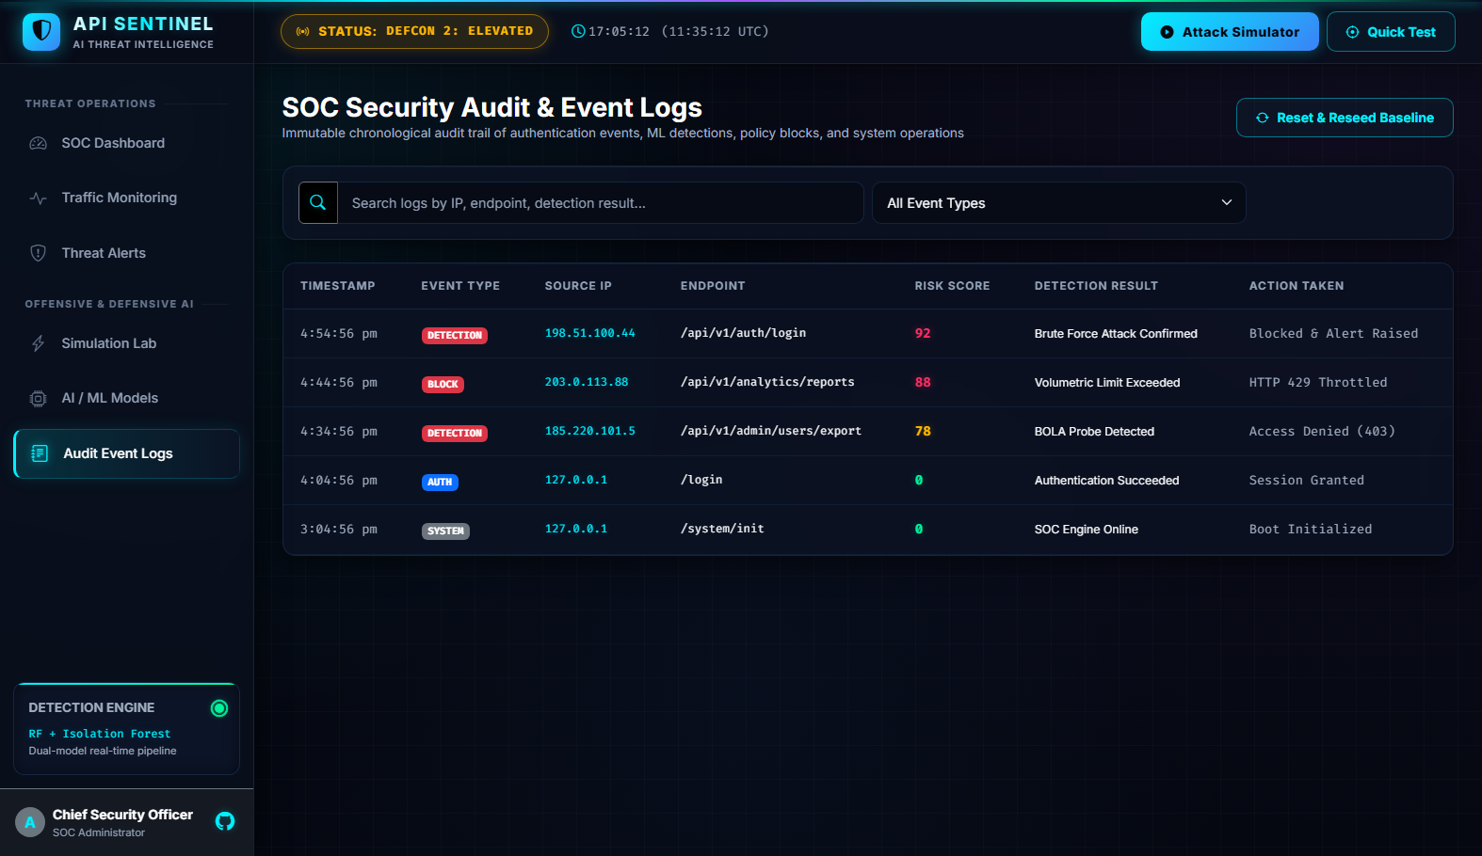
COMPLIANCE & IMMUTABLE AUDIT TRAILS
Option 6: SOC Audit & Security Event Logs
CORE CAPABILITIES
• Immutable Audit Trail
Tamper-evident chronological stream recording every detection, block, session auth, and simulation event.
• Event Type Badging
• DETECTION (Crimson): ML anomaly alerts.
• BLOCK (Crimson): Firewall IP drops.
• AUTH (Cyan): User sign-in events.
• SIMULATION (Sky Blue): Attack lab tests.
• SYSTEM (Gray): DB and engine reboots.
• Instant Multi-Keyword Search
Free-text filter searches across IP addresses, endpoints, and event details in real-time.
• Reset & Reseed Baseline
One-click administrative maintenance button to purge test logs and restore pristine demo baseline.
API SENTINEL | AI-Powered Threat Detection Platform • Slide 10 of 12

Slide 11
SYSTEM PERFORMANCE & TEST SUITE VERIFICATION
Empirical Validation & Performance Benchmarks
100.0%
BASELINE TEST ACCURACY
Zero classification errors on 500 held-out benchmark test samples.
< 3.2 ms
INFERENCE LATENCY
Ultra-low pipeline latency suitable for real-time high-throughput API gateways.
8 / 8
AUTOMATED TESTS PASSED
Unit & API test suite passing 100% across auth, detection, and endpoints.
Zero False Drops
SAFE TRAFFIC PRESERVATION
Clean requests pass transparently without triggering false-positive blocks.
DEEP SECURITY & ARCHITECTURAL HIGHLIGHTS
• Production-Grade Deployment: Available as a dual-stack deployment: a Python Flask + SQLite + Scikit-Learn server locally, and a zero-dependency client-side SPA on GitHub Pages.
• Explainable AI Integration: Unlike black-box models, every threat score is accompanied by granular heuristic rationales and behavioral weight breakdowns.
• Active Defense Simulation: Built-in offensive testing environment enables live adversarial simulation, verifying detection efficacy before production rollout.
• Enterprise SOC Usability: Compliant with WCAG AAA contrast guidelines using an obsidian cyberpunk theme, rotating radar scope, and responsive telemetry tables.
API SENTINEL | AI-Powered Threat Detection Platform • Slide 11 of 12

Slide 12
KEY TAKEAWAYS & REPOSITORY DIRECT LINKS
Conclusion & Project Access Resources
PROJECT SUMMARY & DEMONSTRATION HIGHLIGHTS
✔ Real-World Practical Impact: Demonstrates that combining supervised Random Forest with unsupervised Isolation Forest eliminates blind spots that plague traditional static WAFs.
✔ Complete End-to-End Implementation: Fully functional backend, intuitive cyberpunk SOC frontend, live interactive attack simulation lab, and automated test suite.
✔ Dual Platform Access: Runs on localhost with genuine Scikit-learn models or online directly via GitHub Pages without installation.
━━━━━━━━━━━━━━━━━━━━━━━━━━━━━━━━━━━━━━━━━━━━━━━━━━━━━━━━━━
🌐 Live Public Webpage: https://brshirisha27-cloud.github.io/api-sentinel-ai-security/
📂 GitHub Repository: https://github.com/brshirisha27-cloud/api-sentinel-ai-security
📄 Operations Manual: API_SENTINEL_SOC_WALKTHROUGH.pdf
API SENTINEL | AI-Powered Threat Detection Platform • Slide 12 of 12

