Slide 1
NFL Draft Sentiment Analysis
Brian Singh

Slide 2
ABSTRACT
From Thursday, April 28, 2022 to Saturday, April 30, 2022, the NFL held its annual draft, where teams have the opportunity to bolster their roster with young talent from college football. There are seven rounds, and teams acquire draft picks for each round based on their prior year's record. Of course, draft picks are traded, added as compensatory, etc., which becomes a little more complex. However, fans of NFL teams, or football in general, seldom know the ins and outs of every player drafted. A fan such as myself, only knows college players in the first two rounds, for the most part. After the draft, analysts break down team selections, rating them as positive/negative, typically with an A-F ranking. However, this varies widely based on opinion.
The following analysis aims to pull "expert" analyses from across the web to get an "even" mix of their opinions on the results of the San Francisco 49ers draft. In my personal opinion, I was not ecstatic about the results. The following sentiment analyses using BING, AFINN, and SENTIMENTR tells a different story.

Slide 3
Packages
Packages
Rvest
Dplyr
Tidytext
Wordcloud2
Sentimentr
Ggplot2
Reshape2
Sentimentr

Slide 4
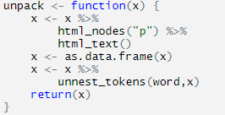

Data Wrangling
Create a list of relevant articles (links)
Create a function to read in the paragraph element of a link and unnest each individual word into a data frame
Iterate through the list of links to pull in all articles append the un-nested list of words to the data frame.

Slide 5
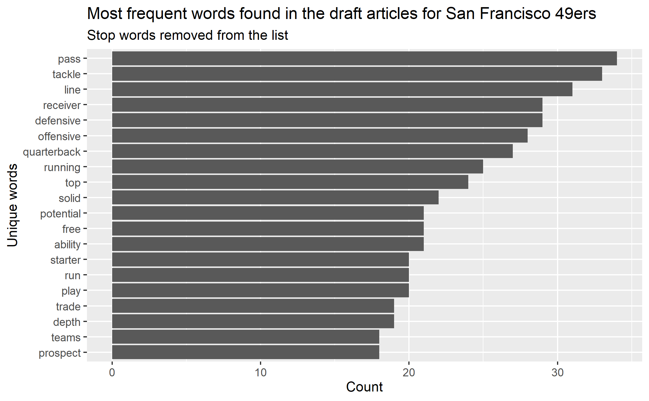
Frequency
I had to recreate the plot multiple times to identify words that would potentially add little-to-no value to my analysis. After identification, I appended stop words to the default stop_words() list. E.g:
49ers
Draft
San Francisco
NFL
2022
Samuel
Trey
Niners

Slide 6
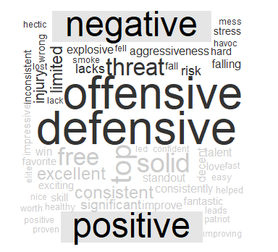


BING & AFINN Sentiment

Slide 7
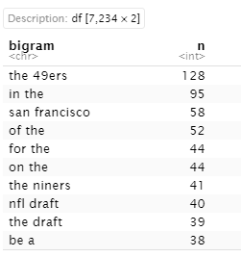
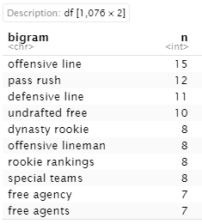
BIGRAMS
Remove Stop Words

Slide 8
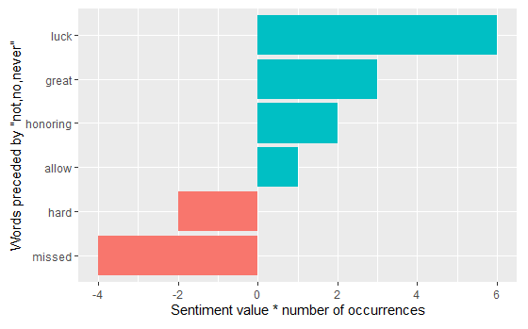
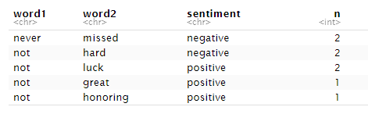

Bigrams & Negated Words
AFINN
BING
*Net +6 “incorrectly” assigned positive sentiment
*Net +1 “incorrectly” assigned positive sentiment

Slide 9
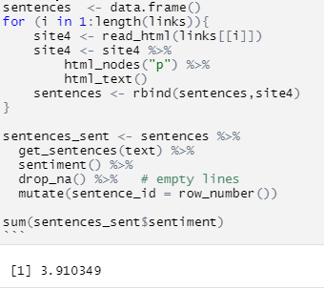
Sentiment on sentences
sentimentr attempts to take into account valence shifters (i.e., negators, amplifiers (intensifiers), de-amplifiers (downtoners), and adversative conjunctions) to perform sentiment analysis

Slide 10
Conclusion
BING, AFINN, and SentimentR all provided a positive sentiment
Analyzing bigrams, negated words did not have a significant impact
Reviewing each article, I then noticed draft grades of B- to A-
Opposite of my personal sentiment
Next Steps
Perform word correlation
Determine bigrams/trigrams that should have a higher weight in sentiment
Analyze total sentiment by article, source, author
Determine if any trends/bias based on website/author

Slide 11
References
https://www.tidytextmining.com/
https://cran.r-project.org/web/packages/sentimentr/readme/README.html

