Slide 1
Sales Dashboard – Task 4
Created an interactive Sales Dashboard using Power BI.
Dataset: Sales/Financial dataset.
Key KPIs:
• Total Revenue: 5M
• Total Profit: 2.76M
Country-wise revenue analysis.
Year-wise revenue trend.
Date-wise sales analysis.
Country slicer for interactive filtering.

Slide 2
Insights and Tools Used
Tools Used
• Power BI Desktop
• Sales/Financial dataset
• Interactive slicers and filters
• Charts and KPI cards
Key Insights
• Revenue and profit can be monitored through KPI cards.
• Country-wise revenue comparison helps identify stronger markets.
• Year-wise and date-wise charts show sales trends.
• The Country slicer allows stakeholders to interact with the dashboard.

Slide 3
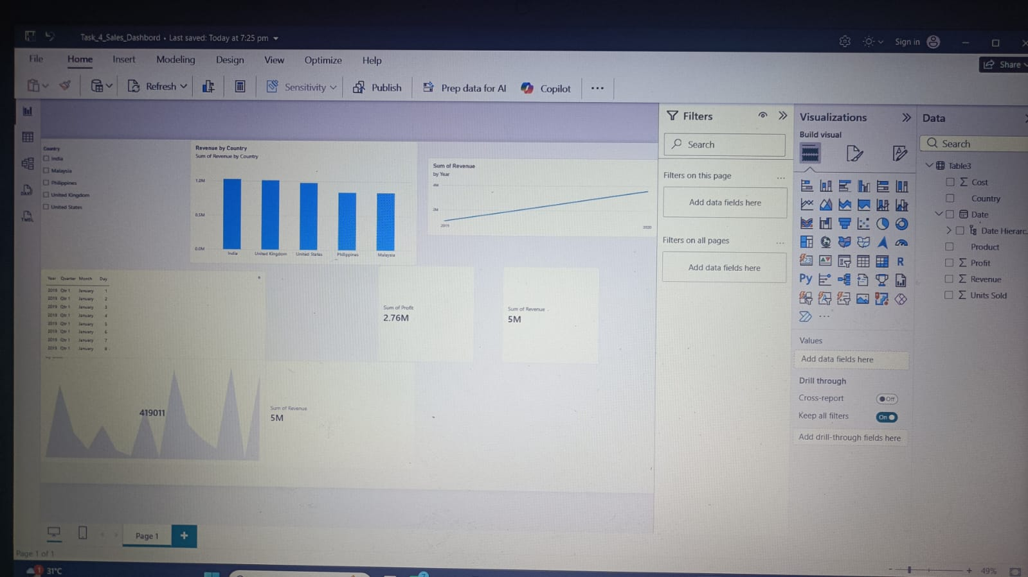
Power BI Sales Dashboard

