Slide 1


Age Prediction Model Guide
Ali Barış Tunalı

Slide 2

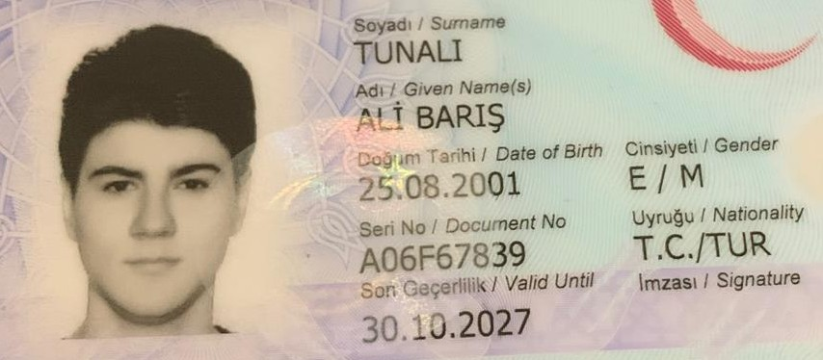

Big system
It is big digital image processing algorithm, if the human is adult, algorithm detect this by predicting the age
And system is going on. Model predicts according to face picture

Slide 3
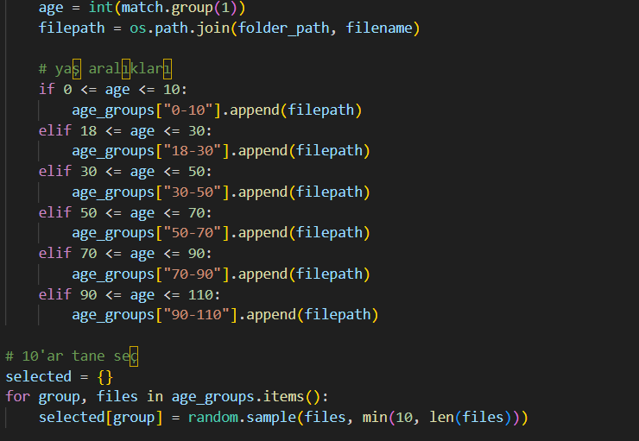
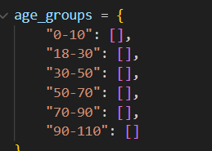
Accuracy score of algorithm. To calculate this we choose random ten pictures of six different age range.

Slide 4
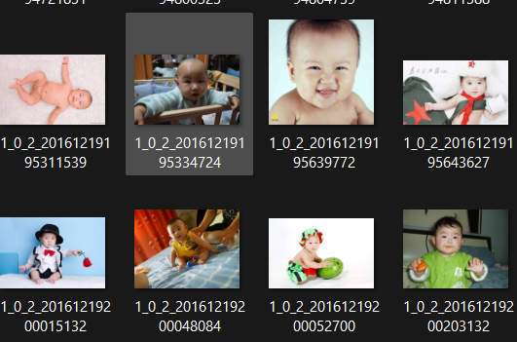
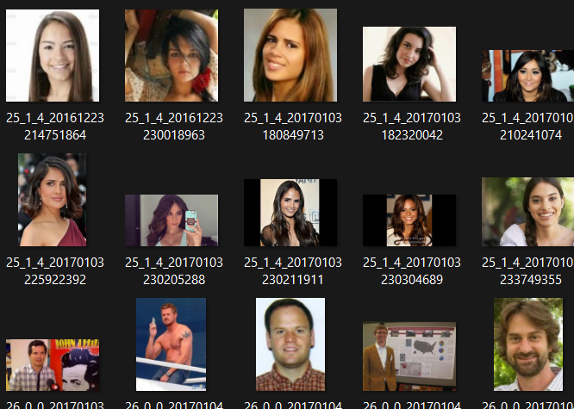
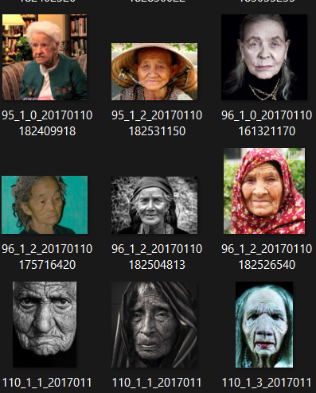
We used a photo database of 10,000 images of people aged 0-110 to train this model.

Slide 5
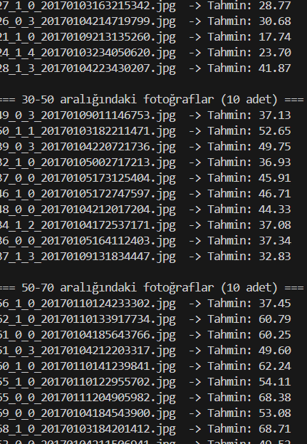
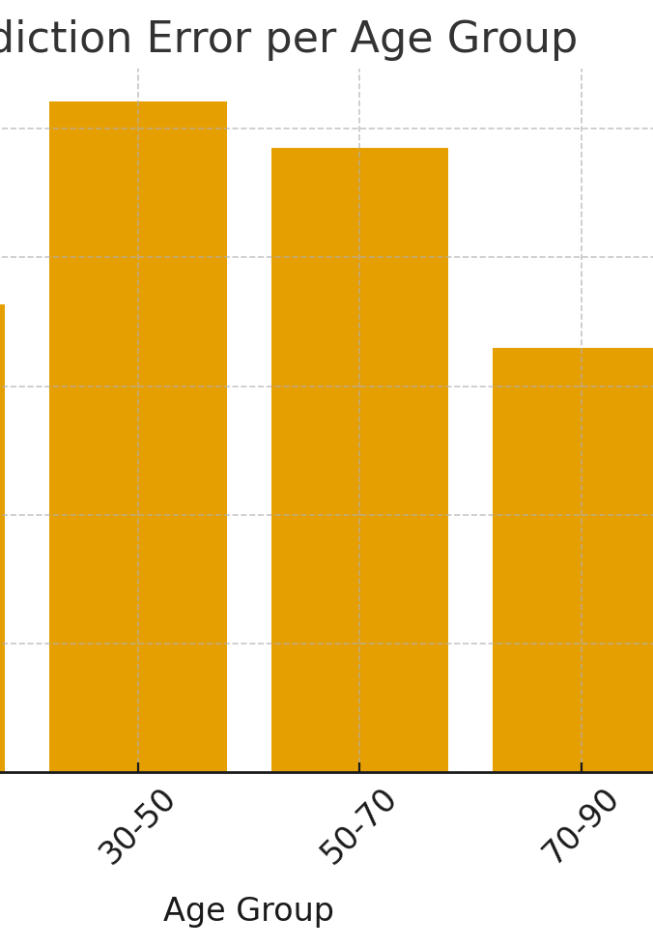
And its accuracy score

Slide 6
Last comment of model
Model Performance Assessment by Age Group
The model demonstrates strong performance in early-age predictions, with the 0–10 group exhibiting the lowest error rates. This indicates that the model captures the visual cues of childhood features reliably and with high precision.
In contrast, prediction accuracy decreases in the 18–30 and 30–50 age groups. These ranges typically involve greater variability in facial appearance—due to lifestyle factors, grooming patterns, and slower but more complex aging effects—which can lead to higher prediction uncertainty. The 30–50 group, in particular, shows the largest deviation, suggesting that mid-age representation within the training data may be less consistent or insufficiently distinctive for the model.
Interestingly, error levels begin to stabilize again in the 50–70 and 70–90 ranges, likely because facial aging markers become more pronounced and easier for the model to interpret. However, variability increases once more in the 90–110 group, where age-related features can be highly diverse and harder to model linearly.
Overall, the model performs best at the extremes of the age spectrum but becomes less reliable in mid-adulthood, highlighting a need for improved feature representation or additional training data in the 18–50 range.

