Slide 1
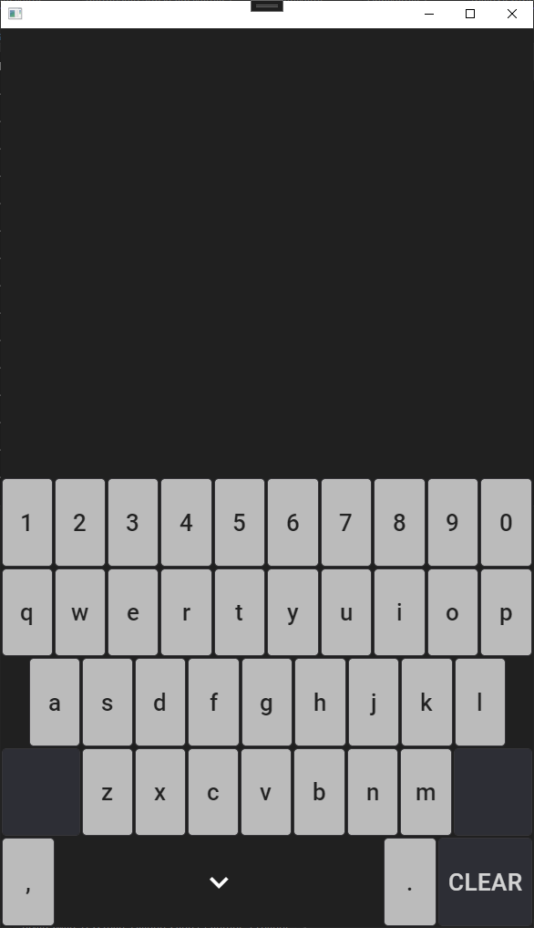
The default theme is dark.
The buttons are themed and have a color associated to their press.
The styles are mainly defined in Resource dictionaries in the Shared app.
The Space bar button uses a font icon

Slide 2
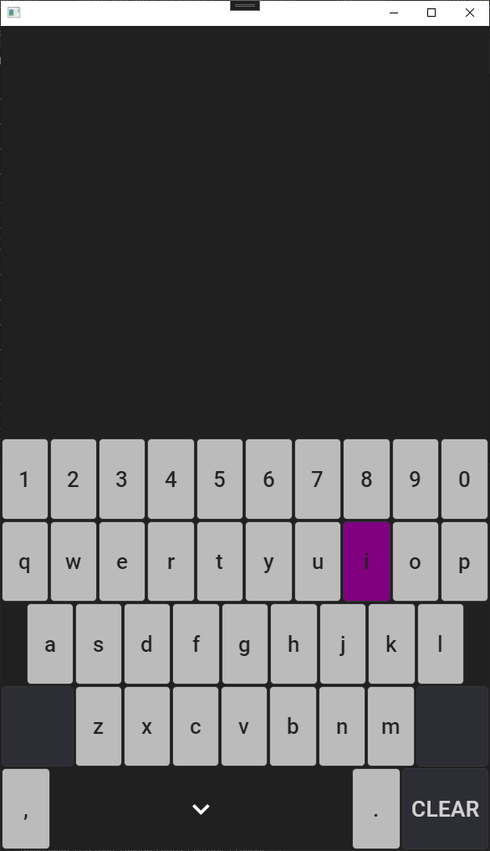

Slide 3
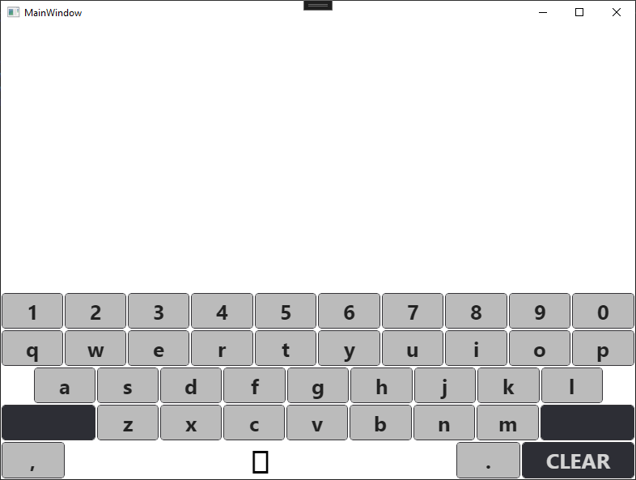
The default theme is dark is not persisted.
The button themes are not consistent – there is no press color with the island.
The Space bar button doesn’t have the font icon even though I reference the same font file.

