Slide 1
Physics-informed neural networks
Python workflow presentation
Lucie-Garance Barot (lucie-garance.barot@ens.psl.eu)
Based on previous work from Dre. Anne Giralt and the BRS team

Slide 2

Overview of the inputs and outputs

Slide 3
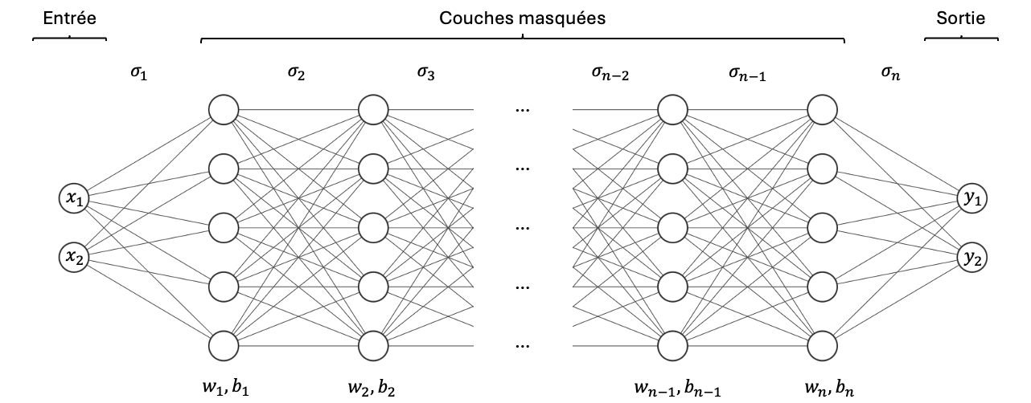
General structure of a PINN model
Input
Hidden layers
Output
Metabolite’s concentrations (time series)
ODE Model
ODE parameters
Training data
Structure of a PINN model

Slide 4
Specifying the data and ODE model
Data specification:
Time series data : list of values for each metabolite
Auxiliary data : list of tensors giving all values per data point
ODE model specification:
Dictionary of lambda functions to calculate the residuals
Dictionary of to be estimated parameters with associated ranges
Dictionary of “constants” parameters with associated value

Slide 5
Hyper-parameters and structure elements
Structure of the PINN:
Number of hidden layers
Activation function and number of neurons per layer are already specified
General hyperparameters:
Optimiser hyperparameters: learning rate and beta parameters of Adam
Scheduler hyperparameters: parameters for the CyclicLR
Number of epochs for training
Loss balancing parametrisation:
Base weights fit
Multiple loss balancing method and its parameters

Slide 6
Outputs of the model
Values predicted by the model for the given time points
Values of the loss function and each of its terms for all epochs
Estimations for learned parameters
Learning rate at each epoch

Slide 7
The PINN workflow and features

Slide 8
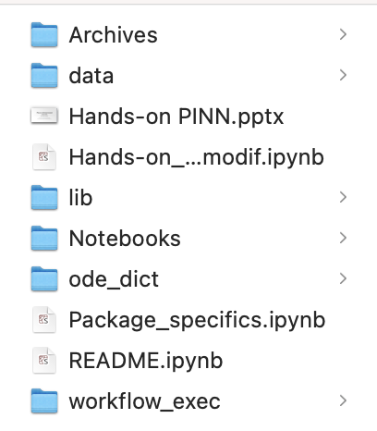
Organisation of the github repository
Workflow for Paul’s data and previous jinns models
Csv datasets : Millard’s data, Paul’s data
The PINN class definition and associated tools
ODE and parameters dictionaries
Notebooks for direct utilization
Executable workflows

Slide 9
The general workflow
Workflows for 1, 10 and 30mM => to get the best model so far
Parameters specified with comments for modification
Allows to reproduce all the results of the report using auxiliary loss
All data available on the folder
workflow.py files can be directly uploaded to server for easy reproducibility of results

Slide 10
Extra elements of the pathway
Early stages of PINN:
pinn_warming_softadapt.py left as early version for using pinn without auxiliary loss
jinns workflow kept for referencing and perspectives
All this work is kept in the archives, with comments and notebooks to run
SBML handling and dictionary builder
Both come in a summarised notebook for running easily
Specifications are made to use only one or the other

Slide 11
Thank you for your attention

