Slide 1
Papers:
Large scale active-learning-guided exploration for in vitro protein production optimization | Nature Communications (Olivier & Mathilde, 2020)
A versatile active learning workflow for optimization of genetic and metabolic networks | Nature Communications(Amir Pandi et al, 2022)
Goals of active learning:
Explore combination space of experimental compositions => increase model accuracy
Optimize these compositions to achive biological target => increase yield/ exploitation

Slide 2
First approach: Mathilde, 2020
Each model is selected by repeatedly train 4 different architechtures and pick the best R2 with prediction on training set
=> select the best weight initialization of the model
Use an ensemble of 25 MLP models
=> calculated mean/ std of predictions
Generate 100,000 new combination and select best 500
=> UCB (ratio exploration / exploitaion = 1.14/1)
- Hard code jupyter notebook

Slide 3
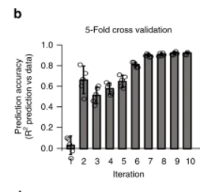
First approach: Mathilde, 2020
Cons:
Cross validation is independant from active learning interation
=> how to prevent over fitting and pick good hyperparameters?
- Prioritize exploration than exploitaion to achieve high accuracy
- Hard code jupyter notebook => not user-friendly

Slide 4
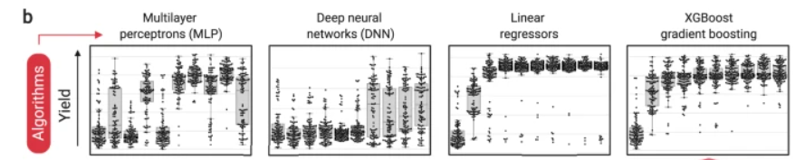
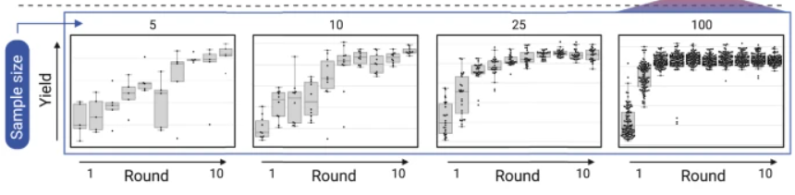
Second approach: Amir, 2022
Use grid-search + cross validation to find best hyperparameters for XGBoost model
=> avoid over fitting and model accuracy will improve faster
_ Use ensemble of 20 models with same parameters to predict => mean/std
_ Investigate nb of new sample can improve accuracy significantly XGBoost
_ Propose changing exploit/explore ratio through interations

Slide 5
Propose framework:
Small initial samples, ~ 100 data points => use more statistical or classic ML models + grid search + cross validation:
+ linear combine L2 regulization
+ Multilayer perceptron with 1 – 2 hidden layers + smaller node numbers (32-64)
+ SVM with regularization
+ XGBoost
+ Gaussian process
Best parameters
_ Ensemble of 5 different models train with same best parameters but on different subset of dataset
_ Changing exploit/explore ratio through interations

Slide 6
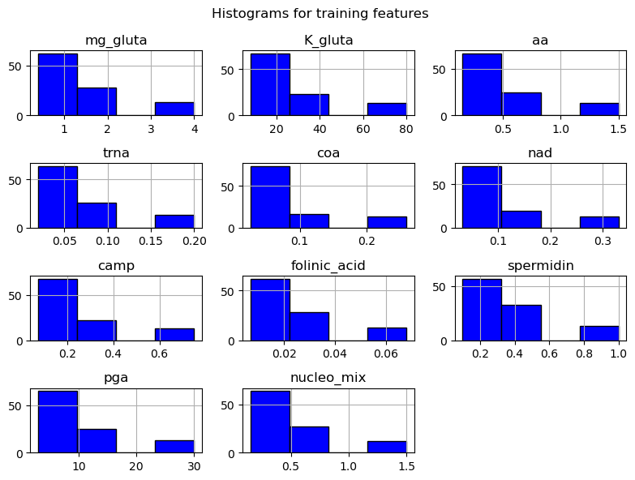
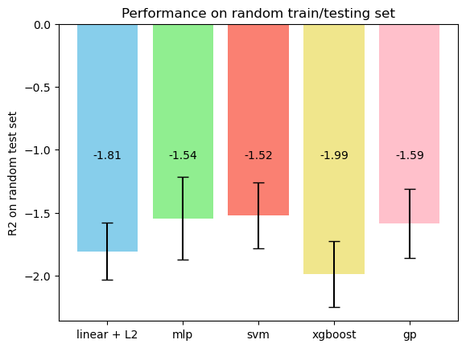
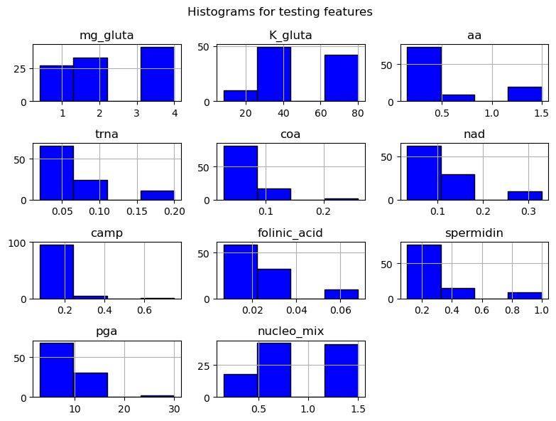
Result:
Day_1 training + random testing

Slide 7
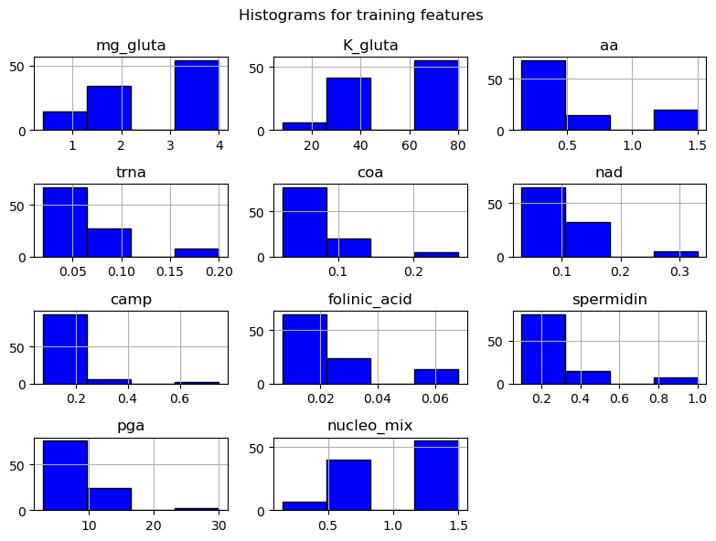
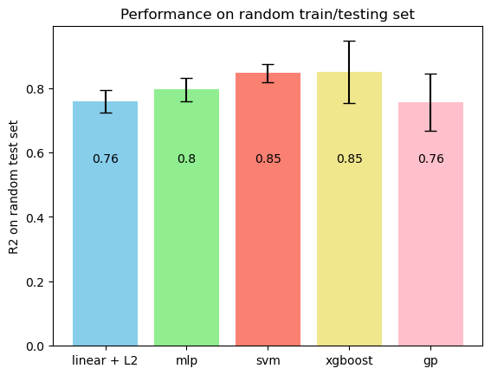
Random training + random testing

Slide 8
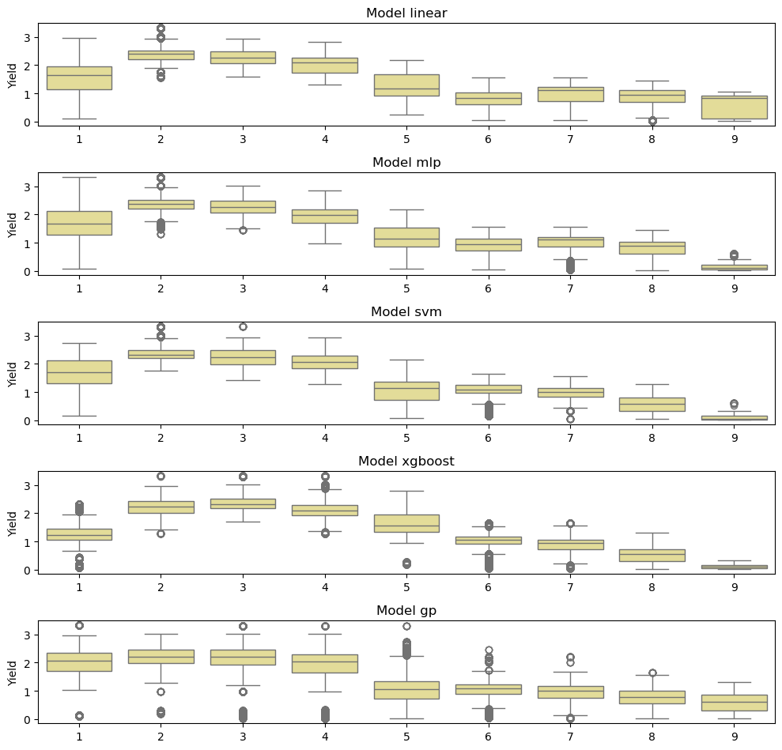
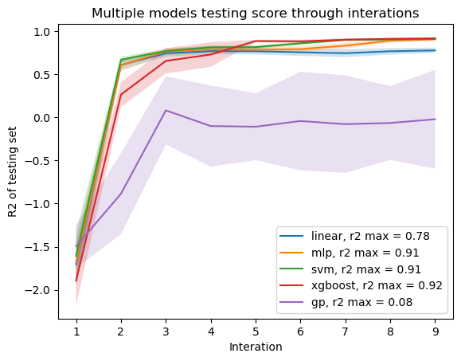
Day_1 training + random testing
Total data point > 1000 from 10 rounds of active learning
Day_1 data is the first round of experiments
The rest of data consider as data pool
Pick best 100 and drop these from pool for next interations

Slide 9
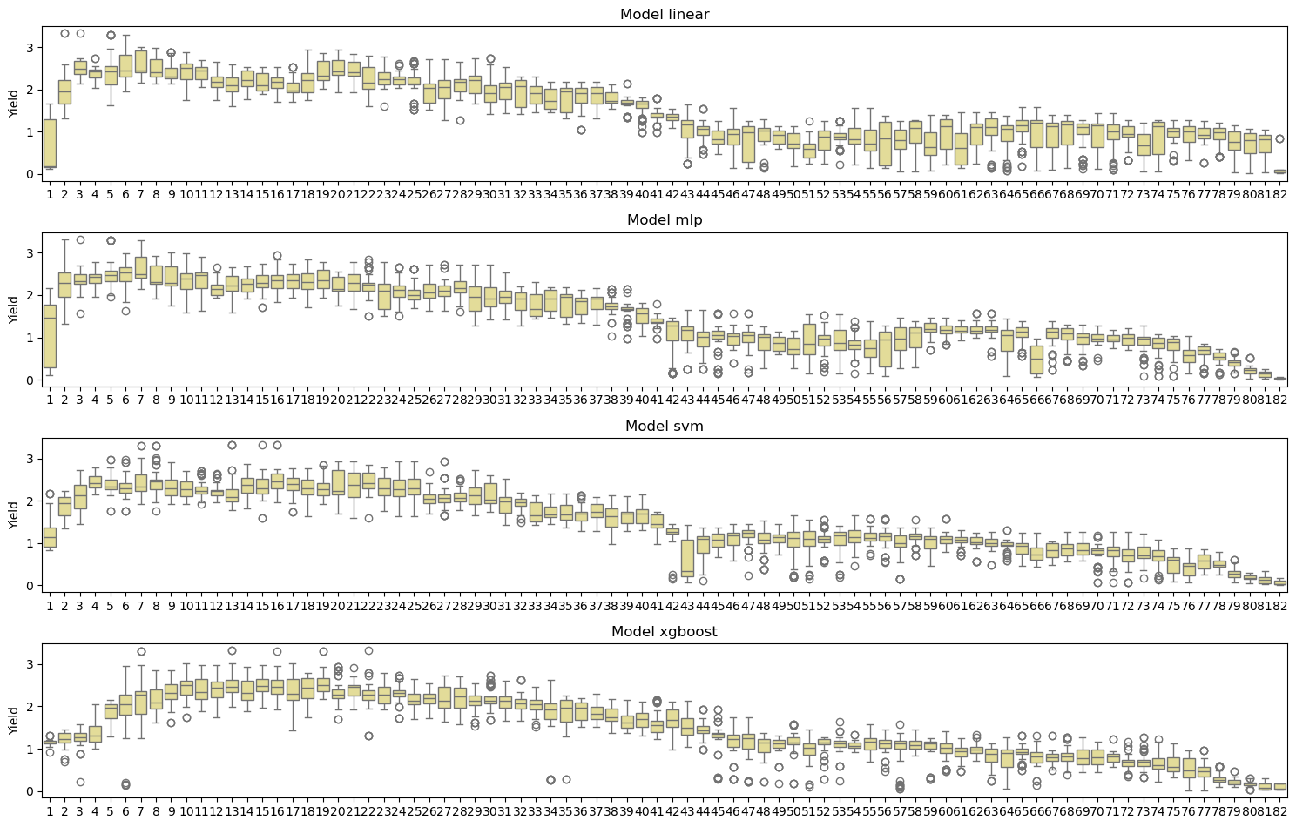
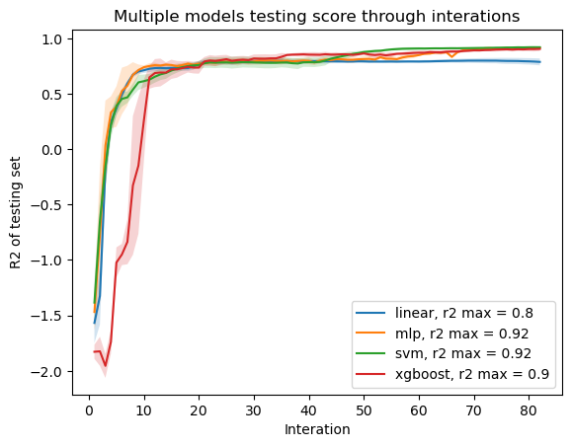
New sample = 10
Every interation only add 10 new data points

Slide 10
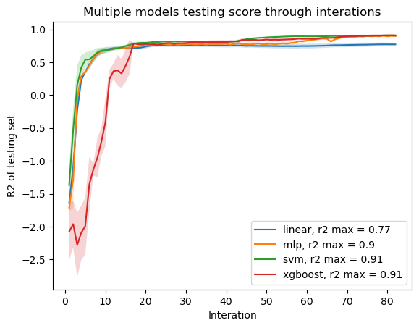
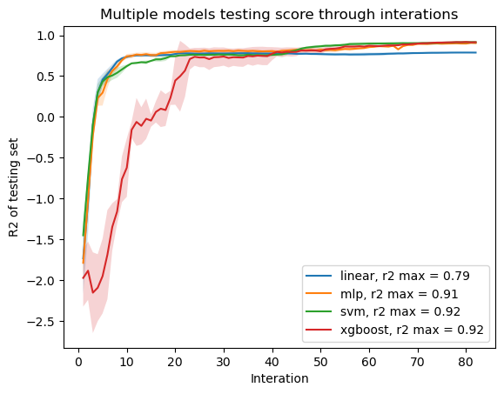
Exploit/ explore ratio
Ratio = 1/ 1.14
Ratio = 1/ 0.5
Ratio = 1/ 0

Slide 11
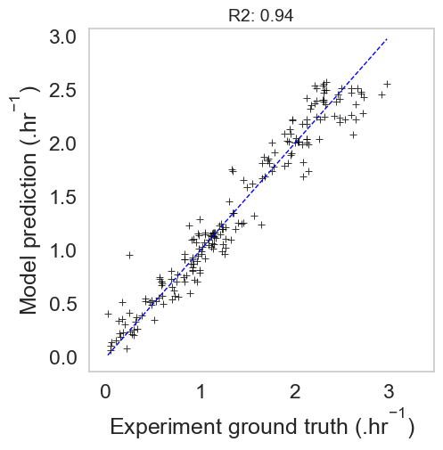
Experiment simulation
Gold model: train on all ~ 1000 points + grid search hyperparameters + 5 folds cross validation
=> provide ground thruth instead of doing experiments
XGBoost - {'learning_rate': 0.01,
'max_depth': 7, 'n_estimators': 500, 'objective': 'reg:squarederror'}
R2: 0.944

Slide 12
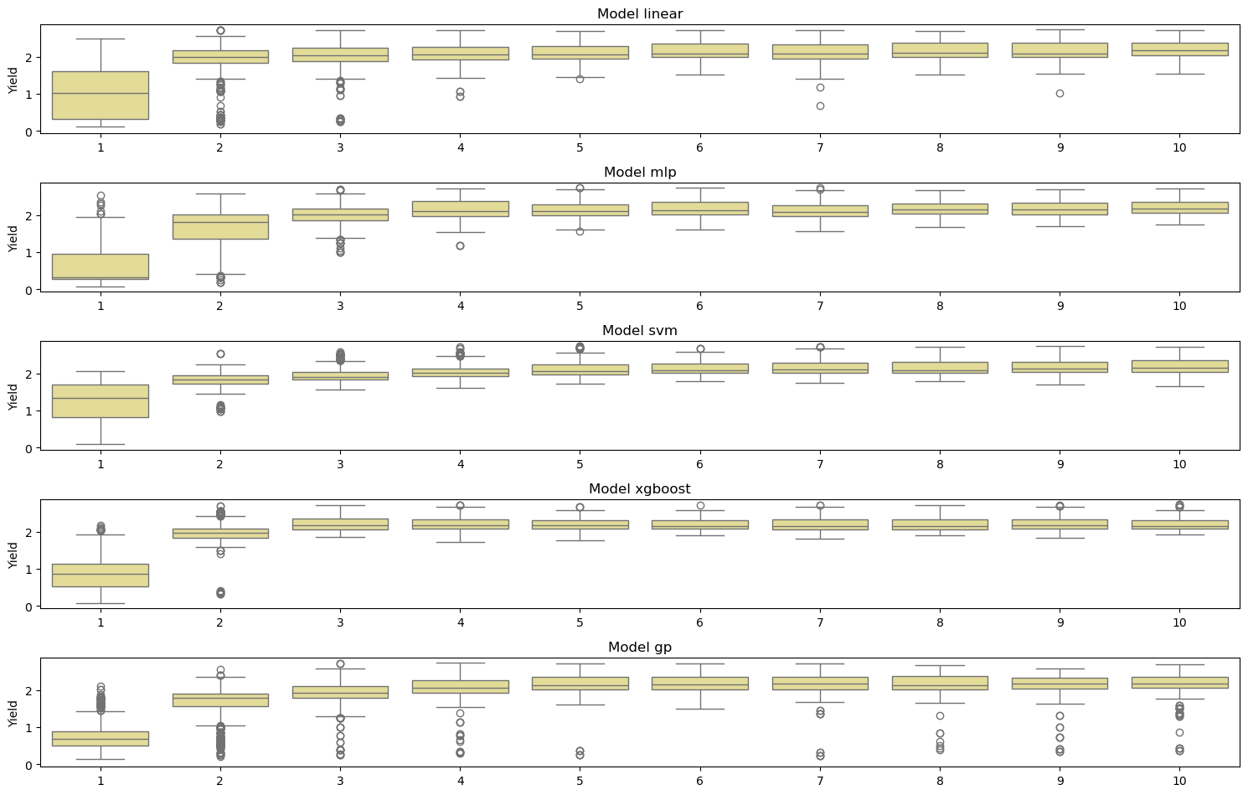
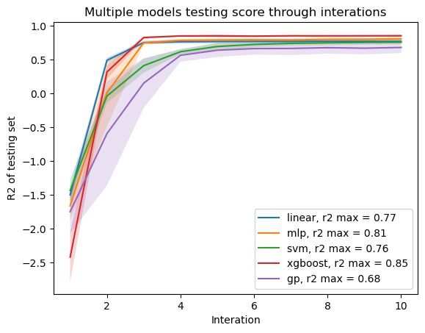
Experiment simulation
Sample = 100

Slide 13
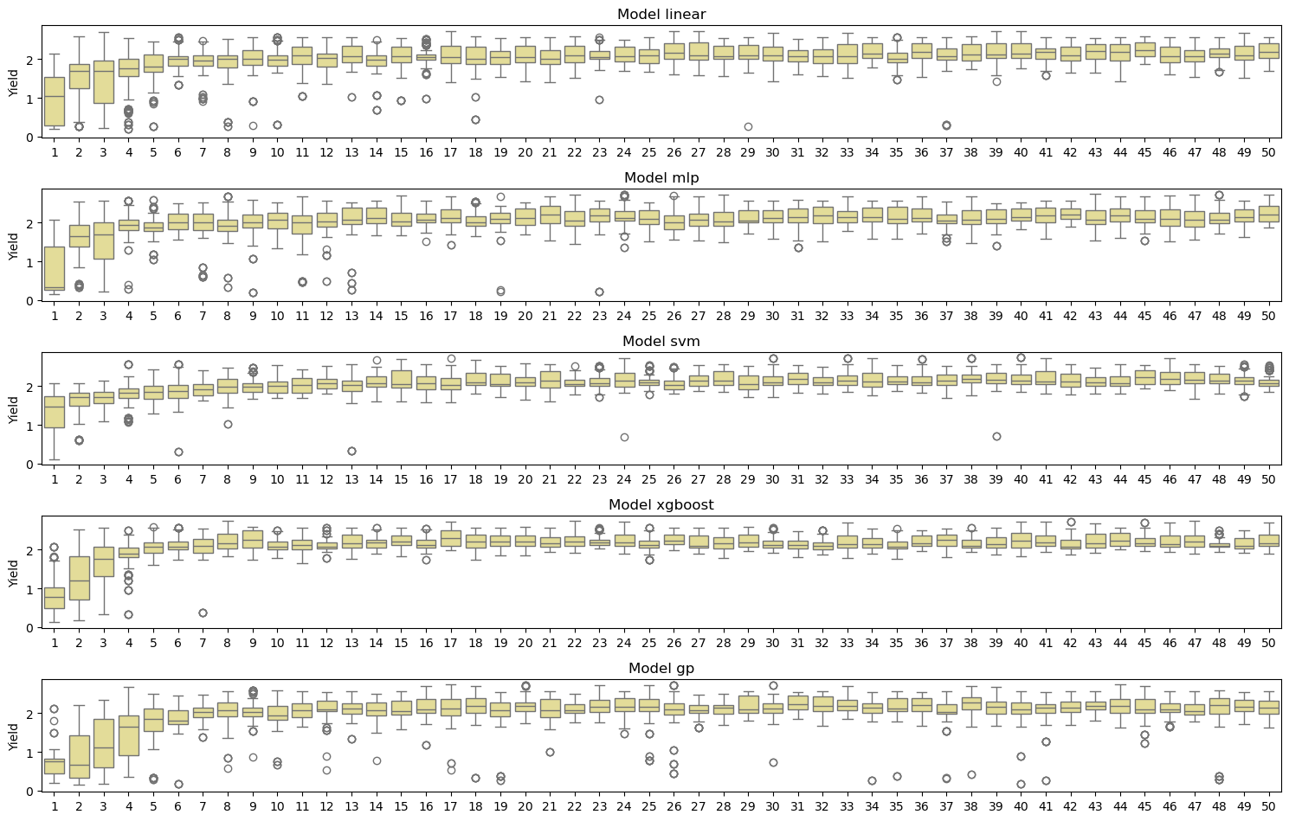
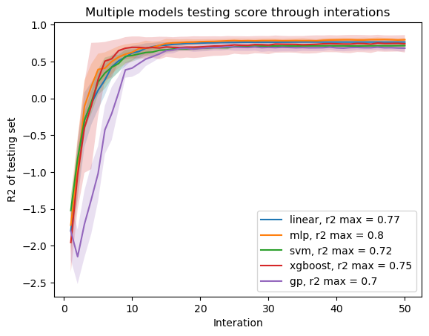
Experiment simulation
Sample = 10

Slide 14
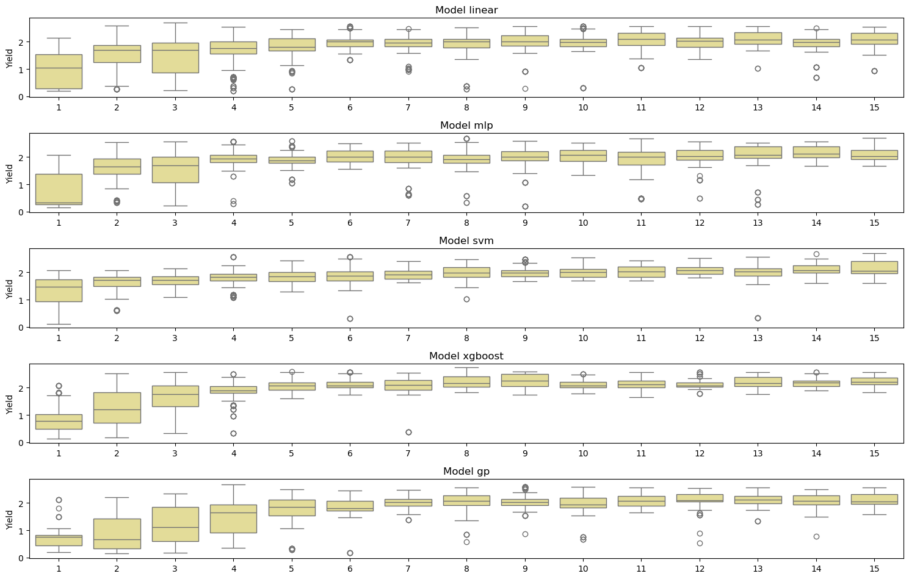
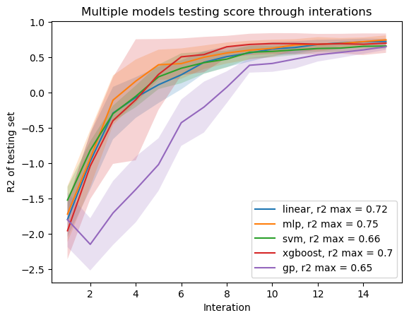
Experiment simulation
Sample = 10,
=> zoom at 15 first interation

Slide 15
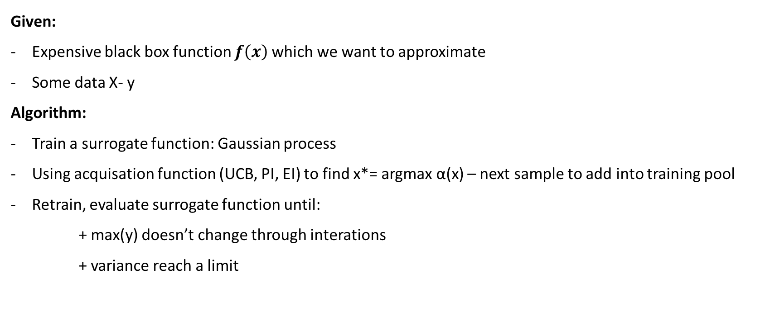
Problem statement from bayesian perspective
Given:
Expensive black box function $f\left(x\right)$which we want to approximate
Some data X- y
Algorithm:
Train a surrogate function: Gaussian process
Using acquisation function (UCB, PI, EI) to find x*= argmax α(x) – next sample to add into training pool
Retrain, evaluate surrogate function until:
+ max(y) doesn’t change through interations
+ variance reach a limit
GpParBayesAnimationSmall - Bayesian optimization - Wikipedia

Slide 16
Bayesian optimization vs Active learning
- Active learning query by comitee: => calculated informativeness through models uncertainty,
select batch of new X
- Bayesian Opt: => calculated informativeness through data distributional assumptions
select only 1 best X
UCB still hold value when select new data in batch but they won’t be as much useful when use model uncertainty
Notes:
Model uncertainty refers to the uncertainty inherent in the structure and parameters of the model itself. It encompasses our lack of knowledge about the true underlying data-generating process

Slide 17
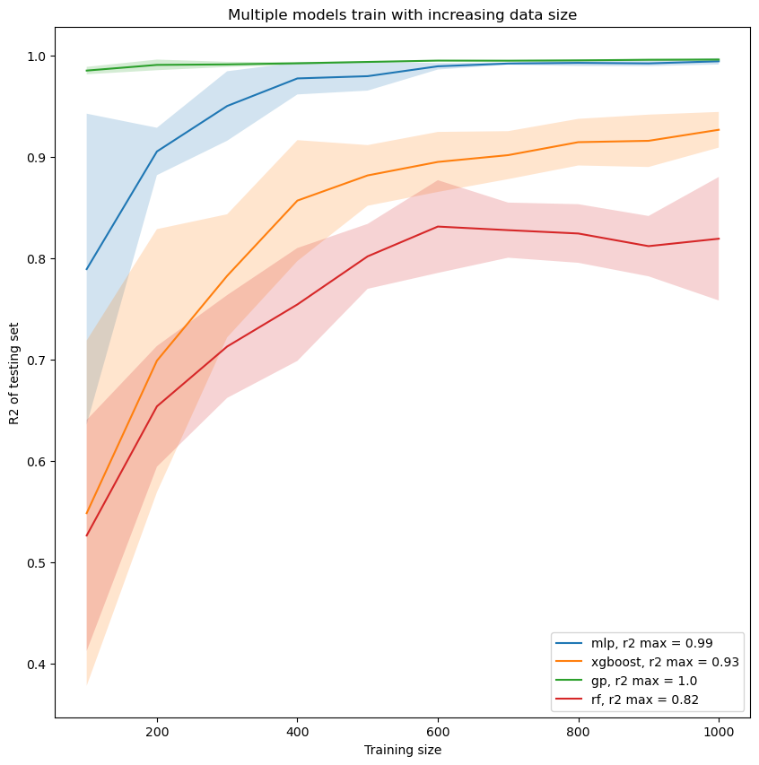
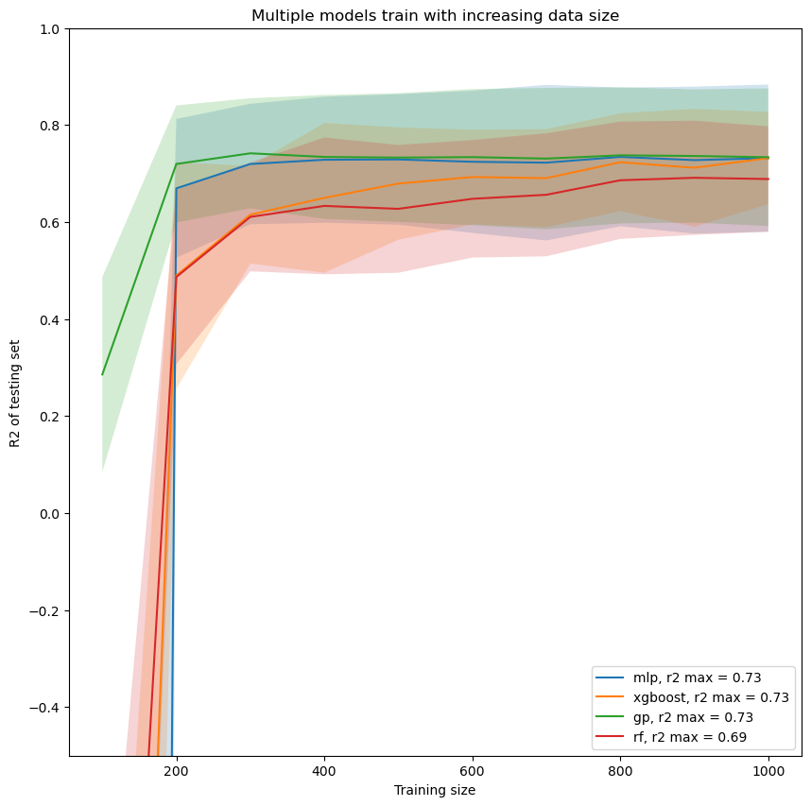
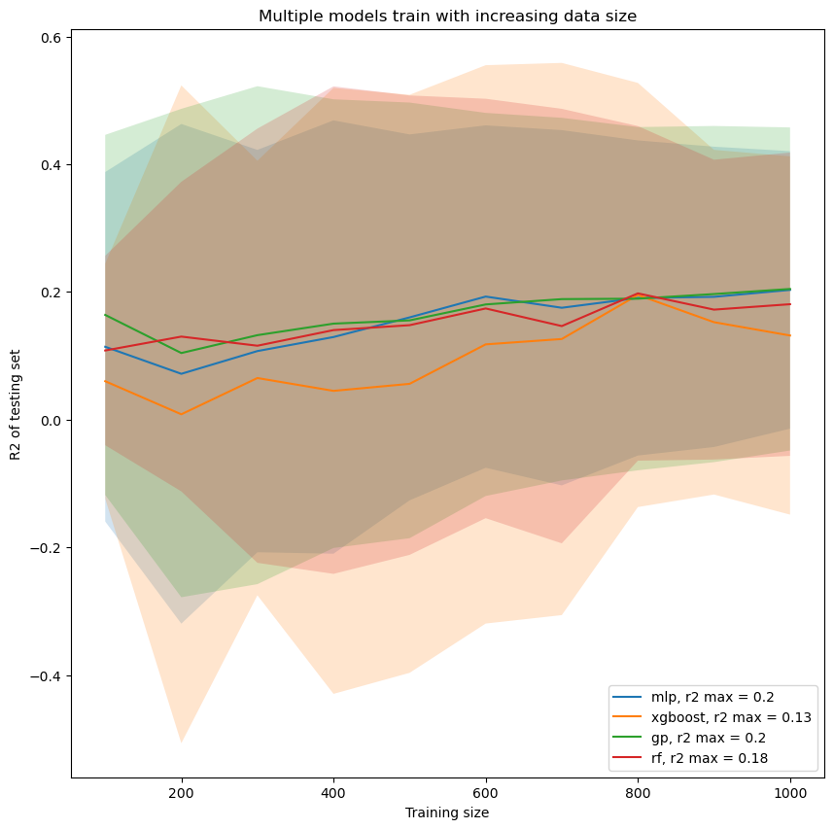
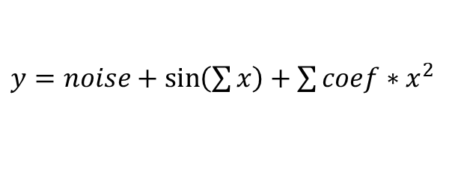
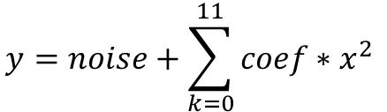
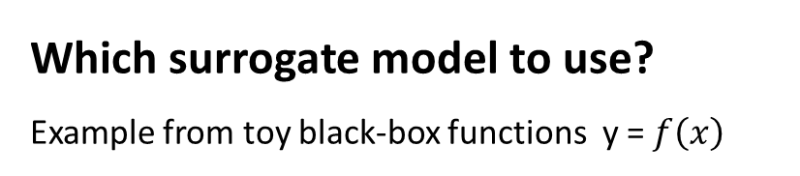
Which surrogate model to use?
Example from toy black-box functions y = $f\left(x\right)$
$$y=noise+\sum_{k=0}^{11}{coef∗x^{2} }$$
$y=noise+coef(sin\left(x1\right)+{e^{−x2 }+x3}^{2}…)$
$y=noise+\sin\left(\sum{x}\right)+\sum{coef∗x^{2}}$
Benchmarking/Example use of framework with RF type surrogate models.ipynb at main · PV-Lab/Benchmarking (github.com)

Slide 18
Which surrogate functions to use?
Gaussian Processes (GP):
Pros:
GPs provide a probabilistic framework for regression and uncertainty estimation. They can model complex relationships and provide uncertainty estimates for predictions. Base model for bayesian optimization.
Well-suited for small datasets, as they don't rely on a fixed number of parameters, and they can adapt to the available data.
Cons:
Computationally expensive, especially as the dataset size increases.
Difficult to select parameters
Interpretability might be challenging.
Neural Networks (NN):
Pros: Neural networks are highly flexible and can capture intricate patterns in data. With small datasets, simpler architechtures can be effective.
Cons: Susceptible to overfitting, especially with limited data.
XGBoost:
1. Pros: Generally less prone to overfitting compared to complex neural networks.
2. Cons: May not capture complex, non-linear relationships as effectively as neural networks in some cases.
=> Cannot perform in extrapolation
Choose based on data size, features size and black-box complexity

Slide 19
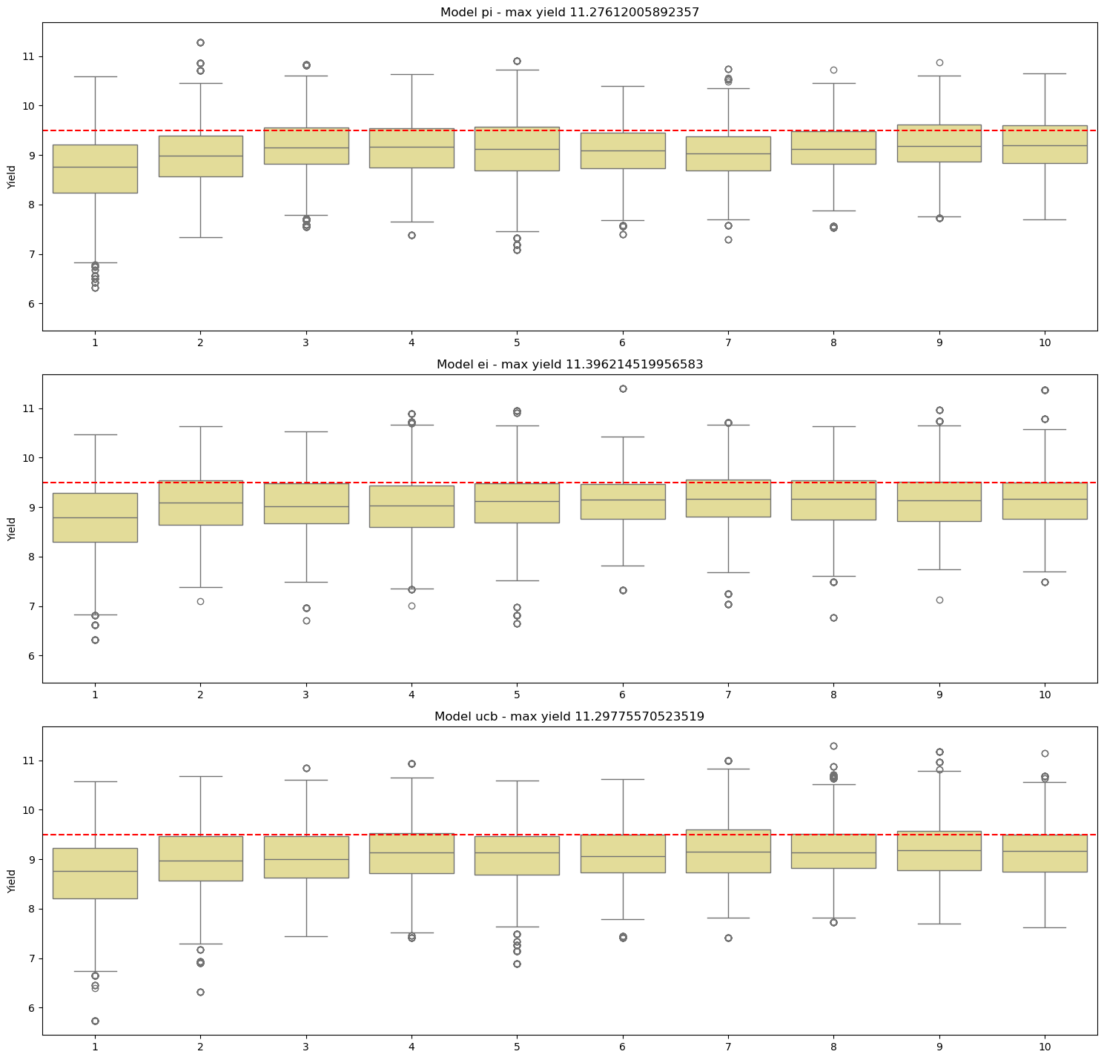
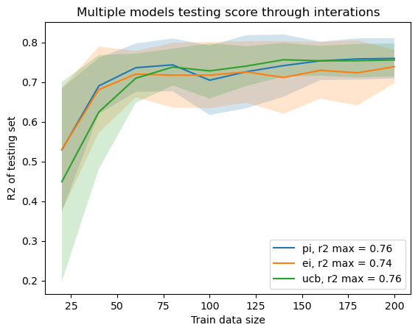
Which acquisition functions to use?
Gaussian process case
PI – probability of impovement, greedy acquisation
EI – Expected improvement, most popular
UCB _ Trade off exploration - exploitation

Slide 20
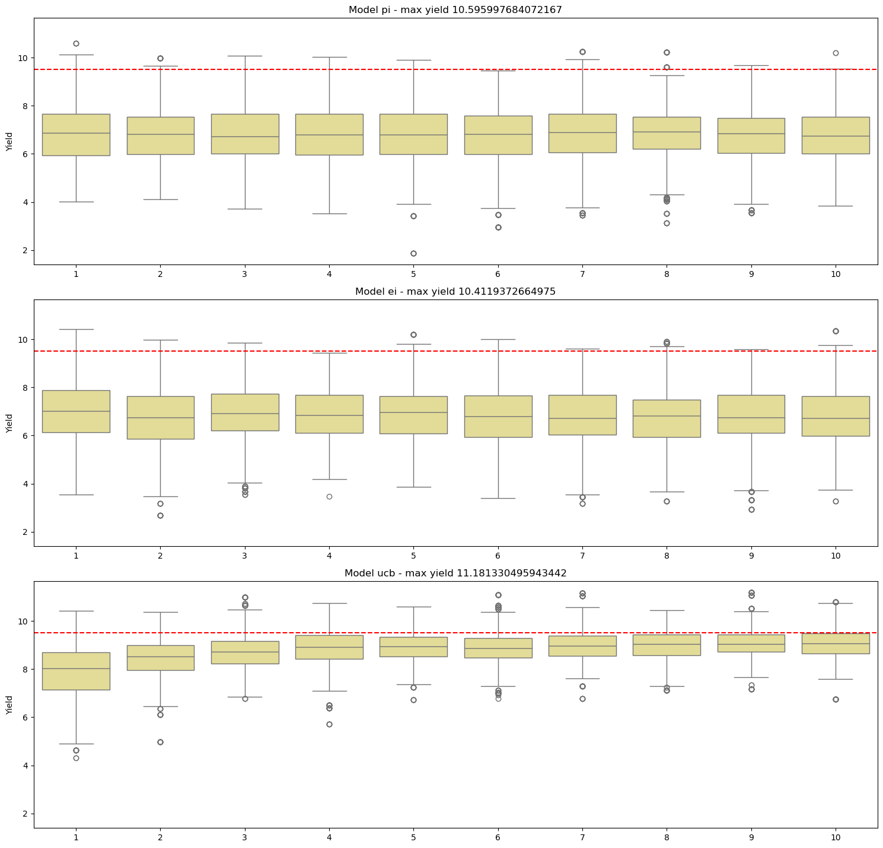
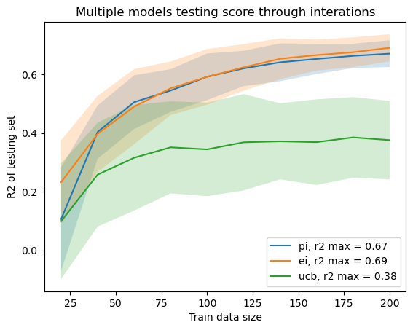
Which acquisition functions to use?
Xgboost case: trade off exploitation / exploration

Slide 21
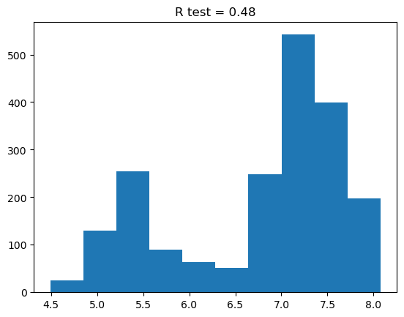
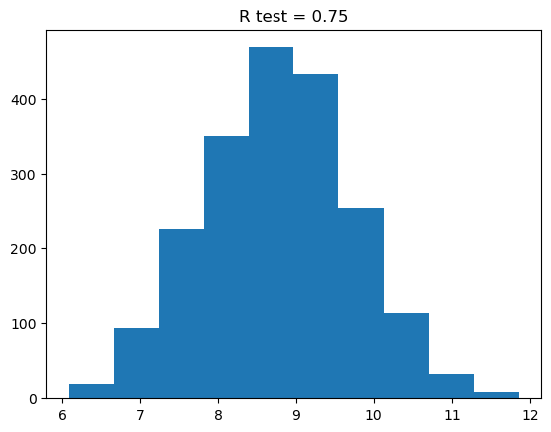
How much data/ experiment needed?
Depend on informativeness distribution

Slide 22
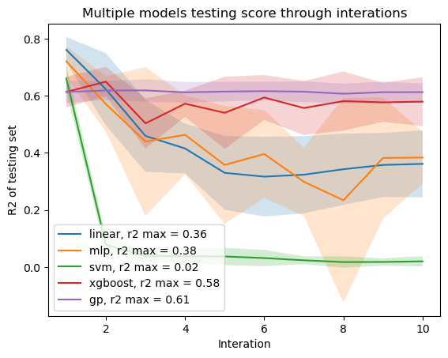
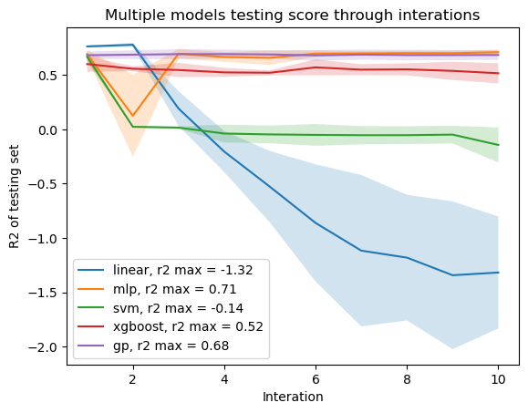
Simulation of lab experiments
N=10
N=100

Slide 23
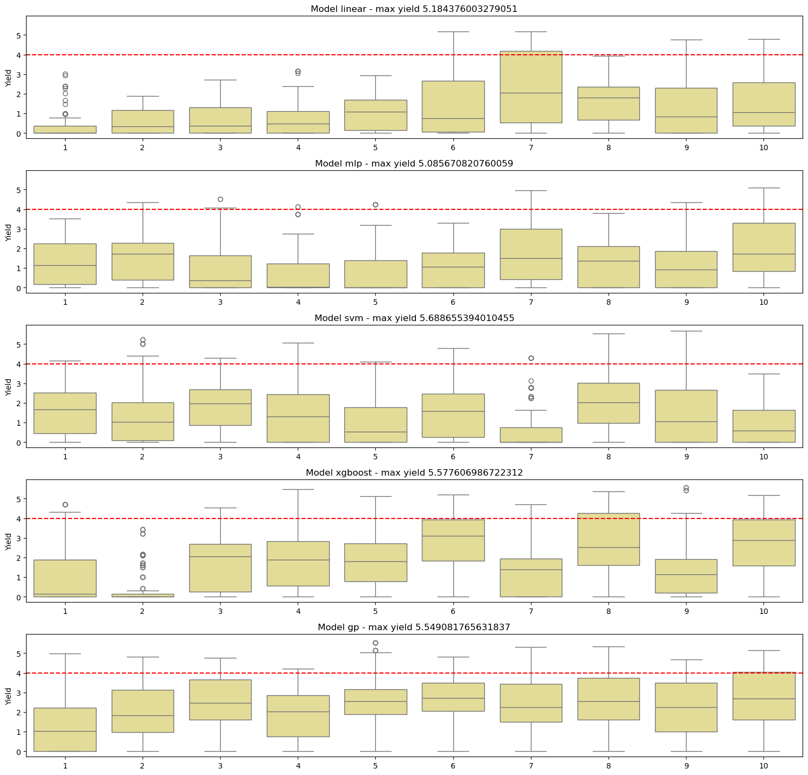
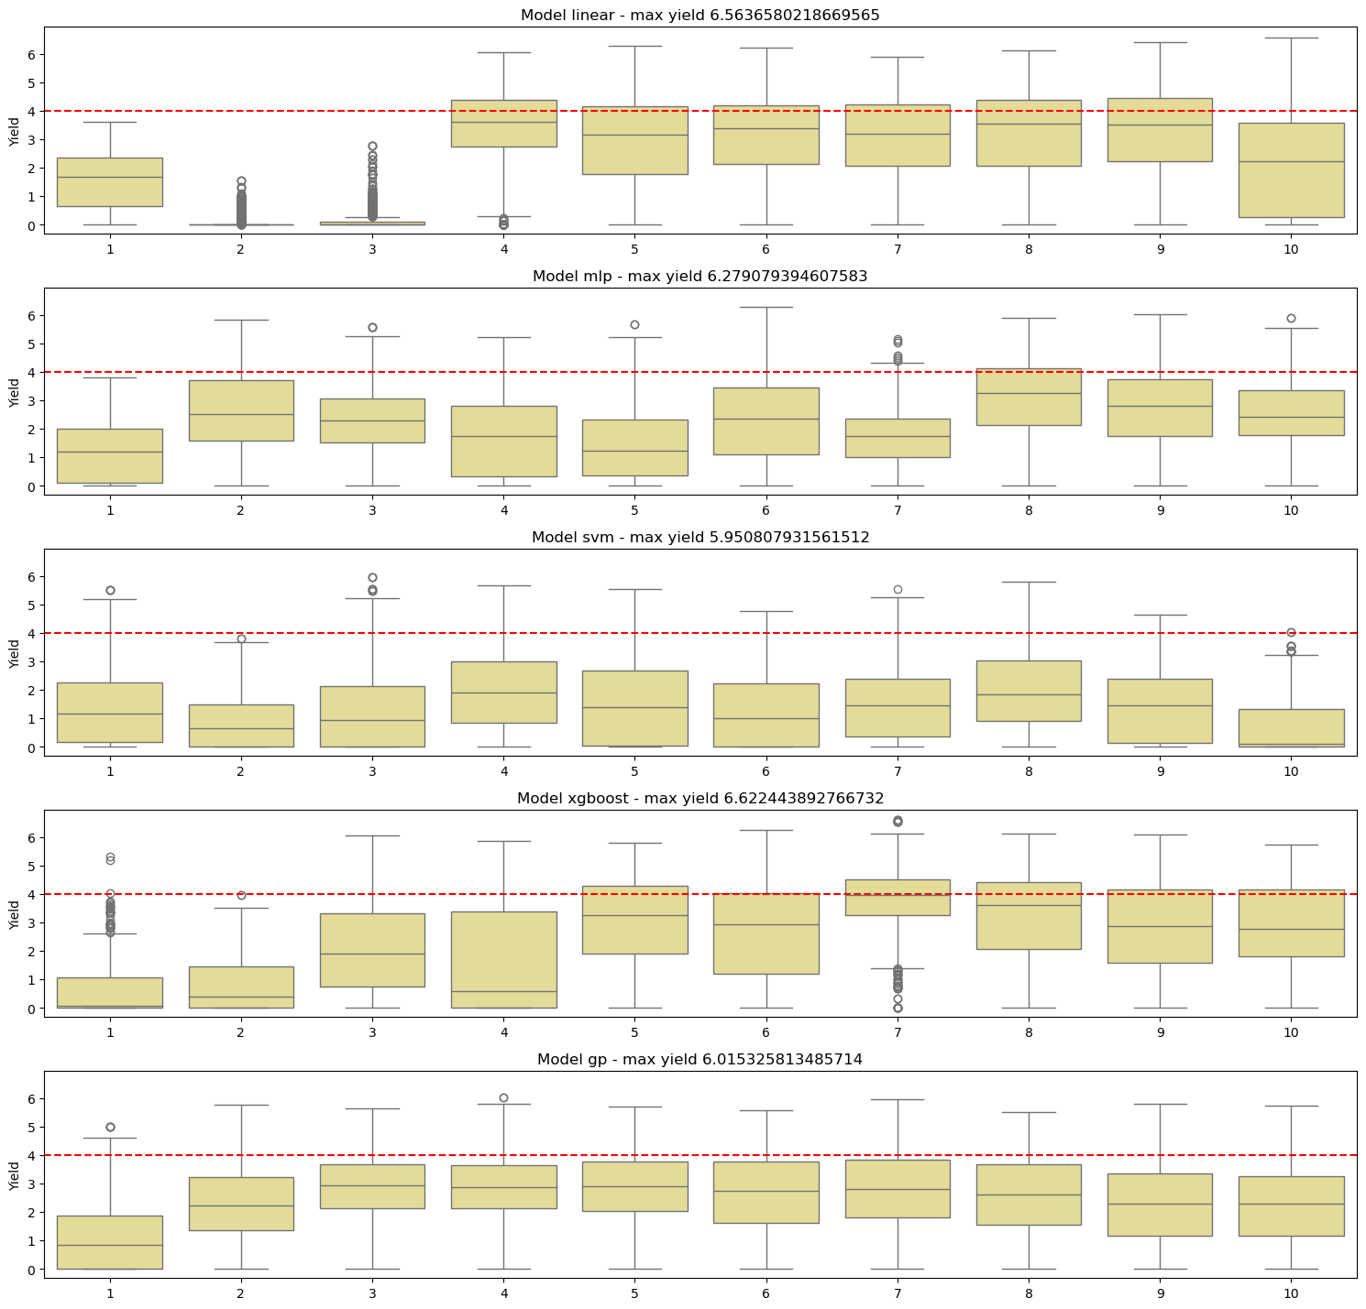
N=10
N=100

Slide 24
Next to try
Use more complex kernel and add noise distribution for gaussian process
Finding best hyperparameters by bayesian opt
Measure uncertainty of neural network by Monte Carlo dropout: Methods for approximating bayesian posteriors - Baal Documentation
Measure uncertainty of Xgboost by quantile regression: Quantile Regression — xgboost 2.1.0-dev documentation
Find more optimal sampling method instead of random (BFGS?)

Slide 25
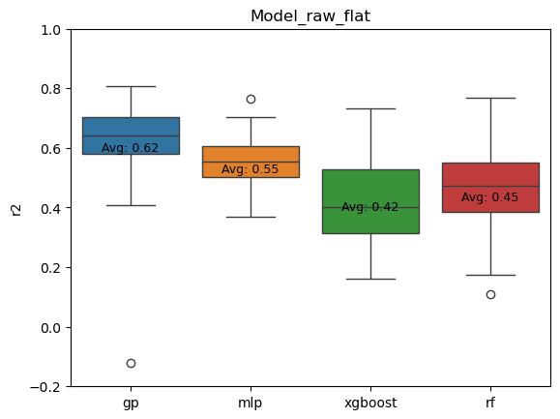
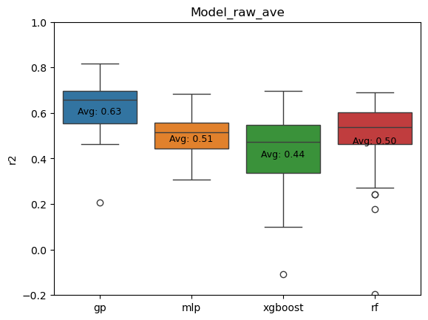
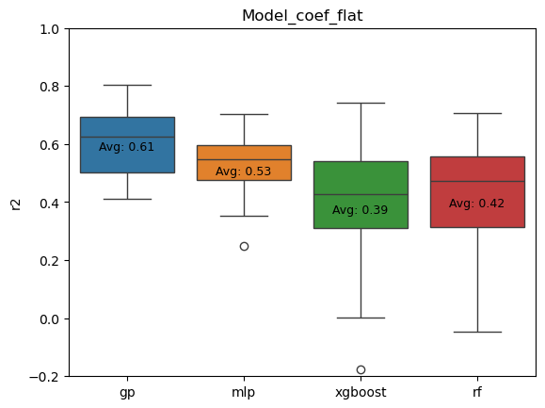
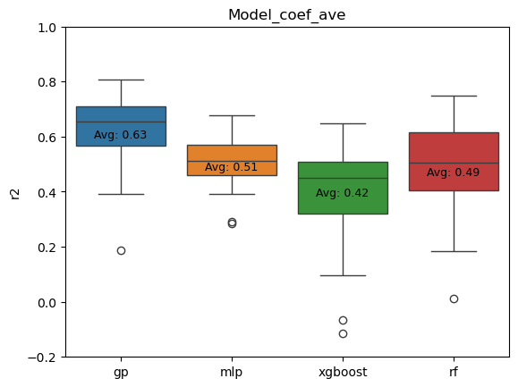
Repeat 50 times random split train/test, pick best parameter based on 5 fold cross validation
Gaussian process performed the best
Training on average data, in general slightly lower bias and improved performance, in case of GP doesn’t have significant effect
Remove outliers doesn’t show significant benefit

Slide 26
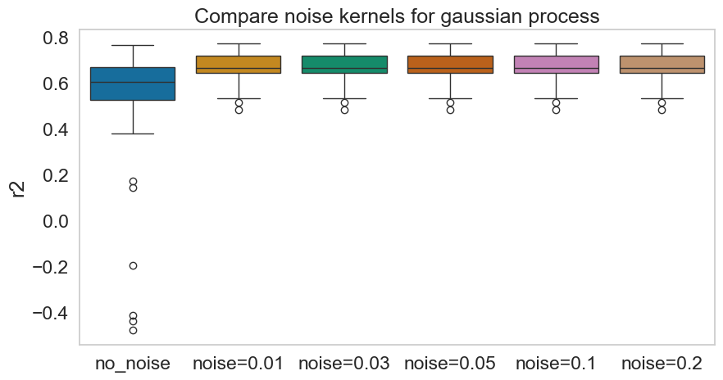
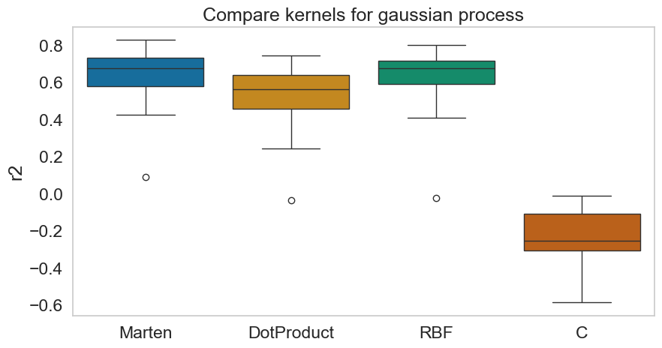
Parameters of gaussian process
ANOVA all:
- fvalue: 7.321
- p_value: 2.989e-06
ANOVA between noise kernels
- fvalue: 1.799e-12
- p_value: 0.999999
=> Adding noise kernel is beneficial but no need to give estimated noise level
Performance:
Marten = RBF > DotProduct >C

Slide 27
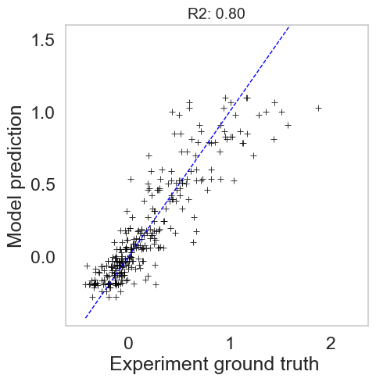
Fitting of all data ( 3 repititions and remove outliers)
Best hyperparameter found: {'kernel': RBF(length_scale=1) + 1**2 + WhiteKernel(noise_level=1)}
Average performance on different testing subsets
0.61 ± 0.1

Slide 28
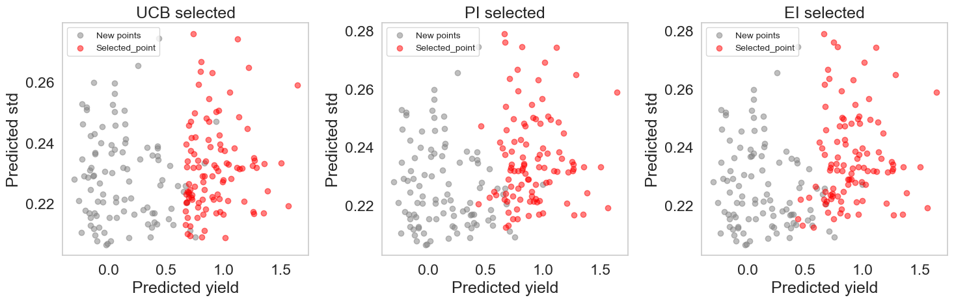
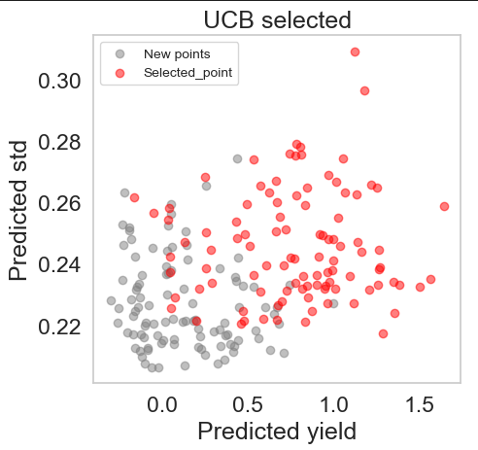
Exploit only, theta = 0
Ucb value based on theta (ratio between explore/exploit)
Pick new point based on ei/pi because 2 formular selected the same points and these points fit more with our expected behaviour of system
( high dna, high ntps => high yield)
theta = 20

Slide 29
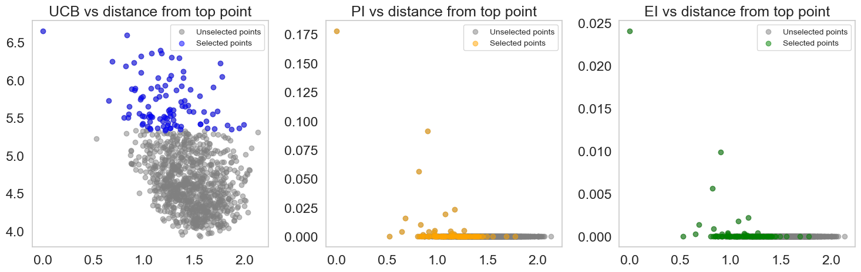
How many experiments to test next?
Theta = 20
Bayersian optimization => select only 1 point with highest ucb/pi/ei
In case of active learning, we want to test more points/experiements during each interations, but from pi/ei point of views many points doesn’t have significant informativeness compare to random select points
=> Suggest: testing only 20-50 new experiments, instead of 100

Slide 30
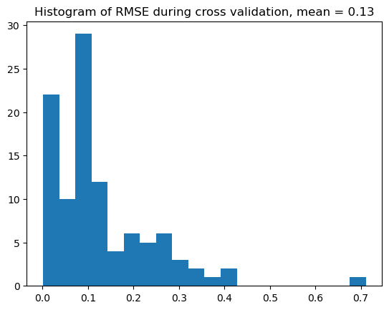
Question: How to simply evaluate model performance?
Leave one out cross validation
Metric RMSE, same unit as yield
=> Draw histogram of each validation point
Round 0 of active learning
Notes:
Best hyperparameter found: {'kernel': Matern(length_scale=1, nu=1.5) + WhiteKernel(noise_level=1)}

Slide 31
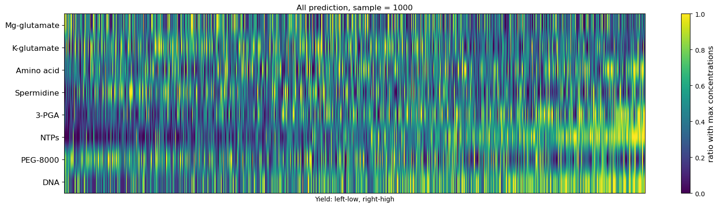
Question: How to interpretate model

Slide 32

Question: How to interpretate model

Slide 33


Round1

Slide 34



Round1

