Slide 1
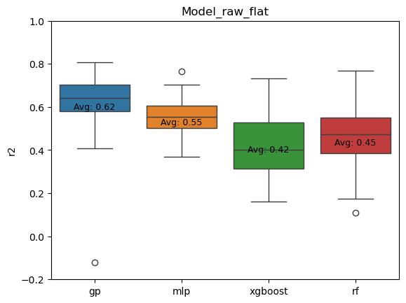
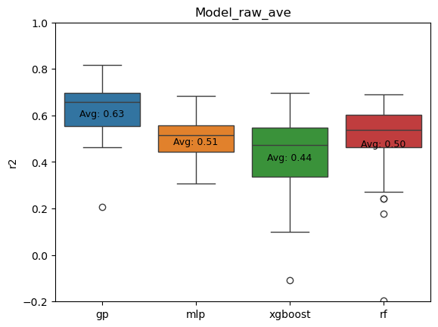
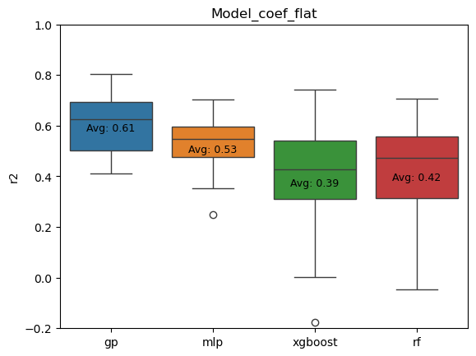
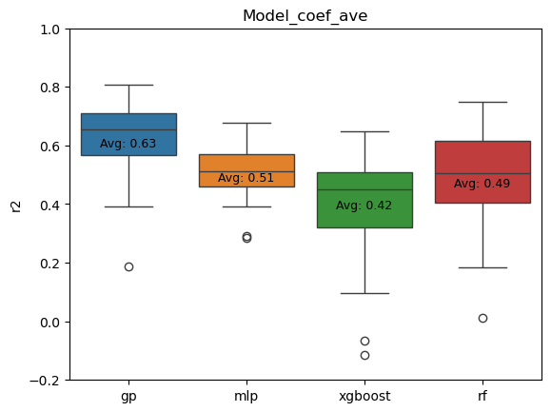
Repeat 50 times random split train/test, pick best parameter based on 5 fold cross validation
Gaussian process performed the best
Training on average data, in general slightly lower bias and improved performance, in case of GP doesn’t have significant effect
Remove outliers doesn’t show significant benefit

Slide 2
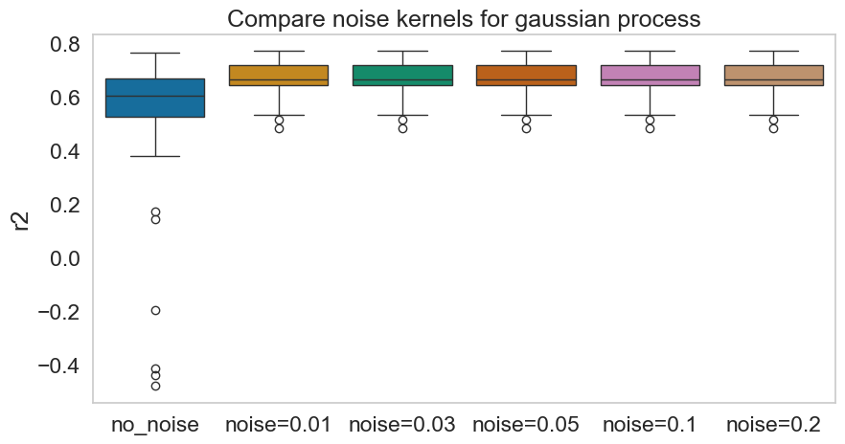
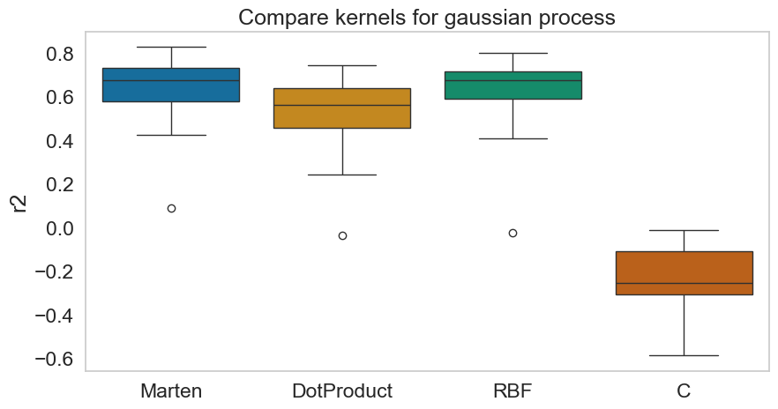
Parameters of gaussian process
ANOVA all:
- fvalue: 7.321
- p_value: 2.989e-06
ANOVA between noise kernels
- fvalue: 1.799e-12
- p_value: 0.999999
=> Adding noise kernel is beneficial but no need to give estimated noise level
Performance:
Marten = RBF > DotProduct >C

Slide 3
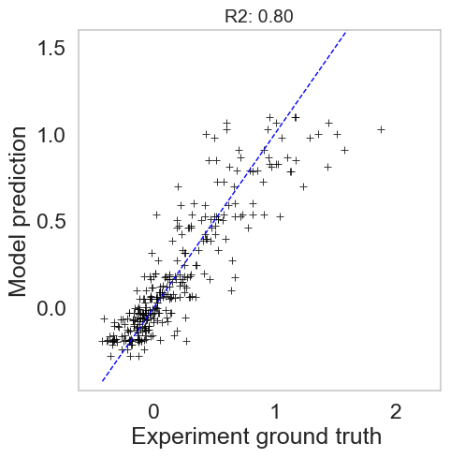
Fitting of all data ( 3 repititions and remove outliers)
Best hyperparameter found: {'kernel': RBF(length_scale=1) + 1**2 + WhiteKernel(noise_level=1)}
Average performance on different testing subsets
0.61 ± 0.1

Slide 4
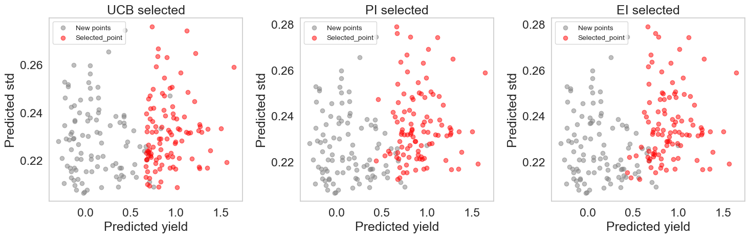
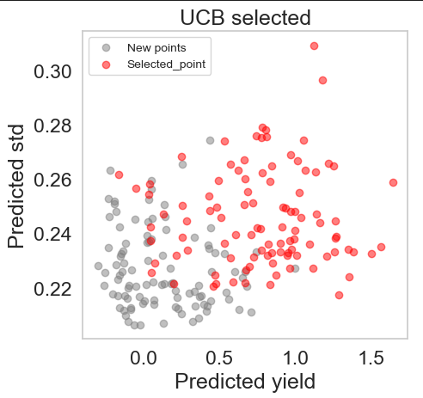
Exploit only, theta = 0
Ucb value based on theta (ratio between explore/exploit)
Pick new point based on ei/pi because 2 formular selected the same points and these points fit more with our expected behaviour of system
( high dna, high ntps => high yield)
theta = 20

Slide 5
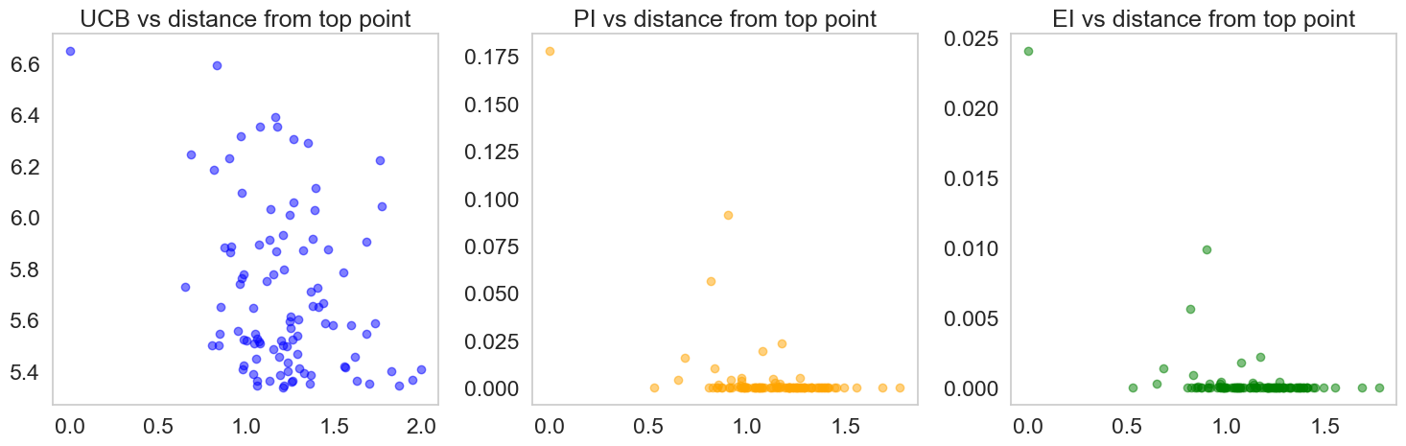
How many experiments to test next?
Theta = 20
Bayersian optimization => select only 1 point with highest ucb/pi/ei
In case of active learning, we want to test more points/experiements during each interations, but from pi/ei point of views many points doesn’t have significant informativeness compare to random select points
=> Suggest: testing only 20-50 new experiments, instead of 100

