Slide 1
Reproducibility Engineering Portfolio Exam
artificial business scenario „ducks vs. fish“
Sebastian Sippl
Thomas Brandl

Slide 2
Table of contend
Variables & Optimization
Feasible Region & Excel Solver
Reproduction Package
Decoupling Dependency
Docker
Zenodo & GitHub
Live demonstration
Notes:
Basti

Slide 3
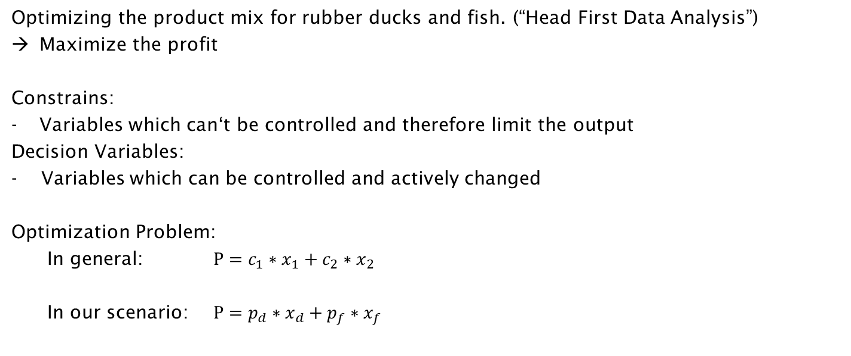

Variables & Optimization
Optimizing the product mix for rubber ducks and fish. (“Head First Data Analysis”)
Maximize the profit
Constrains:
Variables which can‘t be controlled and therefore limit the output
Decision Variables:
- Variables which can be controlled and actively changed
Optimization Problem:
In general: $P=c_{1}∗x_{1}+c_{2}∗x_{2}$
In our scenario: $P=p_{d}∗x_{d}+p_{f}∗x_{f}$
with $p ≔Profit, x≔Number$
$f ≔Fish, d≔Ducks$
[1]
Notes:
Basti

Slide 4
Feasible Region & Excel Solver
Original experimental setup
Rubber subbly for max.
500 ducks & 0 fishs or
400 fishs & 0 ducks
Production Time for max.
400 ducks and
300 fishs
Profits:
one Duck: 5$
one Fish: 4$
Best Product-Mix:
80 fishes * 4$ + 400 ducks * 5$ = 2320$
[1]
Notes:
Tom

Slide 5
Feasible Region & Excel Solver
Historical sales data
Historical sales data about 36 Month
Data format: EXCEL-file (.xls)
[1]
Notes:
Tom

Slide 6
Reproduction Package
Bathing Friends Unlimited
sales_data.xls
Excel-Solver
Book: „Head First Data Analysis“
Repeat
Reproduce
Development-team
Sippl & Brandl
sales_data.csv
python-Solver
LaTeX-Paper
Replicate
Notes:
Tom

Slide 7
Reproduction Package
Bathing Friends Unlimited
sales_data.xls
Excel-Solver
Book: „Head First Data Analysis“
Repeat
Reproduce
Development-team
Sippl & Brandl
sales_data.csv
python-Solver
LaTeX-Paper
Replicate
Notes:
Tom

Slide 8
Decoupling Dependency
Avoid proprietary software
The main advantiges of open source software:
Long term availability
No missing licenses or avoid fee from licensing the tools
Open source alternative for most common tools
MS-Word -> LaTeX
MS-Excel -> R, Python.Numpy/.Matplotlib
Notes:
Basti

Slide 9
Decoupling Dependency
Tools in our experiment
Realize the Excel Solver via python
- computes every possible product mix
- Beneficial for researchers who repeat our experiment and have no access to MS-Tools.
Exchange xls files with csv files
- light-weighted data format
- easy to read for humans (plain text)
- csv is supported by many scientific applications
Realize the documentation via LaTeX
- Documentation is generate automatically
- best look for scientific papers
- automatically import of figures
Notes:
Basti

Slide 10
Decoupling Dependency
Reproducibility results
Solved with python-script
Able to edit the constraints via comand line interface
Same constraints like the origin experiment
+ prediction constraint from historical data
[2][4]
Notes:
Basti

Slide 11
Docker
Build and run the experiment
Docker is used as encapsulated envirement (container)
For developing, shipping and running applications
Easy to share the same contend
An image is a read only template
A container is a runable instance of the image
The container of the repro-package:
Holds the hole setup (data, sourcecode, doku)
During build-prozess all tools are installed and the setup is copied into
The experiment starts automaticly
The dokumentation are generated after that
[3]
Notes:
Tom
Unlike a VM -> contaier don‘t bundle a full OS
- only librarys and settings to run the app
- containers are well-isolated
Image is build via a Dockerfile
Contaiers holds
Historical sales data (CSV)
All python sources
Latex-doku

Slide 12
Zenodo & GitHub
History and long term availability
Git and GitHub:
For a traceable project history
To organize the project in the team
No garantee for long-term documentation at GitHub
Zenodo
financed by public funds from the EU
Link to a releases of the project/experiment
referenceable by other researchers with a DOI
[5][6]
Notes:
Tom

Slide 13
Live demonstration of the experiment
Notes:
Basti

Slide 14
References
[1] Michael Milton, ”Optimization: Take It to the Max,” in Head First Data Analysis, O’Reilly Media Inc, 2009, pp. 75-109
[2] Microsoft, 2022, https://support.microsoft.com/enus/office/define-and-solve-a problem-by-usingsolver-5d1a388f-079d-43ac-a7eb-f63e45925040 (accessed on 03.02.2022)
[3] Docker Docs, 2021, https://docs.docker.com/getstarted/overview/ (accessed on 13.02.2022)
[4] The Matplotlib Development team, 2021 https://matplotlib.org/ (accesed on 17.02.2022)
[5] GitHub, Inc., 2022, https://github.com/ (accesed on 17.02.2022)
[6] CERN Data Centre Invenio., 2022, https://zenodo.org/ (accessed on 17.02.2022)

