Slide 1
Conway’s Game of Life
An exploration of life in parallel universes
Ben Taylor and Marty Scherr

Slide 2
The Game of Life
A zero-player game on a wrapping grid
The rules:
A “living” (1) cell with 2 or 3 neighbors survives
A “dead” (0) cell with 3 neighbors becomes alive
All other cells remain/become dead
The simplest form of life: The glider

Slide 3
Implementations
Serial (with GUI in SDL)
OpenMP
Intel Cilk Plus
OpenMPI
NVIDIA CUDA

Slide 4
Optimizations
There are lots of ways to optimize the basic Game of Life algorithm
Some really impressive ones using large bitmaps… We didn’t do that
Only track living/dead cells – whichever you have fewer of… We didn’t do that either
Magic numbers instead of array lookups to determine cell state… We did this, didn’t keep
Bitshifts to reduce LUT size… We did this one!
Helps with CUDA memory alignment, easy to do

Slide 5
The basic timestep
// (0,8) => 8
// (1,0) => 8
// (1,7) => 15
// (1,8) => 15
const unsigned char rules[16] = {0,0,0,1,0,0,0,0,0,0,1,1,0,0,0,0};
square_t neighbors = grid((i - 1 + rows) % rows, j )
+ grid((i - 1 + rows) % rows, (j - 1 + cols) % cols)
+ grid((i - 1 + rows) % rows, (j + 1) % cols )
+ grid(i , (j - 1 + cols) % cols)
+ grid(i , (j + 1) % cols )
+ grid((i + 1) % rows , j )
+ grid((i + 1) % rows , (j - 1 + cols) % cols )
+ grid((i + 1) % rows , (j + 1) % cols );
//self << MSB| neighboring cell sum
return rules[(grid(i,j) << 3) | neighbors];

Slide 6
Implementation Details: Serial
O(n²), nested for loops
Didn’t measure GUI performance, because a pause was necessary to make it watchable
About an hour to get the basic version working
Another 2 hours or so to learn SDL and write a GUI

Slide 7
Implementation Details: OMP/Cilk+
Wrap a pragma/cilk_for around the serial code.
Done.
Roughly 5 minutes each on top of serial development, mostly spent testing correctness
Worth it? See for yourself.

Slide 8
Implementation Details: MPI
Intelligently breaks grid into tiles
Each tile comm’s with the neighbors to get surrounding cells
Significant re-write; only version without significant shared code
Approximately 8 hours of development time beyond serial
Traditional debuggers are totally useless; slows development significantly

Slide 9
Implementation Details: CUDA
Also tiles the grid, less intelligently
No communication between processes
Still shares roughly ½ code with serial version
Approximately 2 hours to implement beyond serial
NVIDIA’s compiler is a pain – easily half that time spent debugging compiler quirks

Slide 10
The CUDA timestep
Same basic concept, but no more looping!
const int j = blockIdx.x * gridDim.x + threadIdx.x;
const int i = blockIdx.y * gridDim.y + threadIdx.y;
if(i < rows && j < cols) {
const unsigned char rules[16] = {0,0,0,1,0,0,0,0,0,0,1,1,0,0,0,0};
square_t neighbors = grid((i - 1 + rows) % rows, j )
+ grid((i - 1 + rows) % rows, (j - 1 + cols) % cols)
+ grid((i - 1 + rows) % rows, (j + 1 ) % cols)
+ grid( i , (j - 1 + cols) % cols)
+ grid( i , (j + 1 ) % cols)
+ grid((i + 1) % rows, j )
+ grid((i + 1) % rows, (j - 1 + cols) % cols)
+ grid((i + 1) % rows, (j + 1) % cols);
newGrid(i,j) = rules[(grid(i,j) << 3) | neighbors];

Slide 11
A brief demonstration
Tested with a “glider gun”
Spawns a new glider every 15 timesteps
Pay no attention to the man behind the curtain

Slide 12
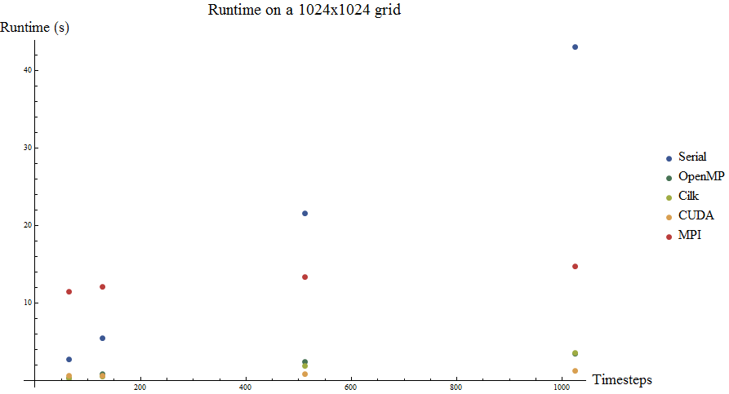
Results: Small (1024x1024) grid

Slide 13
Results: Large (2048x2048) grid

Slide 14
Conclusions
CUDA is really good at matrix manipulation
Shocking
MPI gets killed by communication
Shocking-er
OMP and CilkPlus give very good results
Considering how little effort they take to implement
Serial code does not scale well
Who didn’t show up to class until today?

