Slide 1
Maths 3C
2D Rigid Analysis in C++
Ben North Bharat Kunwar Saleema Hughes Sarah Lemasney Stephen Milonas

Slide 2
Stages
INPUT NODES, MEMBERS, FORCES, SUPPORTS
CALCULATE THE DEGREES OF FREEDOM
FORMULATE THE GLOBAL STIFFNESS MATRIX AND MATRIX INVERSION
WORK OUT THE DEFLECTIONS AND ROTATIONS
IMAGE PRODUCED ON AUTOCAD SHOWING THE PREDICTED DEFLECTION

Slide 3
Data Input
NODES
The second column represents the x co-ordinate
The first line is the number of nodes minus 1 (first node is 0)
n
0 0.1 0.2
1 1.2 1.4
The first column represents the node ID
The third column is the y co-ordinate

Slide 4
Data Input (continued)
MEMBERS
n
0 0 1 1 1 1
Last member ID
Current ID member
End 0
End 1
E, A and I values respectively

Slide 5
Data Input (continued)
Direction in the y axis
LOADS
Node number
Magnitude of the force
1 1 -1
-1
End of loads input
SUPPORTS
Direction
0= fixed in x direction
1= fixed in y direction
2= rotational fixity
Node number
0 0 0 1
0 2
-1
End of support input

Slide 6
Degrees of Freedom
(a x b) + c = d
where:
a = Member ID
b = Degrees of freedom at one node
c = +0 for x-axis, +1 for y-axis, +2 for rotational
d = Degrees of freedom of the system
Member | 0 | 1 | 2 | 3
X | 0 x 3 = 0 | 1 x 3 = 3 | 2 x 3 = 6 | 3 x 3 = 9
Y | (0 x 3) + 1 = 1 | (1 x 3) + 1 = 4 | (2 x 3) + 1 = 7 | (3 x 3) + 1 = 10
ϴ | (0 x 3) + 2 = 2 | (1 x 3) + 2 = 5 | (2 x 3) + 2 = 8 | (3 x 3) + 3 = 11

Slide 7
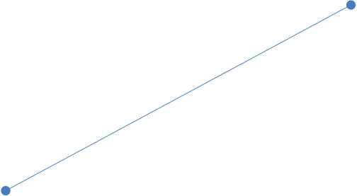


Forces
Fx2
Fy2
Lx = x2 – x1
Ly = y2 – y1
Fx1 = (-)F Cosθ = (-)F Lx/L
Fx2 = F Cosθ = F Lx/L
Fy1 = (-)F Sinθ = (-)F Ly/L
Fy2 = F Sinθ = F Ly/L
y
Fx1
Fy1
x

Slide 8


Moments
M2
Lx = x2 – x1
Ly = y2 – y1
M1 = EI/L(4θ₁+2θ₂+6d/L)
M2 = EI/L(2θ₁+4θ₂+6d/L)
y
M1
x

Slide 9
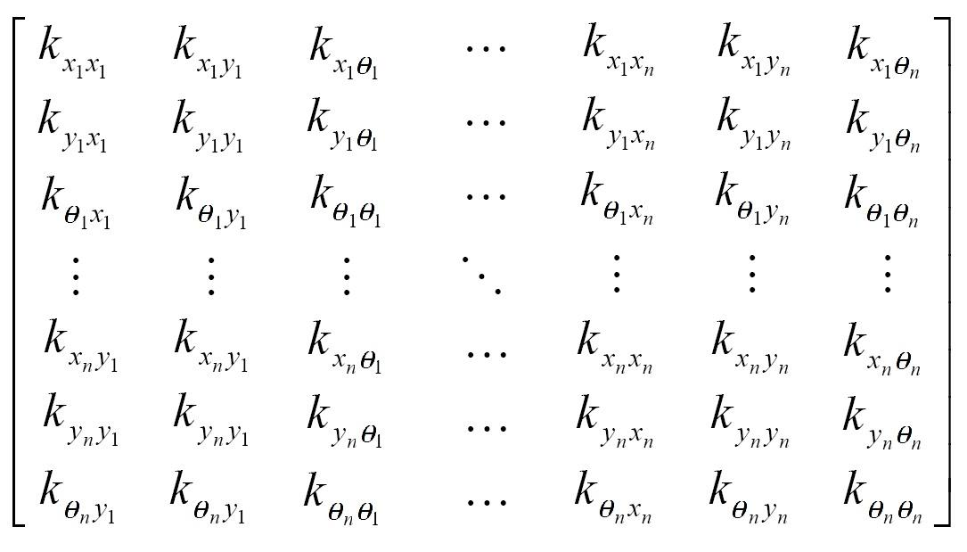
Account for supports
If node 1 is fixed in the y axis, the following would be introduced...

Slide 10
Account for supports (continued)
0
0
1
0
0
0
0
0
0
0
0

Slide 11
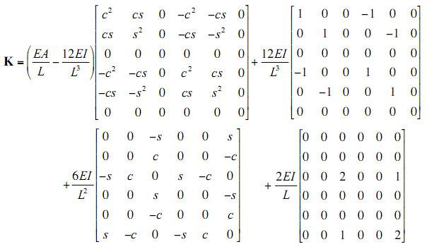
Global Stiffness Matrix

Slide 12
EA/L - 12EI/L³
Loop ThisAxis from 0 to 1 {
Loop ThatAxis from 0 to 1 {
MemberStiffness = EA/L - 12EI/L³ for ThisAxis and ThatAxis
Loop ThisQuadrant from 0 to 1 {
Loop ThatQuadrant from 0 to 1 {
Determine This and That position in the global stiffness matrix
If leading diagonal, add to the global stiffness matrix
Else, subtract from the global stiffness matrix
}
}
}
}

Slide 13
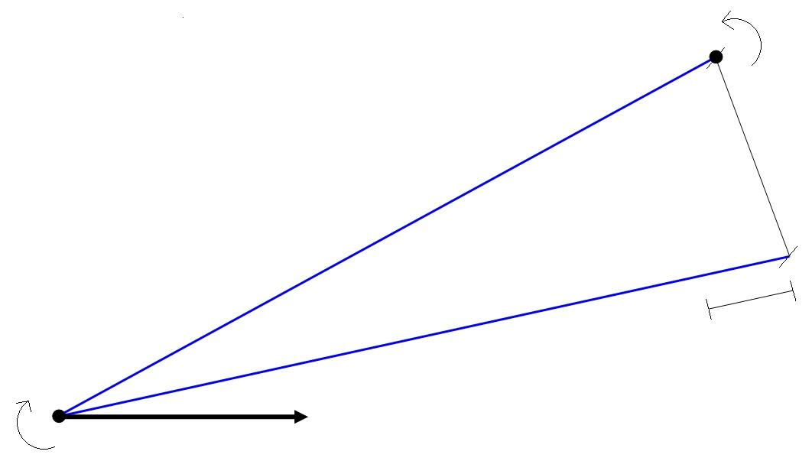
Deflection, rotation, forces and moments
θ₂
Δ
e
θ₁
e = elongation
Δ = displacement
θ₁, θ₂ = rotation at each end

Slide 14
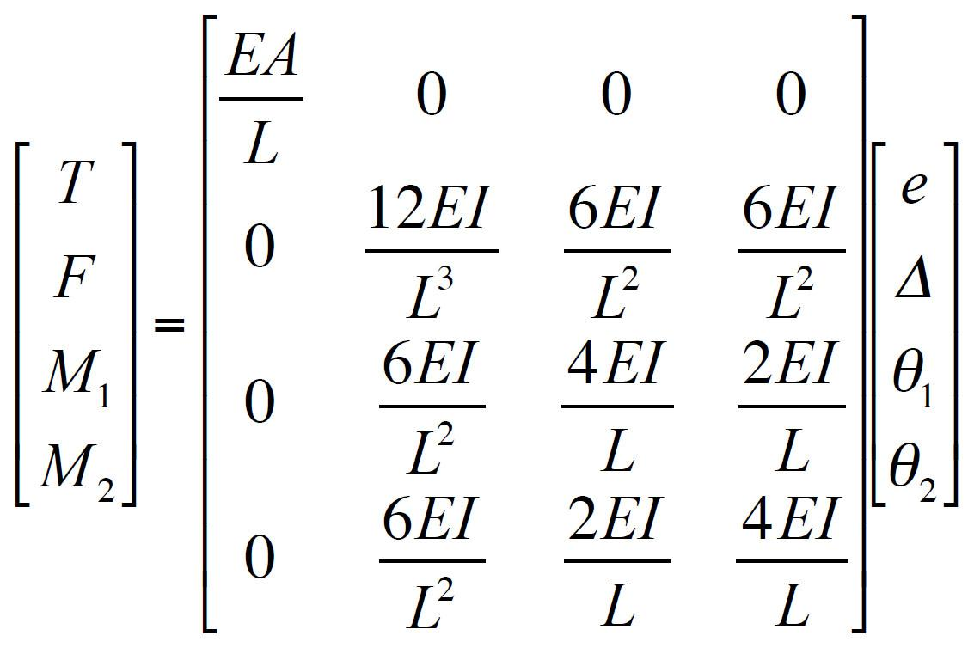
Deflection, rotation, forces and moments
T = tension
F = shear force
M₁, M₂ = moments at each end
T = e(EA/L)
F = Δ(12EI/L³) + θ₁(6EI/L²) + θ₂(6EI/L²)
M₁ = Δ(6EI/L²) + θ₁(4EI/L) + θ₂(2EI/L)
M₂ = Δ(6EI/L²) + θ₁(2EI/L) + θ₂(4EI/L)

Slide 15
Output
Stiffness.txt Log of how the stiffnesses are compiles
Data.txt Forces, moment and deflections and rotations for each member
Drawing.dwg This is the file that contains the AutoCAD drawing

Slide 16
Program Demonstration!

Slide 17
Any questions??

Slide 18
Thanks!
Hope that made sense =]

