Slide 1
City Wellness/Find a neighbourhood
Bharat, Harry, Andy, Monica
Led by Kirk, Dianna

Slide 2

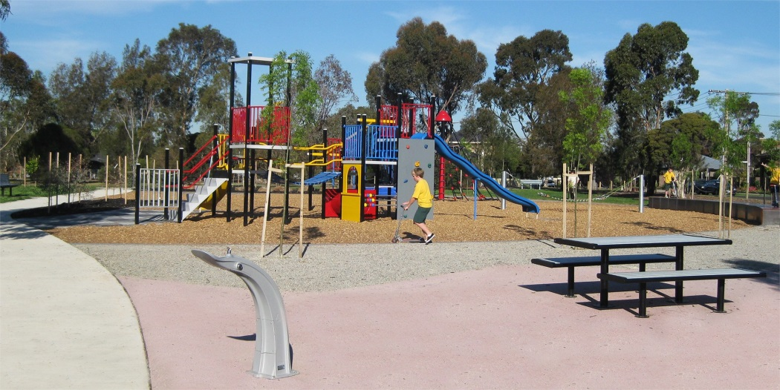

The Problem:
Looking for an area to live in a new city: what characteristics of a neighbourhood are important?
Priorities will vary by individual, family

Slide 3
Solution
Customisable online map which allows users to prioritise the attributes of an area which are most important for them
Greenspace
Crime
Access to services: GP, supermarket, post office
Unemployment
Type of housing

Slide 4
Result

Slide 5
What we’ve learned/practiced
Techniques for discrete vs continuous ranking
Google Fusion tables, HTML5 x 2
More experience with Javascript
Data sourcing
Data analysis

