Slide 1


Slide 2

Detecting Movie Spoilers
Brian tracy

Slide 3

Background
Information that reveals important plot details or surprises
Reviews influence consumer attitude and decisions on seeing a movie
Users will avoid resources that present them with spoilers
Notes:
Spoiler can be explicit, i.e. revealing detail or implicit, something like ‘you won’t believe the twist ending’
Statista data shows about 2/3 of adults use movie read movie reviews
While some sites specialize in movie spoilers (themoviespoiler.com)

Slide 4

Business Problem
Current model relies on site moderation and user reporting
Automated flagging systems can free resources for other problems
Goal: increase user confidence they will not be presented with spoilers
Notes:
IMDB does moderate their site but mostly relies on the users flagging their reviews themselves or reporting other reviews
By employing automated flagging systems to hide user reviews

Slide 5
Data Understanding
Data sourced from Kaggle
573,913 reviews between 1998 and 2018
1572 unique films being reviewed
Additional film metadata and spoiler tagging

Slide 7
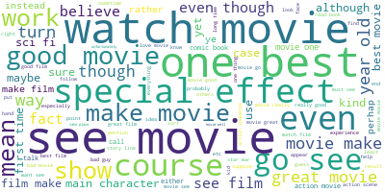
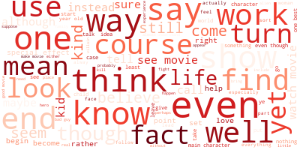
Word Cloud
Non-spoiler reviews
Spoiler reviews

Slide 8
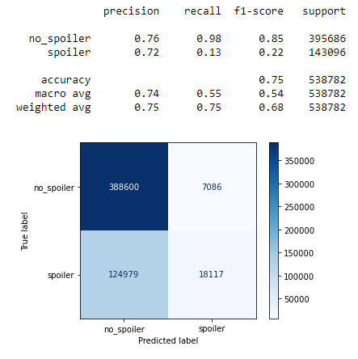
Baseline modeling
Premise: users will self-tag spoilers
Does not account for negation
Also modeled non-language features
Results in all reviews predicted as no spoiler

Slide 9
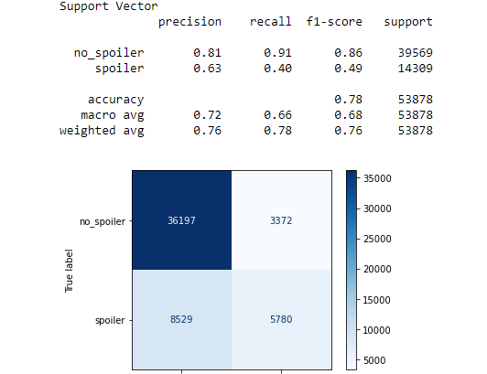
Results
Iterative testing with different encoding tools and parameters
Evaluating using f1-score and overall accuracy
Encoding with tfidf, including bi- and tri-grams with a minimum count of 8 produced the best results during testing
Notes:
More than doubled the f1-score for spoiler detection while maintaining high recall on non-spoilers
Iterative testing showed continued, but smaller incremental, improvement

Slide 10
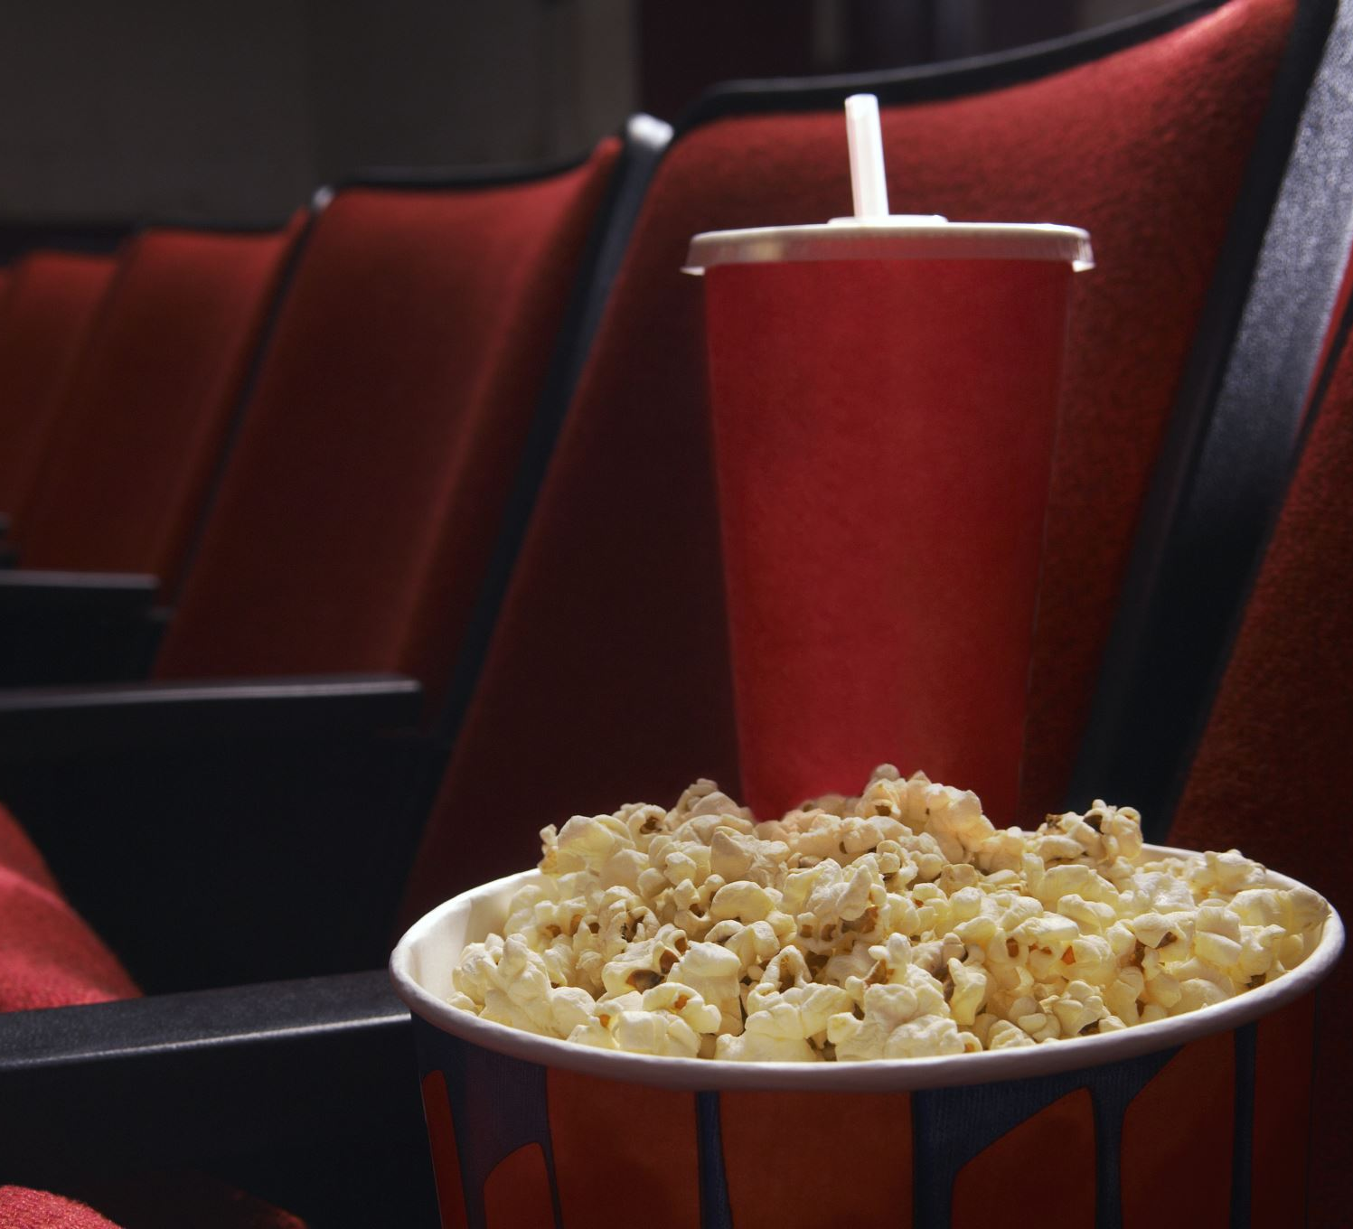
Next Steps
Scrape movie-centric subreddits
Explore cosine similarity
Use transfer learning
Notes:
Some of the largest subreddit communities are related to films and movies. The community moderators generally do a good job enforcing self-censorship when it comes to spoiler content
The tags used would identify specific text strings that contain the spoiler which can help future modeling efforts
For sites like IMDB, reviews generally occur on a page for a known film. It may be worth exploring cosine similarity between the film synopsis and the review to flag spoilers
Top of the line NLP models like BERT and roBERTa are trained on massive amount of text data and can be adapted to this problem. We attempted to implement this technique but were met with hardware and time restrictions

