Slide 1


Waterpoint Prediction in Tanzania
Enabling directed local action

Slide 2
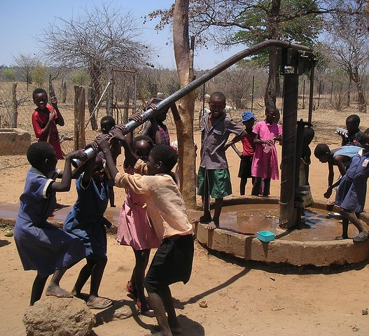
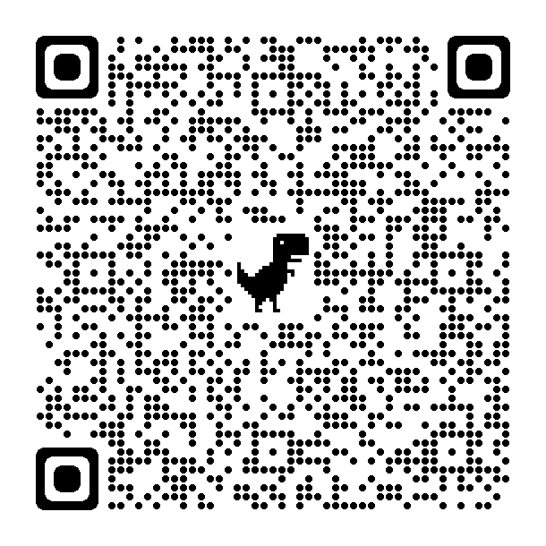
The current problem
70% of the country’s population lives in rural areas, where access to clean water covers only about 45% of the population
International efforts are focused on improving this access through maintenance and new installations

Slide 3
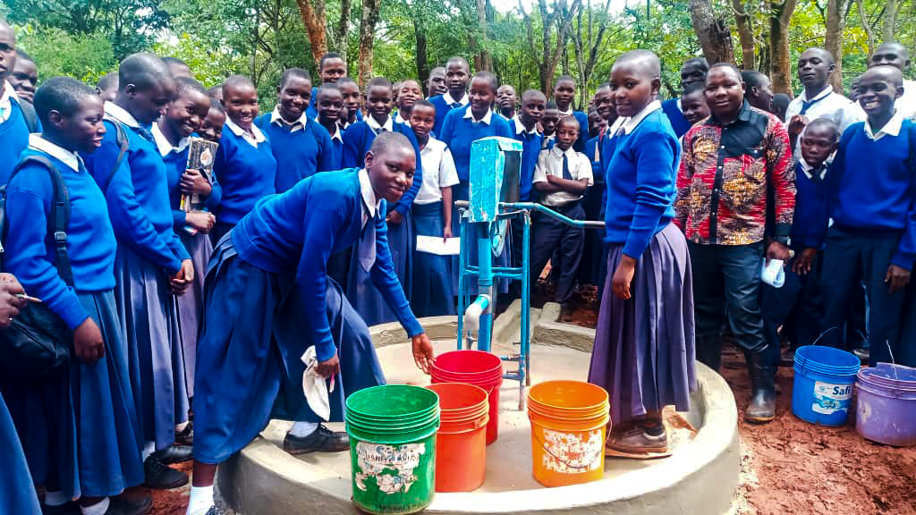
Business understanding
Tanzania Development Trust (TDT) focuses on small projects with local involvement
Current rural water development focuses on borehole and rope pump installation in NW region
New benefactor wants to increase scope of project
  Wells are easier to repair than replace
  Identify concentrations of failed waterpoints to replace
Tasked with modeling well status to assist in allocating resources accordingly

Slide 4
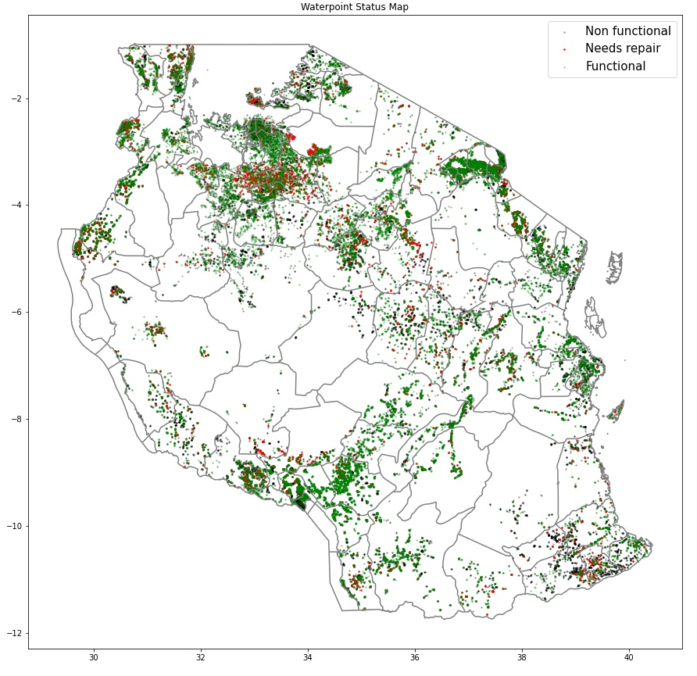
Data understanding
Data source: Taarifa waterpoints dashboard
  aggregate data from the Ministry of Water
Features include geographic data, extraction information, operational and source data
59,400 entries recorded between 2011 and 2013

Slide 5
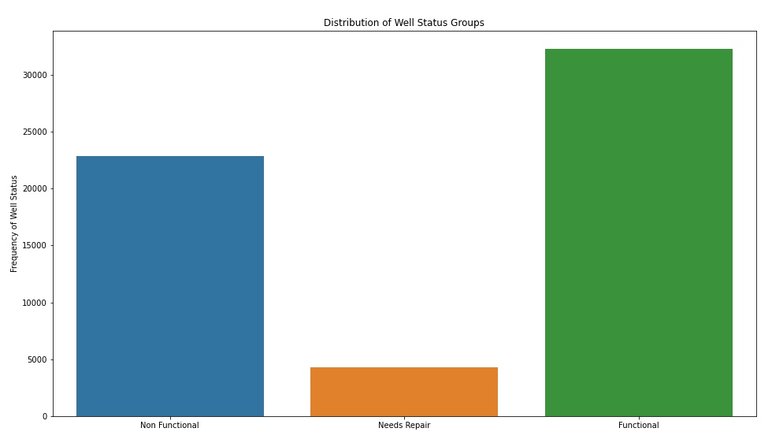
Modeling process

Slide 6
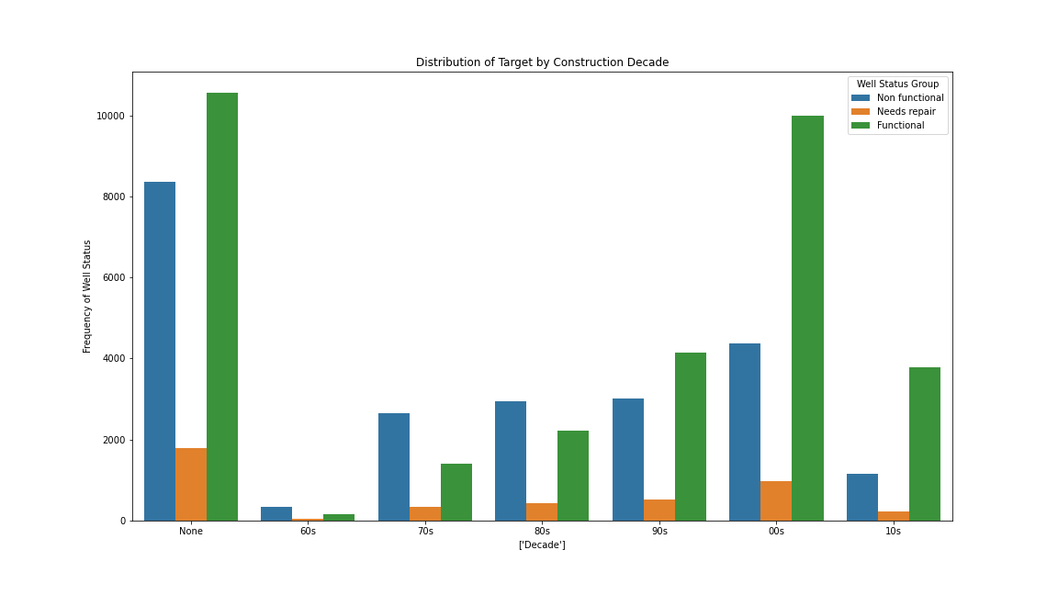
Initial insights

