Slide 1

Pneumonia diagnosis using machine learning

Slide 2


Background
Pneumonia is one of the leading causes of death for children under 5 years old in China
Vector of infection dictates the course of treatment
Diagnosis generally begins with a physical exam and includes imaging/testing

Slide 3



Business problem
Chest X-ray interpretation can result in misdiagnosis
Guangzhou Medical University wants to streamline pneumonia diagnosis
Tasked with developing a classification model for chest X-ray images

Slide 4
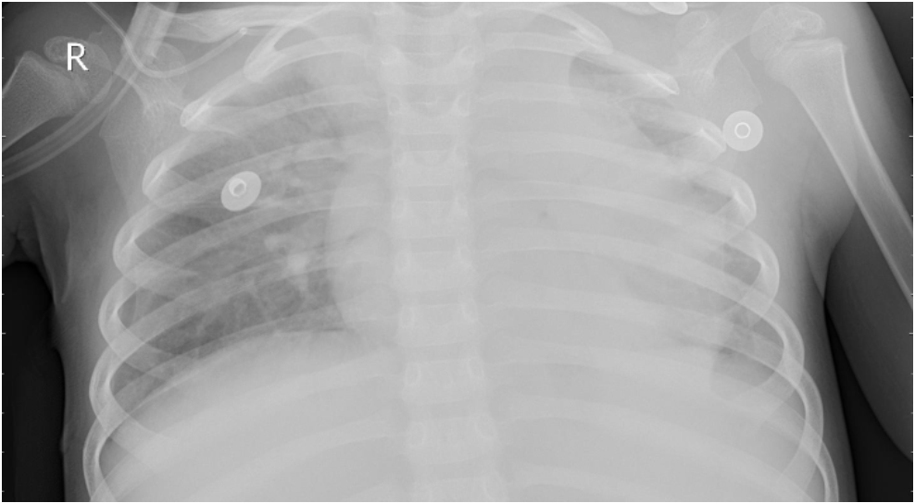
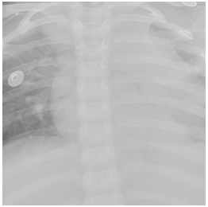
Data understanding
Chest X-ray images from pediatric patients 1-5 years old
Original images screened for quality control and labeled
5,856 images representing 2 categories
  Label imbalance, 75% pneumonia
Organized into train/validation/test image sets

Slide 5
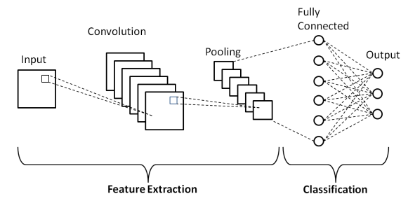
Modeling process
Baseline modeling with Multilayer perceptron
Iterative model training using convoluted neural networks
Focus on maintaining high recall for pneumonia classification while reducing false positive errors
Evaluated models with classification reports and confusion matrices

Slide 6
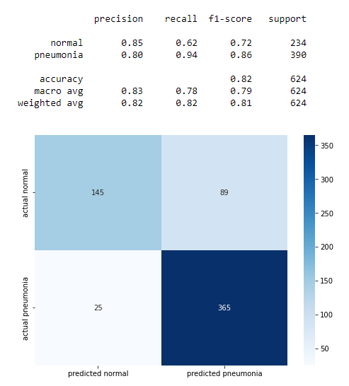
Final model selection
Evaluated model on testing data
Focus on preserving high recall on pneumonia cases, secondary total accuracy
Our best model had overall accuracy of 82%
Recall for pneumonia cases was 94%

Slide 7
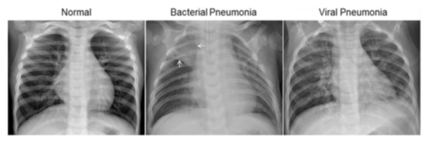
Next steps
Evaluate pretrained model performance
See if we can adjust to ternary classification
  Bacterial versus viral pneumonia
Create web app allowing users to predict on uploaded images

Slide 8

Thank you
Brian Tracy
brtracy1984@gmail.com
https://github.com/brtracy/phase4_project

