Slide 1
CREATING A FORM FOR HOSPITAL MANAGEMENT SYSTEM USING VISUAL BASIC
BY
DHANIYALAKSHMI S
DHARANI S
DIVYA SREE T
ELAKKIYA S
FATHIMASIRIN A

Slide 2
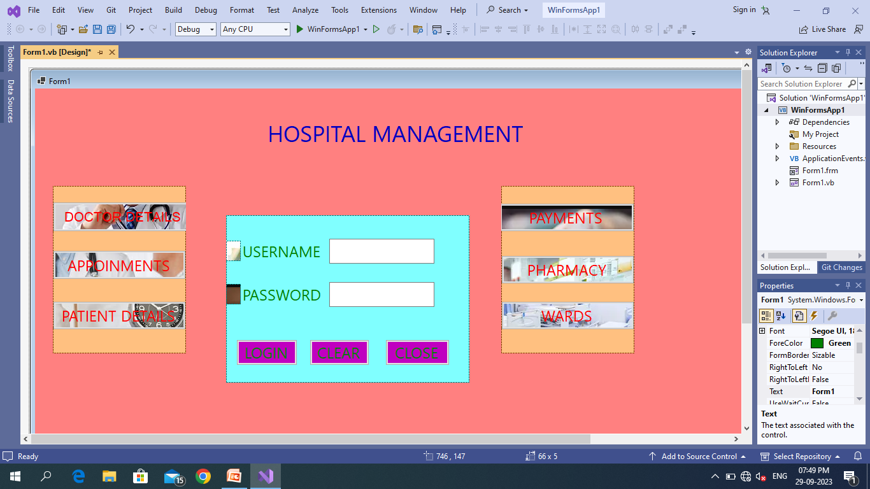
MAIN FORM
IN THIS FORM REPRESENTS THE HOSPITAL MANAGEMENT FEATURES

Slide 3
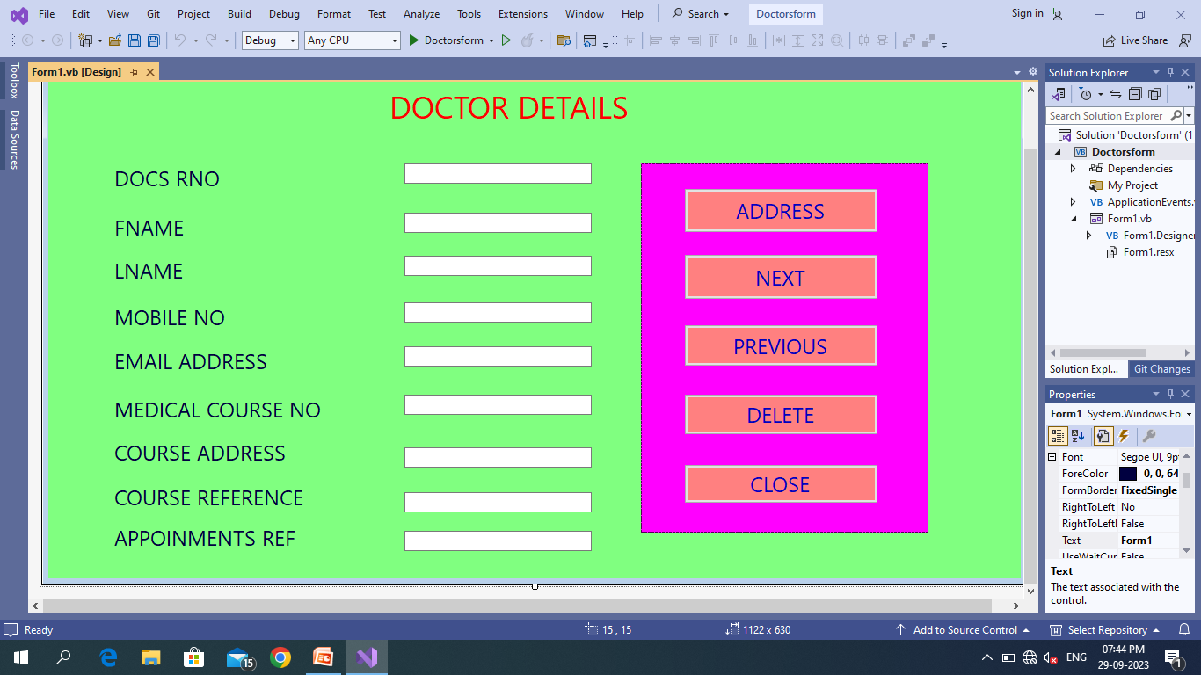
DOCTOR DETAILS
IN THIS FORM REPRESENT THE DOCTORS INFORMATIONS LIKE NAME MOBILE NO EMAIL RNO

Slide 4
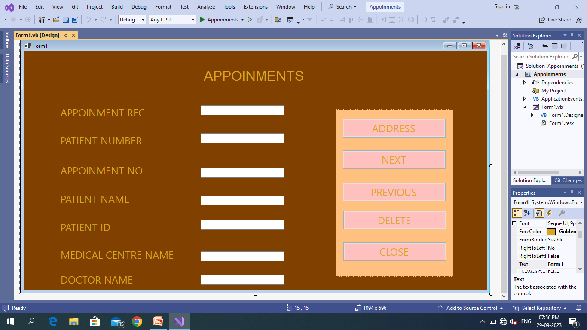
APPOINMENTS
IN THIS FORM REPRESENTS THE REGISTER PATIENTS APPOINTMENTS FOR TREATMENTS CHECKUP

Slide 5
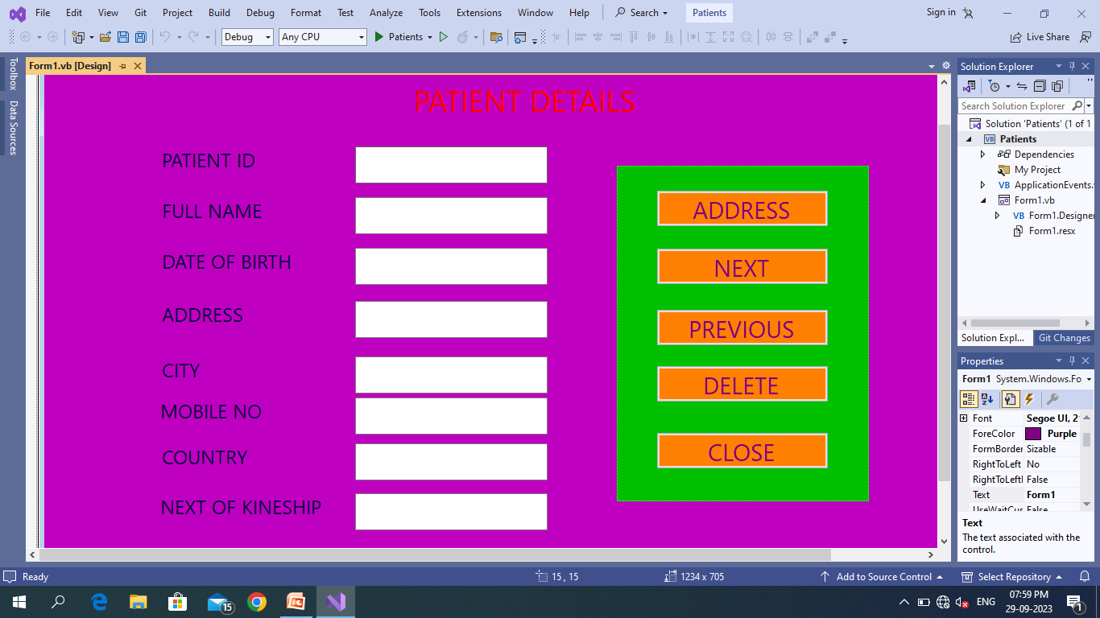
PATIENT DETAILS
IN THIS FORM REPRESENTS THE PATIENTS DETAILS LIKE NAME ADDRESS ID MOBILE NO

Slide 6
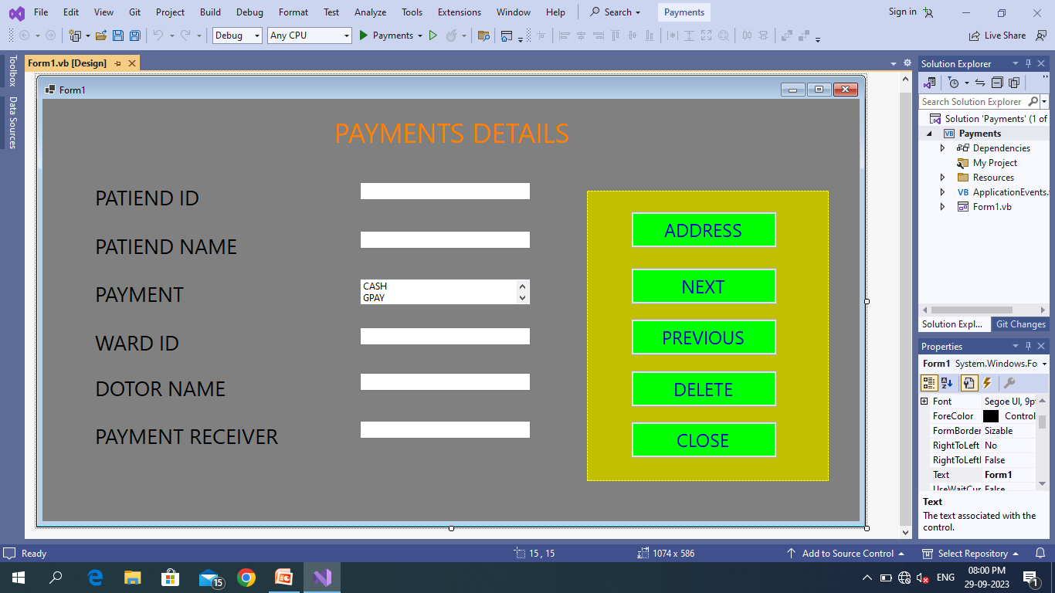
PAYMENTS
IN THIS FORM REPRESENTS THE REGISTER PAYMENTS RECEIVED IN THE PATIENTS

Slide 7
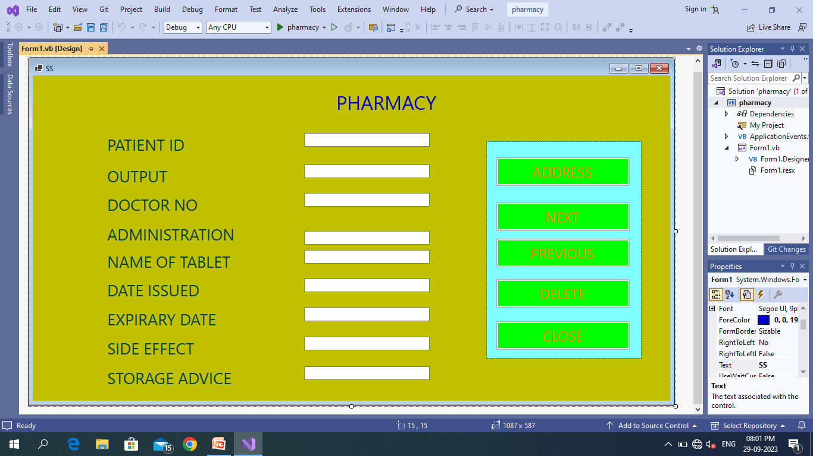
PHARMACY
IN THIS FORM REPRESENTS THE PHARMACY DETAILS OF EVERY PATIENTS OF THE HOSPITAL

Slide 8
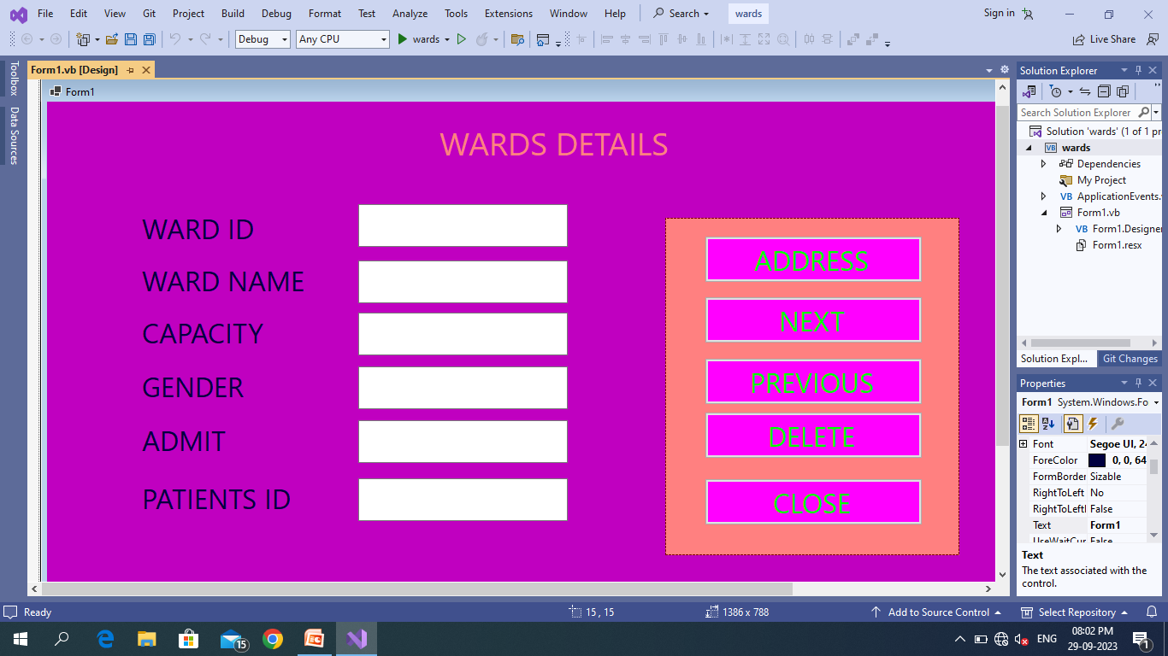
WARDS
IN THIS FORM REPRESENTS THE WARD DETAILS FOR ADMIT PATIENTS OF THE HOSPITAL

Slide 9
THANK YOU

