Slide 1
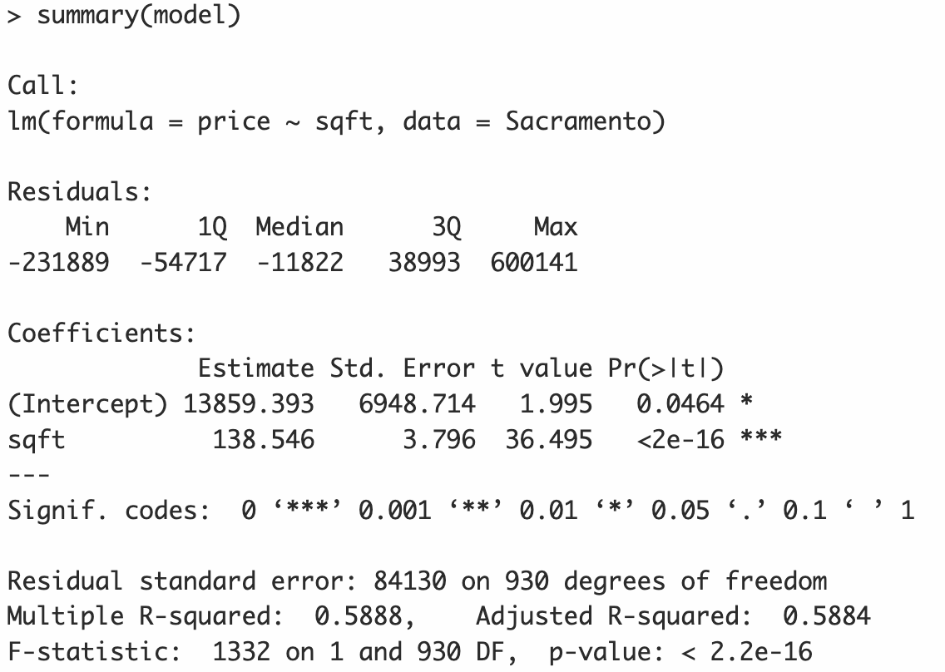


$${\hat{β}}_{0}$$
$${\hat{β}}_{1}$$

Slide 2

Summary statistics for the residuals
$$\hat{σ}$$

Slide 3
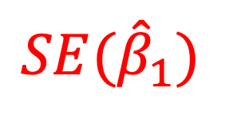


$$T_{obs}$$
$${SE(\hat{β}}_{1})$$
$p$-value

Slide 4
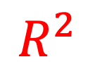
$$R^{2}$$

