Slide 1
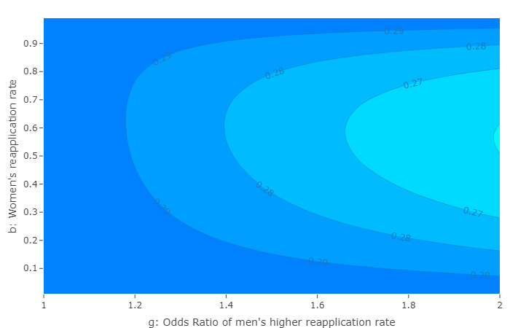
Figure 2. Effects on equilibrium female share of the total applicant pool from gender differences in reapplication (g, horizontal axis) and the baseline (women’s) reapplication rate (b, vertical axis) plotted as a contour plot. The female share of first-time applicants (p) in the figure is 0.30, or 30%. The rejection rate experienced by all applicants (r) in this figure is 0.70, or 70%. Each contour line in the panel represents a 1 percentage point change (0.01) from the initial female share of first-time applicants (p=0.30).

Slide 2
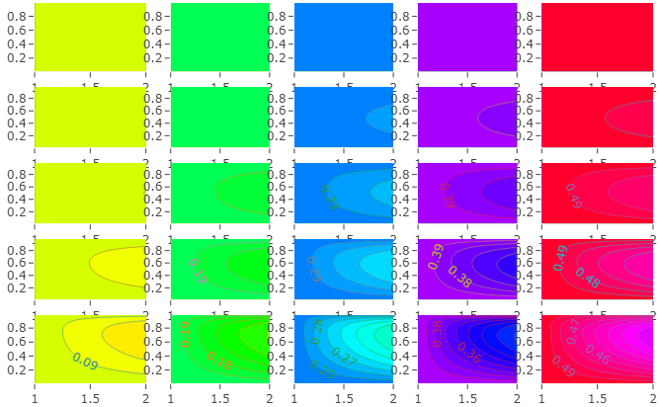
Figure 3. Effects on equilibrium female share of the total applicant pool from gender differences in reapplication (g) and the three other model parameters: baseline (women’s) reapplication rate (b), female share of first-time applicants (p), and rejection rate experienced by all applicants (r). Each row of panels has the same rejection rate (r). Each column of panels has the same female share of first-time applicants (p). Each contour line in the panels represents a 1 percentage point change (0.01) from the initial female share of first-time applicants (p) for the panel.
r=0.10
b
r=0.30
b
r=0.50
b
r=0.70
b
r=0.90
b
g
p=0.10
g
p=0.20
g
p=0.30
g
p=0.40
g
p=0.50

Slide 3
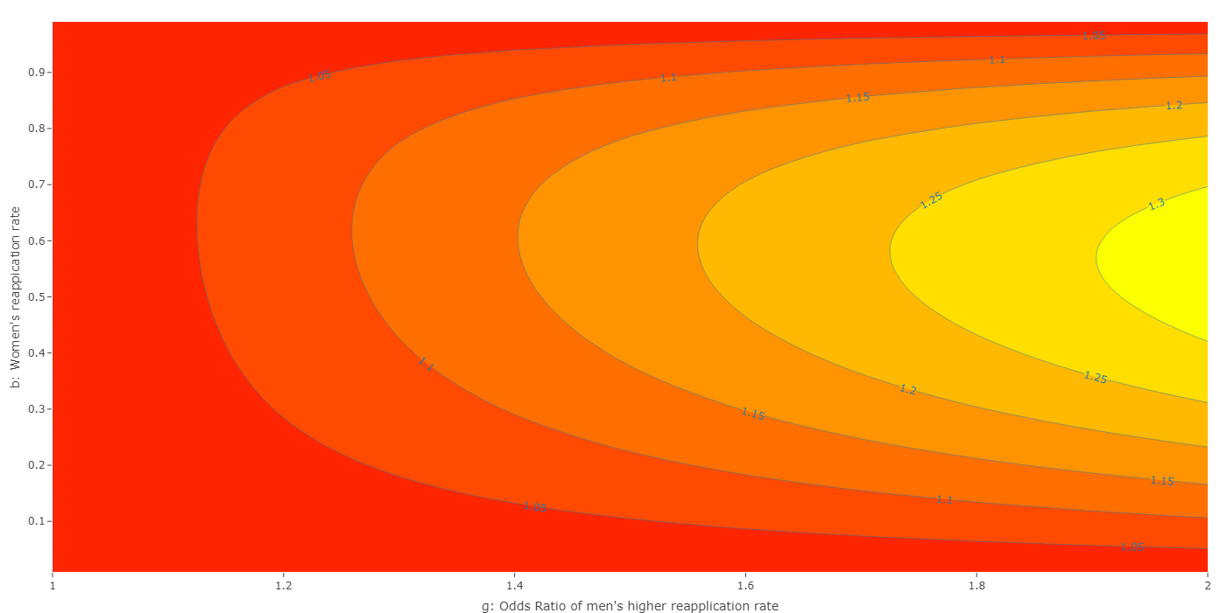
Figure 4. Model effects in terms of equivalent sex bias. Contour plot of the Odds Ratio (OR) of male-favoring selection bias that yields the same equilibrium female share of selected first-time applicants as the equilibrium female share of the total applicant pool from model parameters. The vertical axis is gender differences in reapplication (g), and the vertical axis is the baseline reapplication rate (b). Female share of first-time applicants (p) for this figure is set at 0.30 or 30%, and the rejection rate experienced by all applicants (r) is set at 0.70 or 70%. Each contour line in the figure represents a 0.05 change in the OR from an unbiased OR of 1.

Slide 4
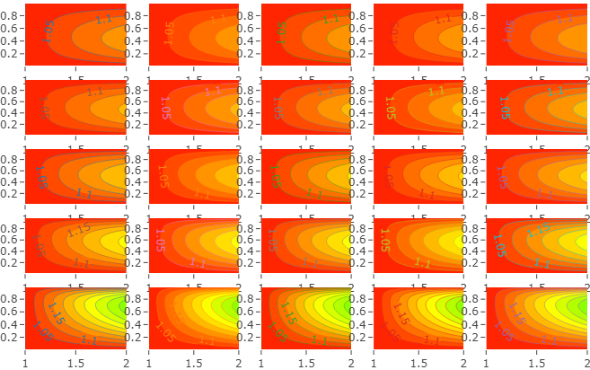
Figure 5. Model effects in terms of equivalent sex bias. Panels plot the Odds Ratio (OR) of male-favoring selection bias that yields the same equilibrium female share of selected first-time applicants as the equilibrium female share of the total applicant pool from gender differences in reapplication (g) and the three other model parameters: baseline (women’s) reapplication rate (b), female share of first-time applicants (p), and rejection rate experienced by all applicants (r). Each row of panels has the same rejection rate (r). Each column of panels has the same female share of first-time applicants (p). Each contour line in the panels represents a 0.05 change in the OR from an unbiased OR of 1.
r=0.10
b
r=0.30
b
r=0.50
b
r=0.70
b
r=0.90
b
g
p=0.10
g
p=0.20
g
p=0.30
g
p=0.40
g
p=0.50

Slide 5
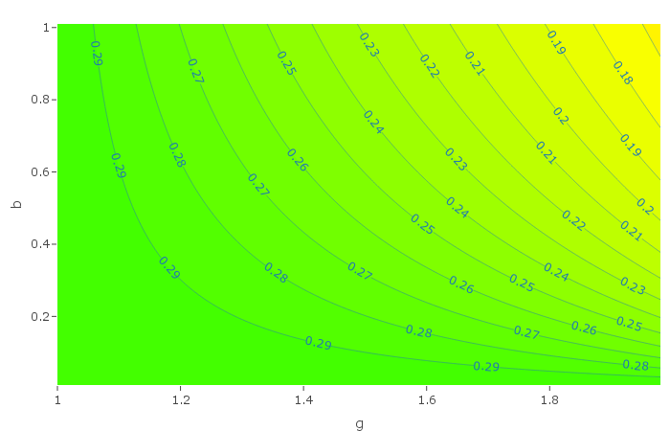
Figure 2. Effects on equilibrium female share of the total applicant pool from gender differences in reapplication (g, horizontal axis) and the baseline reapplication rate (b, vertical axis) plotted as a contour plot. The female share of first-time applicants (p) in the figure is 0.30, or 30%. The rejection rate experienced by all applicants (r) in this figure is 0.70, or 70%. Each contour line in the panel represents a 1 percentage point change (0.01) from the initial female share of first-time applicants (p=0.30).
b: baseline reapplication rate
g: gender differences in reapplication

Slide 6
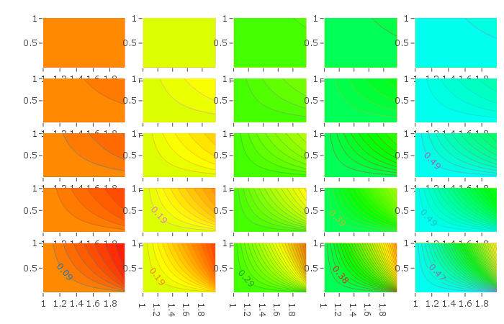
Figure 3. Effects on equilibrium female share of the total applicant pool from gender differences in reapplication (g) and the three other model parameters: baseline reapplication rate (b), female share of first-time applicants (p), and rejection rate experienced by all applicants (r). Each row of panels has the same rejection rate (r). Each column of panels has the same female share of first-time applicants (p). Each contour line in the panels represents a 1 percentage point change (0.01) from the initial female share of first-time applicants (p) for the panel.
r=0.10
b
r=0.30
b
r=0.50
b
r=0.70
b
r=0.90
b
g
p=0.10
g
p=0.20
g
p=0.30
g
p=0.40
g
p=0.50

Slide 7
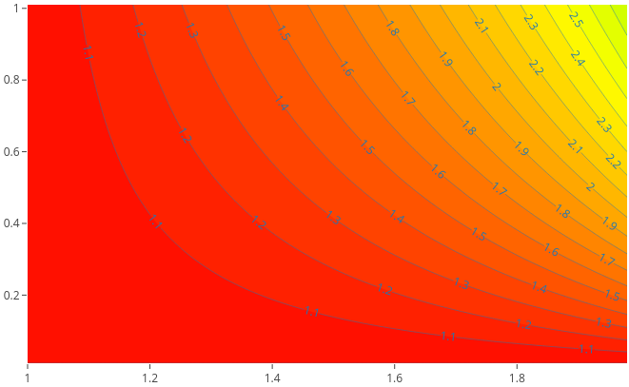
Figure 4. Model effects in terms of equivalent sex bias. Contour plot of the Odds Ratio (OR) of male-favoring selection bias that yields the same equilibrium female share of selected first-time applicants as the equilibrium female share of the total applicant pool from model parameters. The vertical axis is gender differences in reapplication (g), and the vertical axis is the baseline reapplication rate (b). Female share of first-time applicants (p) for this figure is set at 0.30 or 30%, and the rejection rate experienced by all applicants (r) is set at 0.70 or 70%. Each contour line in the figure represents a 0.1 change in the OR from an unbiased OR of 1.
b: baseline reapplication rate
g: gender differences in reapplication

Slide 8
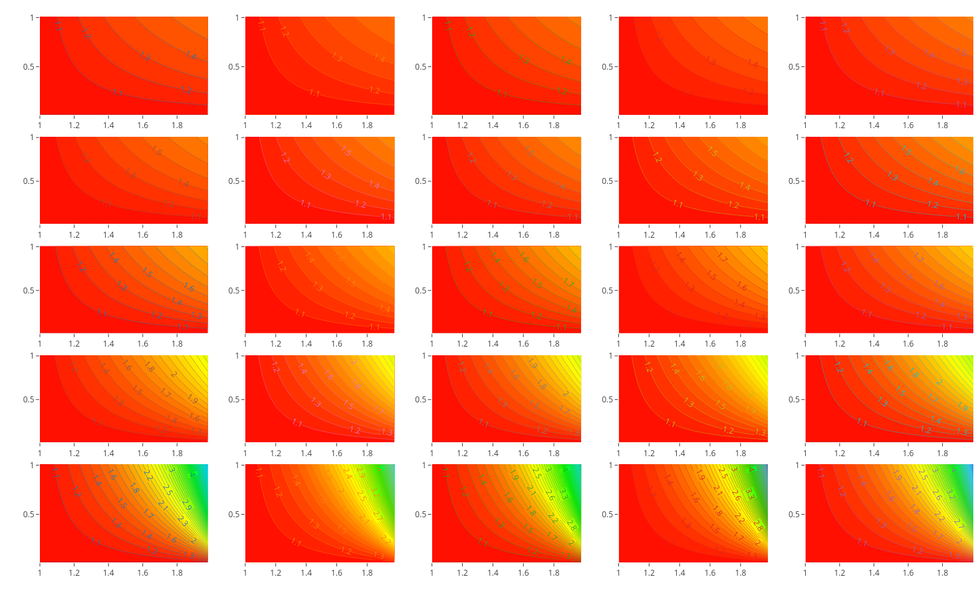
Figure 5. Model effects in terms of equivalent sex bias. Panels plot the Odds Ratio (OR) of male-favoring selection bias that yields the same equilibrium female share of selected first-time applicants as the equilibrium female share of the total applicant pool from gender differences in reapplication (g) and the three other model parameters: baseline reapplication rate (b), female share of first-time applicants (p), and rejection rate experienced by all applicants (r). Each row of panels has the same rejection rate (r). Each column of panels has the same female share of first-time applicants (p). Each contour line in the panels represents a 0.1 change in the OR from an unbiased OR of 1.
r=0.10
b
r=0.30
b
r=0.50
b
r=0.70
b
r=0.90
b
g
p=0.30
g
p=0.10
g
p=0.20
g
p=0.30
g
p=0.40
g
p=0.50

