Slide 1

E-commerce Data Analytics
BRUCE LAM

Slide 2
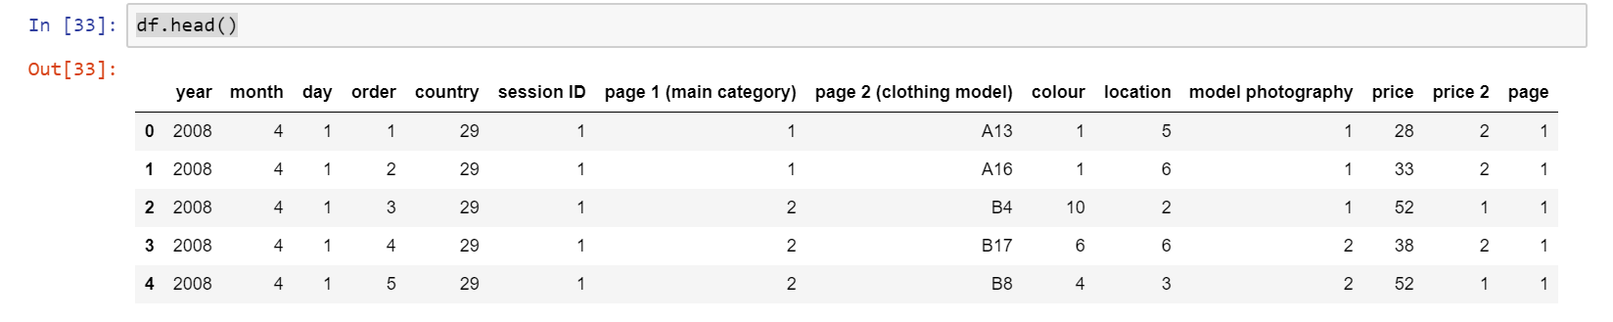
Raw Data Set:

Slide 3
IMPORTANT COLUMNS
*Columns that will most likely affect the revenue

Slide 4
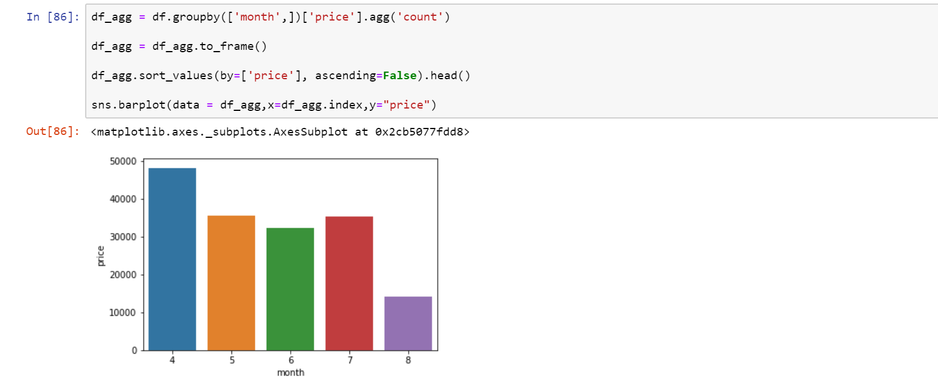
Training set and testing set
I used Data of May as training set
Data of July as Testing set
Reason: They have similar totally revenue

Slide 5
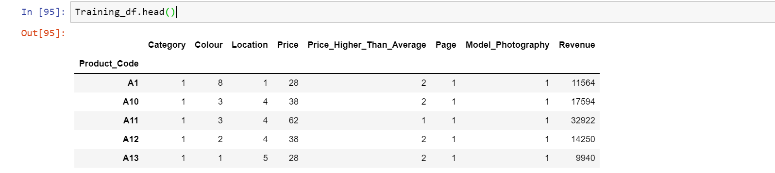
Data conversion (for machine learning)

Slide 6
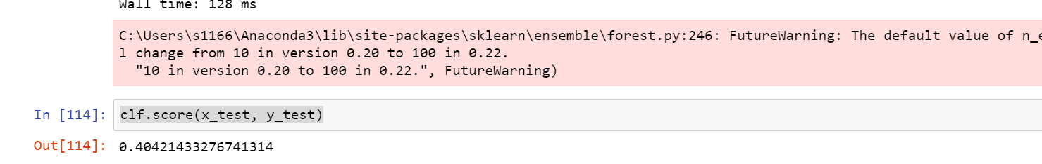
Accuracy
*Conclusion:Those variable are not a good predictor to predict the revenue

Slide 7
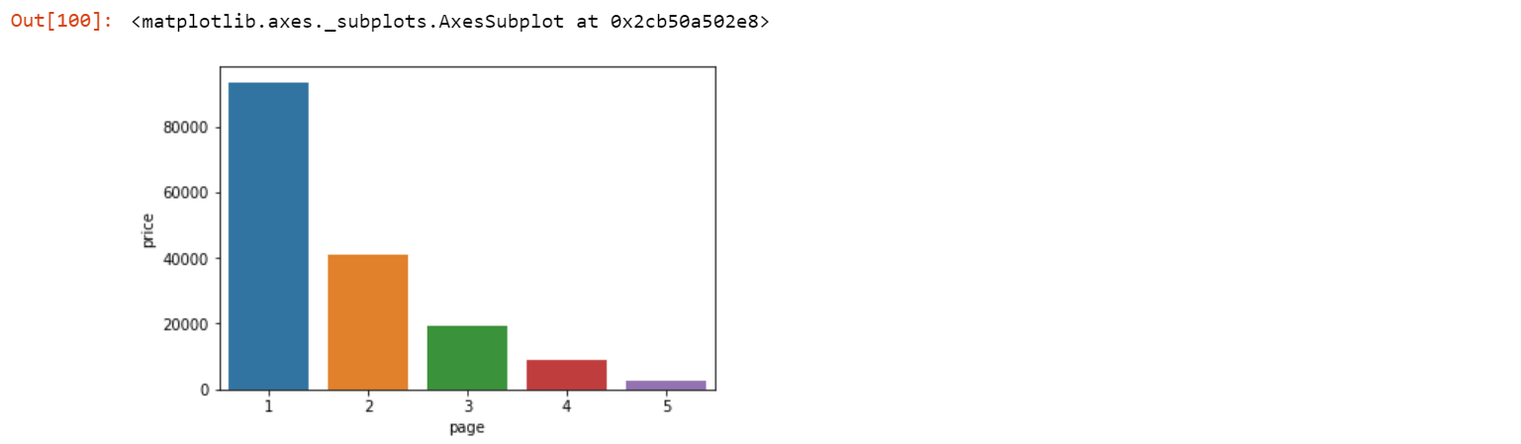
Data exploring
Page 1 is the most important page, which making the most revenue
* Page 1 is probably the home page of the website

Slide 8
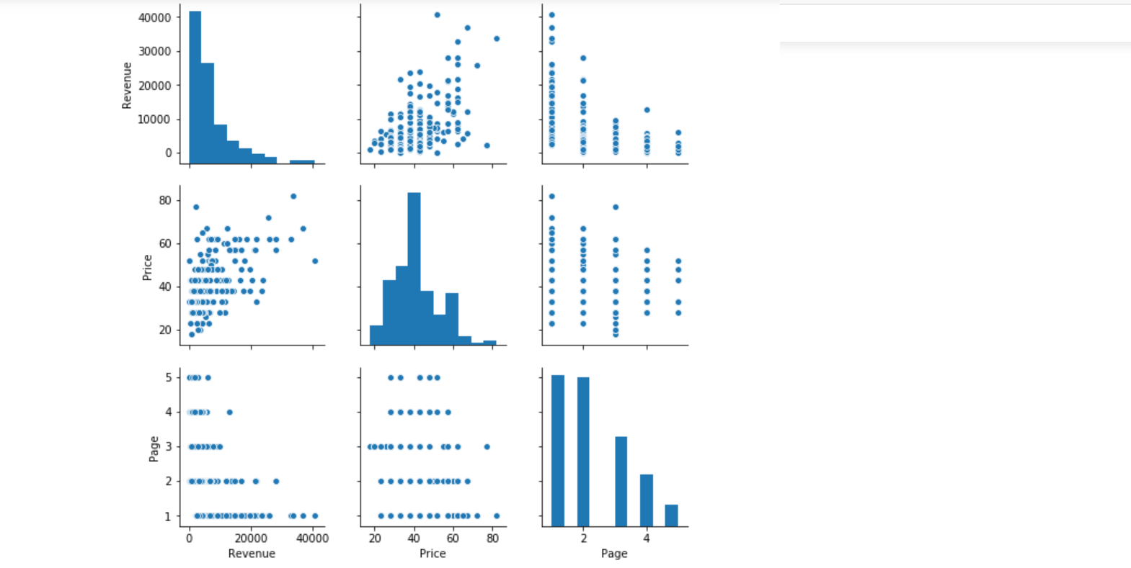
Correlation between Revenue and:
1. Price (0.522)
2. Number of Page (-0.493)
Product Price Ranged
From $40 - $60 are making the most revenue
Smaller the page number, bigger the revenue
*Which means first page makes the most revenue

Slide 9
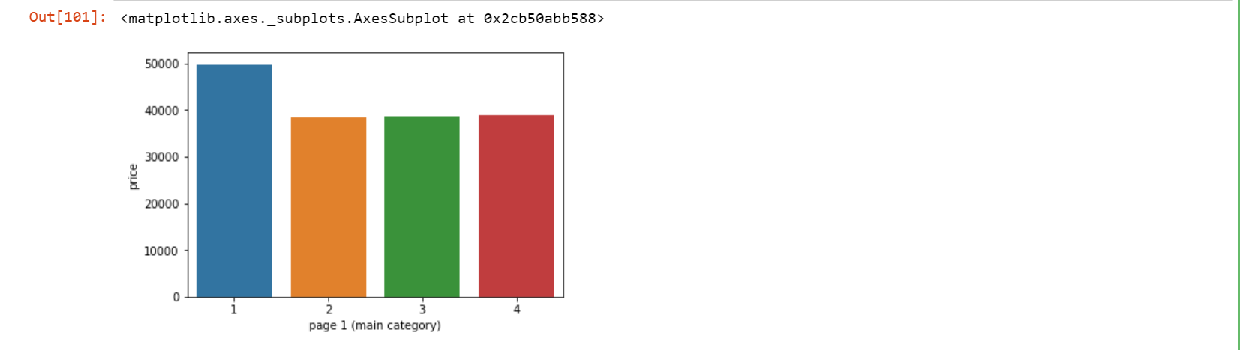
DATA EXPLORING
Category:
1-trousers
2-skirts
3-blouses
4-sale
Trousers is making the most revenue

Slide 10
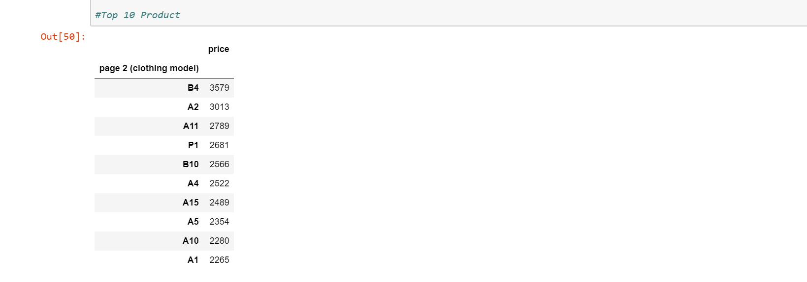
DATA EXPLORING

Slide 11

Data exploring
1-en face (front view)
2-profile (side view)
Enface(front view) photography making much more revenue

Slide 12
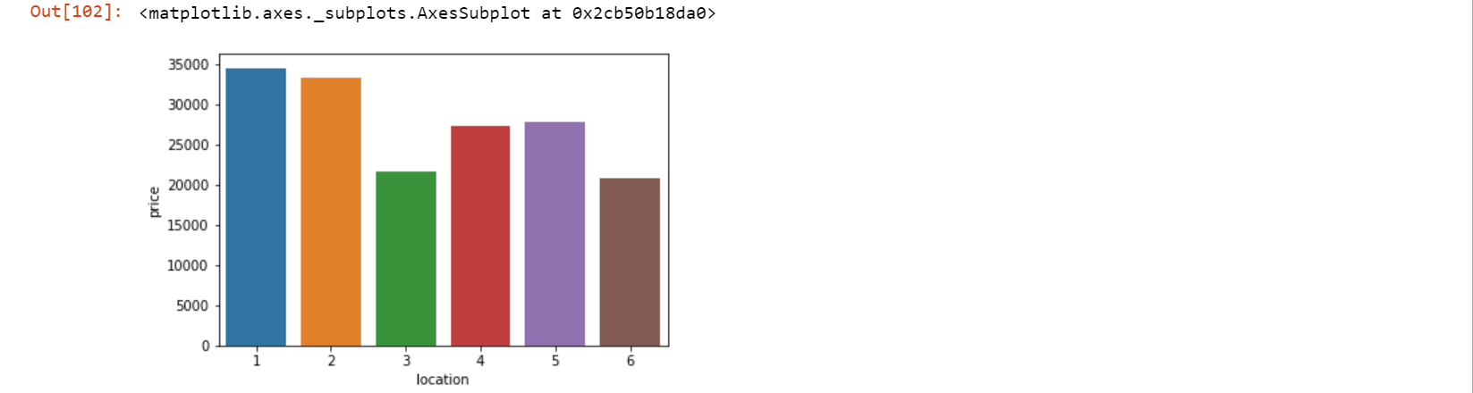
Data exploring
1-top left
2-top in the middle
3-top right
4-bottom left
5-bottom in the middle
6-bottom right
Top Left and Top mid are making the Most Revenue

Slide 13
SOLUTION
1. For those product making the most revenue (B4, A2, A11,P1), they should be placed at page one, ideally at top left and top middle position, to maximize revenue
2. Use more enface model photography
3. Black and blue are the 2 most popular colour, place them at page 1or 2 or at least placed them at nice position
4. Most of the customers are from Poland, make sure the website has Polish version

Slide 14
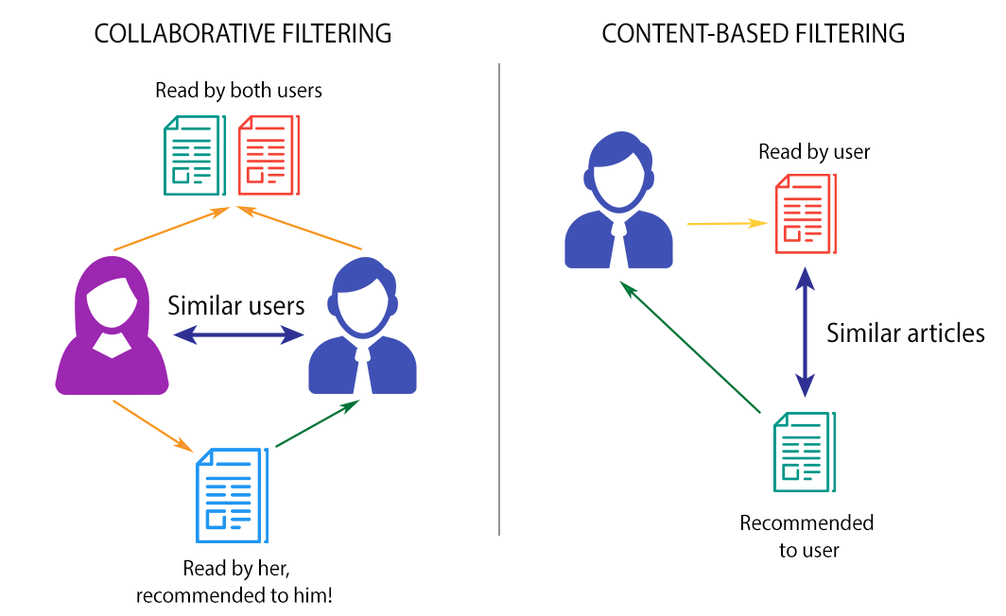
HOW TO IMPROVE THE WEBSITE IN THE FUTURE
The order has the session ID recorded, that allows us to find out similar users
Based on that we can make a recommendation system, after a customer put something in their cart, we can recommend other products based on their choice.

Slide 15
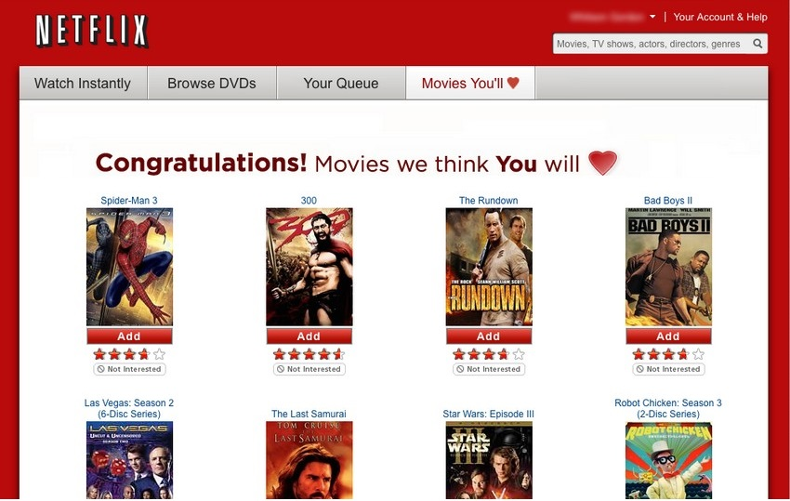
Recommandation system EXAMPLE:

Slide 16
Thanks!

