Slide 1
Customized Offers for Mobile Games
Release-2
SSAD-6
Team 29
Yahnit Sirineni, Subramanyam Makam, Adrian Joseph Alva

Slide 2

Client details
Name: Mr. Ravi Kiran, GoLive gaming solutions, CIE, IIIT Hyderabad

Slide 3
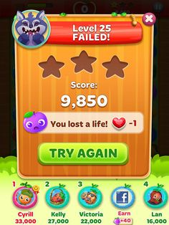
Have you ever found yourself stuck in a game and wished if only you had some help?

Slide 4
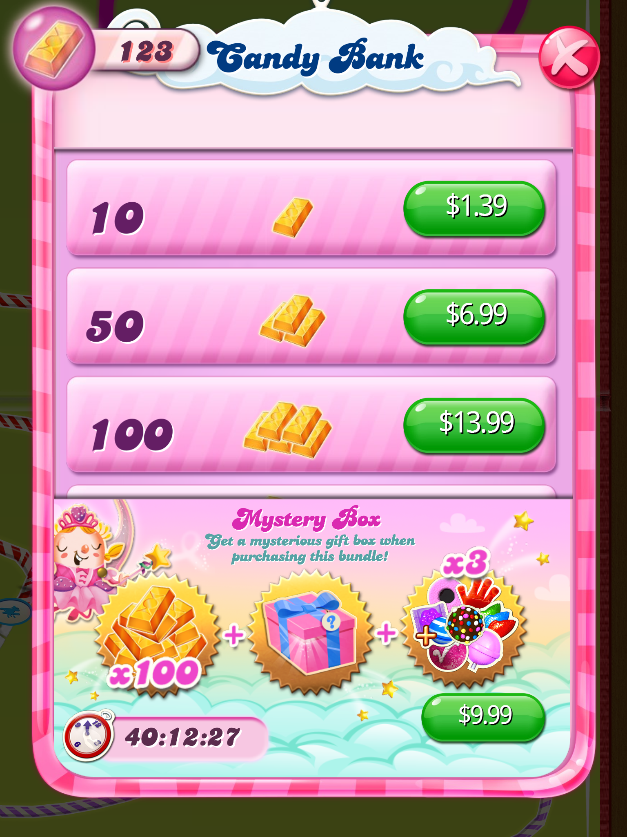
Well, then you certainly need an offer!

Slide 5
But does just any offer help you?
Complaints!
Too costly
Not enough to help me
I already got this offer
......etc

Slide 6
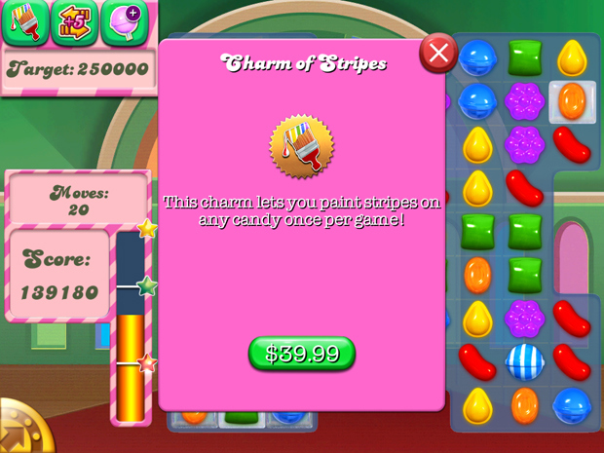
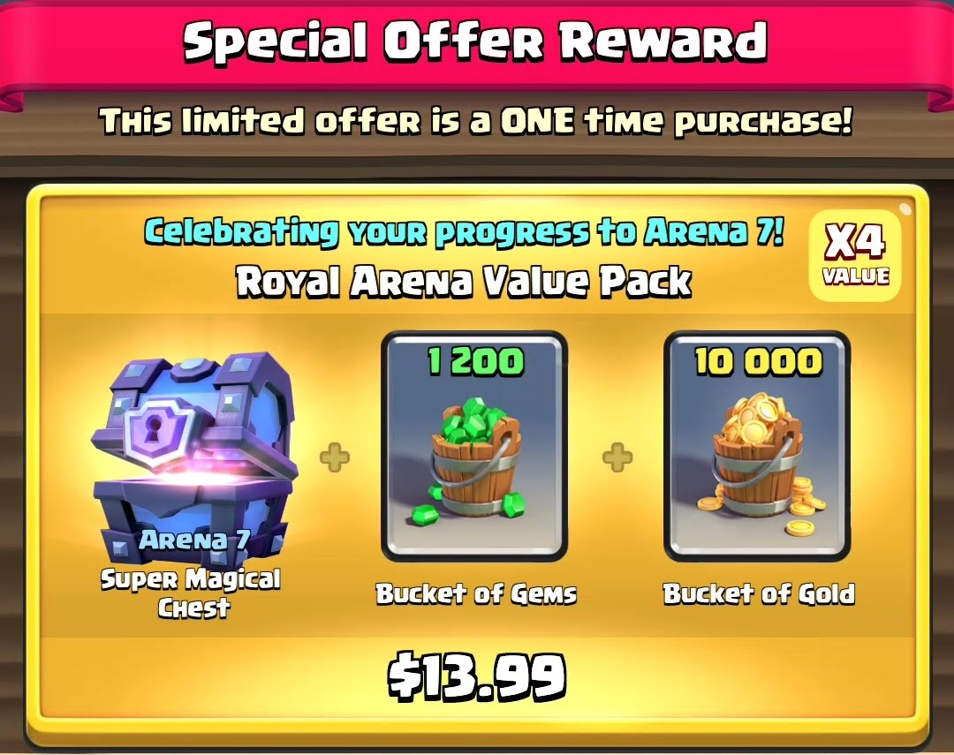
What you REALLY need is a CUSTOM OFFER!

Slide 7
So what does customizing an offer give you?
Customization understands your behaviour in the game and uses this knowledge/data to give you EXACTLY what you want!
Finds out what are your preferences
The right offer is given at the right level and at the right time
You keep progressing in the game!

Slide 8
Milestones – Release 1
Milestones | Due Date | Deliverable?
Understand Google Analytics | 14/08/2017 | No
Give client and server based solutions to offer triggers | 23/08/2017 | Yes
Give a draft of the requirements | 25/08/2017 | Yes
Give an algorithm to generate the list of users appearing consecutively every x days | 01/09/2017 | Yes
Create and implement the source code for the above algorithm | 09/09/2017 | Yes
Develop and implement algorithm to list users based on transactions crossing a given threshold | 23/09/2017 | Yes
Develop and implement algorithm to list users based on number of attempts on a given level | 23/09/2017 | Yes
Develop and implement algorithm to list users based on the total time spent on a given level | 23/09/2017 | Yes

Slide 9
Milestones – Release 2
Milestones | Due Date | Deliverable?
Develop and implement algorithm to list users based on the total number of sessions in a given time period | 12/11/2017 | Yes
Develop and implement algorithm to list users based on their expenditure of earned coins to unlock levels | 12/11/2017 | Yes
Given the set of offers as input, identify the list of users eligible for each offer (Python based) | 12/11/2017 | Yes
Given the set of store items as input, identify the corresponding store items for each of the users eligible for one or more offers (JavaScript based) | 12/11/2017 | Yes
Integration of the python and JavaScript code bases for offer classification and store item listing for every user | 12/11/2017 | Yes
Testing of the offer generation pipeline on live data from APPICE database (for Jungle Book game) | 12/11/2017 | Yes

Slide 10
Software development methodology
Rapid Agile Development (RAD) methodology was used in the implementation of this project.
A Scrum master was assigned to the team and weekly scrums were held.

Slide 11
Technologies used
Python 2.7 and above
JavaScript
Google Analytics
APPICE
GameSparks
Babel
Node

Slide 12
What factors best describe player behaviour?
Which level is the player in?
Has he/she spent money on offers in the past?
What is his/her frequency of playing the game per week for instance
What time the player spends on a level?
.......etc

Slide 13
How were these factors chosen?
By studying and analysing player data through Google analytics, a popular web analytics service
The user explorer feature of google analytics extensively lists the data of every player’s session (session: every use of the game app)

Slide 14
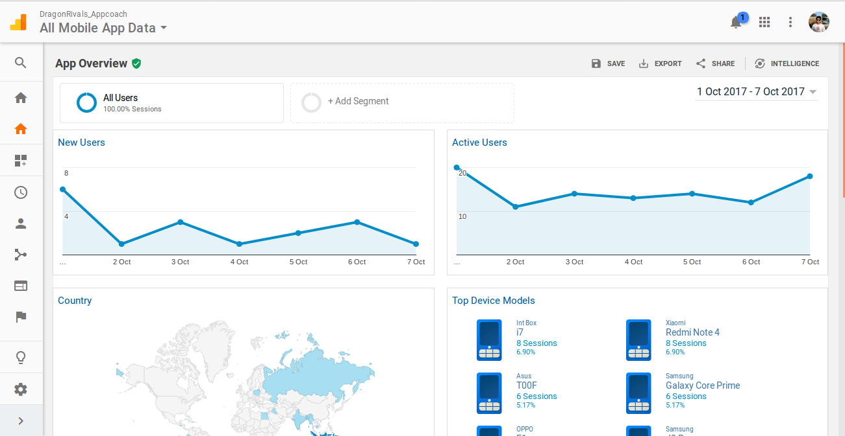
What Google Analytics looks like

Slide 15
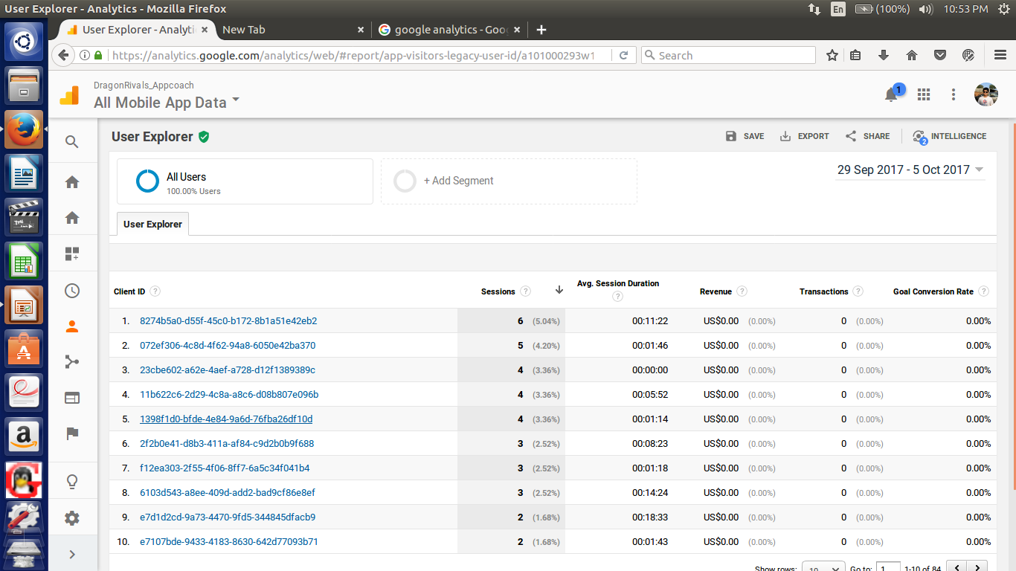
What user explorer looks like

Slide 16
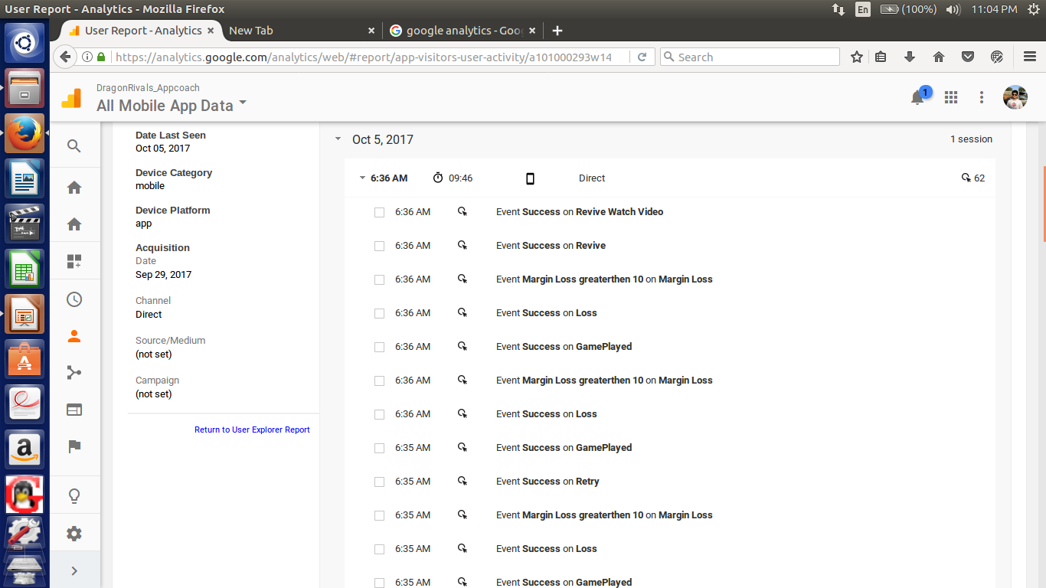
Every session’s details are provided

Slide 17
Some terminology.....
Session: Each use of the game app
Session object: An object containing the fields representing the data associated with the player’s session
The format of the session object is JSON
All the data used by the system is taken from APPICE database

Slide 18
What is an offer ?
In the context of the project, an offer is simply a set of parameters of the game with each parameter having a specific set/range of values.
If a player’s behavior satisfies ALL of these conditions on the offer’s parameters, the offer is given to the player

Slide 19
An example of an offer
{
"offer_id": 1,
"offer_price": 3,
"offer_type": ["Cheat", "Price Utility"],
"amount_spent": 3,
"consecutive_days": 2,
"attempts_upperbound": 10,
"attempts_lowerbound": 5,
"time_spent": 5,
"level_lowerbound": 5,
"multiple": true,
"no_sessions_lowerbound": 2,
"no_sessions_upperbound": 2,
"no_of_coins": 50
}

Slide 20
What are store items ?
In the context of the project, a store item is a specific resource associated with a game
For example, in the game version of the popular story ‘The Jungle Book’, store items can be animals in the jungle

Slide 21
An example of store items
{
"Name" : "Langur",
"price": 3,
"offerTypes": ["Cheat", "Price Utility"]
},
{
"Name": "Board",
"price": 5,
"offerTypes": ["Challenge" ,"Fun"
]
},
{
"Name": "Jakala",
"price": 10,
"offerTypes": ["Functional", "Character Competency"
]
}

Slide 22
The offer generation pipeline
Briefly, the customized offers project does the following:
Take every offer, and find the list of users eligible for each offer
Take each user, and find the list of store items to be offered to the user

Slide 23
A brief overview of the system
Classify
Users
Into
Offer
categories
Generate Offer
APPICE
Data
Store Items
Create Offer
Offer classifications
Gamesparks

Slide 24
The Pipeline
Classification
System
-Frequency
-Transactions
-Level attempts
-Time on a level
-Sessions
-Coins spent
Classified
Users for
Each offer
APPICE
Data
List of
Custom Offers
List of
Offers
Store Items
Create Offer
Bucket of store items

Slide 25
Detailed pipeline : Release 1
Player Classification
System
1. Based on frequency
2. Based on transactions
3. Based on level attempts
4. Based on level time
5. Based on sessions
6. Based on inapp
purchases/coins spent
ListofActiveUsers.json
ListOfAppInPurchases.json
APPICE
Data
ListOfMoneySpenders.json
ListofNumSessionUsers.json
ListOfUsersStuckAtALevel.json
TimeSpentOnLevel.json

Slide 26
Detailed pipeline: Release 2: Stage 1
Player Classification
System
1. Based on frequency
2. Based on transactions
3. Based on level attempts
4. Based on level time
5. Based on sessions
6. Based on inapp
purchases/coins spent
Offer 1_Classified users
APPICE
Data
Offer 2_Classified users
Offer 3_Classified users
Offer Classifications
Offer 4_Classified users
Offer 5_Classified users

Slide 27
Detailed pipeline: Release 2: Stage 2
Store Items
Create Offer
Bucket of Store
Items for each
offer
Offer Classifications

Slide 28
Detailed pipeline: Release 2: Stage 3
Bucket of Store
Items for each
offer
Generate
Offer
Output of
Custom
Offers for
users
Offer based classifications
of users

Slide 29

Game used for testing the implementation

Slide 30
The specifics now.....
The parameters that we use to describe a player are the following:
Number of consecutive appearances
Number of transactions previously made
Number of attempts on a level
Time spent on a level
Total number of sessions
Number of In-App purchases made (for example, the number of earned coins spent to unclock levels)

Slide 31
Each of the parameter has a seperate python script written to check if the player has a specified value / range of values for that parameter.
For example, if we wish to find the users who have between 5 and 10 attempts at level 7, then these parameter values are passed to the level_attempts python script which checks every player for this condition

Slide 32
Since we have six parameters that are associated with every player, there are six corresponding python scripts that are run to check if a player is eligible for a particular offer.
Once this is done for every offer in the list of available offers, JSON files are created for every offer listing the users eligible for that offer.

Slide 33
Classified users
{
"classified_users": [
"7b03eaa612cfcbdcea93f89b2726217b5c3c8d4b"
],
"offer": {
"level_lowerbound": 5,
"amount_spent": 3,
"attempts_lowerbound": 5,
"consecutive_days": 2,
"offer_price": 3,
"offer_id": 1,
"no_of_coins": 50,
"time_spent": 5,
"no_sessions_upperbound": 2,
"multiple": true,
"attempts_upperbound": 10,
"offer_type": [
"Cheat",
"Price Utility"
],
"no_sessions_lowerbound": 2
}
}

Slide 34
Offer types
Every offer comes in a certain offer ‘type’, that is, the offer type describes the particular aspect of the game that the offer improves
Some offer types used in our implementation are the following
Cheat
Price Utility
Challenge
Fun
Character Competency
Functional

Slide 35
Assigning store items to players
Once every offer has the list of eligible players, we generate a bucket of store items for a given price and offer type.
Every store item has some price associated with it, for example, in jungle book game, ‘Langur’ may cost $3, ‘Hathi’ may cost $15 and so on

Slide 36
Every store item is also associated with an offer type. For example, in the jungle book game, ‘Hathi’ is of offer type ‘Fun’ and ‘Functional’.
The Create Offer module is then run automatically after classifying users into offer categories that finds the set of store items that can be given to the player as a custom offer.

Slide 37
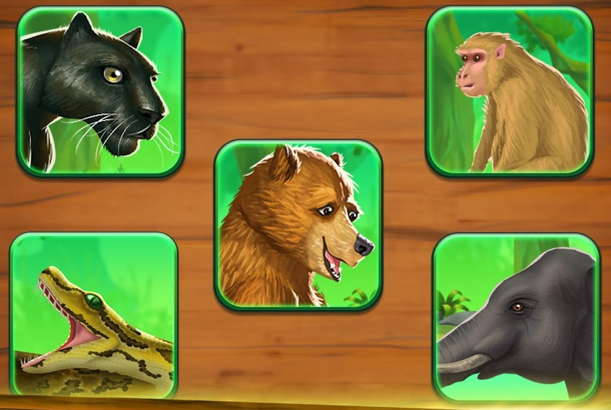
Customization means to give exactly the required store items to the user

Slide 38

An example
OFFER CONDITIONS
{
"level_lowerbound": 5,
"amount_spent": 3,
"attempts_lowerbound": 5,
"consecutive_days": 2,
"offer_price": 3,
"offer_id": 1,
"no_of_coins": 50,
"time_spent": 5,
"no_sessions_upperbound": 2,
"multiple": true,
"attempts_upperbound": 10,
"offer_type": [
"Cheat",
"Price Utility"
],
"no_sessions_lowerbound": 2
}
CUSTOM OFFER
{"Name": "Langur",
"price": 3,
"offerTypes": [
"Cheat",
"Price Utility"] }

Slide 39
Just two input files required!
The project is highly game developer- friendly. Based on the developer and designer’s experience and analysis, only identifying valid offers and store items is enough!
The system will automatically generate the specific custom offer for every eligible player

Slide 40
Applicability of the project
The project can be used for a wide variety of mobile games. Any game with different levels and resources associated with each level can use it to generate custom offers
The only two inputs to be given to the software are the list of offers and store items as two seperate JSON files

Slide 41
Deployment
The best part of this project is that its being deployed! On the Digital Ocean server.
Our project is going to be used to generate customized offers for their renowned game ‘Jungle Book’.

Slide 42
Thank you very much!
We would like to express our heartfelt thanks to Prof. Raghu Reddy
SSAD TA Shubham Kumar
SSAD TAs

